Slide 1
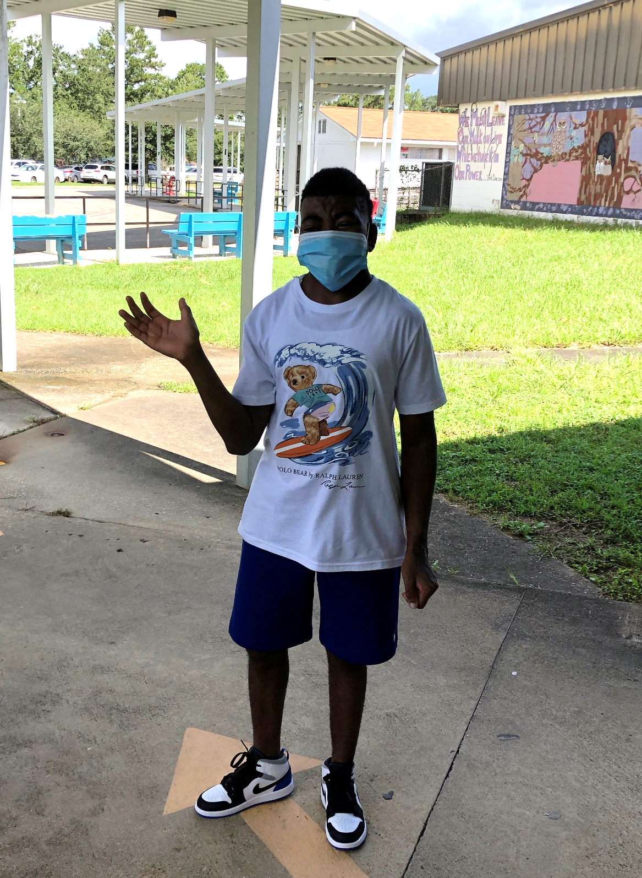
Time To Go Back To School
By: Cara Edenfield and Joy Delaney
groupbygroup.wordpress.com

Slide 2
We’ve been out of school since Spring Break!
Time to go back to school.

Slide 3
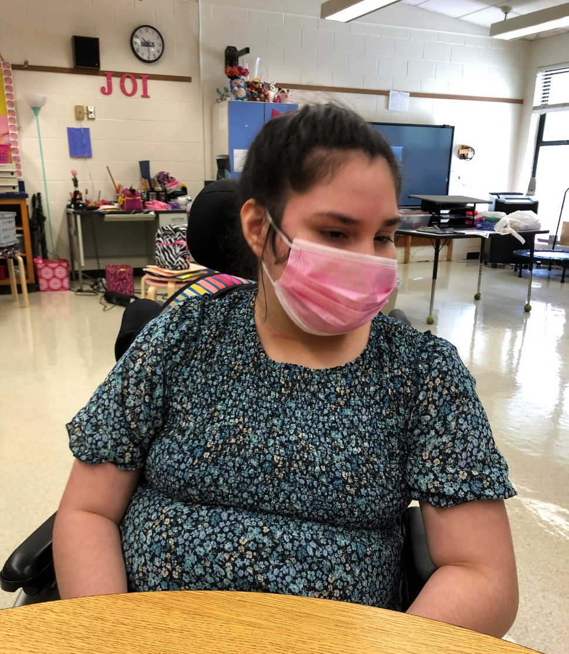
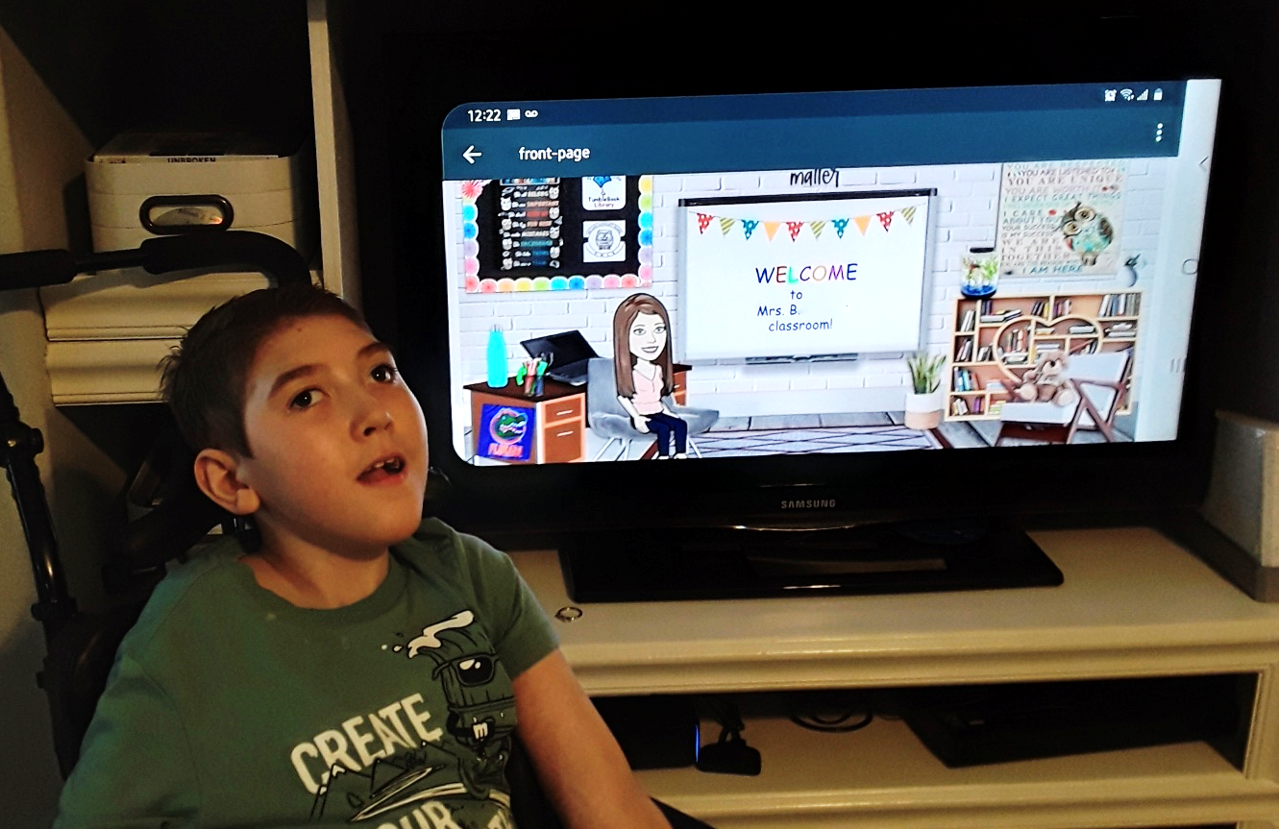
Some of us will be attending school, and some of us
will work from home.
Time to go back to school.

Slide 4
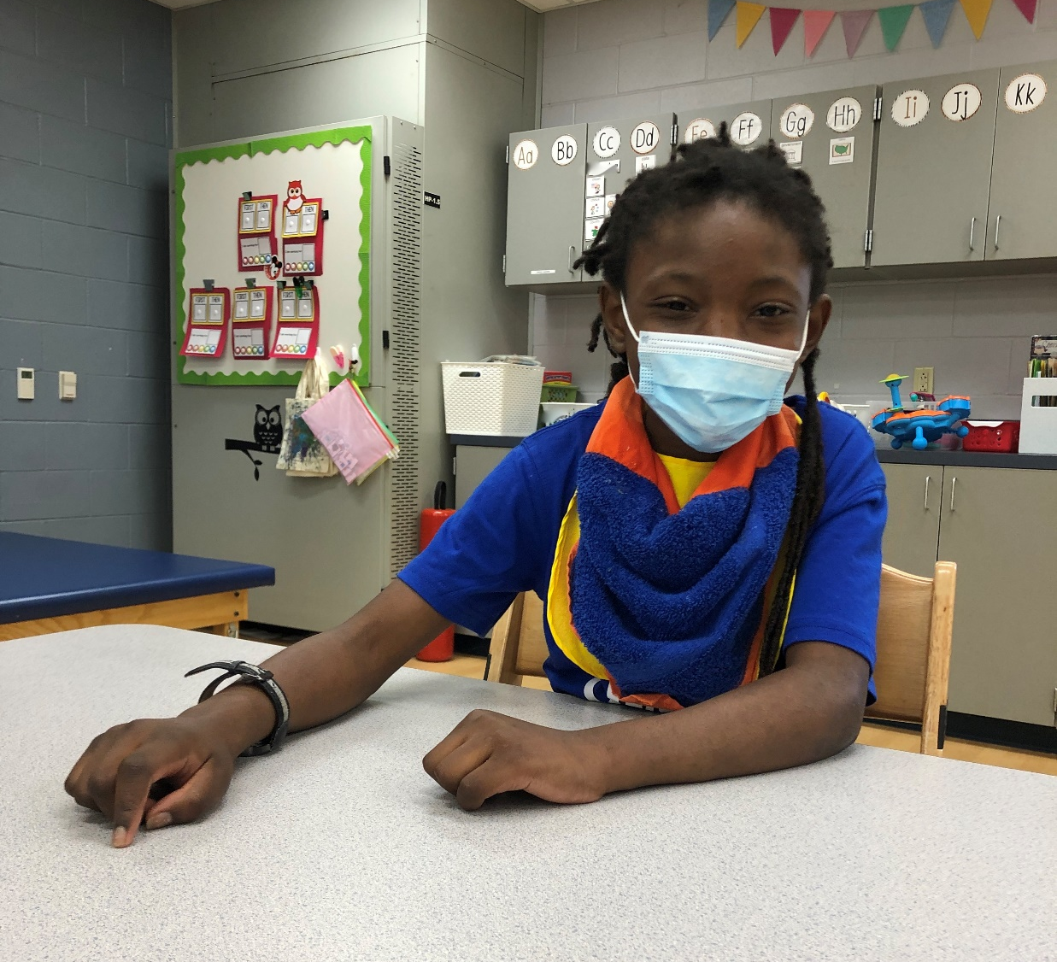
School looks a little different this year because of
COVID-19. We have to wear masks.
Time to go back to school.

Slide 5
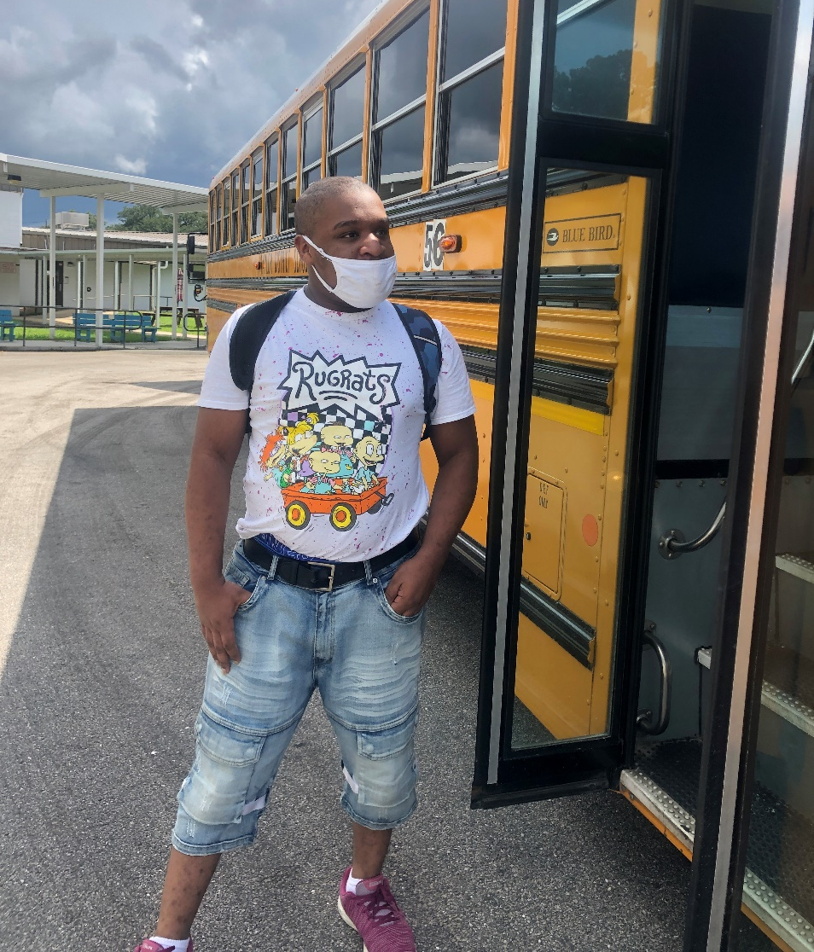
We will still have the bus to drive us to and from our
homes, but we have to make sure to have our masks on.
Time to go back to school.

Slide 6
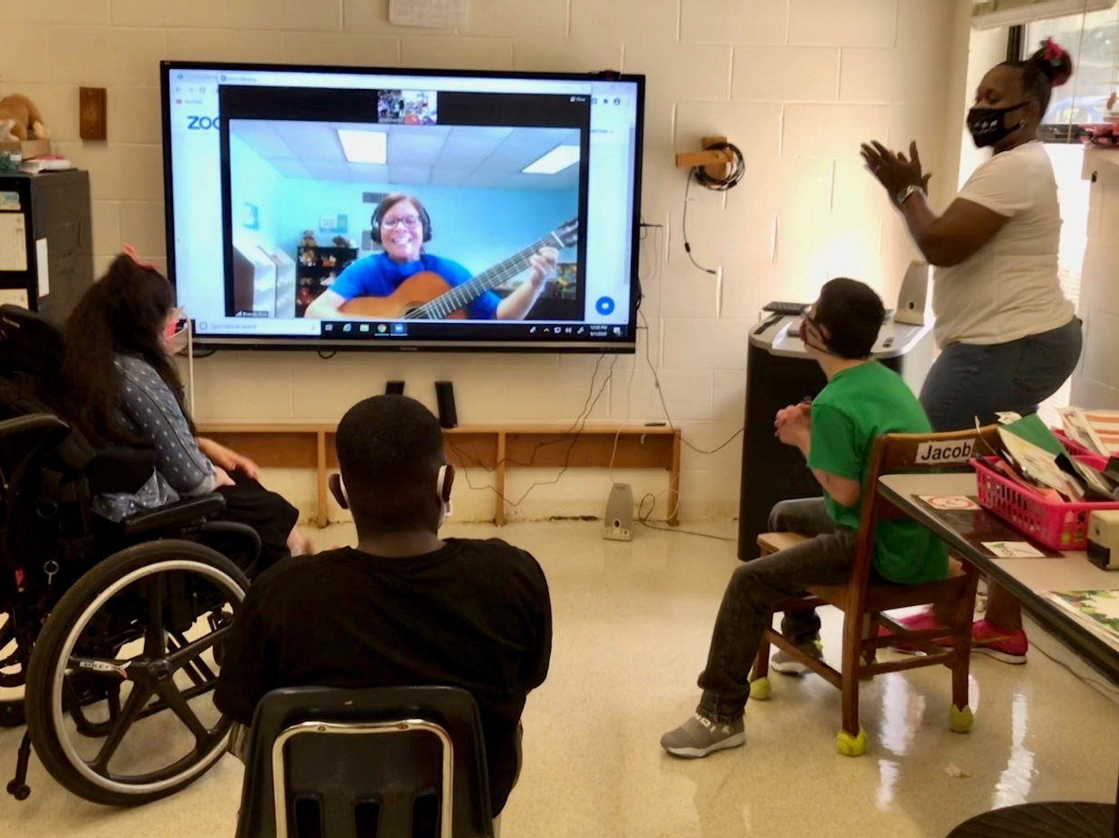
Special area will be different too. We’ll have fun
in our live virtual lessons!
Time to go back to school.

Slide 7
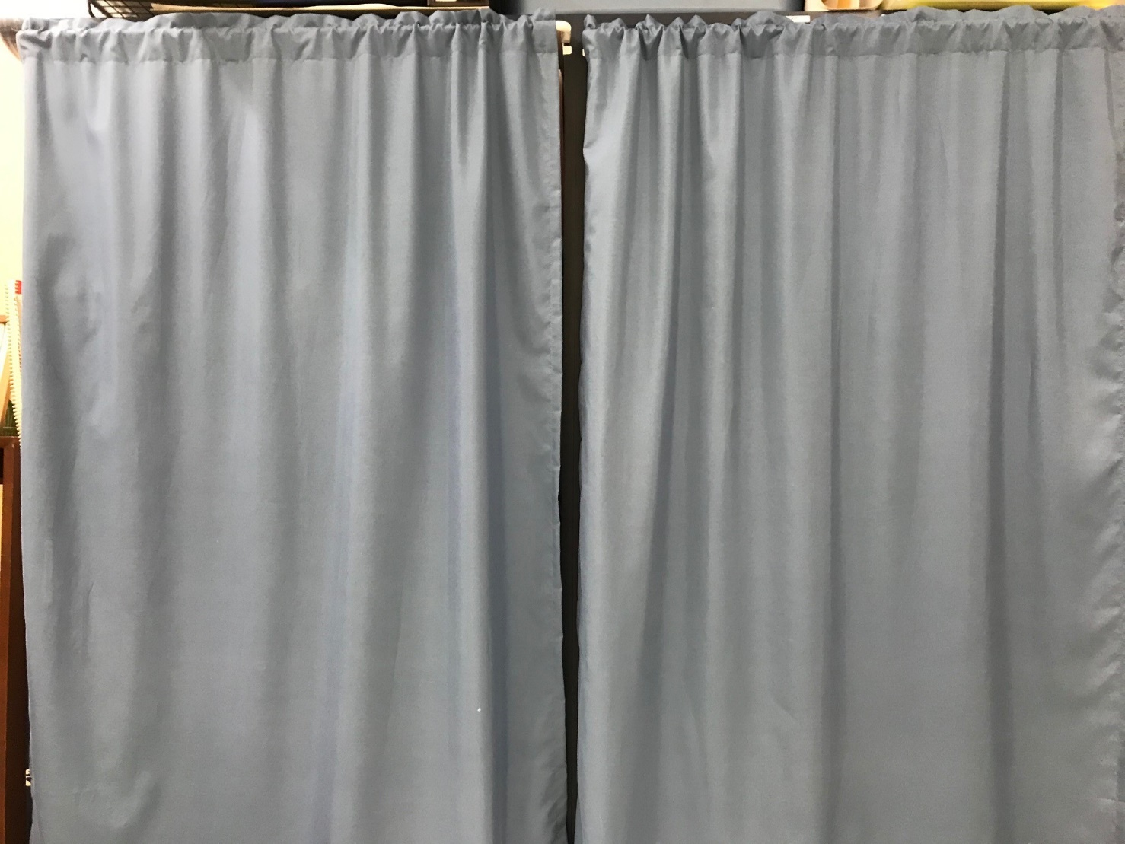
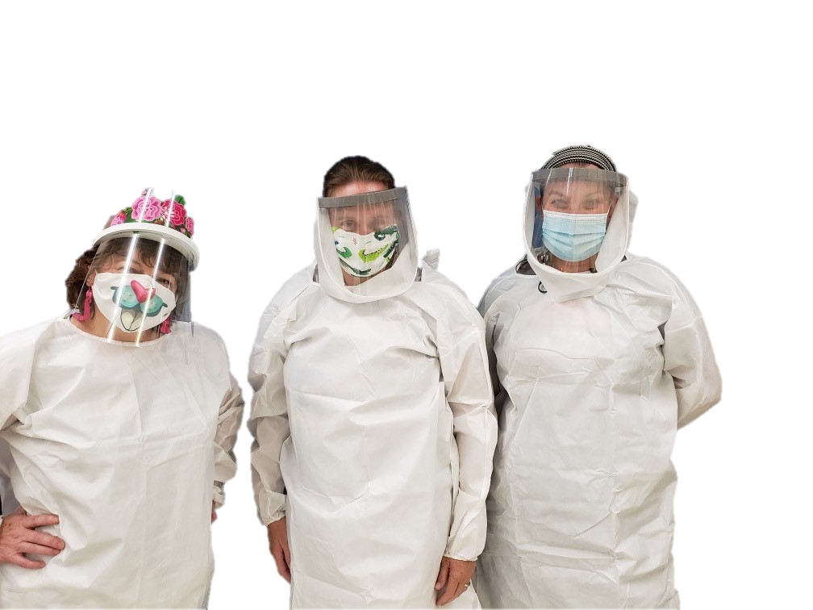
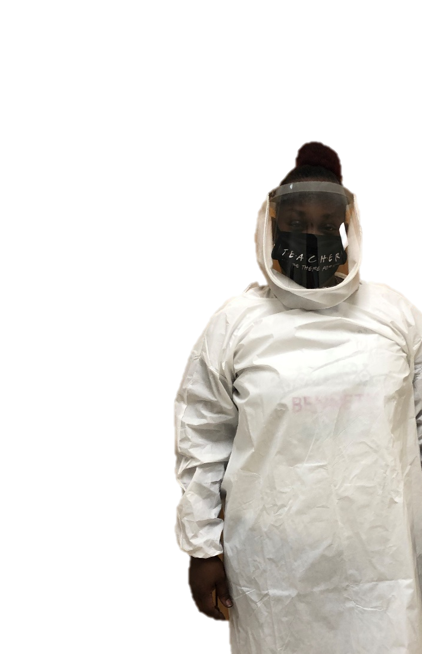
Things may look a little different, but we will get
through this together.
Time to go back to school.

Slide 8
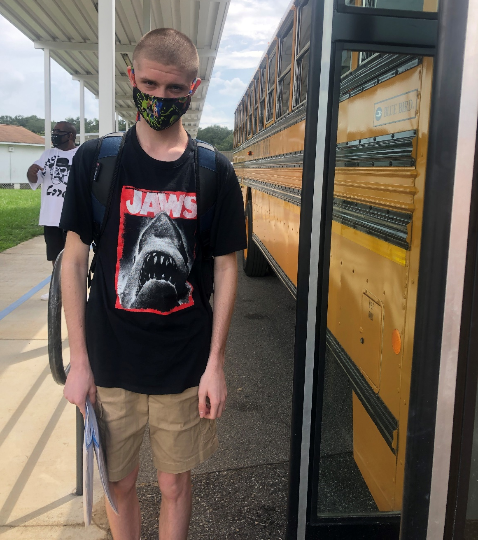
The End

