Slide 1
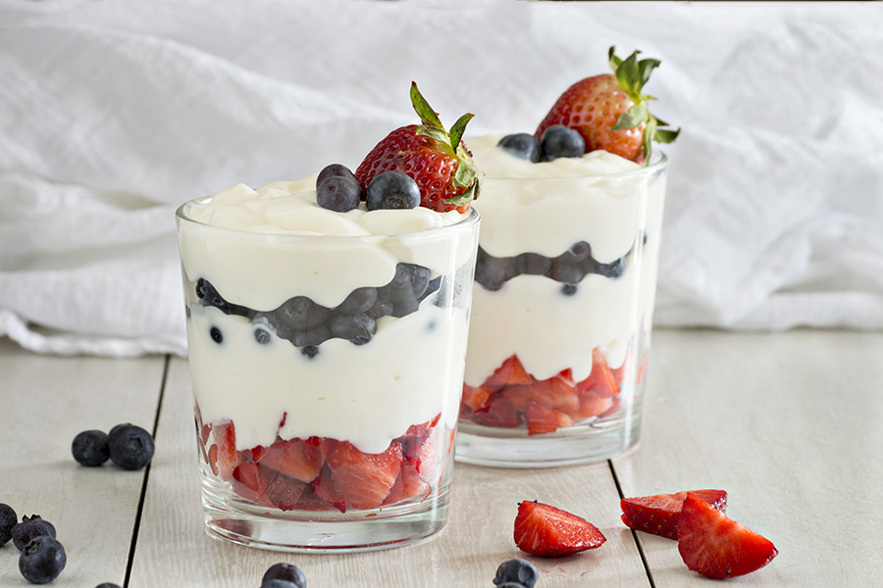
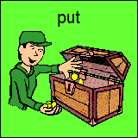
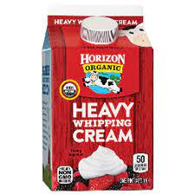
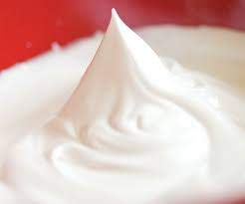
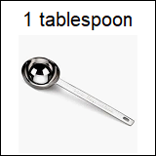
Let’s Make Patriotic Parfaits
Groupbygroup.wordpress.com
1.
2.
until
start to form
stiff peaks
3.
and
until
form
4.
stiff peaks

Slide 2
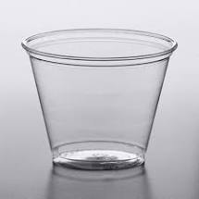
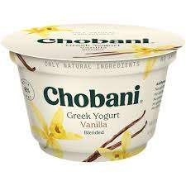
5.
cup
cup
Vanilla Greek yogurt
6.
cup
7.
cup
8.
then
then
cup
9.

