Slide 1
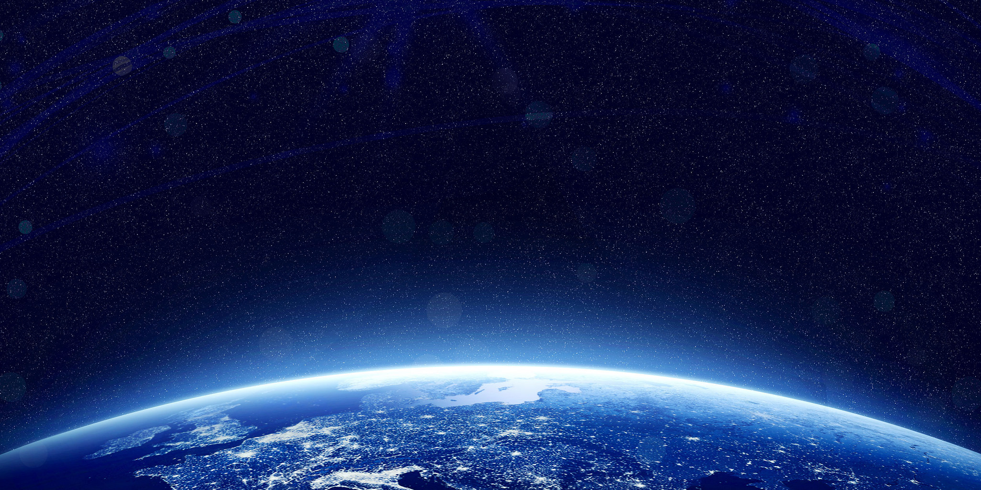
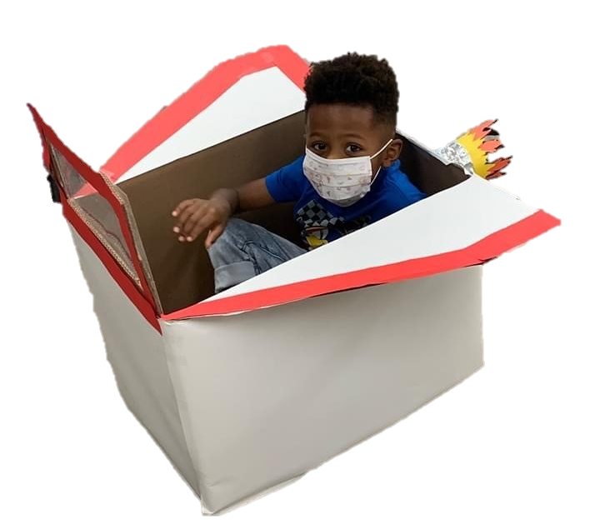
Let’s Learn About Space
By: Cara Edenfield and Joy Delaney
Groupbygroup.wordpress.com

Slide 2
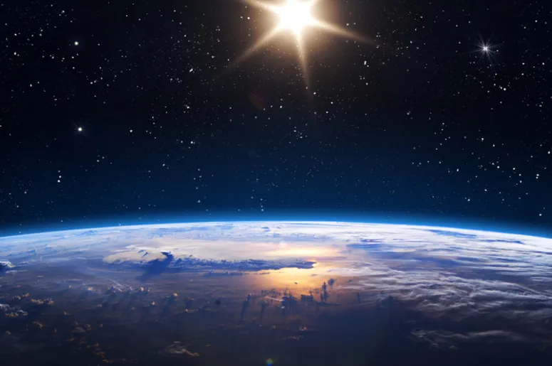
Space is completely silent because there is
no atmosphere which means sound can’t travel.
Let’s learn about space

Slide 3
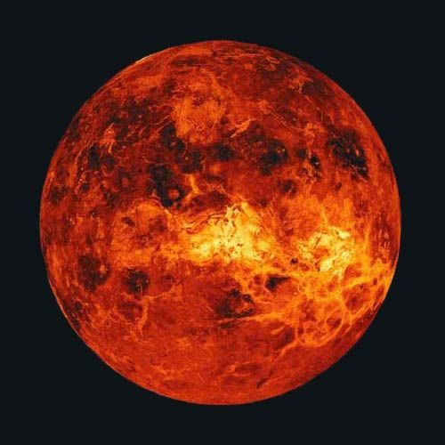
Venus is the hottest planet and has an average
temperature of 842 degrees Fahrenheit.
Let’s learn about space

Slide 4
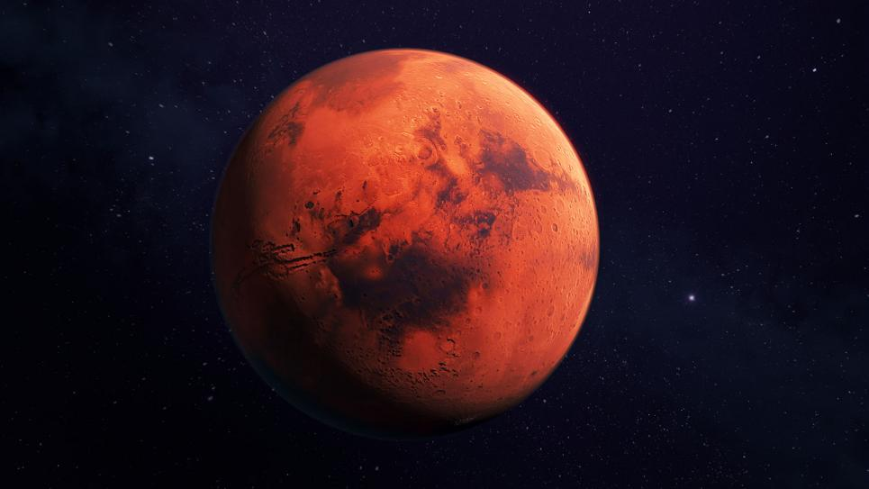
Of all the planets other than Earth, Mars is the one
that would most likely be able to contain life.
Let’s learn about space

Slide 5
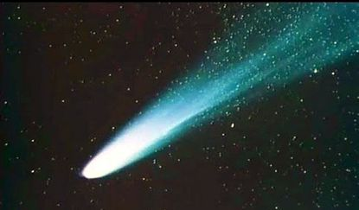
Halley’s comet, discovered in 1705, was last seen orbiting
past Earth in 1986 and won’t be seen again until 2061.
Let’s learn about space

Slide 6
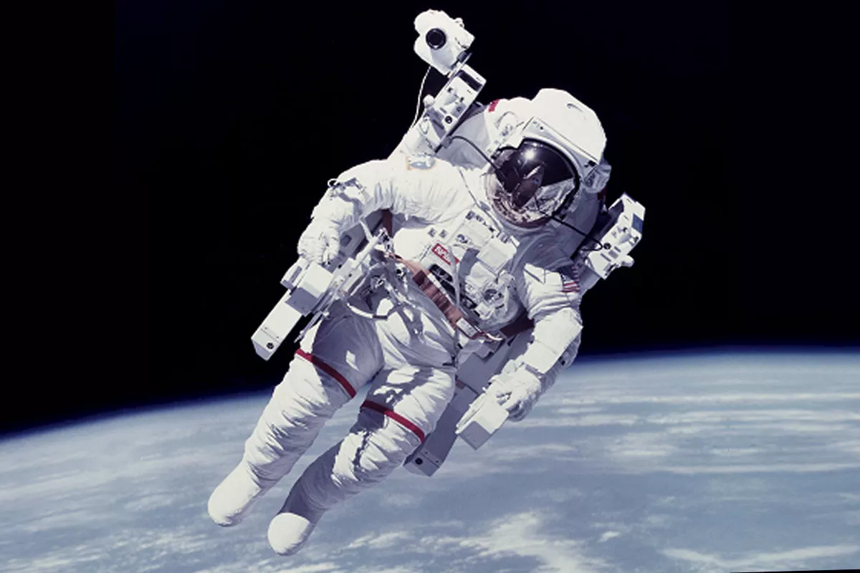
A full NASA space suit costs $12,000,000.
Let’s learn about space

Slide 7
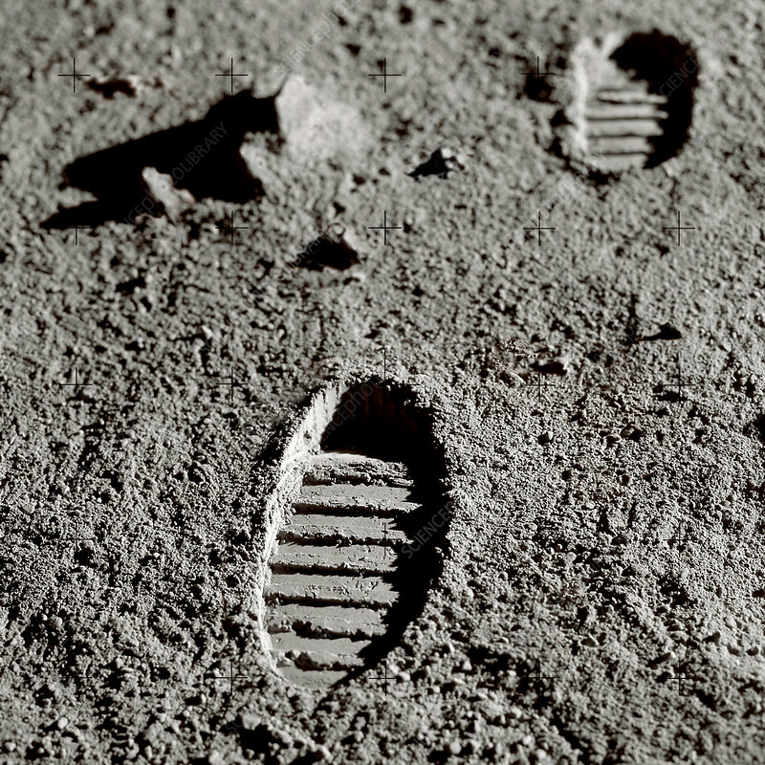
The footprints on the moon will be there for
100 million years.
Let’s learn about space

Slide 8
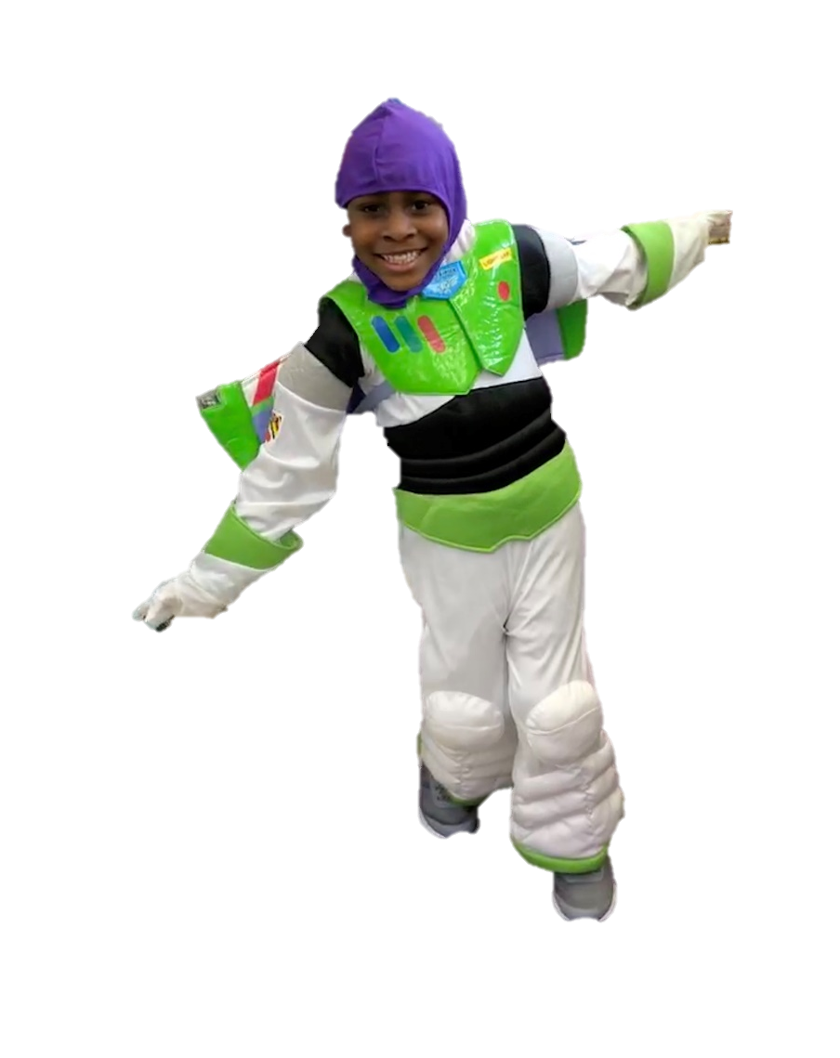
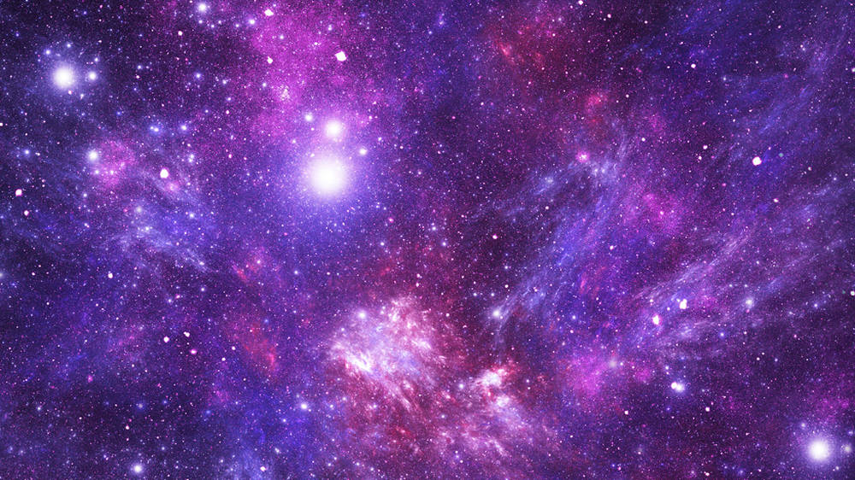
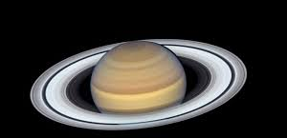
The End

