Slide 1
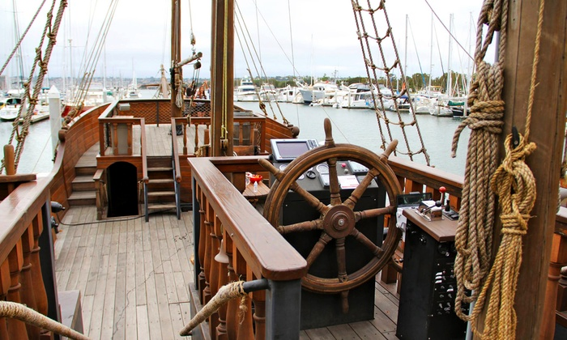
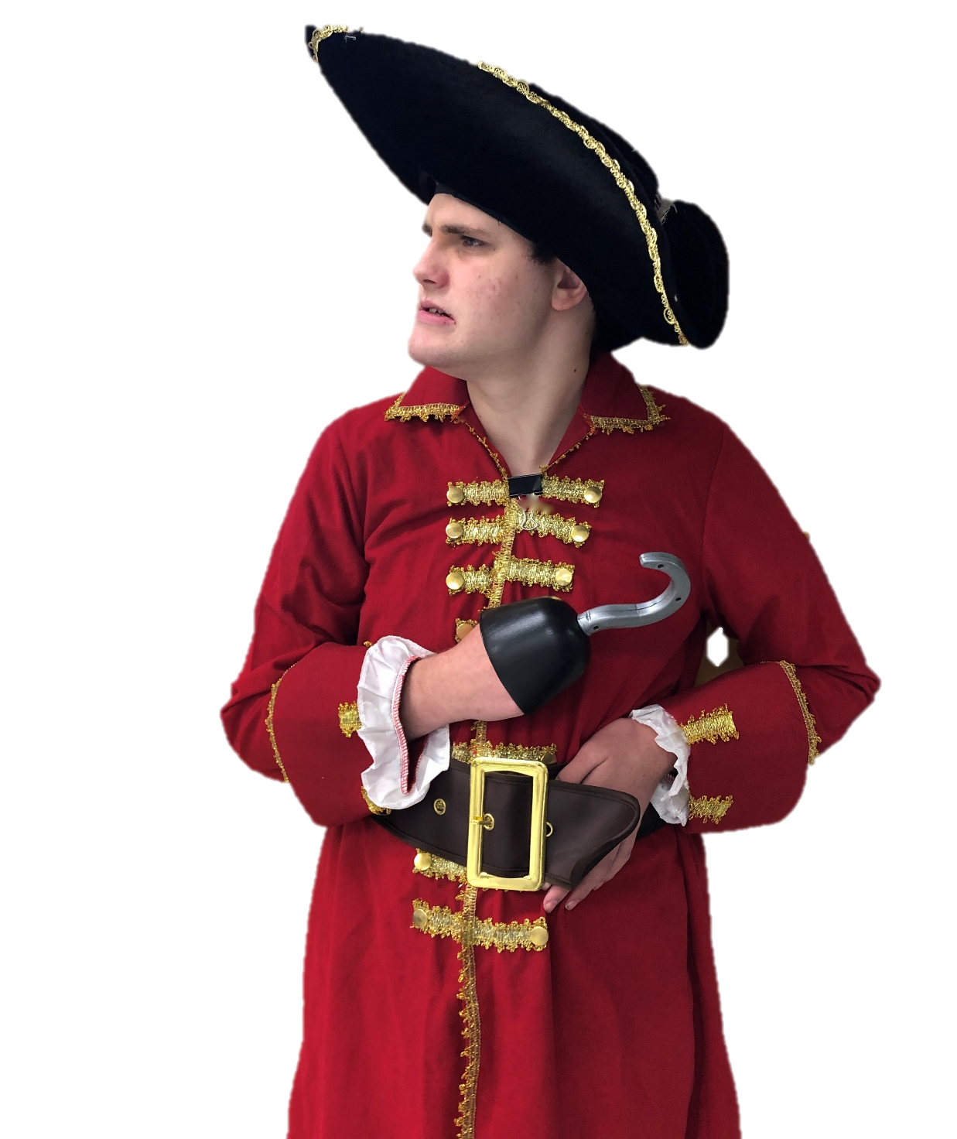
Let’s Learn About Pirates
By: Cara Edenfield and Joy Delaney
Groupbygroup.wordpress.com

Slide 2
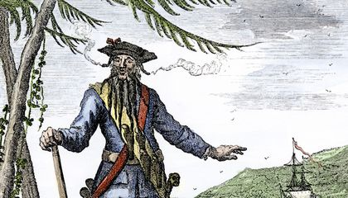
Blackbeard was the most feared pirate of all.
Let’s learn about pirates.

Slide 3
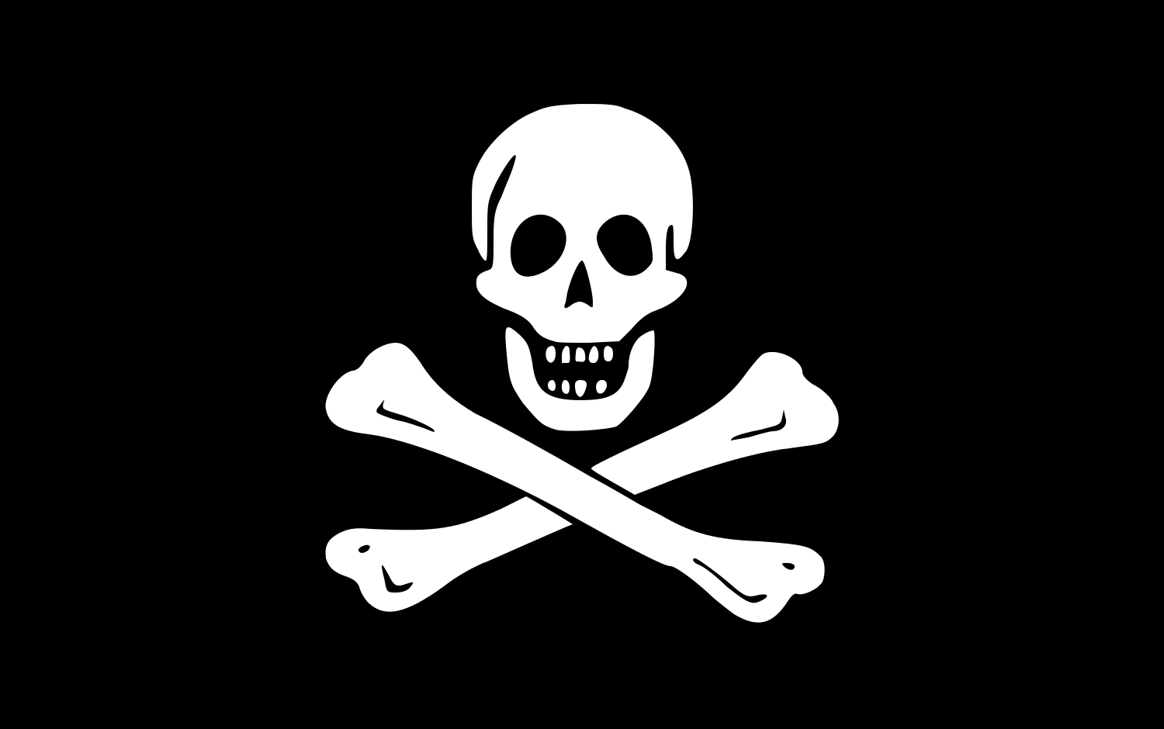
The skull and crossbones flag at the top
of a pirate ship is called a Jolly Roger.
Let’s learn about pirates.

Slide 4
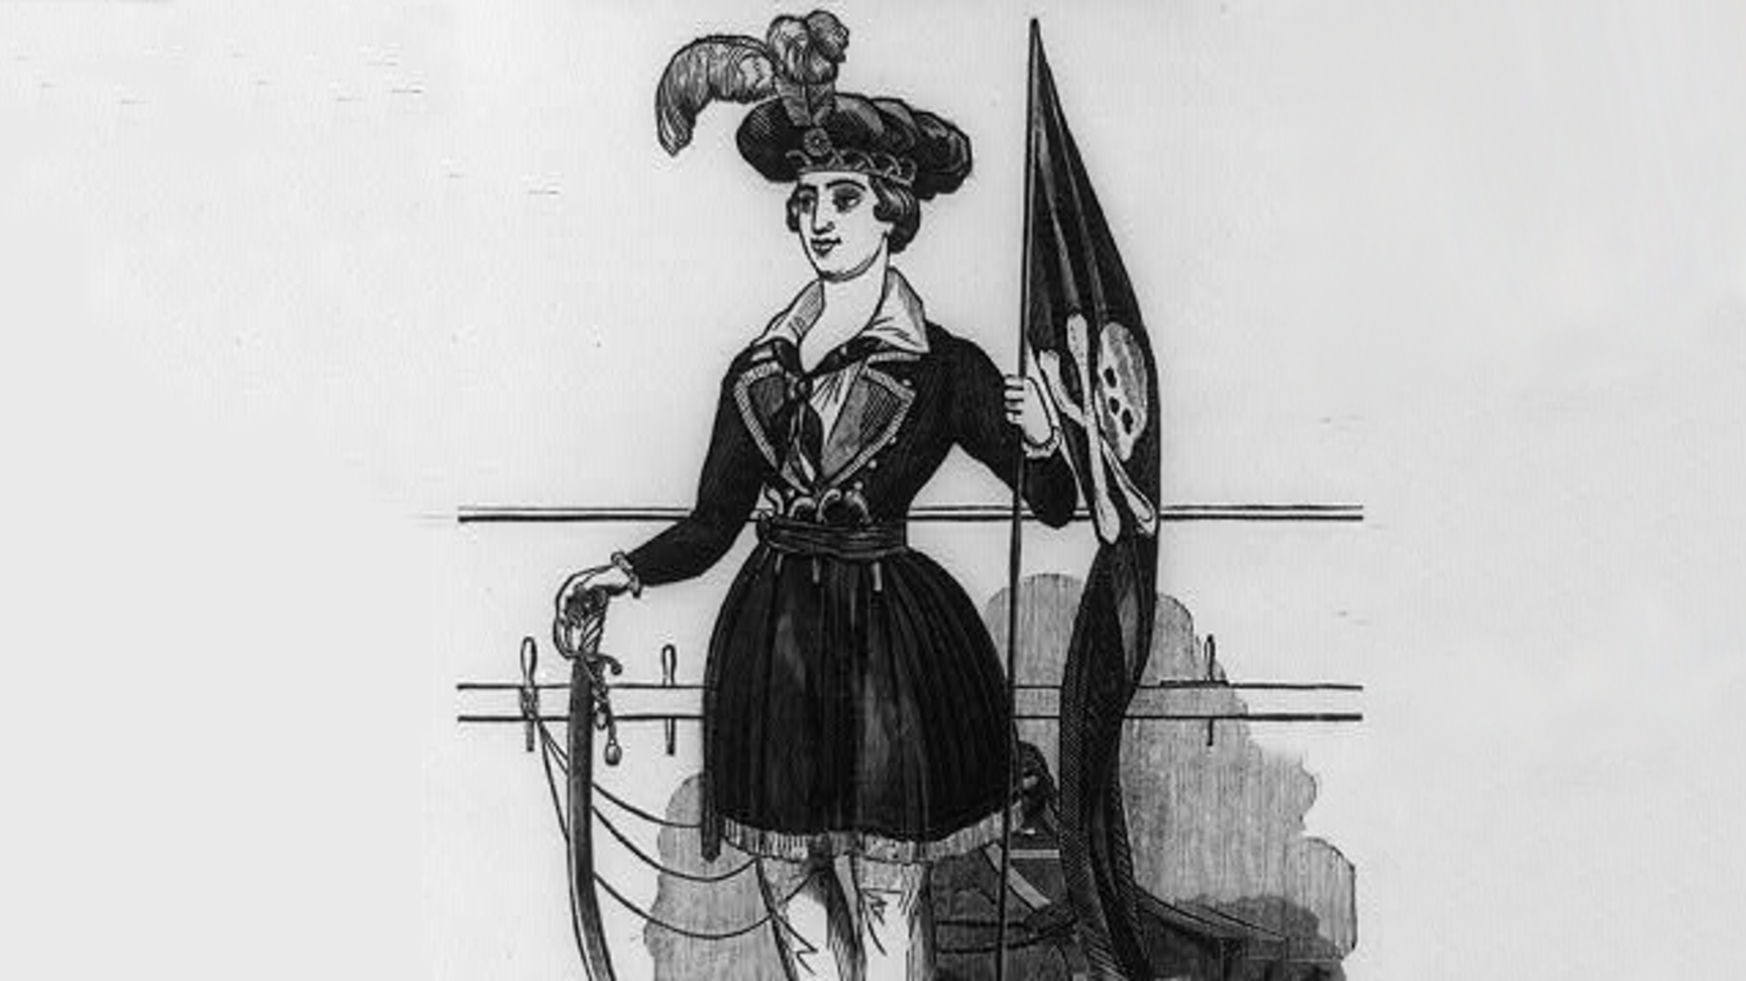
Men weren’t the only pirates.
There were women pirates too.
Let’s learn about pirates.

Slide 5
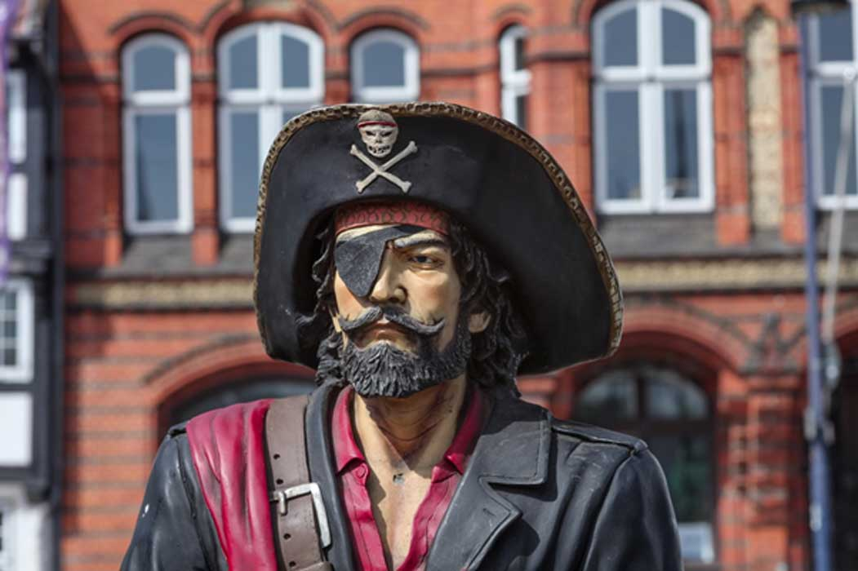
It’s been said that one of the reasons pirates wore eye
patches was to help keep one eye adjusted
to night vision for seeing below deck.
Let’s learn about pirates.

Slide 6
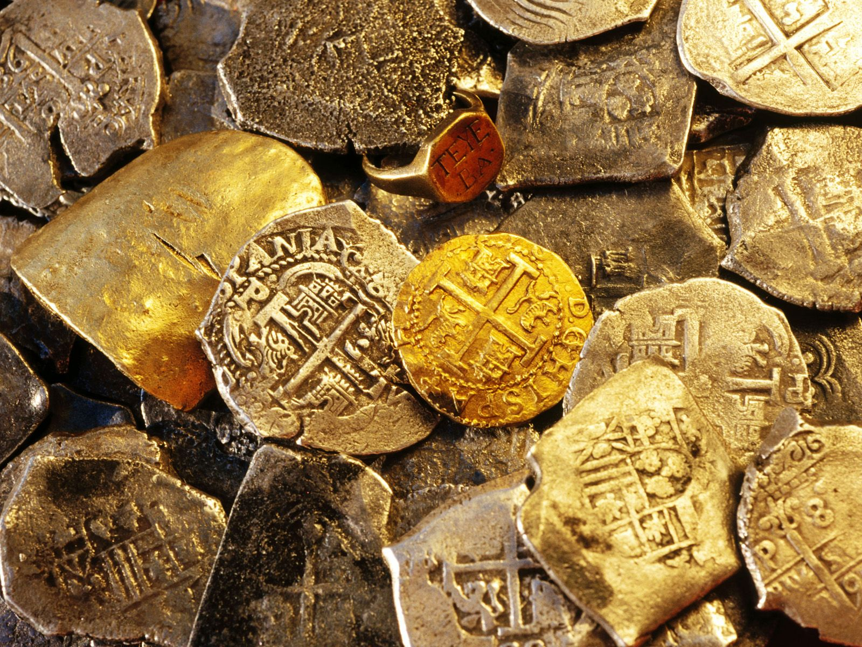
Pirates didn’t always bury their treasure right away.
Treasure also didn’t always have gold and silver.
Most of it was food, lumber, cloth, and animal hides.
Let’s learn about pirates.

Slide 7
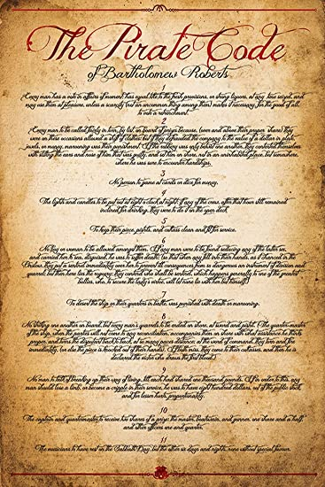
Each pirate ship had its own set of rules and code.
One of the most common rules was
no fighting onboard.
Let’s learn about pirates.

Slide 8
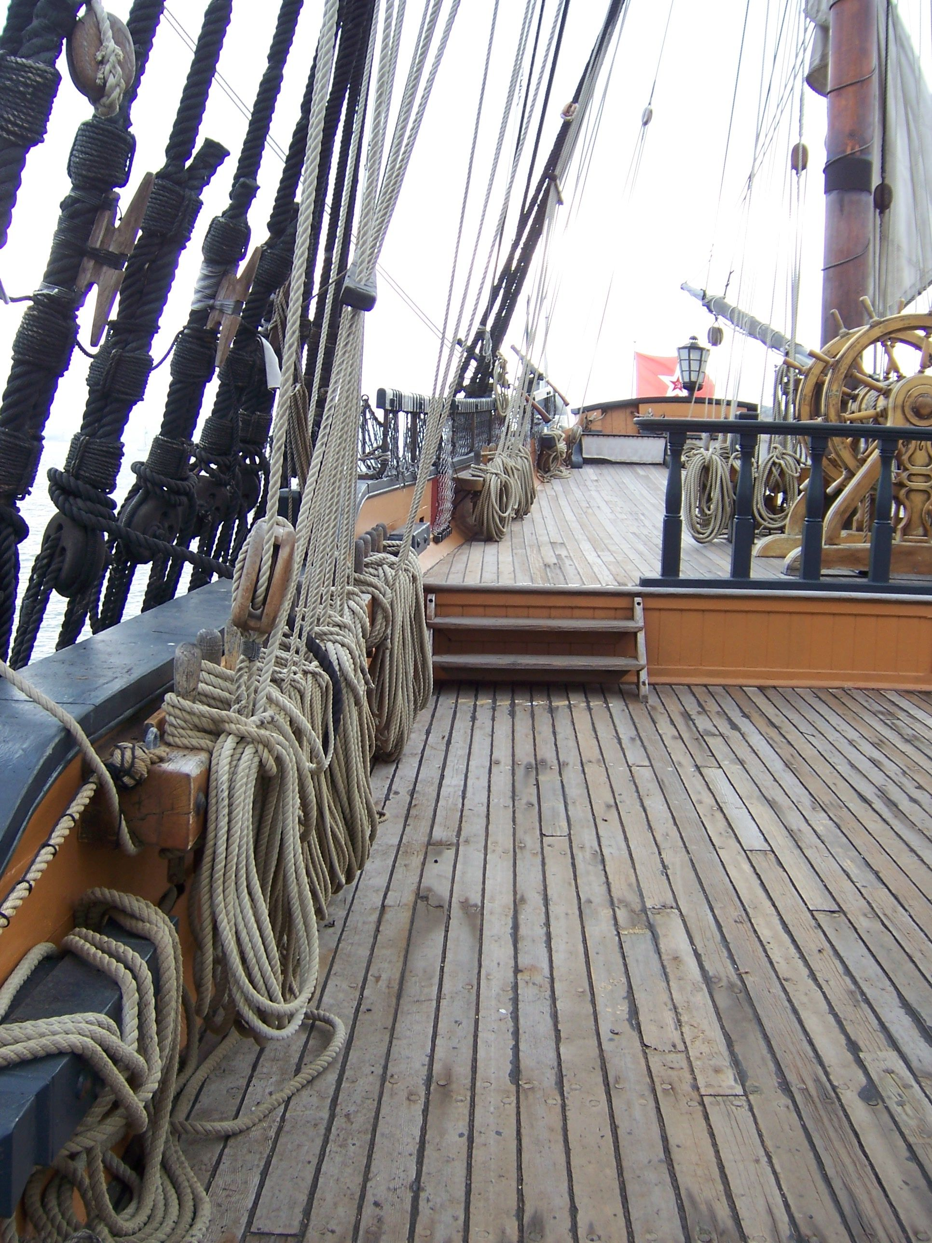
The End arggggg!

