Slide 1
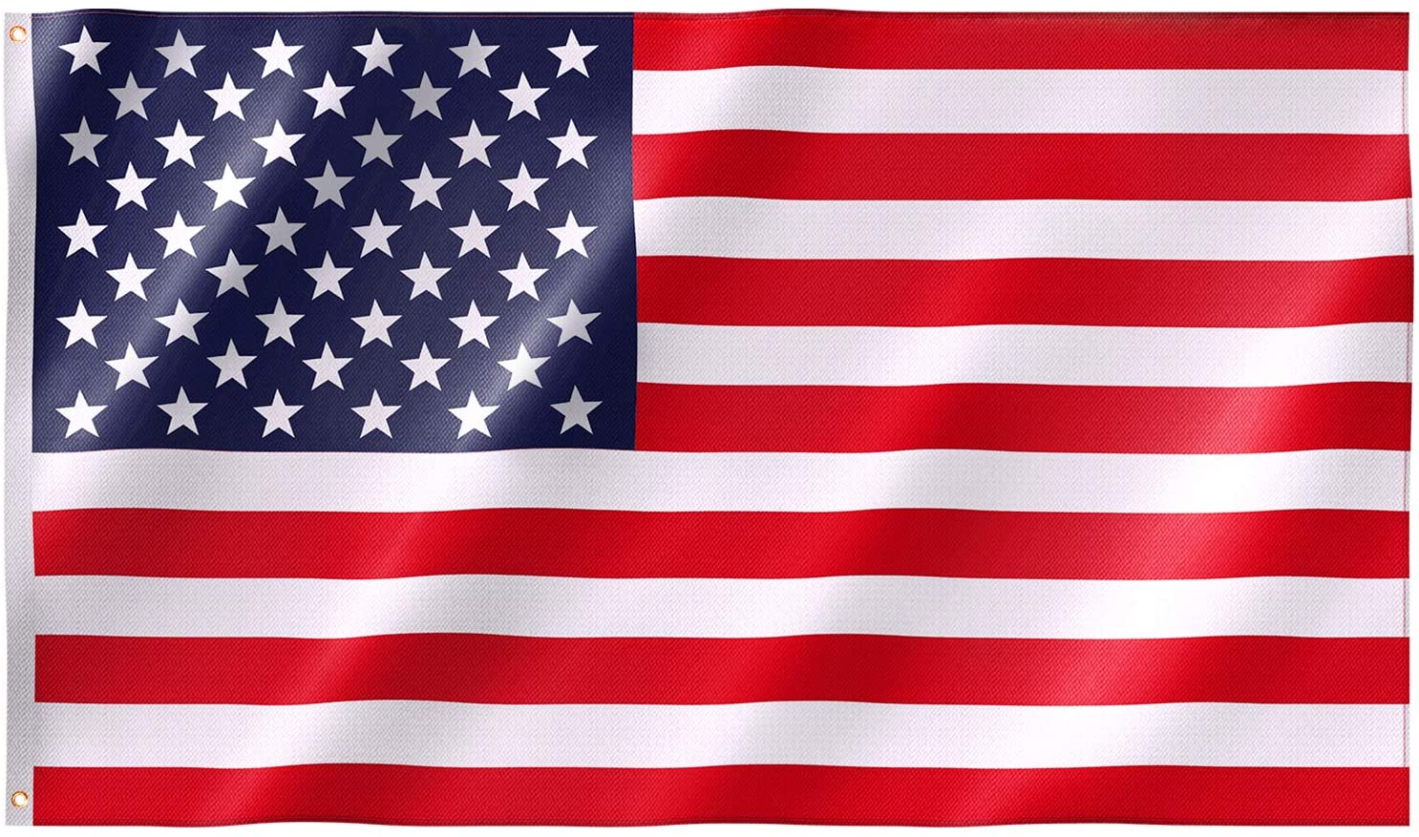
Fun Facts About Uncle Sam
By: Cara Edenfield and Joy Delaney
Groupbygroup.wordpress.com

Slide 2
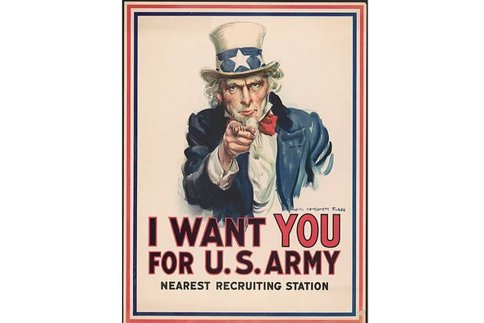
Uncle Sam was first featured on a poster during World War I.
It was used to get men and women to sign up for the army.
Fun facts about Uncle Sam

Slide 3
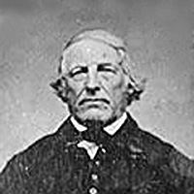
Uncle Sam is based on a real person named Samuel Wilson, a meat
packer who supplied food for American soldiers during the War of 1812.
The troops knew Samuel was sending the food and called it
“Uncle Sam’s” since U.S. was printed on the barrels.
Fun facts about Uncle Sam

Slide 4
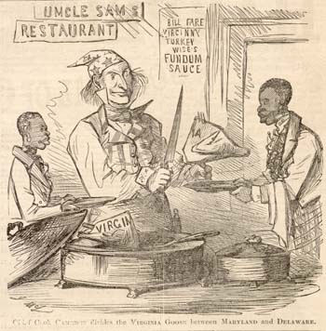
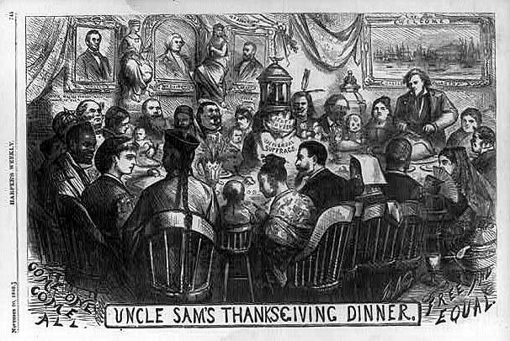
In 1813, Sam’s local newspaper heard of the soldiers referring
to him as “Uncle Sam” and ran with it. Soon, “Uncle Sam”
became the go-to nickname for the U.S. government.
Fun facts about Uncle Sam

Slide 5
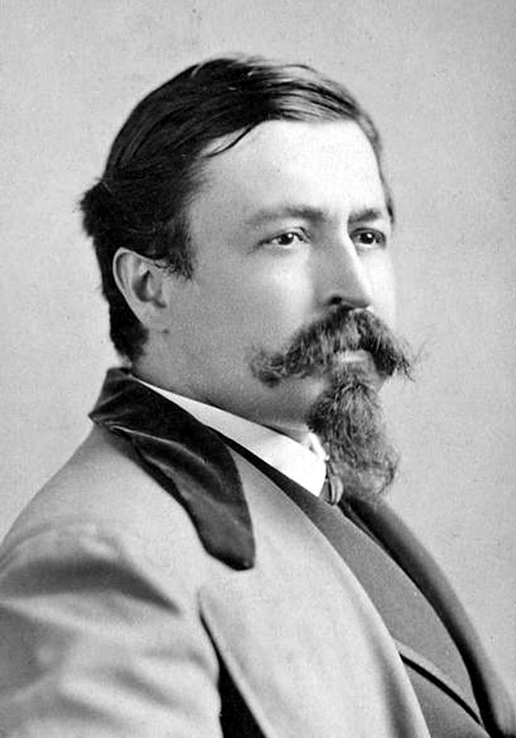
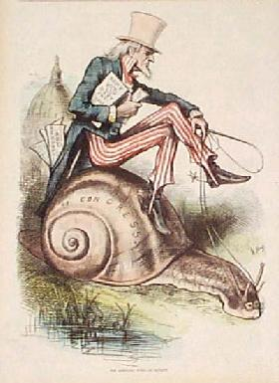
Thomas Nast was the first to popularize the image of
Uncle Sam, from 1860-1870. Nast gave him a white
beard and a Stars and Stripes suit.
Fun facts about Uncle Sam

Slide 6
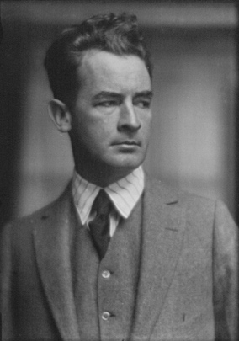
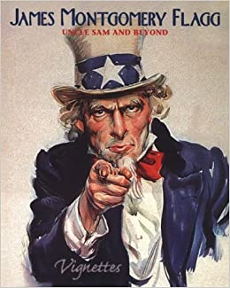
In 1916, James Montgomery Flagg drew his own version of
Uncle Sam. In his version Uncle Sam was wearing a tall
top hat, blue jacket, and was pointing straight at the viewer.
Fun facts about Uncle Sam

Slide 7
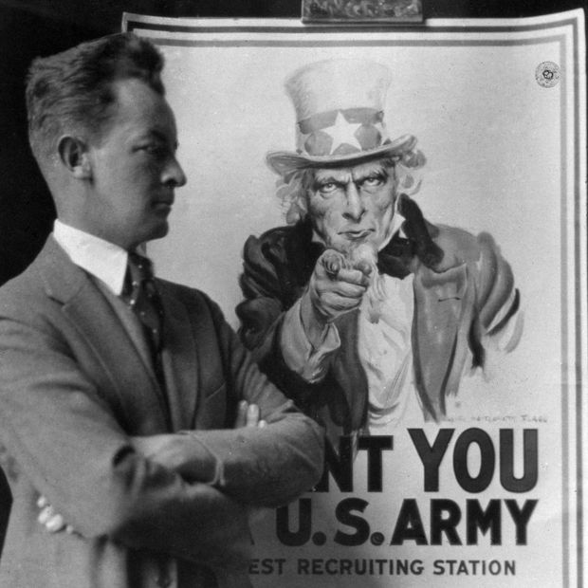
In 1917 Flagg’s Uncle Sam reappeared as a poster with the
caption “I Want You.” This poster was used all throughout
World War I and reappeared in World War II.
Fun facts about Uncle Sam

Slide 8
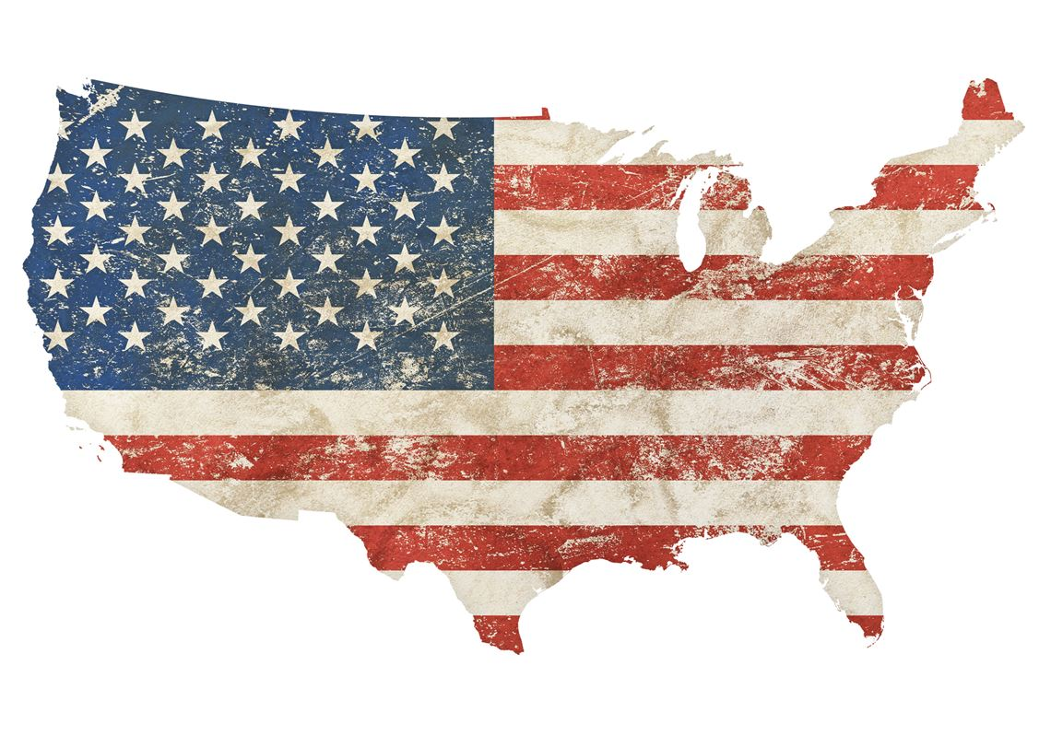
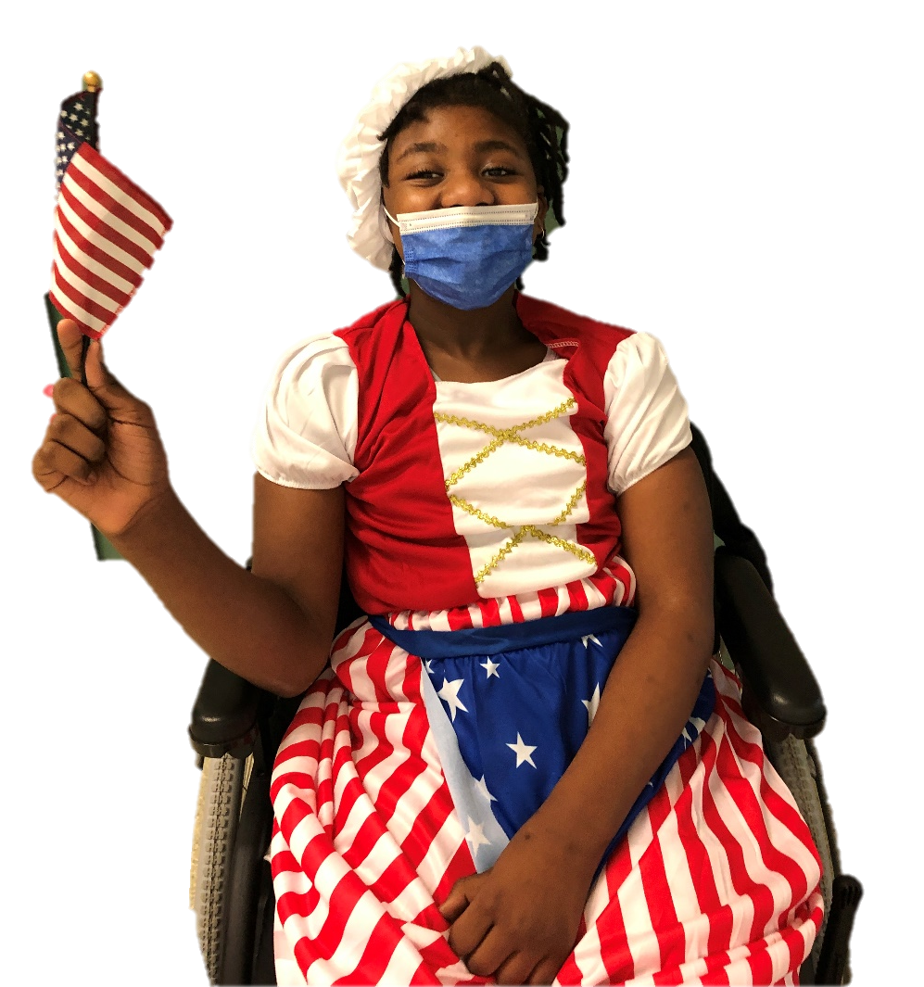
The End

