Slide 1
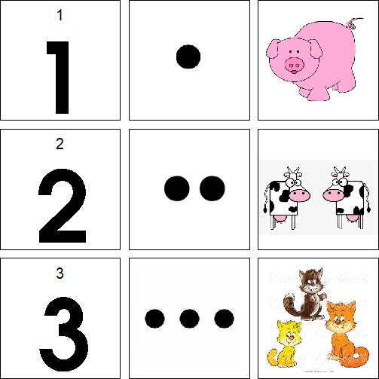
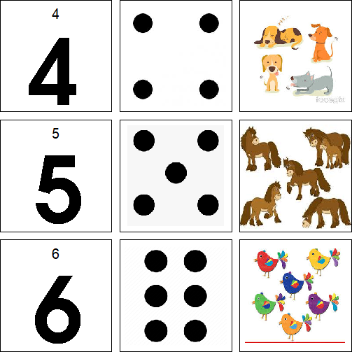
Cut out each of the pictures. You can start with just 2 different
numbers at a time. Put the numbers out. Help your child match
the right number of dots and animals to the right number.

Slide 2
