Slide 1
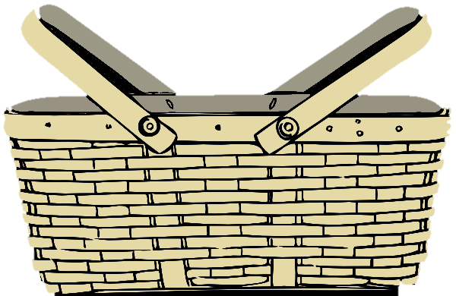
What Should We Bring To The Picnic?

Slide 2
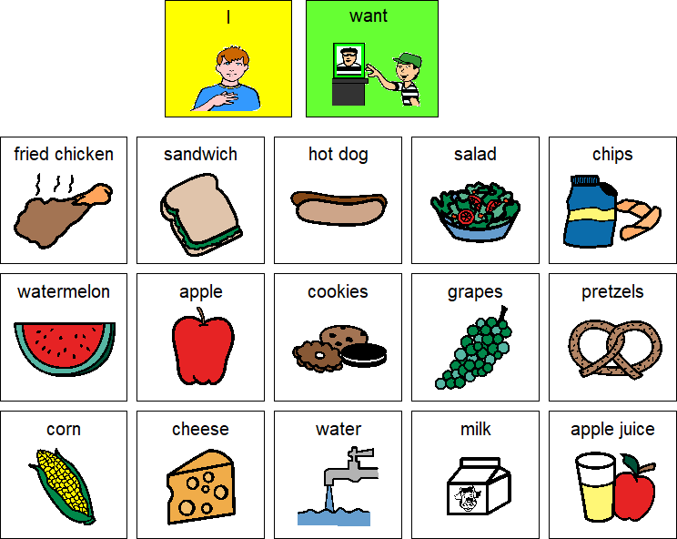

Slide 3
Tips on how to make this picnic interactive:
Cut out the picnic basket on the front and cut a slit at the top.
Cut out each of the food and drink pictures. Have your child use the symbols “I want” to show you which items they would want to bring on the picnic.
Put the pictures of the preferred foods through the slit in the top of the basket.
Talk about the types of food there are: fruit, vegetable, dessert, snack, etc.
You can even spread out a blanket inside (or outside!) and pretend to have a picnic, or have a real one!

