Slide 1
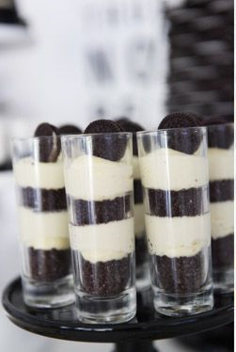
Let’s Make A Zebra Striped Parfait
Groupbygroup.wordpress.com

Slide 2
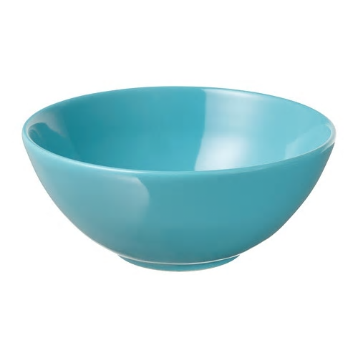
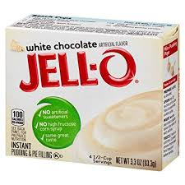
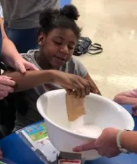
Put 1 box of instant white chocolate pudding mix
into a bowl.

Slide 3
Put 2 cups of milk into the bowl.

Slide 4
Mix together until the pudding is thickened.
Set pudding aside.

Slide 5
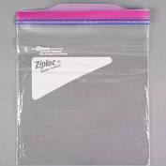
a few Oreos in a plastic baggy.

Slide 6
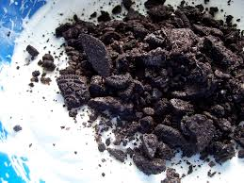
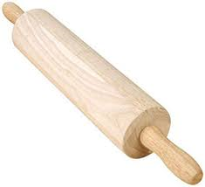
Use a rolling pin to crush the Oreos up into crumbs.

Slide 7
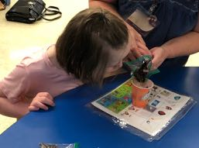
Put a spoonful of pudding into a cup and top with
half of the Oreo crumbs. Repeat one more time.

Slide 8
Eat and enjoy!

Slide 9
What did you think?

