Slide 1
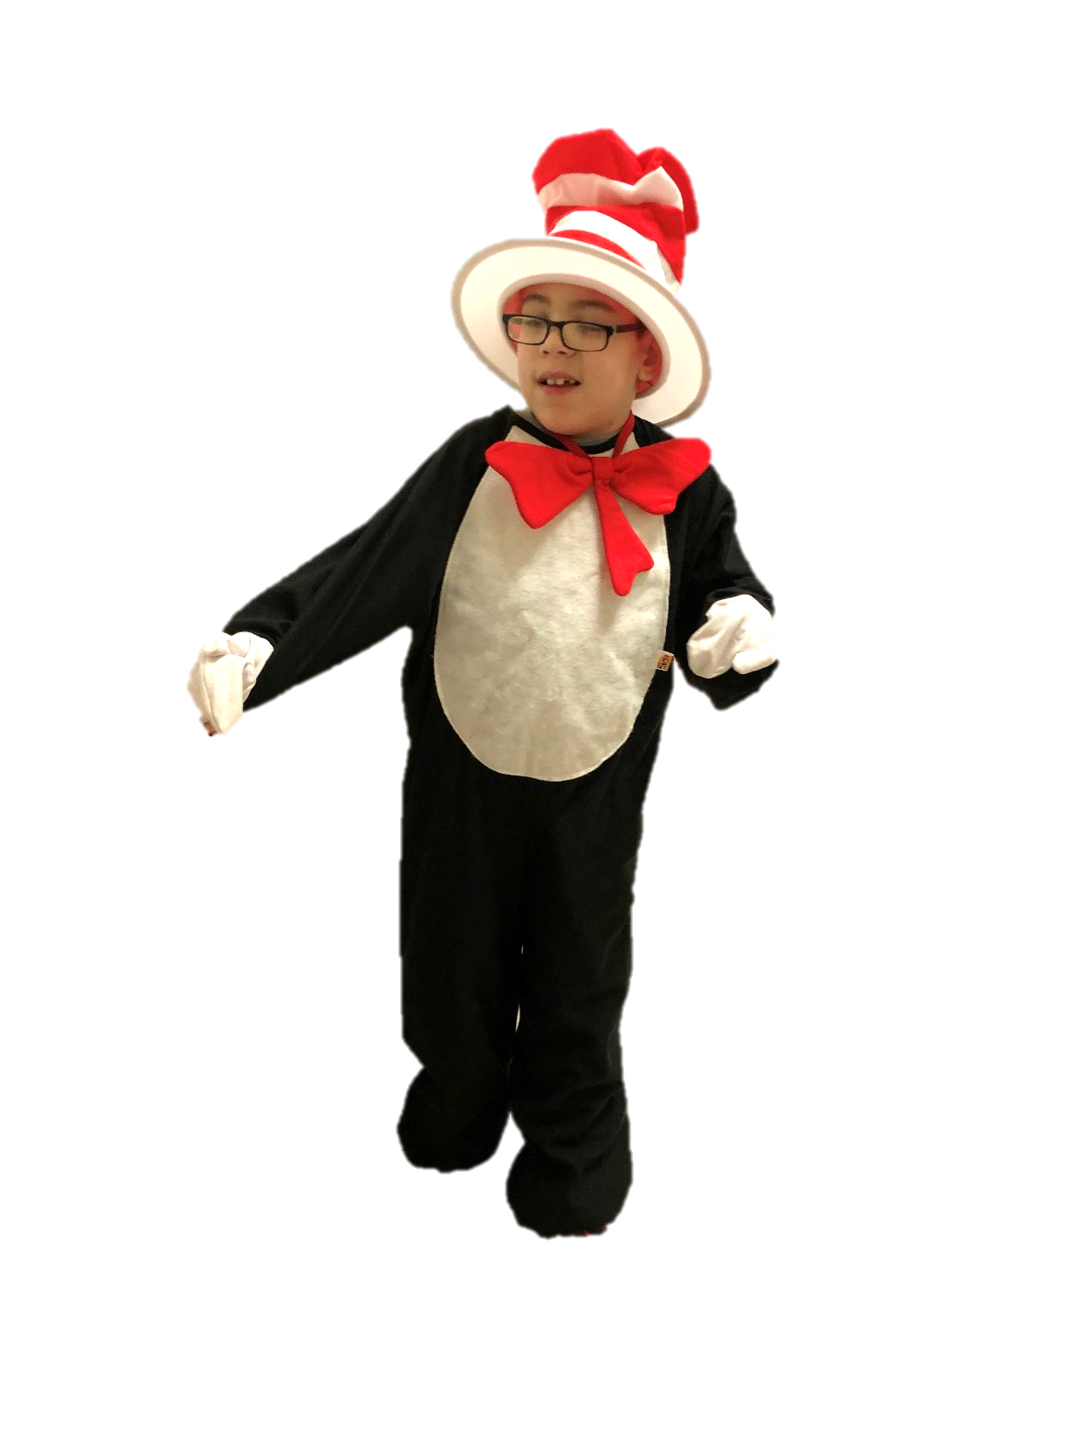
Take A Look At Our Favorite Books
By: Cara Edenfield and Joy Delaney
Groupbygroup.wordpress.com

Slide 2
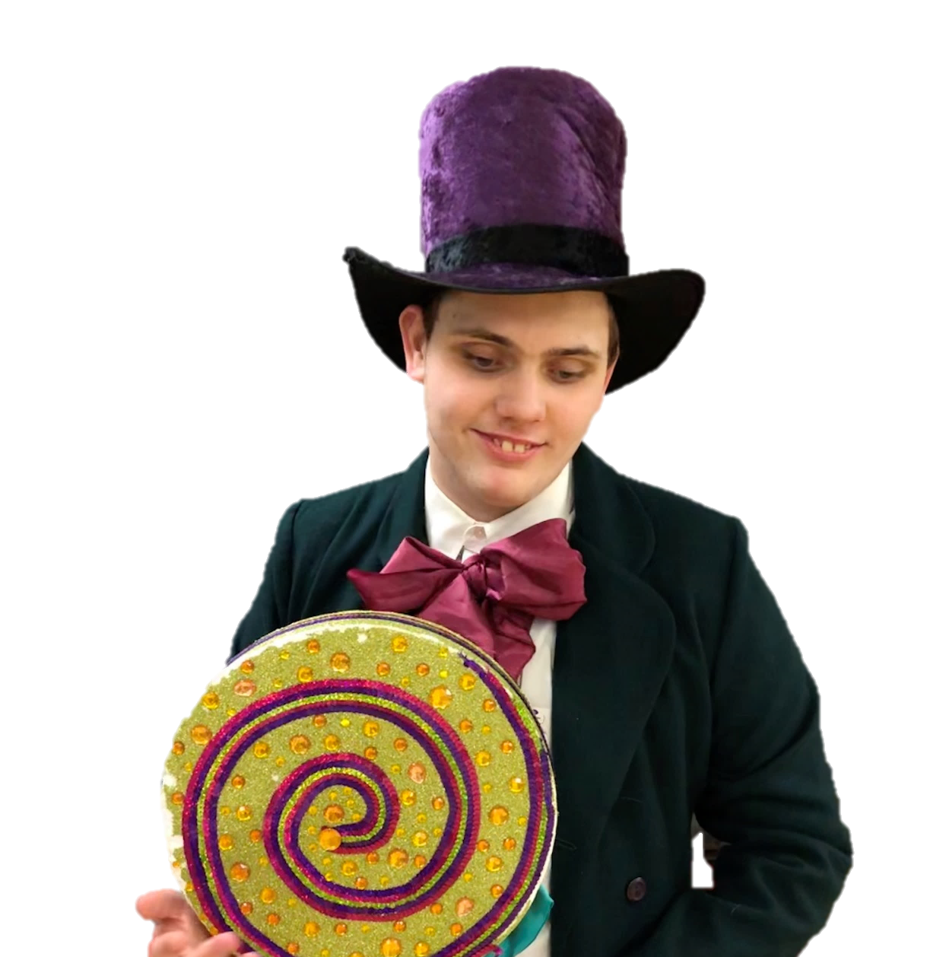
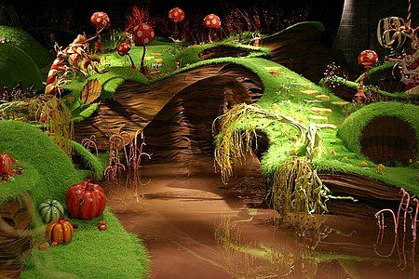
We like to read Charlie and the
Chocolate Factory.
Take a look at our favorite books.

Slide 3
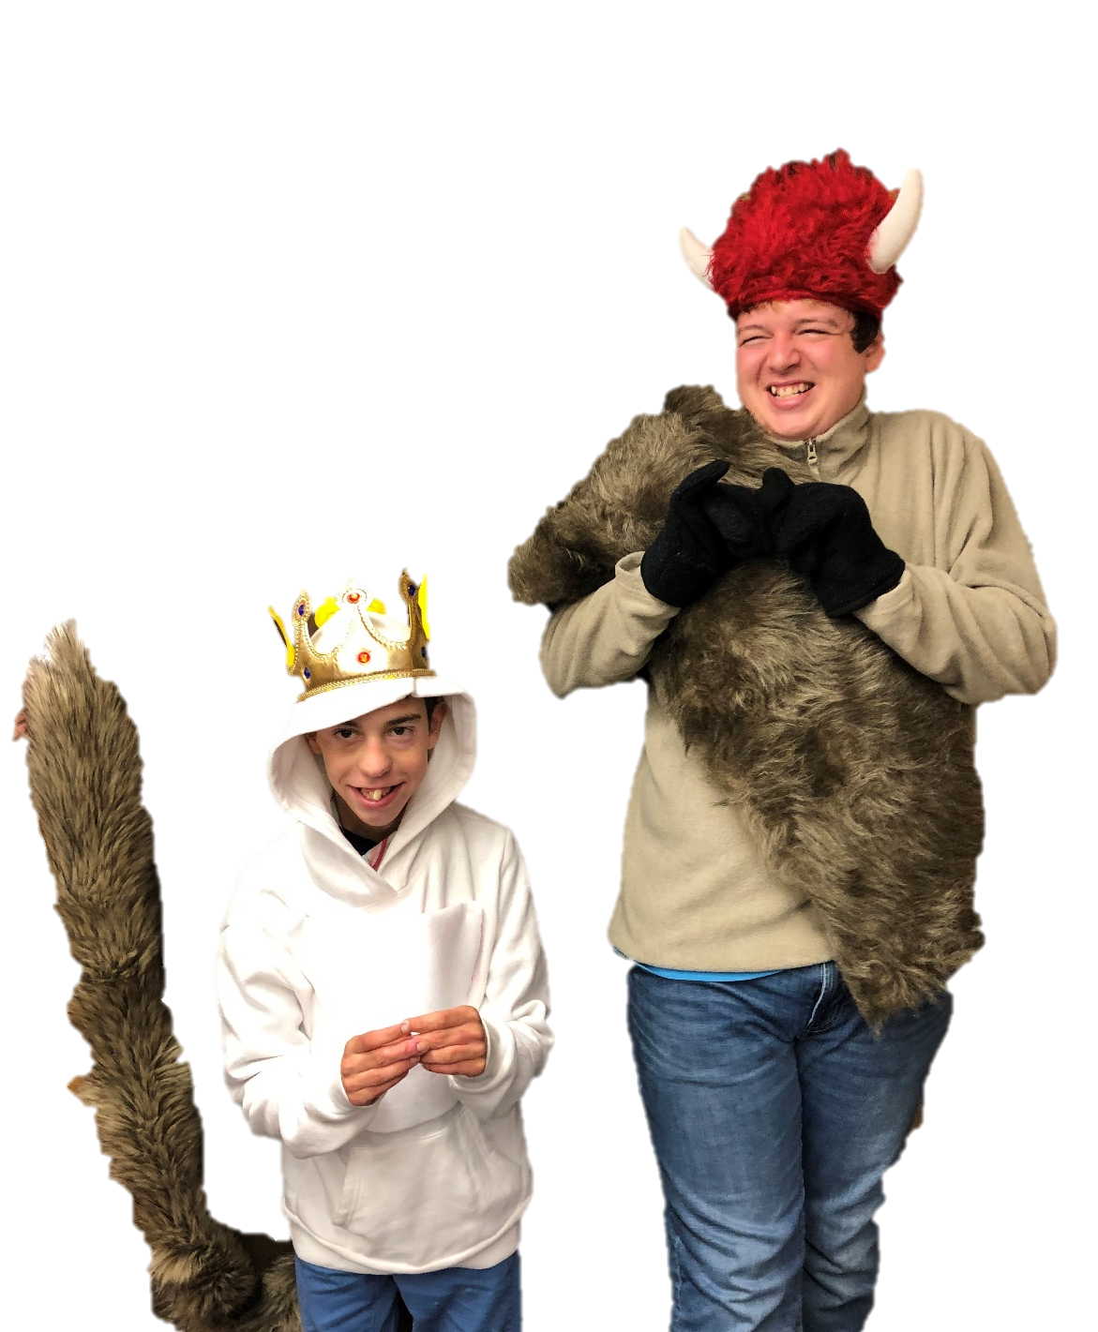
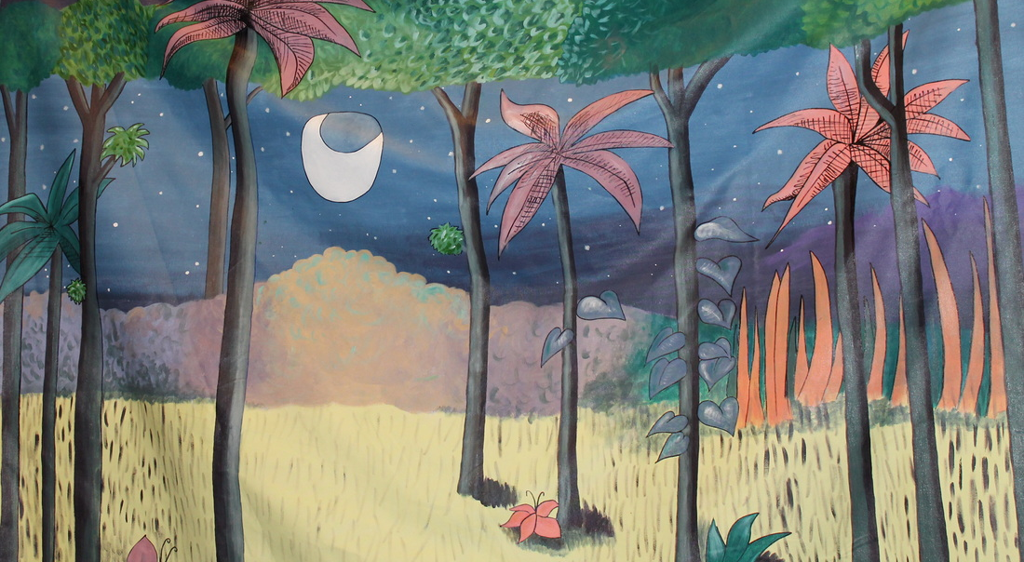
We like to read Where The Wild Things Are.
Take a look at our favorite books.

Slide 4
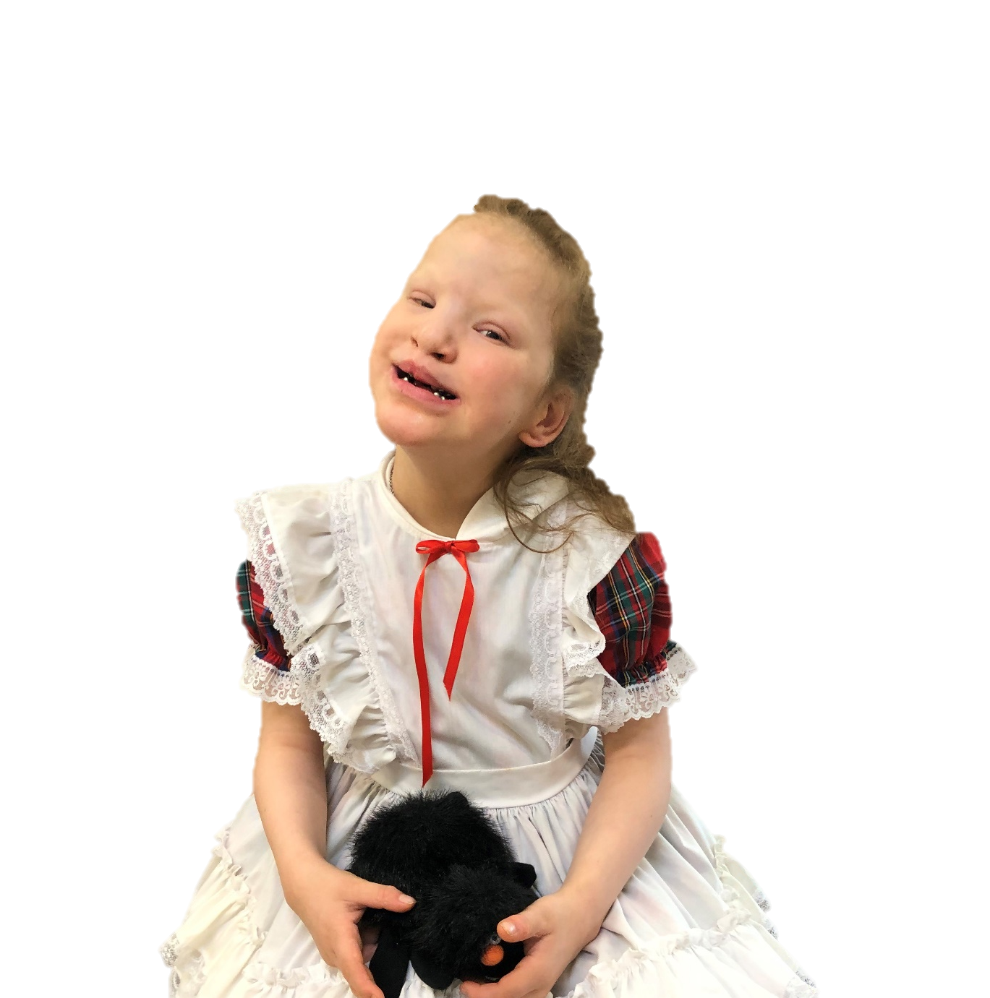
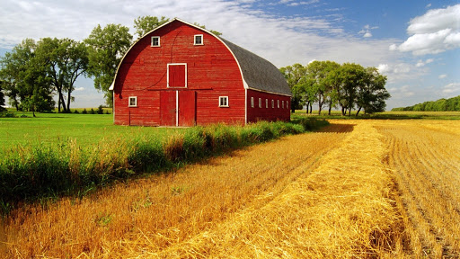
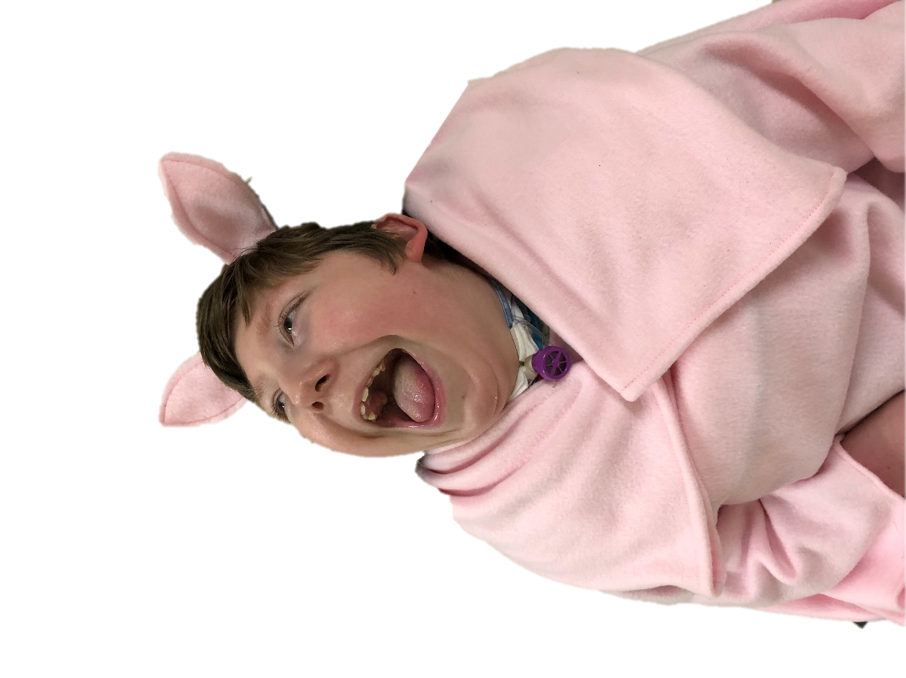
We like to read Charlotte’s Web.
Take a look at our favorite books.

Slide 5
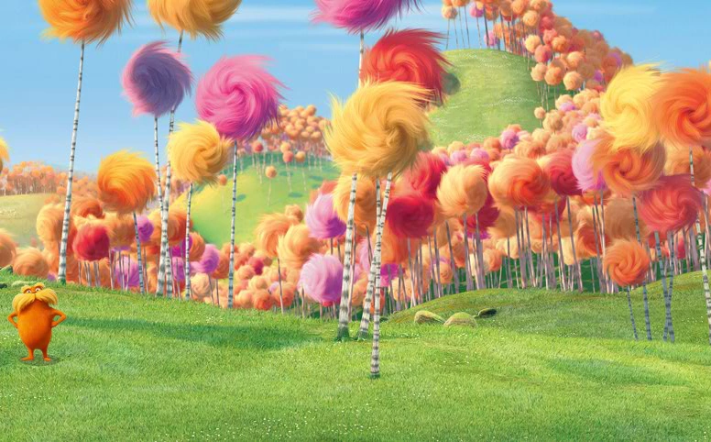
We like to read The Lorax.
Take a look at our favorite books.

Slide 6
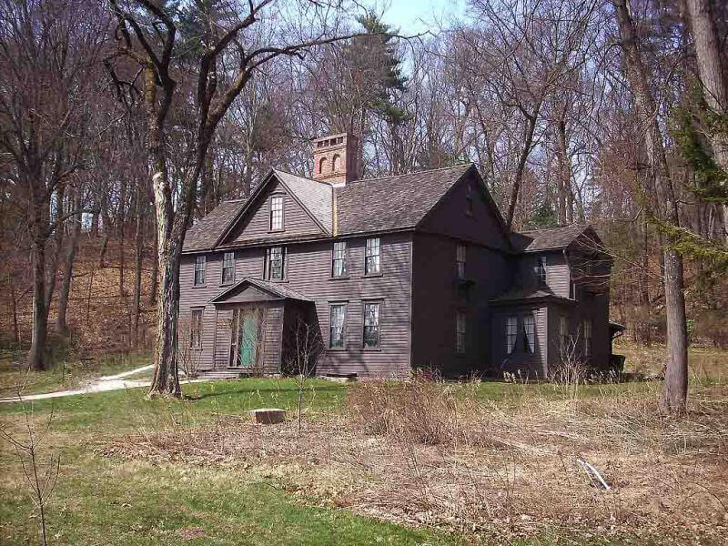
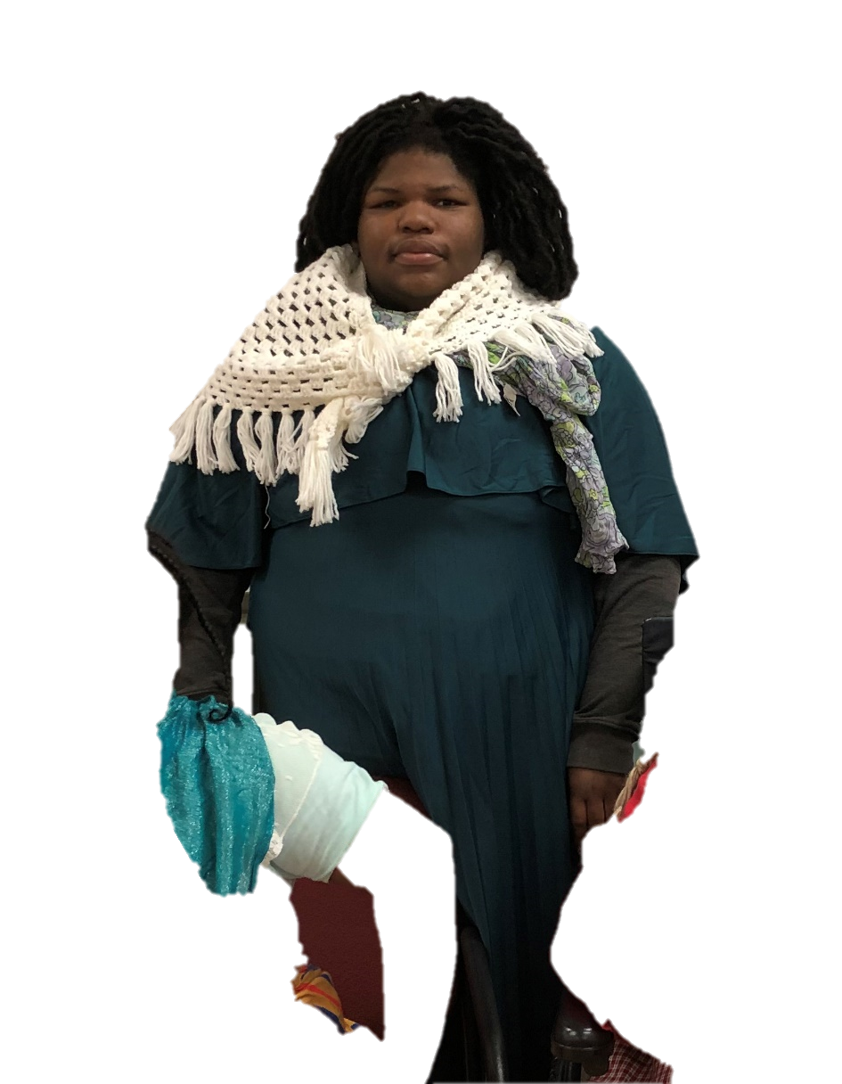
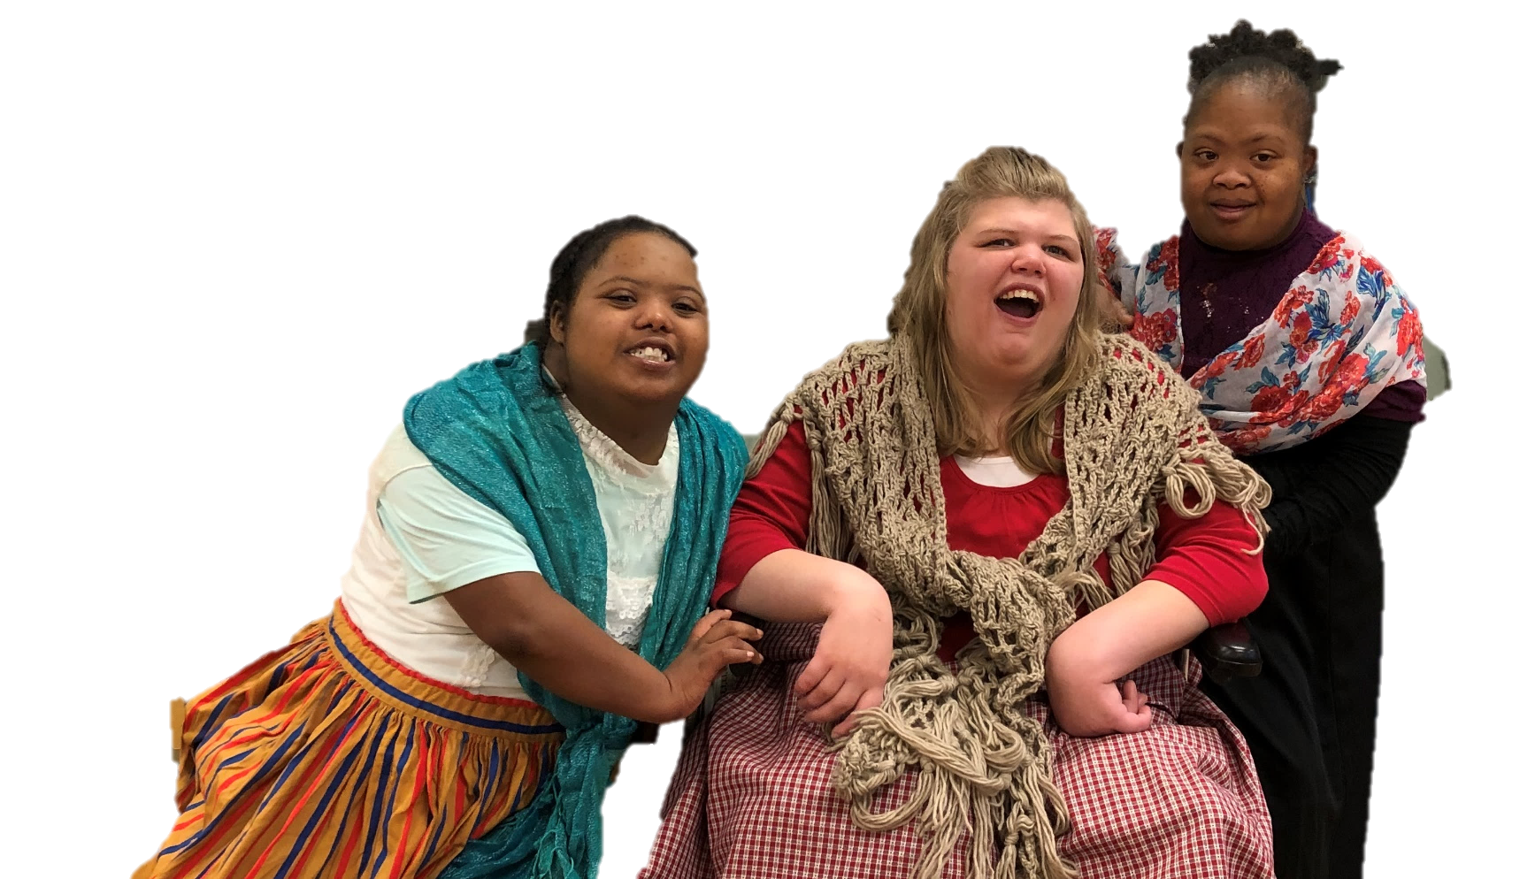
We like to read Little Women.
Take a look at our favorite books.

Slide 7
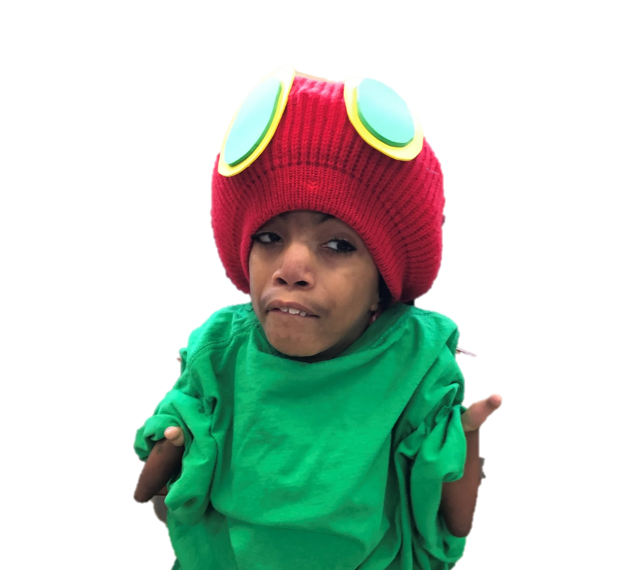
We like to read The Very Hungry Caterpillar.
Take a look at our favorite books.

Slide 8
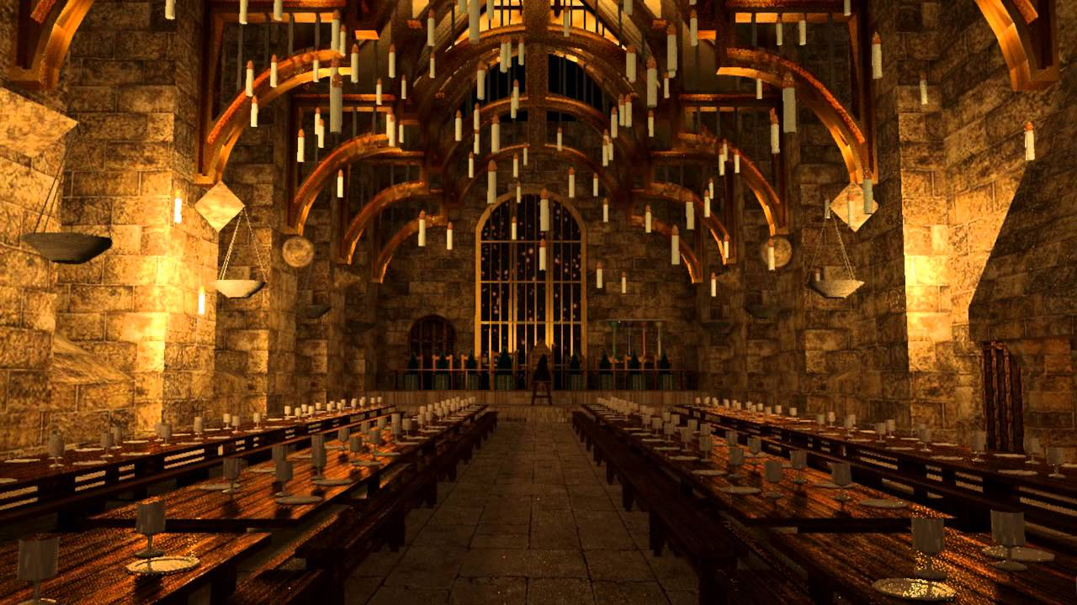
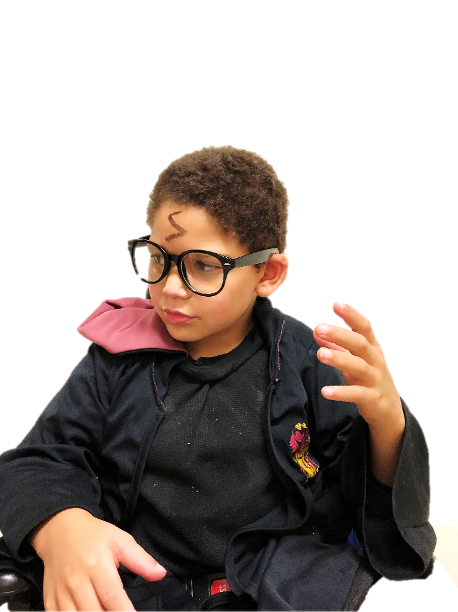
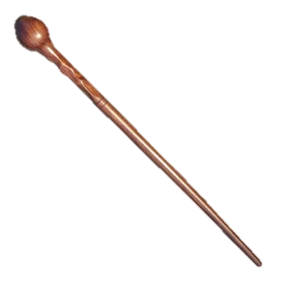
We like to read Harry Potter.
Take a look at our favorite books.

Slide 9
We like to read The Lion, The Witch,
And The Wardrobe.
Take a look at our favorite books.

Slide 10
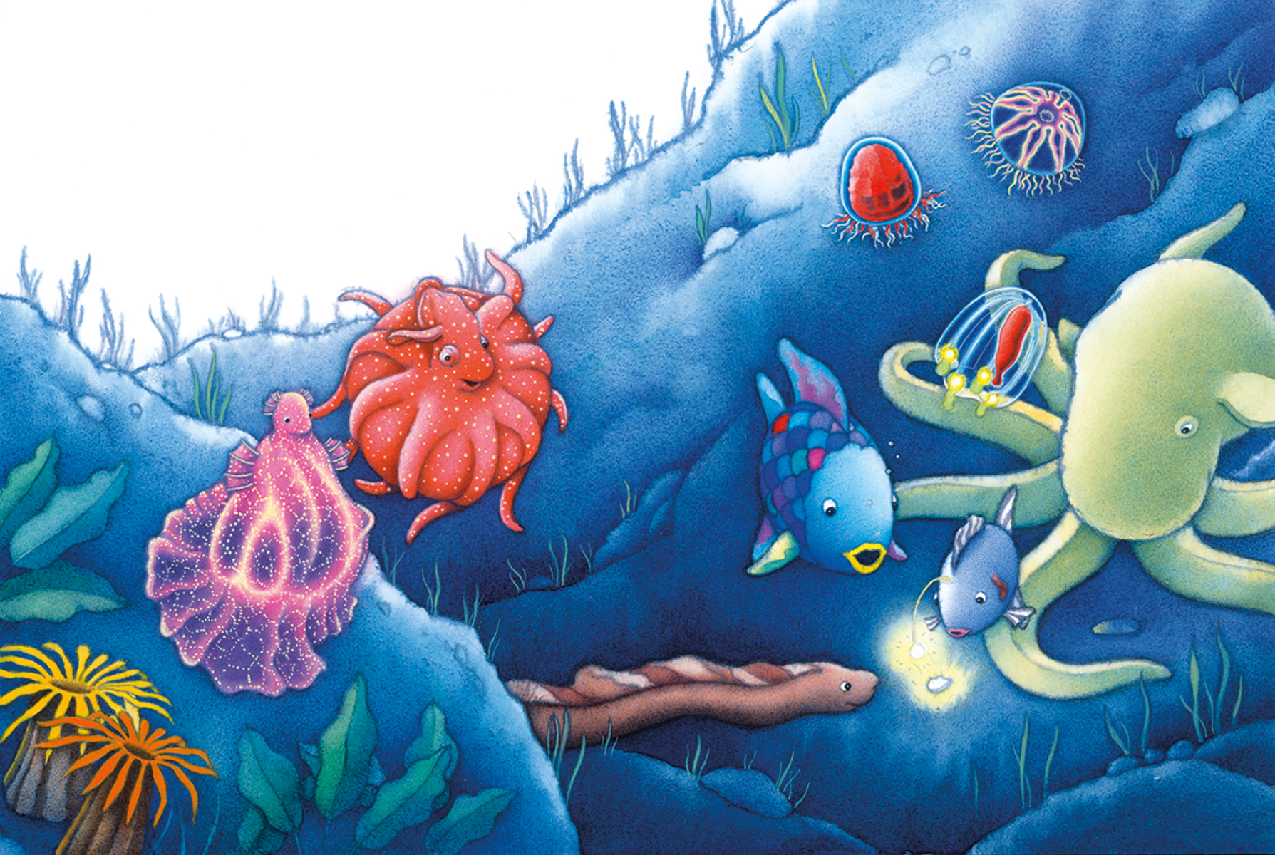
We like to read The Rainbow Fish.
Take a look at our favorite books.

Slide 11
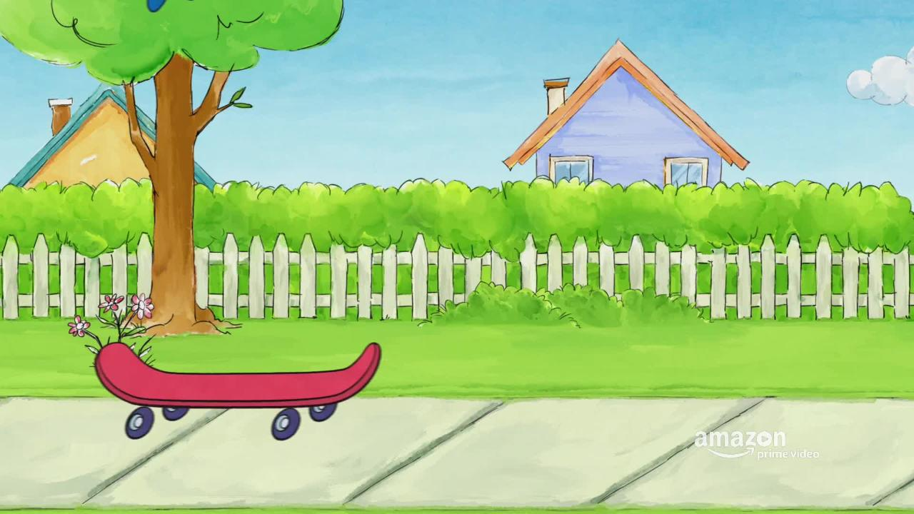
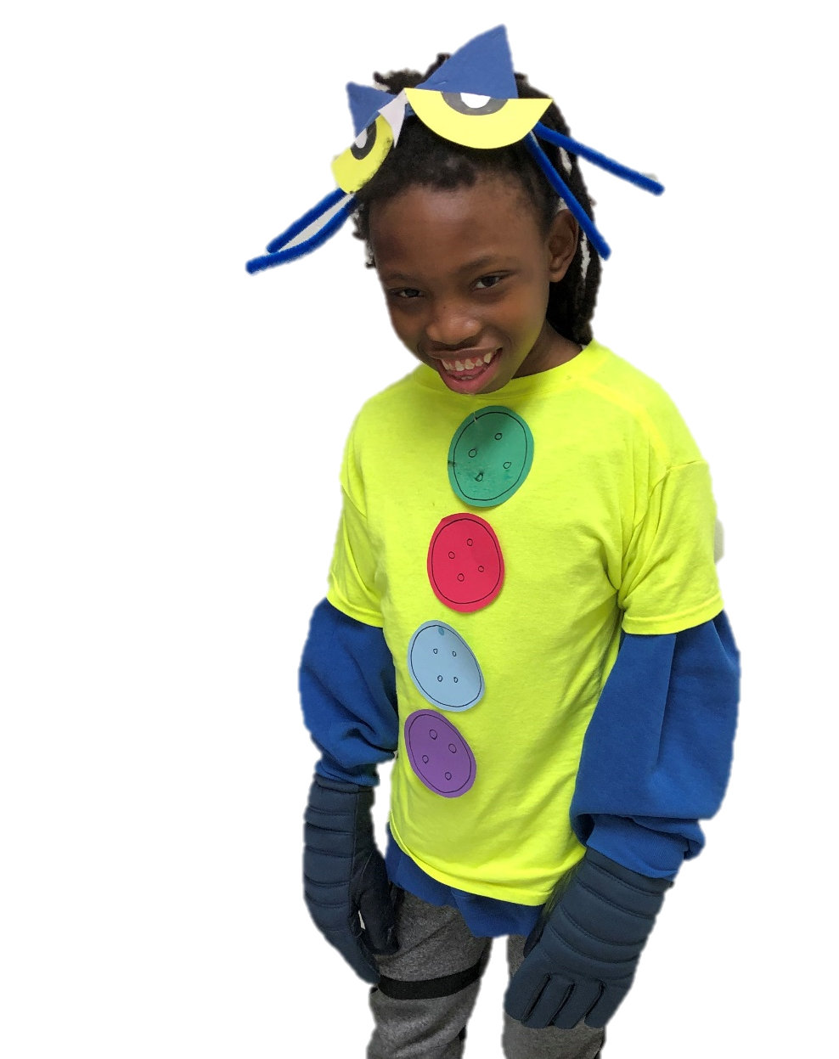
We like to read Pete The Cat.
Take a look at our favorite books.

Slide 12
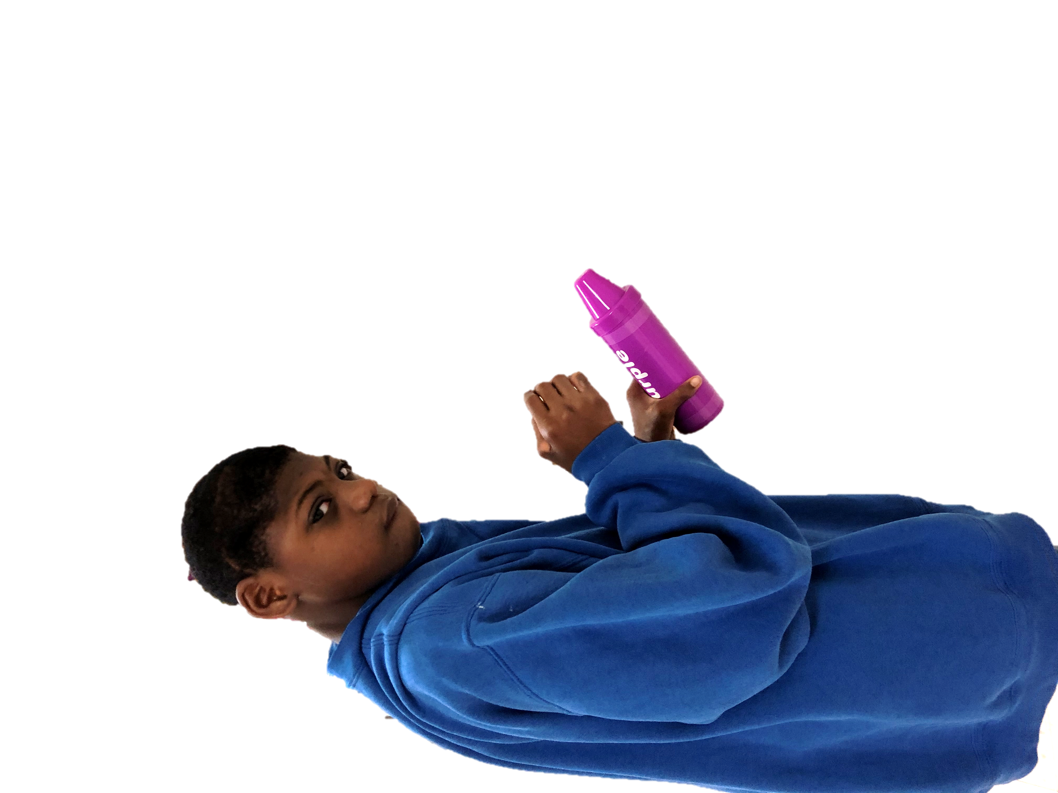
The
End

