Slide 1
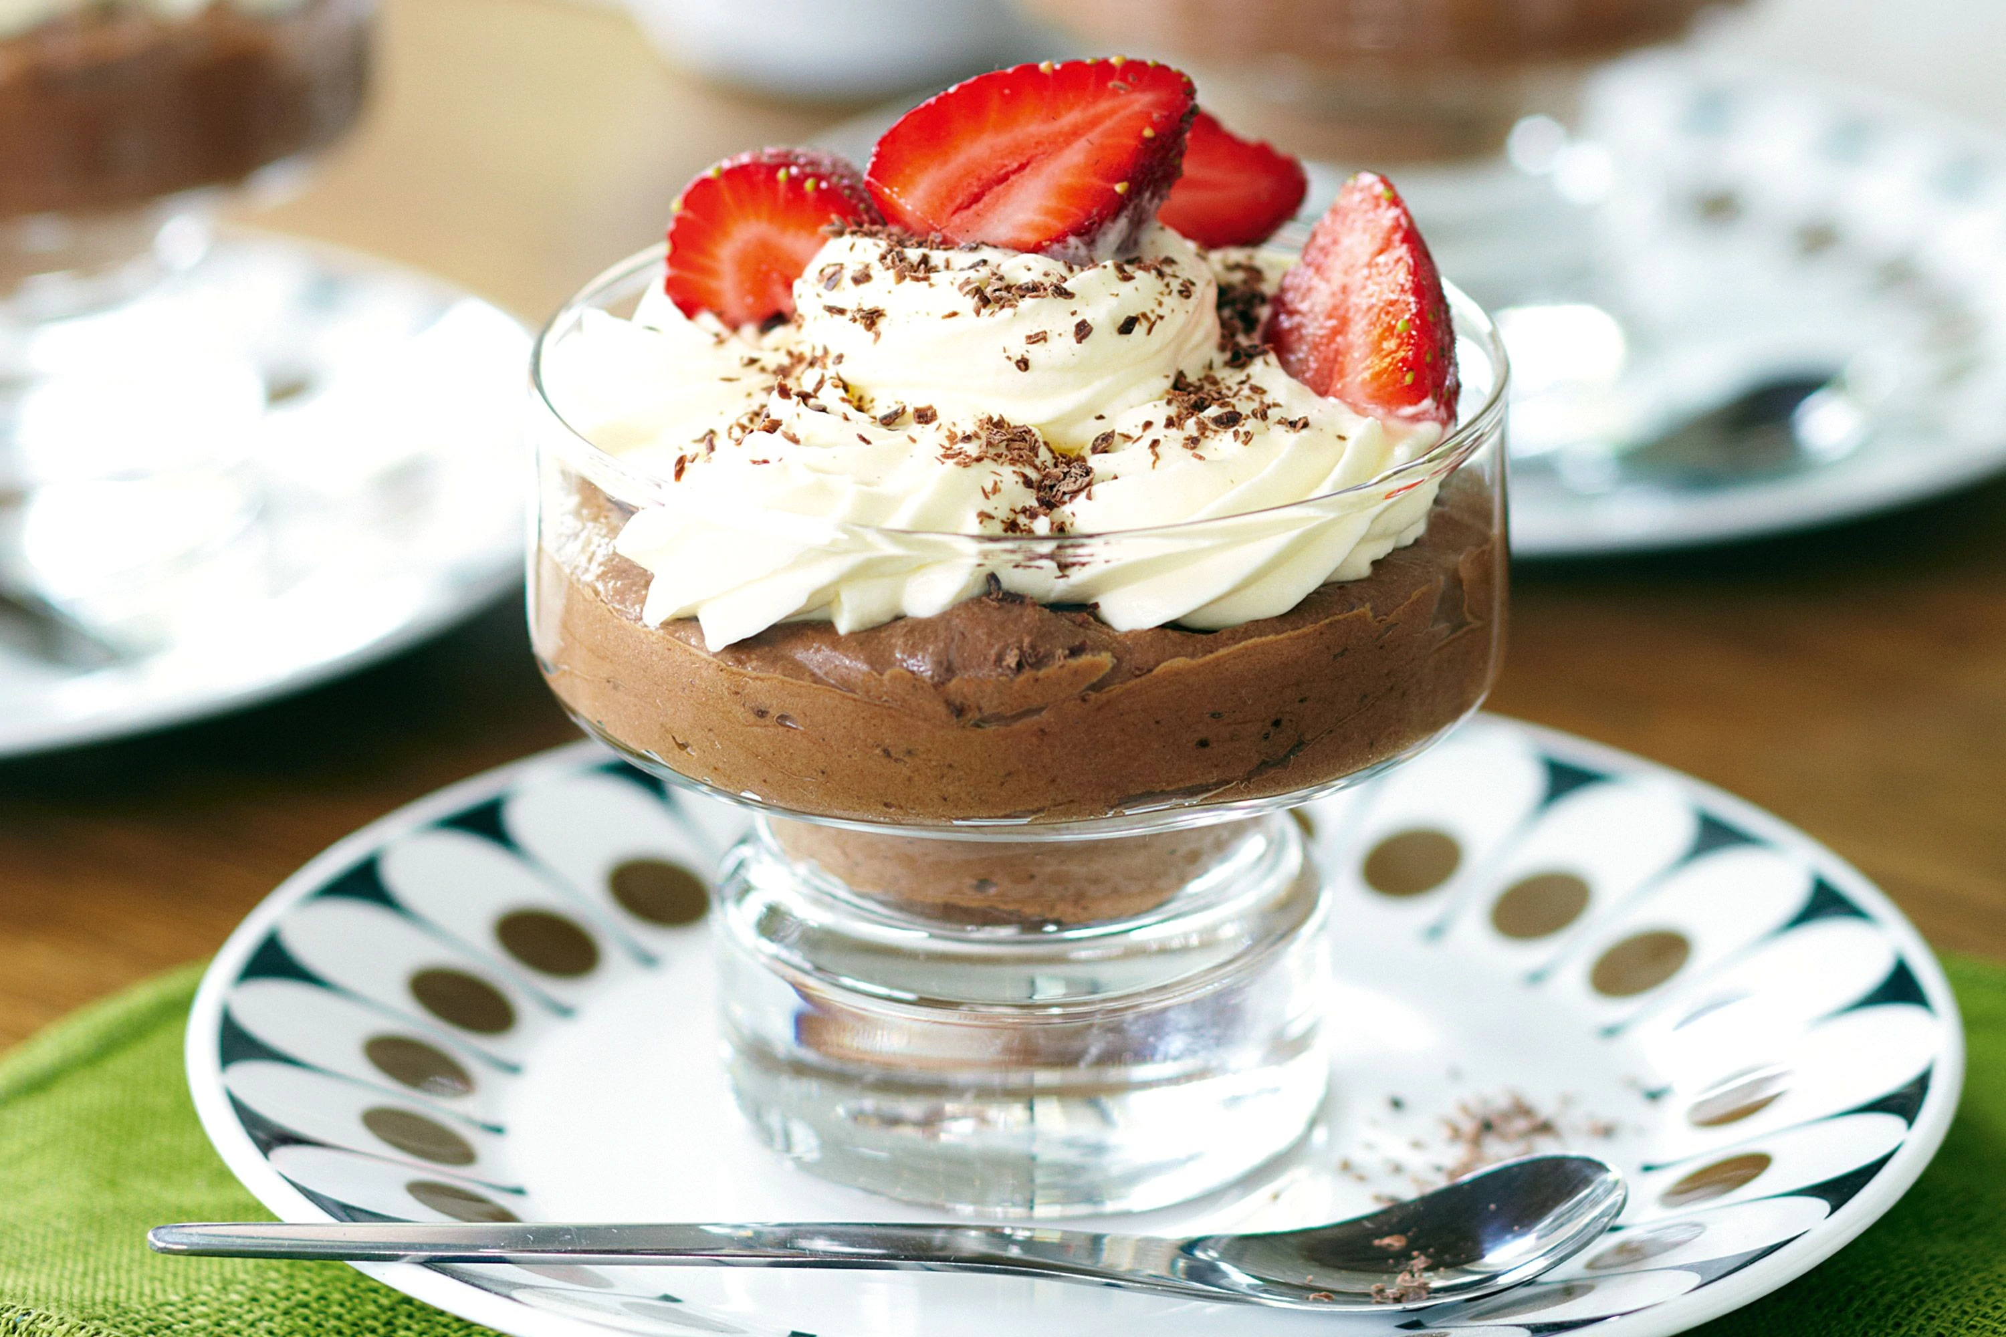
Let’s Make Willy Wonka’s Chocolate Mousse
Groupbygroup.wordpress.com

Slide 2
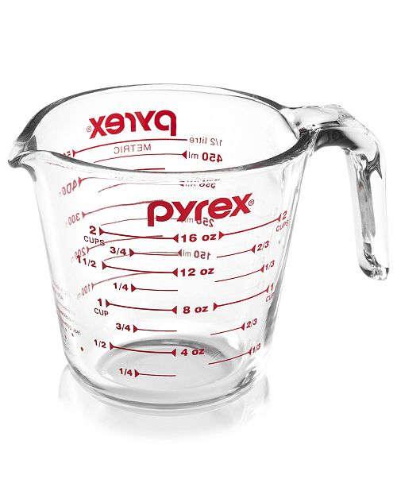
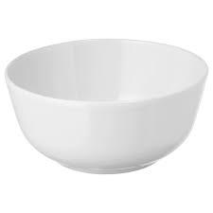
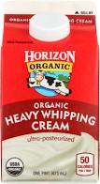
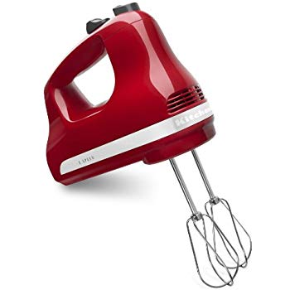
Put 1 ½ cups of heavy whipping cream in a bowl.
Mix until thickened slightly.

Slide 3
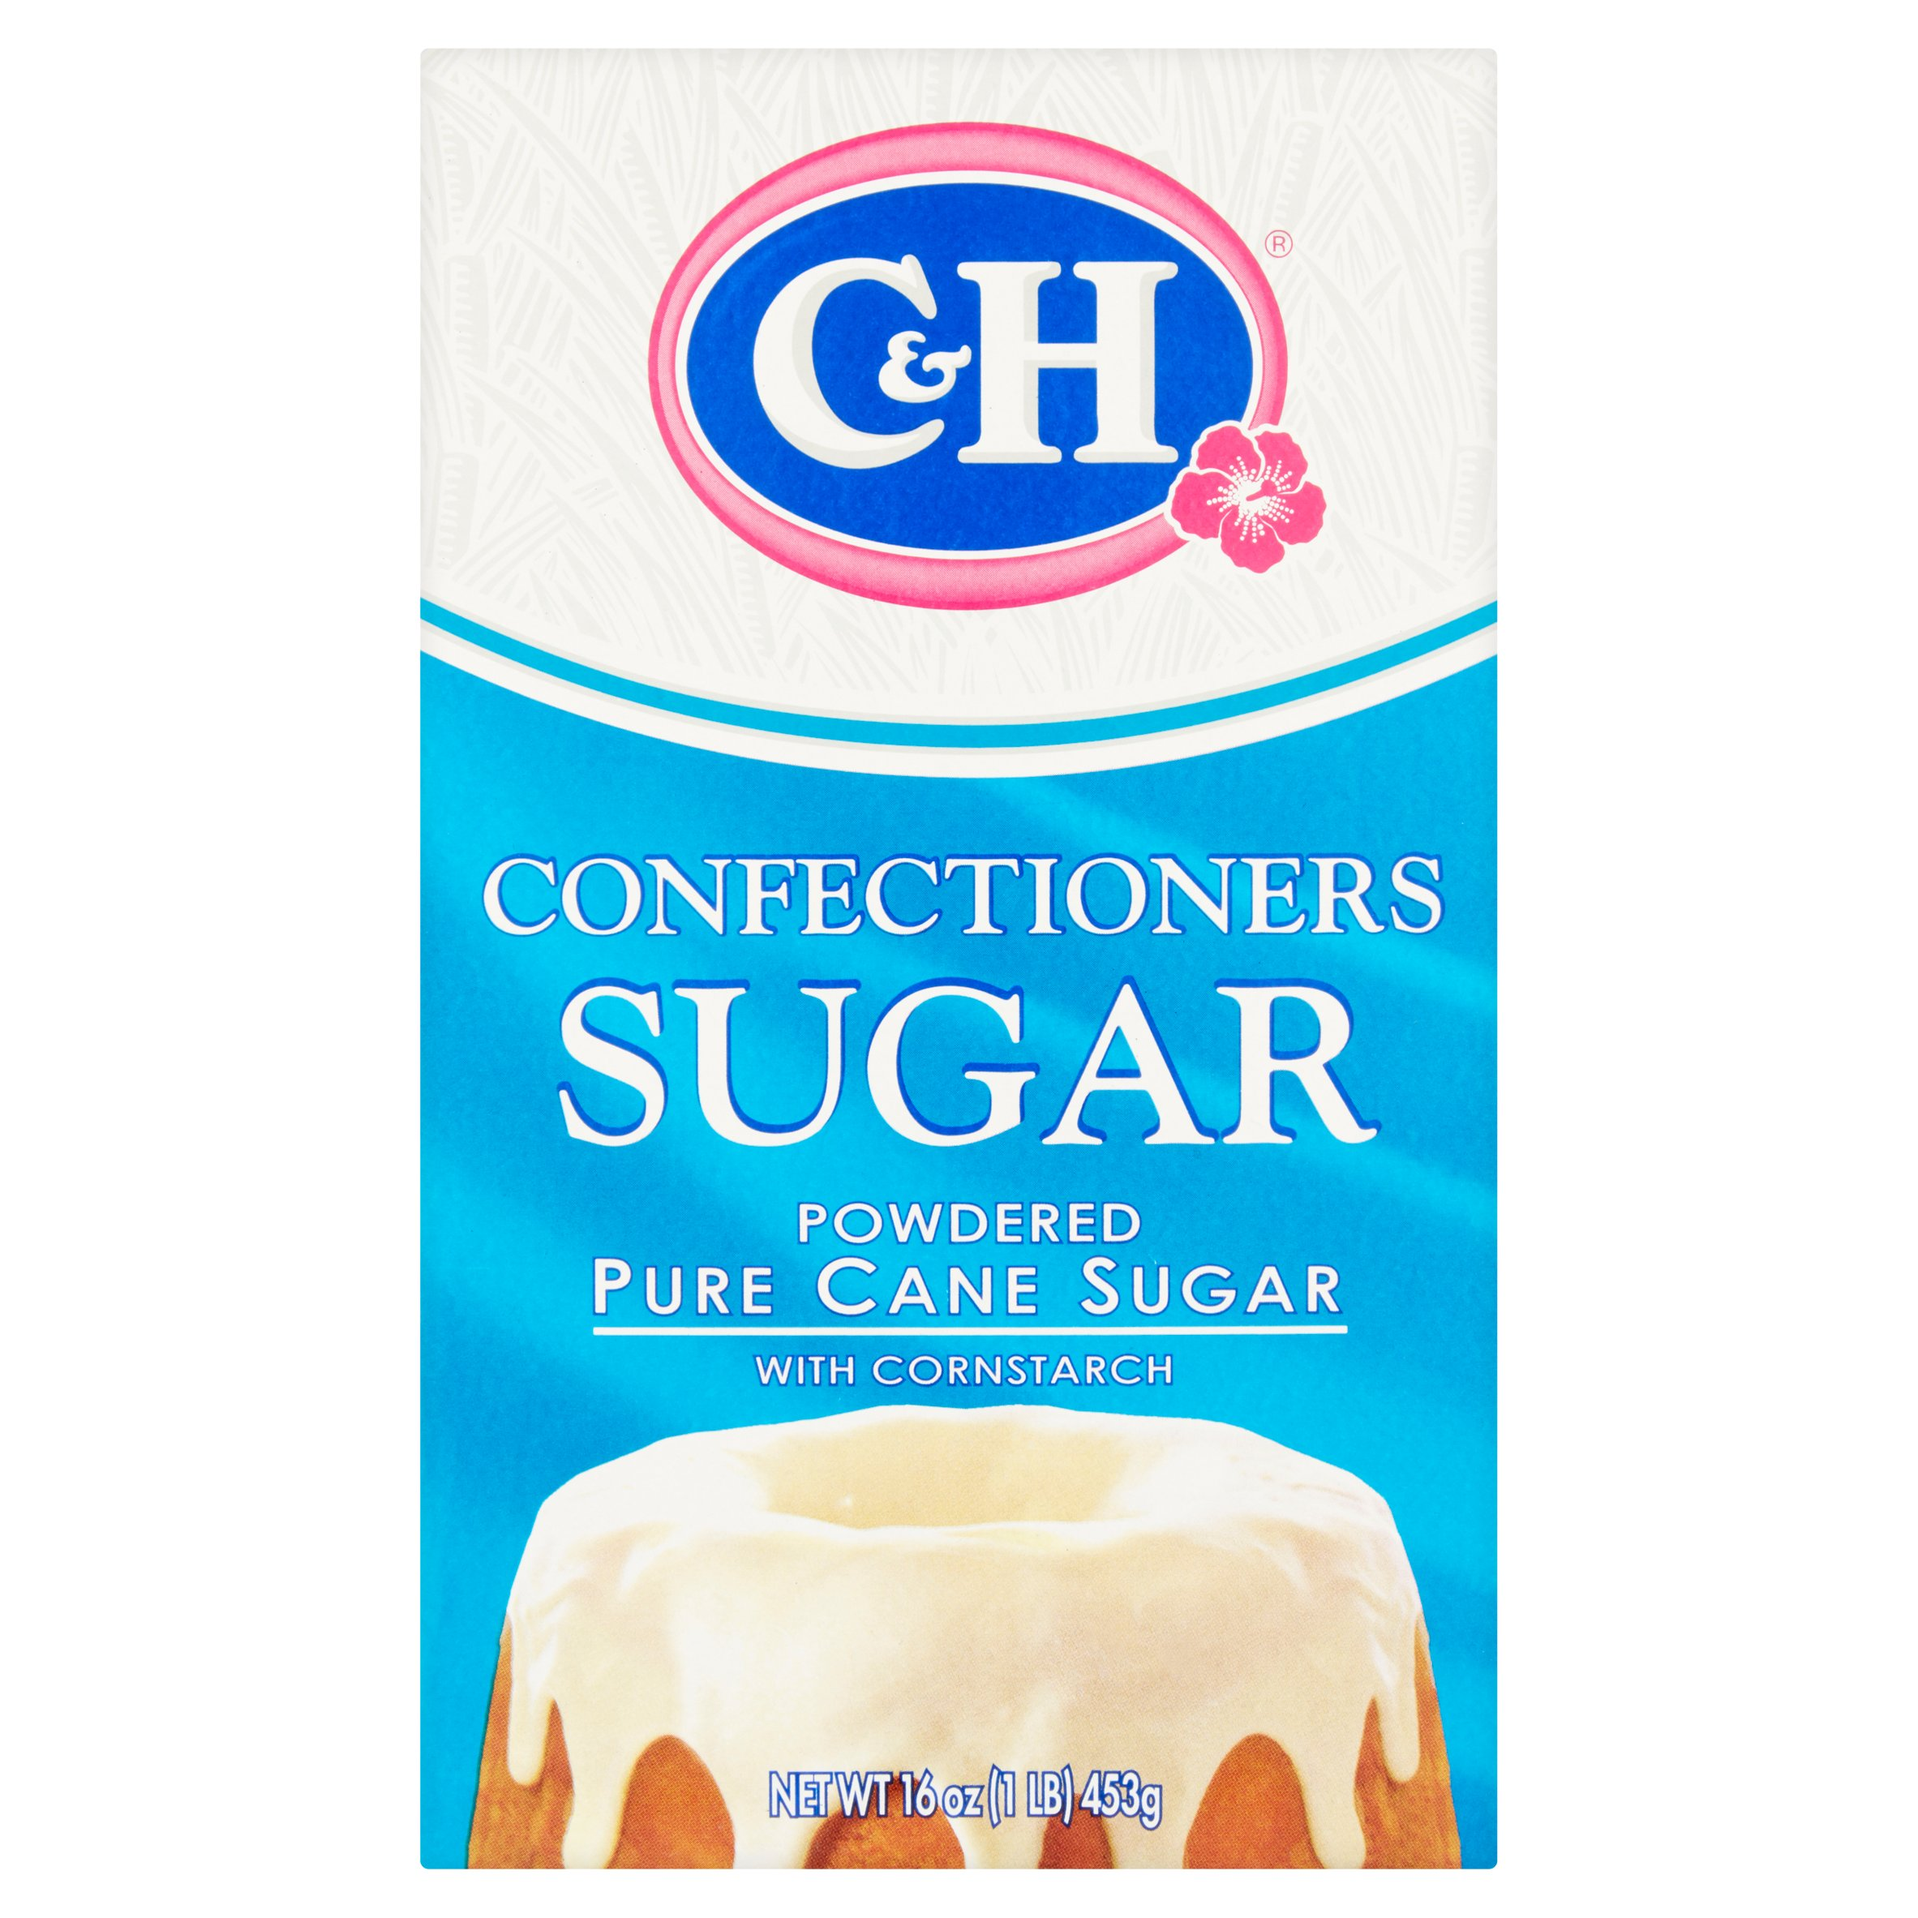
Put ¼ cup of powdered sugar into the bowl with
whipping cream.

Slide 4
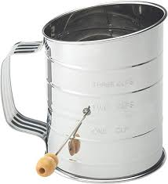
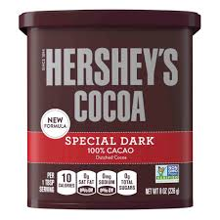
Sift 1/3 cup dark chocolate cocoa powder
into the bowl.

Slide 5
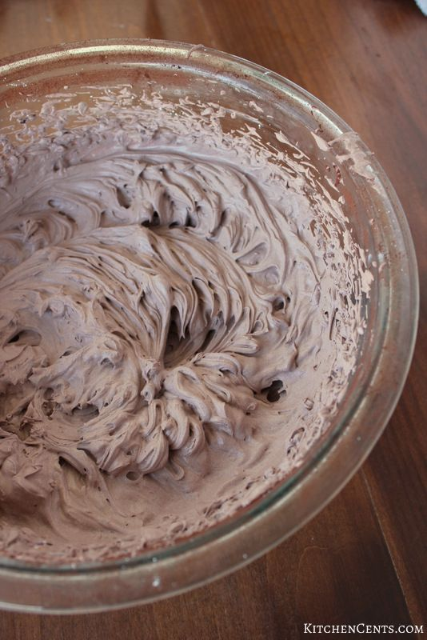
Mix all ingredients until stiff peaks form.

Slide 6
Put mousse in cups. Top with whipped cream
and strawberries. Eat and enjoy!

