Slide 1
Let’s Learn About Sound And Light
By: Cara Edenfield and Joy Delaney
Groupbygroup.wordpress.com

Slide 2
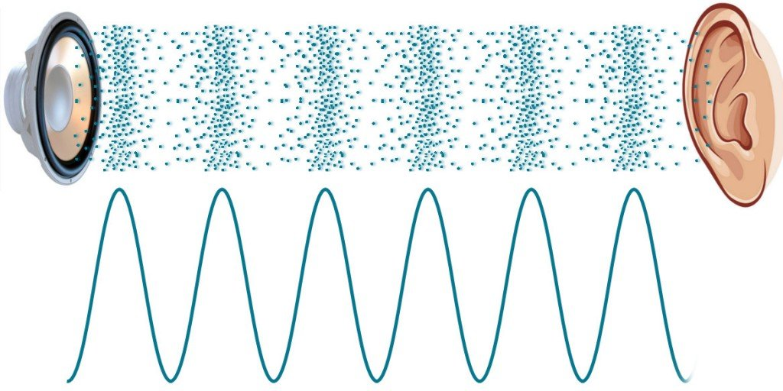
Sound is a vibration, or wave, that travels through matter
(solid, liquid, or gas) and can be heard.
Let’s learn about sound and light.

Slide 3
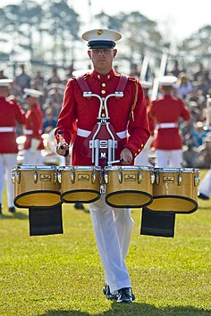
The vibration is started by some mechanical movement,
like someone hitting a drum or knocking on a door.
These vibrations make air molecules move from molecule to
molecule causing the sound to travel.
Let’s learn about sound and light.

Slide 4
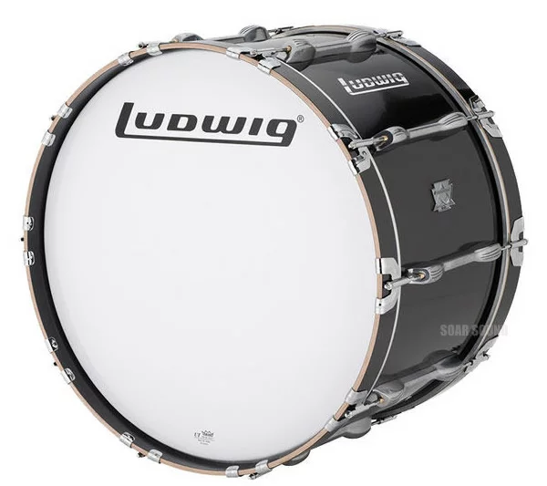
Sound changes depending on how fast or slow an object
vibrates to make sound waves. If an object vibrates quickly
we hear a high-pitched sound, and if an object vibrates
slowly we hear a low-pitched sound.
Whistle
High pitched sound
Bass drum
Low pitched sound
Let’s learn about sound and light.

Slide 5
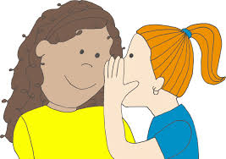
The volume of sound is the measure of loudness. Loud sound
has a high volume while soft sound has a low volume.
Let’s learn about sound and light.

Slide 6
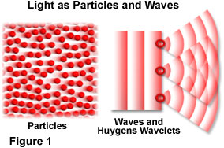
Light is a form of energy made of photons. Light is unique
in that it behaves like both a particle and a wave.
Let’s learn about sound and light.

Slide 7
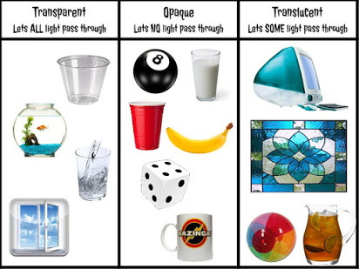
Depending on the type of matter it comes into contact with, light will
behave differently. Transparent objects allow light to pass through.
Opaque objects reflect light. Translucent objects do some of
both and tend to scatter the light.
Let’s learn about sound and light.

Slide 8
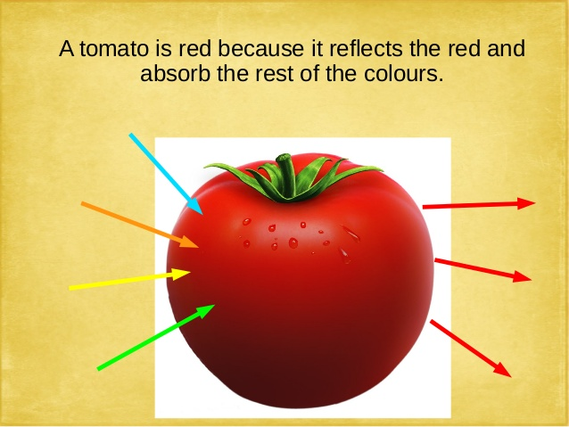
Light of different wavelengths looks like different colors to us.
When we see an object of a certain color that means that
light of that color's wavelength is being reflected
off the object.
Let’s learn about sound and light.

Slide 9
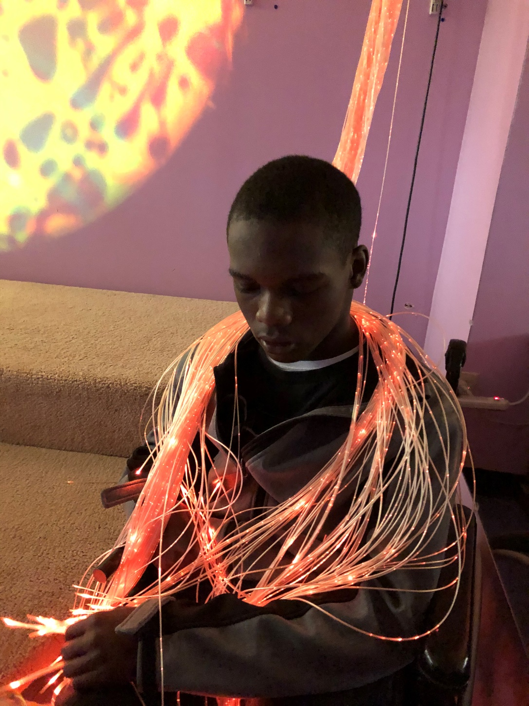
The End

