Slide 1
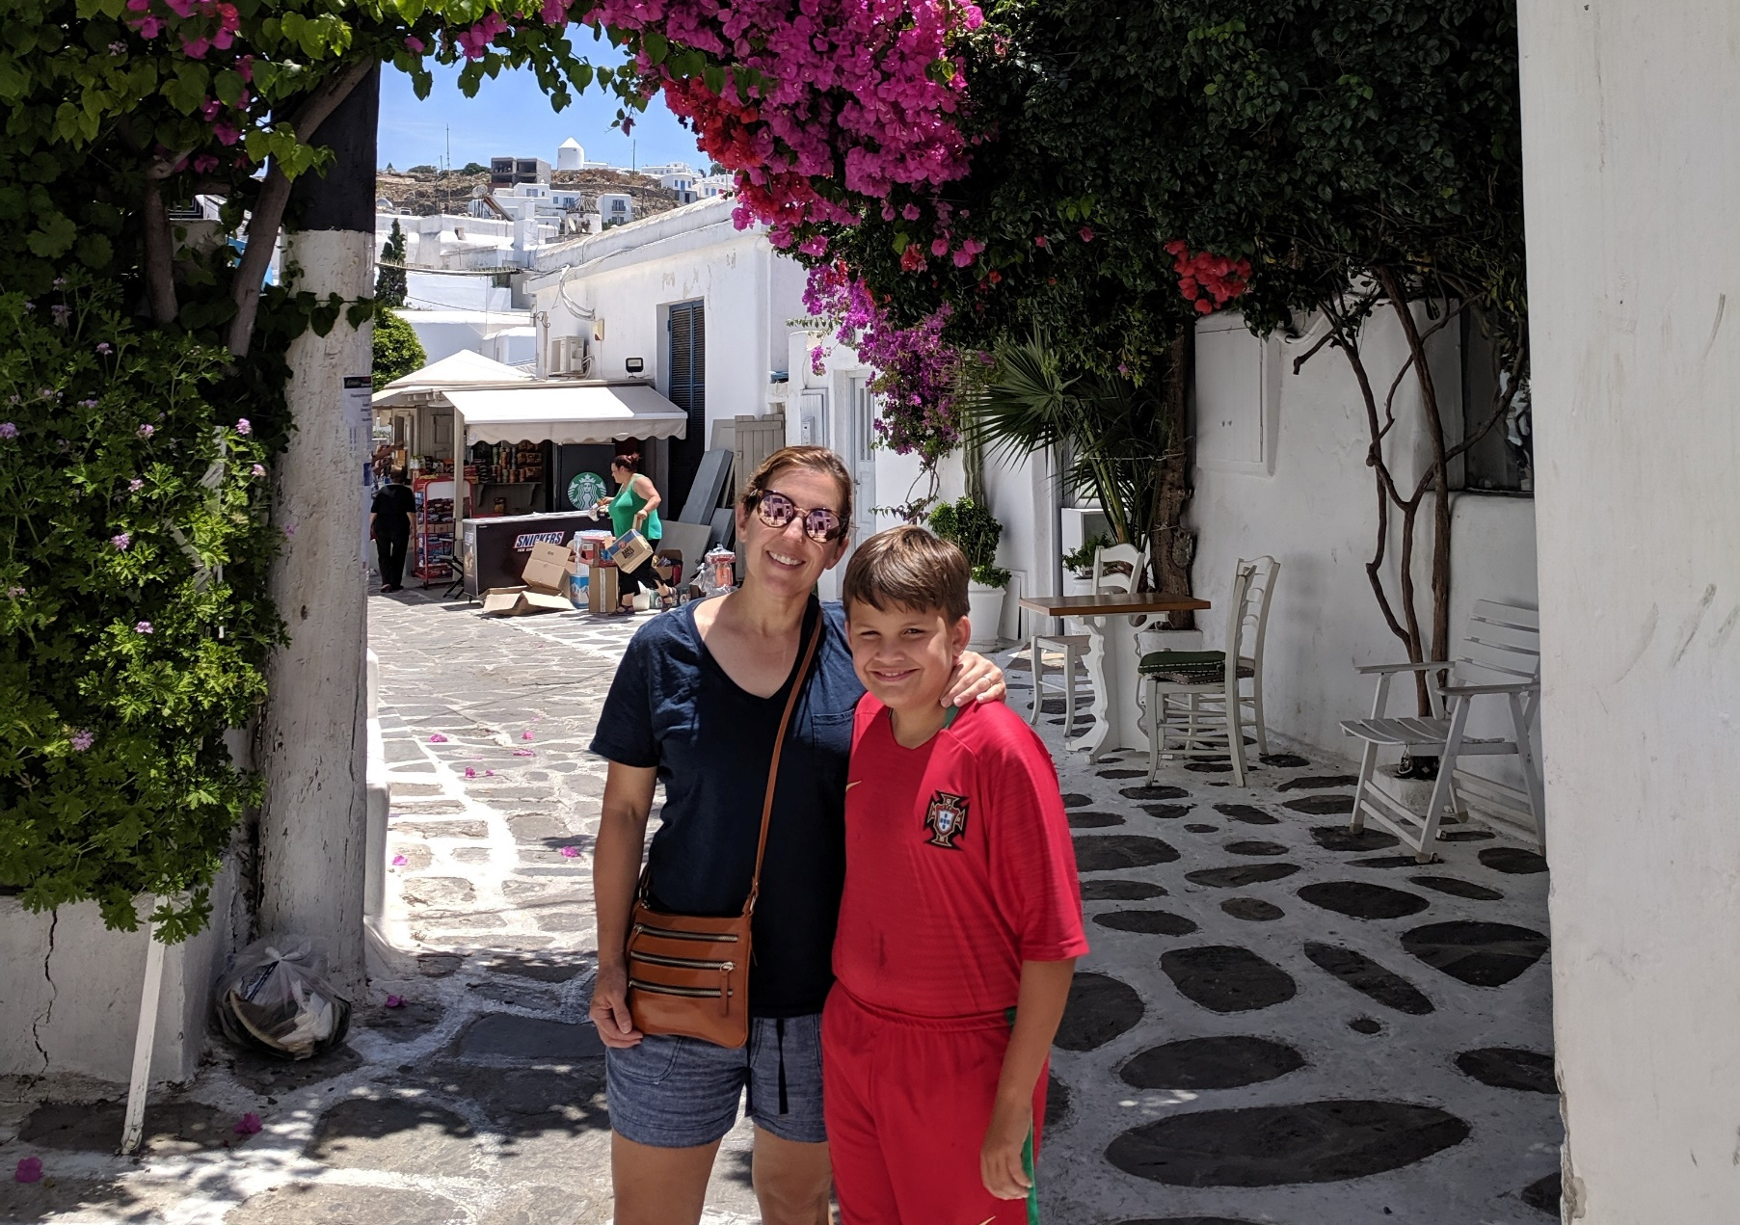
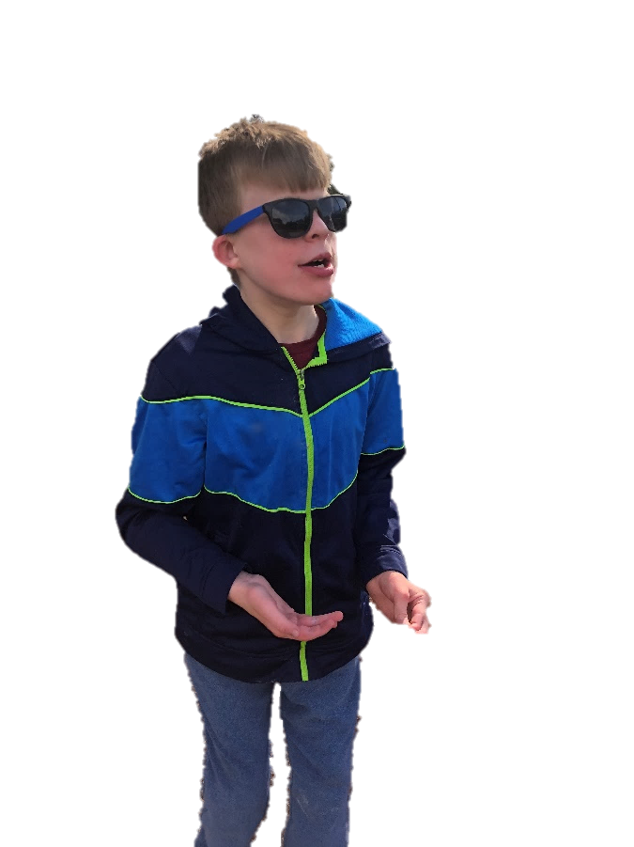
Let’s Learn About Greece
By: Cara Edenfield and Joy Delaney
Groupbygroup.wordpress.com

Slide 2
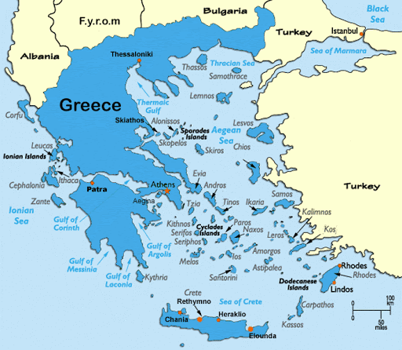
Greece is located in southeast Europe,
close to both Africa and Asia.
Let’s learn about Greece.

Slide 3
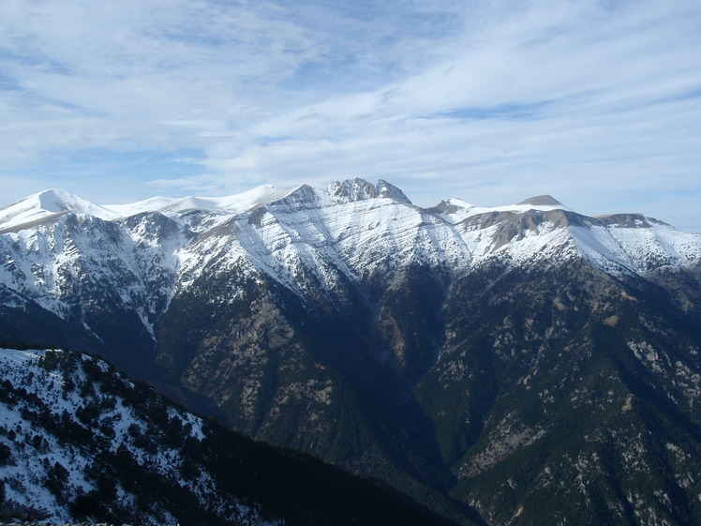
The highest mountain in Greece is Mount Olympus.
In Greek mythology Mount Olympus was the home
of the gods and the site of the throne of Zeus.
Let’s learn about Greece.

Slide 4
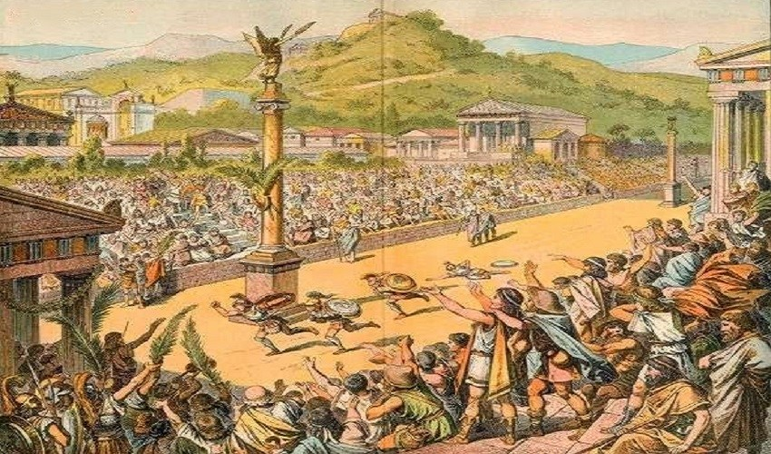
The Olympic Games originated in Ancient Greece.
Events included wrestling, boxing, long jump,
javelin, discus and chariot racing.
Let’s learn about Greece.

Slide 5
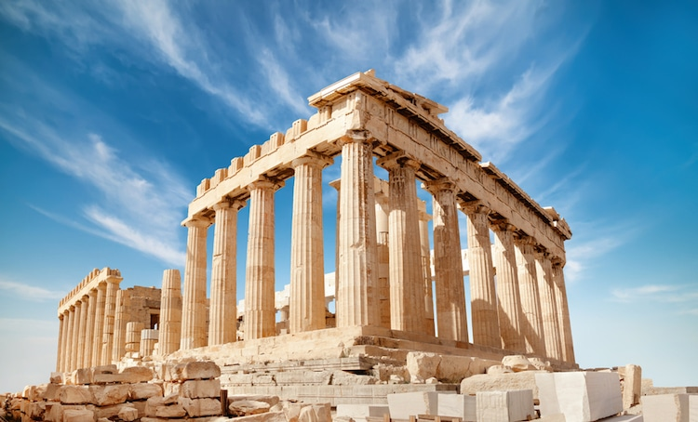
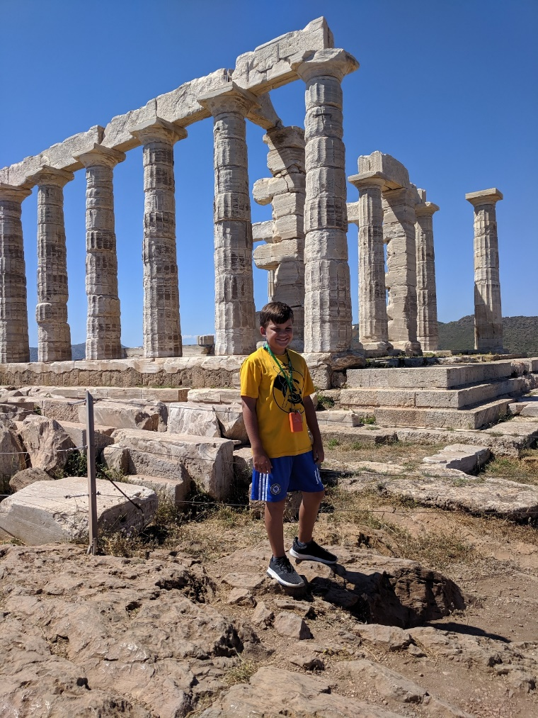
Statues of Greek gods and goddesses were placed
inside temples, the most famous of which is the
Parthenon. This temple in Athens was built for the
goddess Athena, the protector of the city.
Let’s learn about Greece.

Slide 6
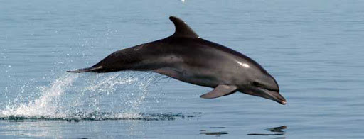
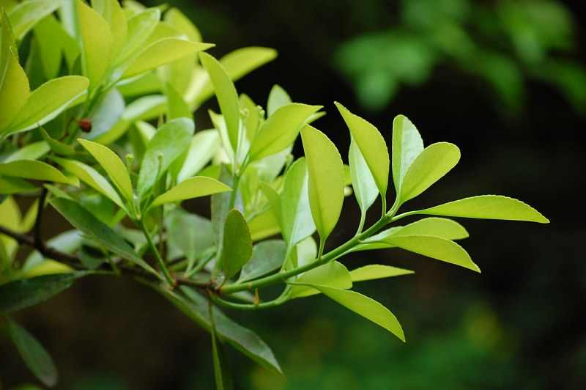
The animal of Greece is the dolphin and the
flower is the Laurel branch.
Let’s learn about Greece.

Slide 7
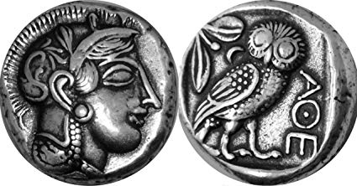
In Greek mythology the owl was sacred to Athena,
the goddess of wisdom. Therefore it was considered
a protector of the Greek armies.
Let’s learn about Greece.

Slide 8
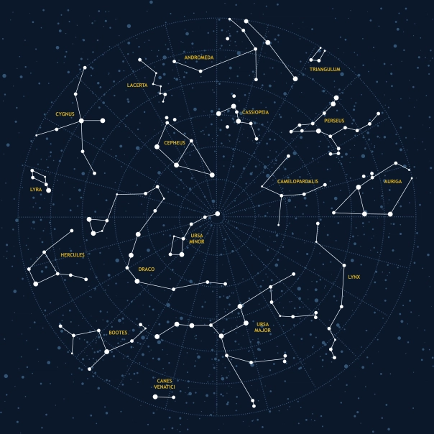
Early Greek civilizations would use and make patterns
from the stars to tell stories of their gods and heroes
in their folklore and would also use these patterns
to know where they were and what time of year it was.
Let’s learn about Greece.

Slide 9
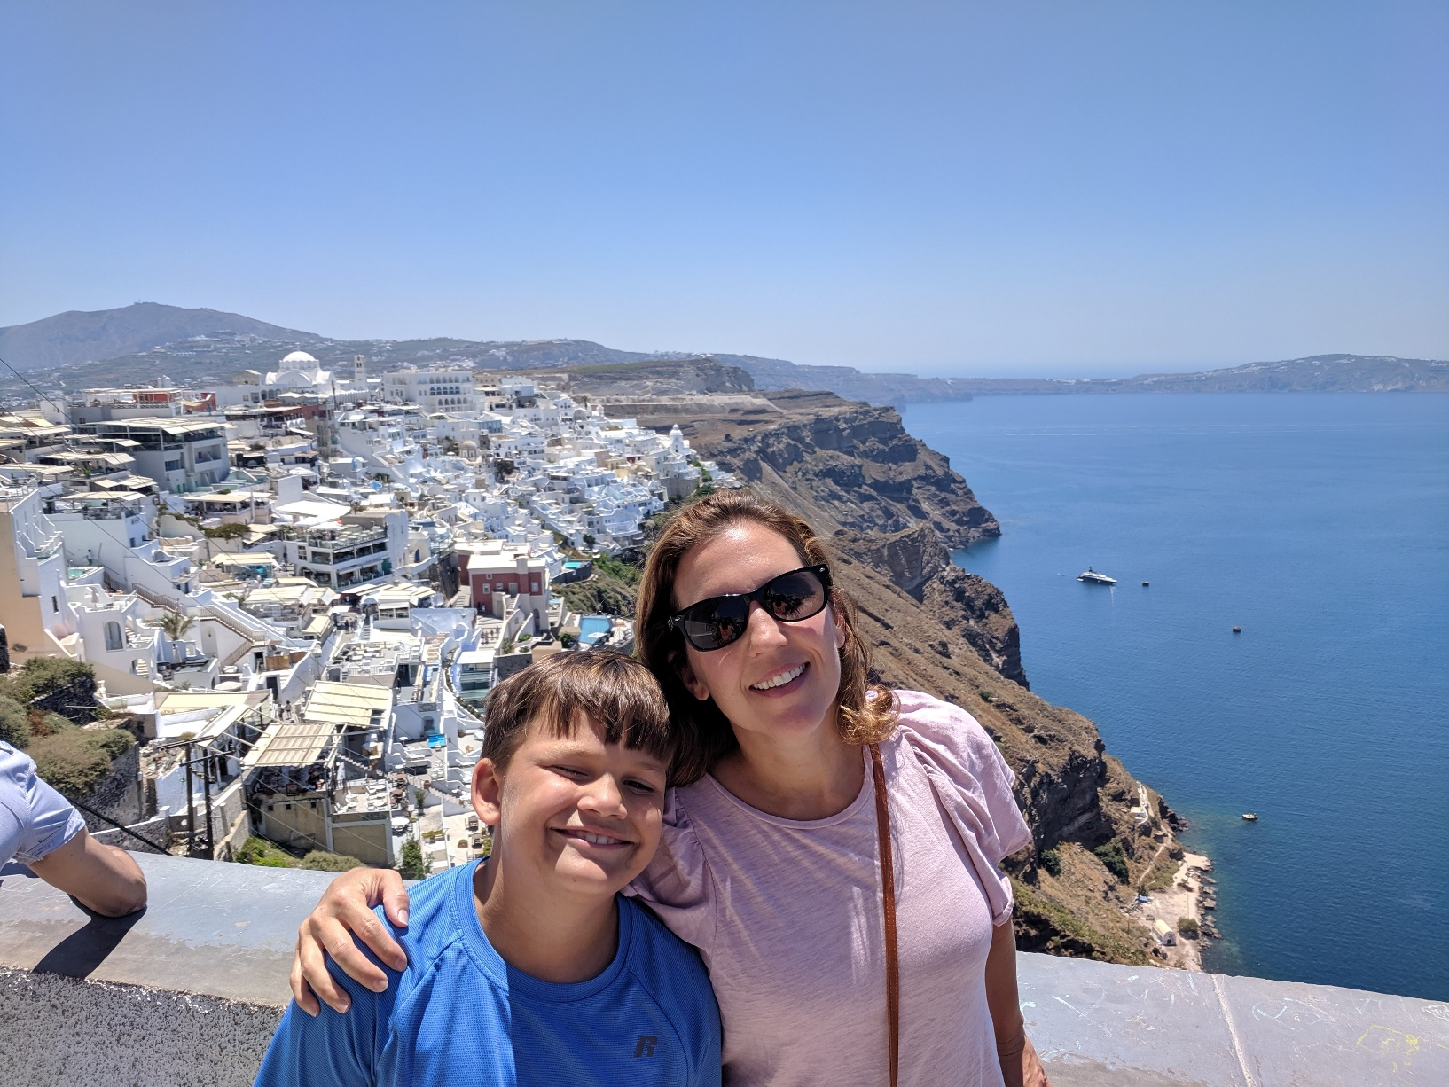
The End

