Slide 1
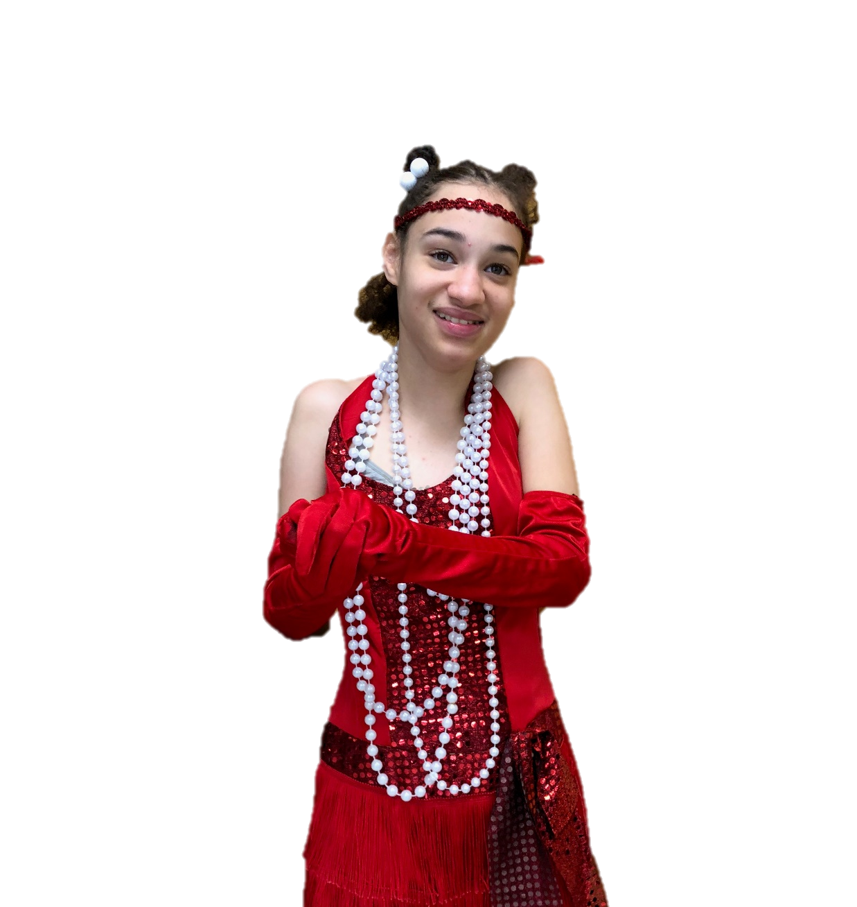
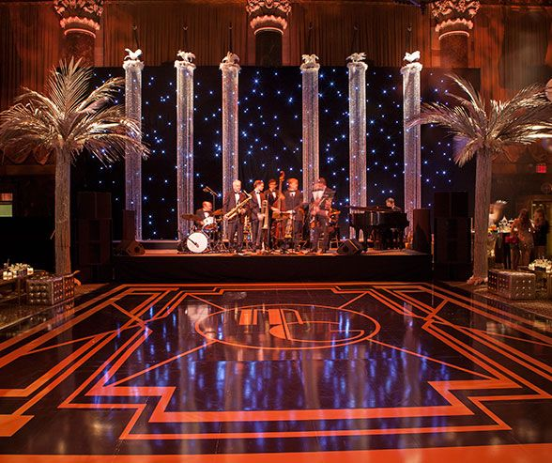
What Happened In The 1920s?
By: Cara Edenfield and Joy Delaney
Groupbygroup.wordpress.com

Slide 2
What happened in the 1920s?
The Nineteenth Amendment was ratified in 1920
giving women the right to vote in the United States.

Slide 3
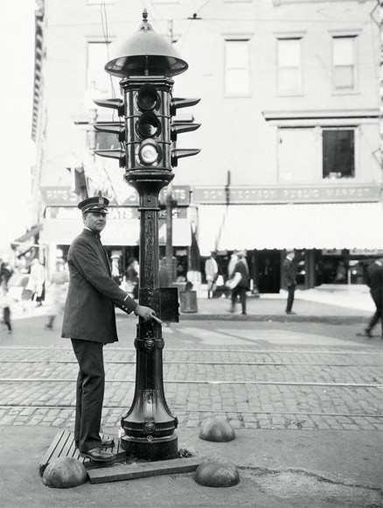
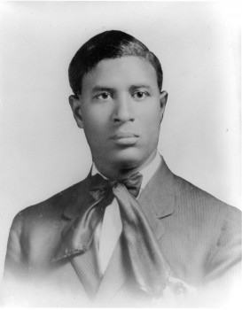
What happened in the 1920s?
In 1923, Garrett Morgan patented an electric automatic traffic signal.

Slide 4
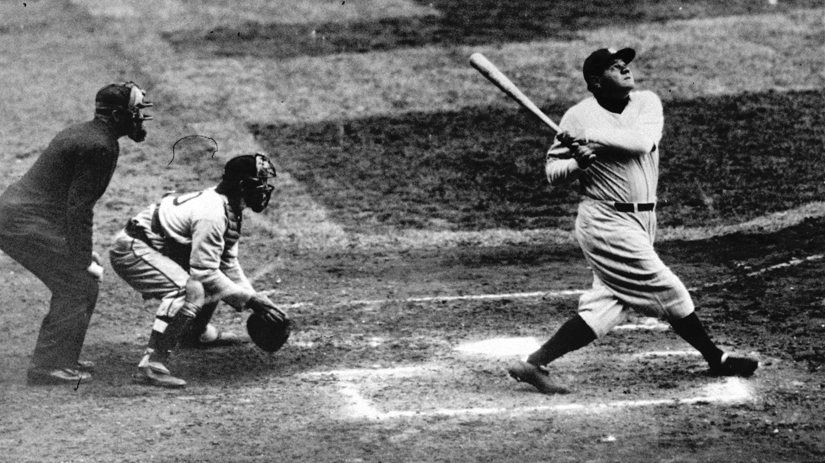
What happened in the 1920s?
In 1927 Babe Ruth, a baseball player for the Yankees,
set a home run record that would stand for 70 years.

Slide 5
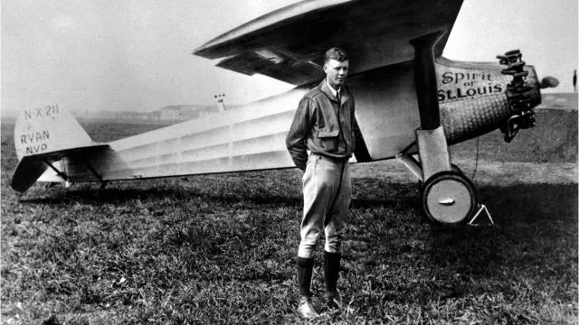
What happened in the 1920s?
Also in 1927, Charles Lindbergh flew solo
across the Atlantic Ocean in the "Spirit of St. Louis."

Slide 6
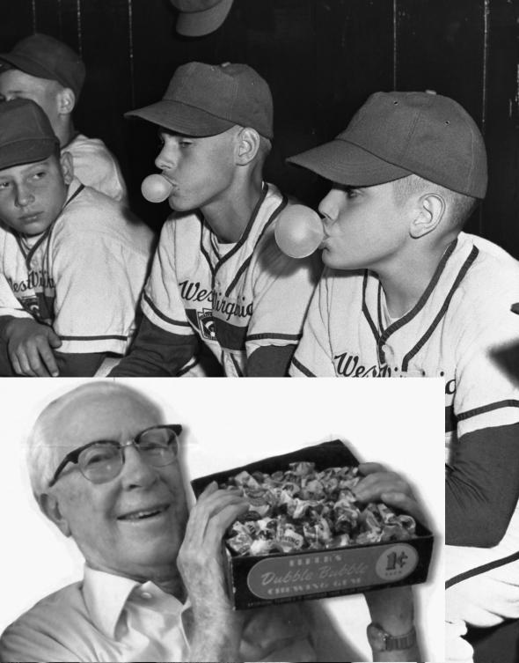
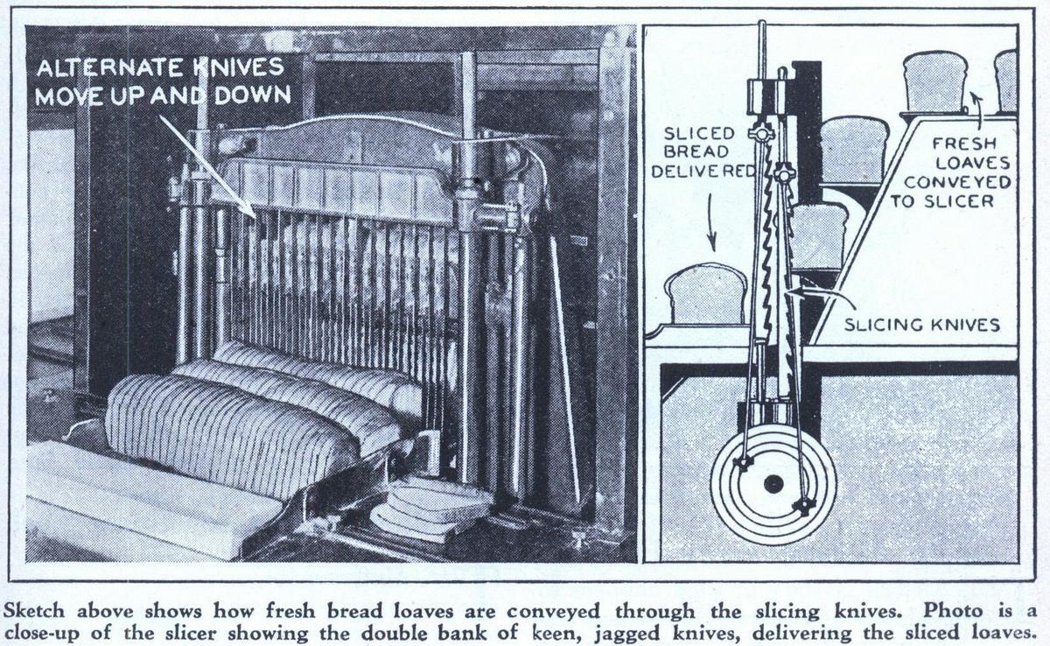
What happened in the 1920s?
Sliced bread and bubblegum were invented in 1928.

Slide 7
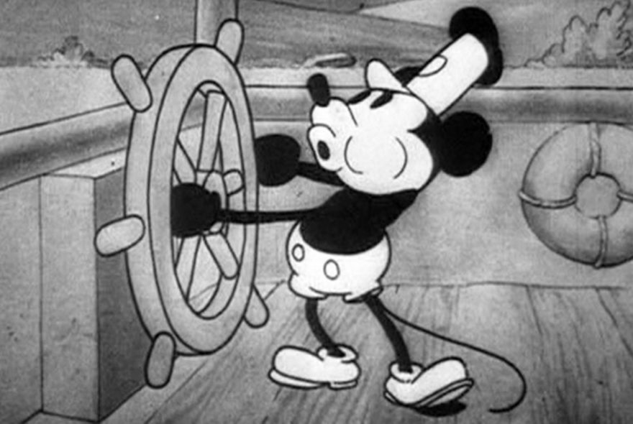
What happened in the 1920s?
Disney’s Steamboat Willie, the first film starring Mickey Mouse to
be released with synchronized sound, was shown in 1928.

Slide 8
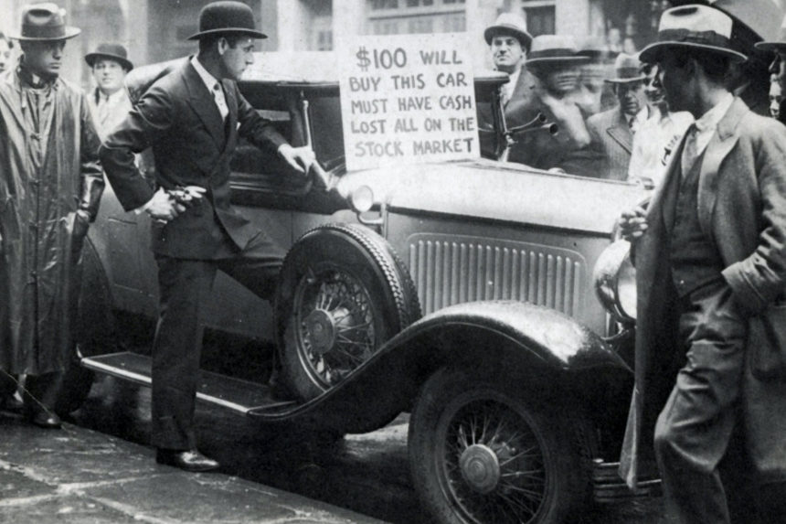
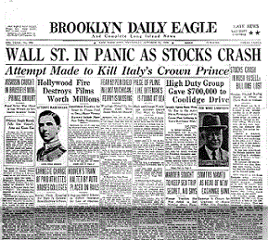
What happened in the 1920s?
In 1929, the stock market crashed, marking the beginning
of the Great Depression.

Slide 9
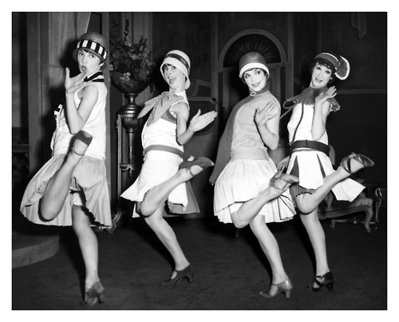
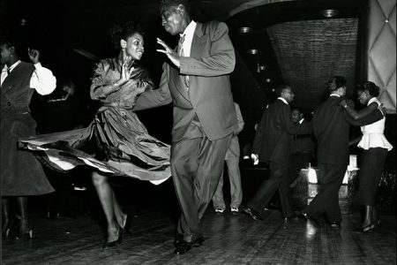
What happened in the 1920s?
Sometimes the Roaring Twenties is also called the "Age of Jazz.“
People listened to it on the radio and heard live jazz bands at dance halls.

Slide 10
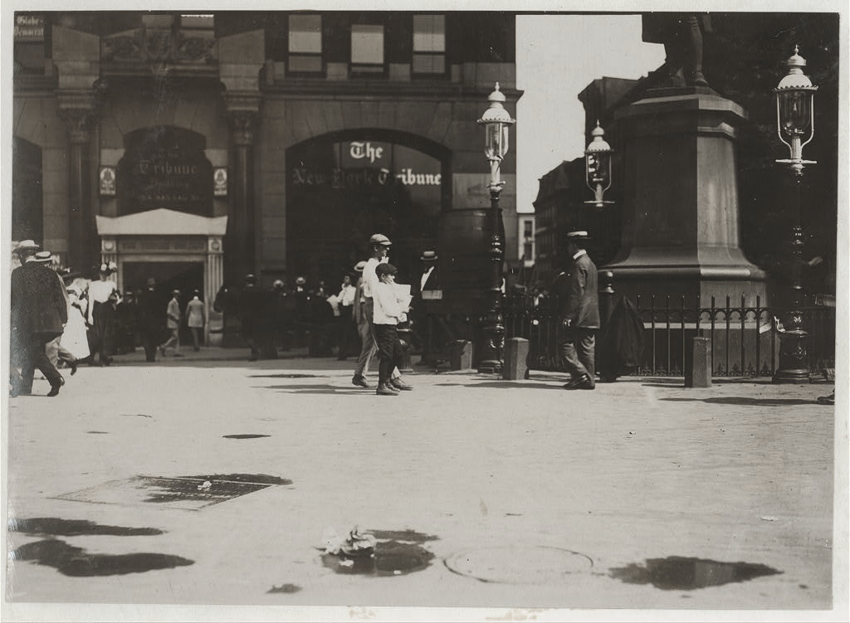
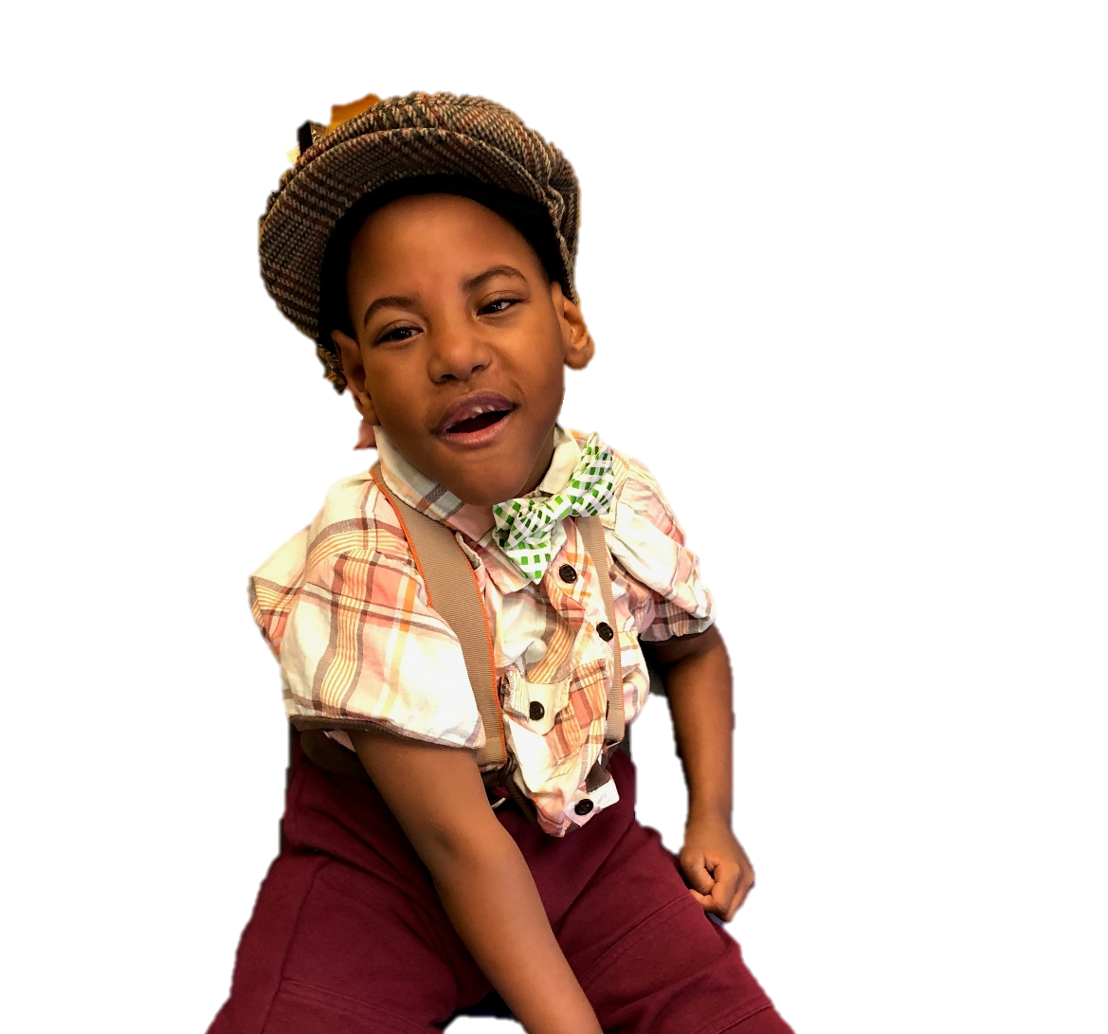
The End

