Slide 1
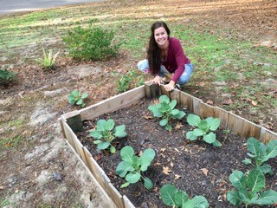
There Are Lots Of Different Hobbies
By: Cara Edenfield and Joy Delaney
Groupbygroup.wordpress.com

Slide 2
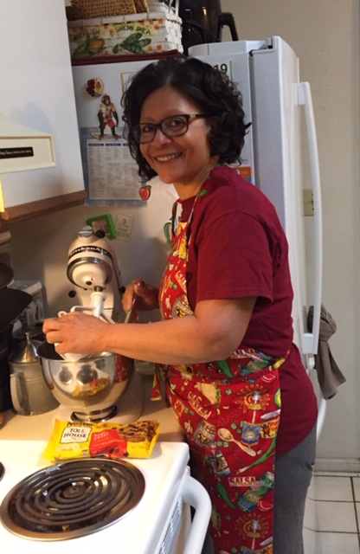
Some people like cooking.
There are lots of different hobbies.

Slide 3
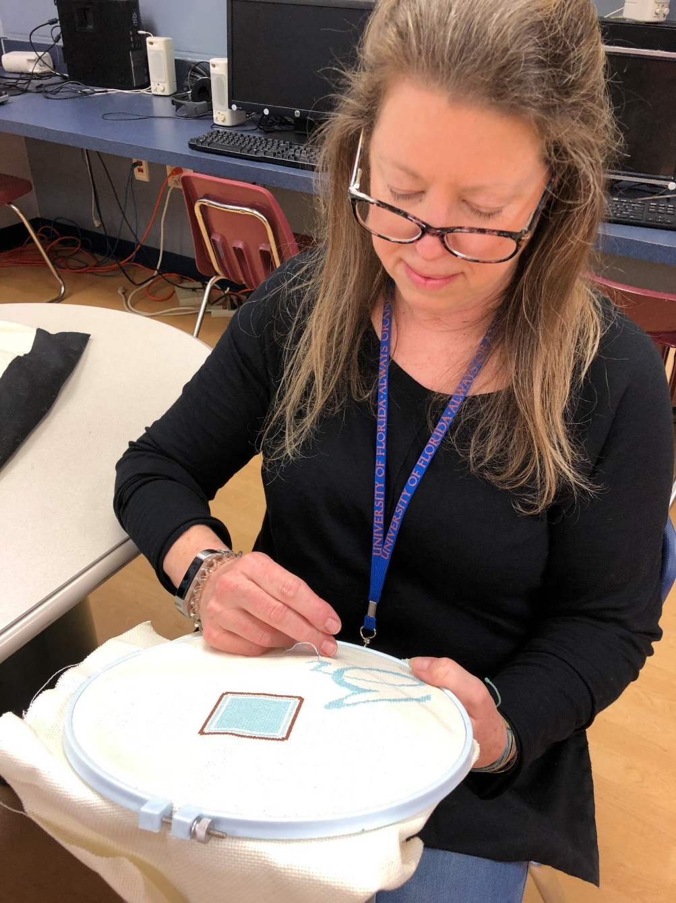
Some people like to cross stitch.
There are lots of different hobbies.

Slide 4
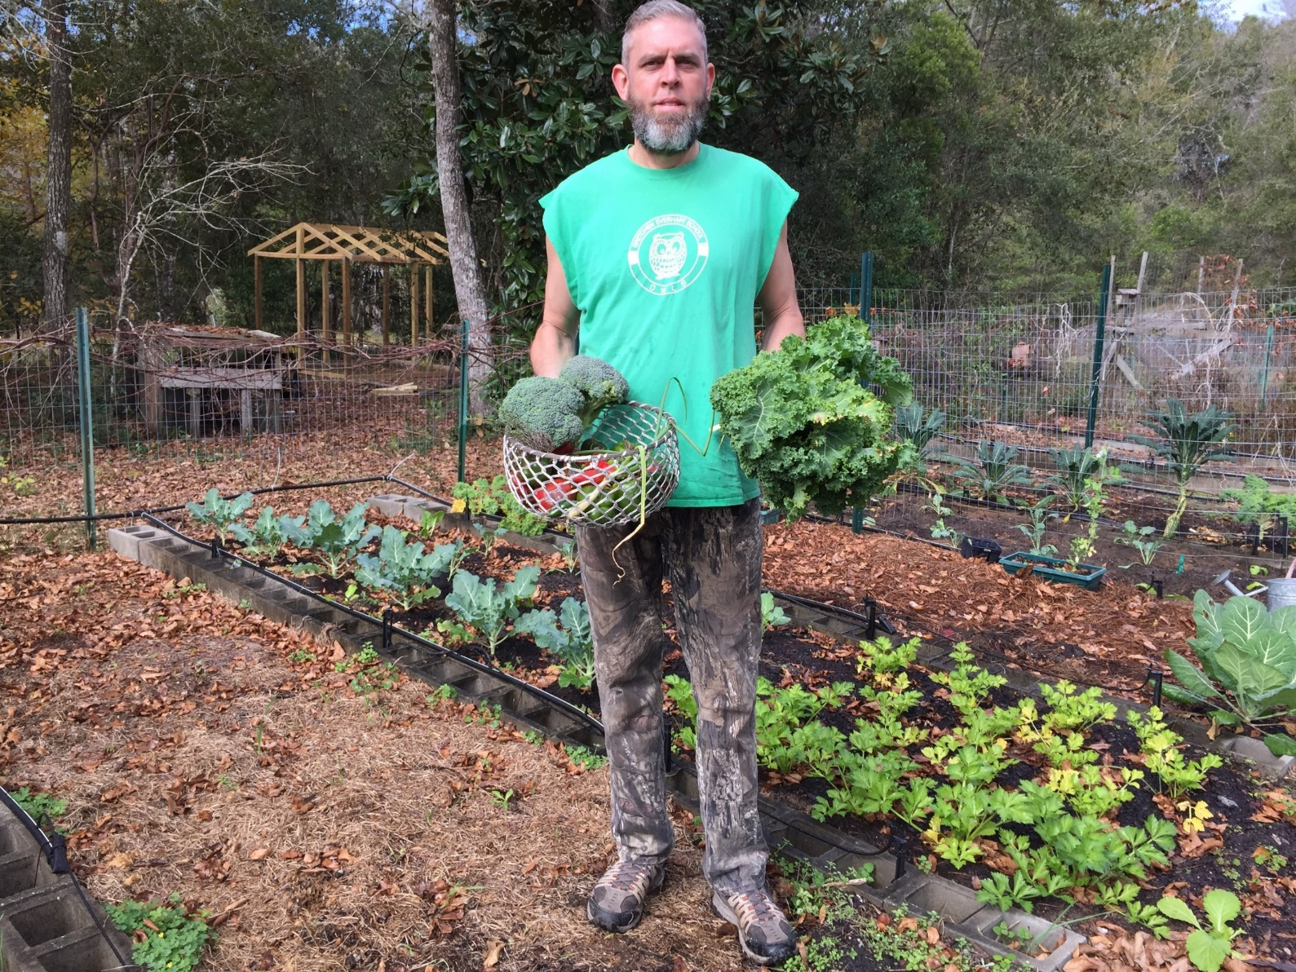
Some people like gardening.
There are lots of different hobbies.

Slide 5
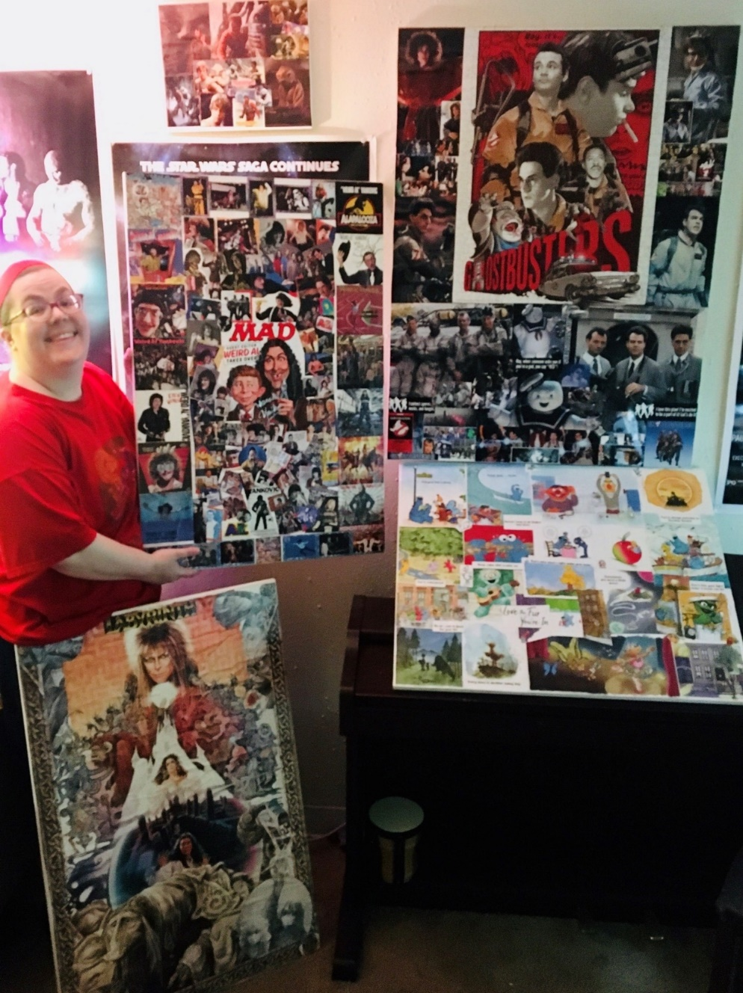
Some people like collaging.
There are lots of different hobbies.

Slide 6
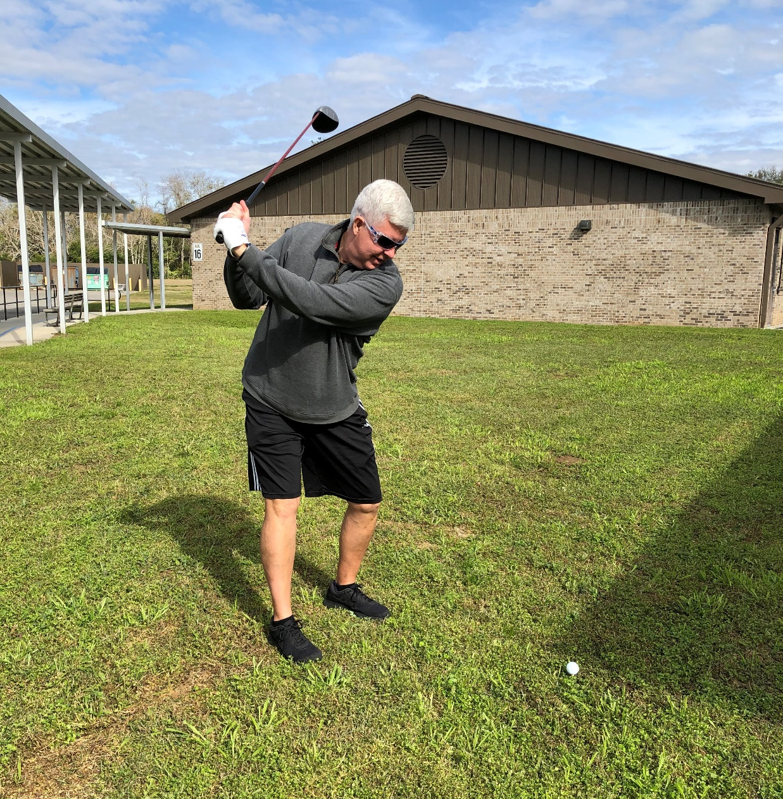
Some people like to golf.
There are lots of different hobbies.

Slide 7
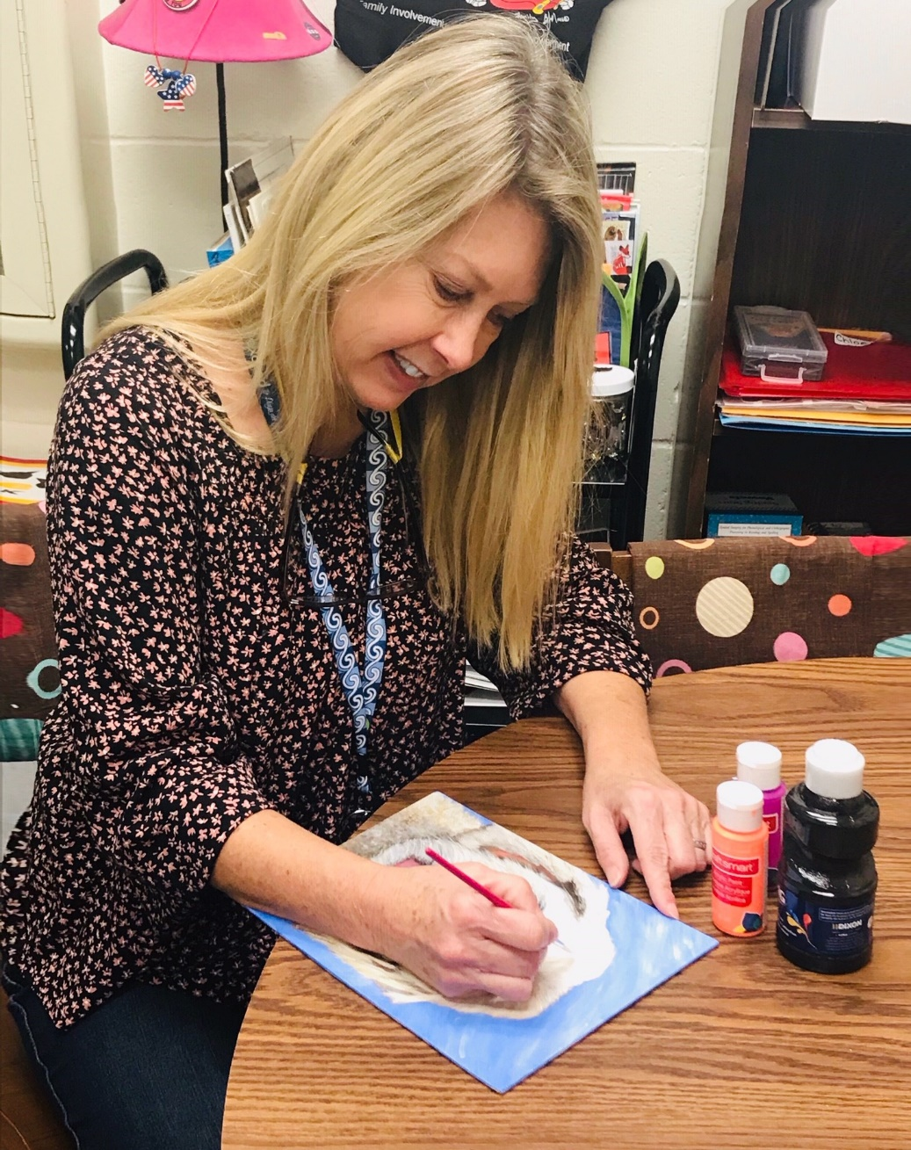
Some people like to paint.
There are lots of different hobbies.

Slide 8
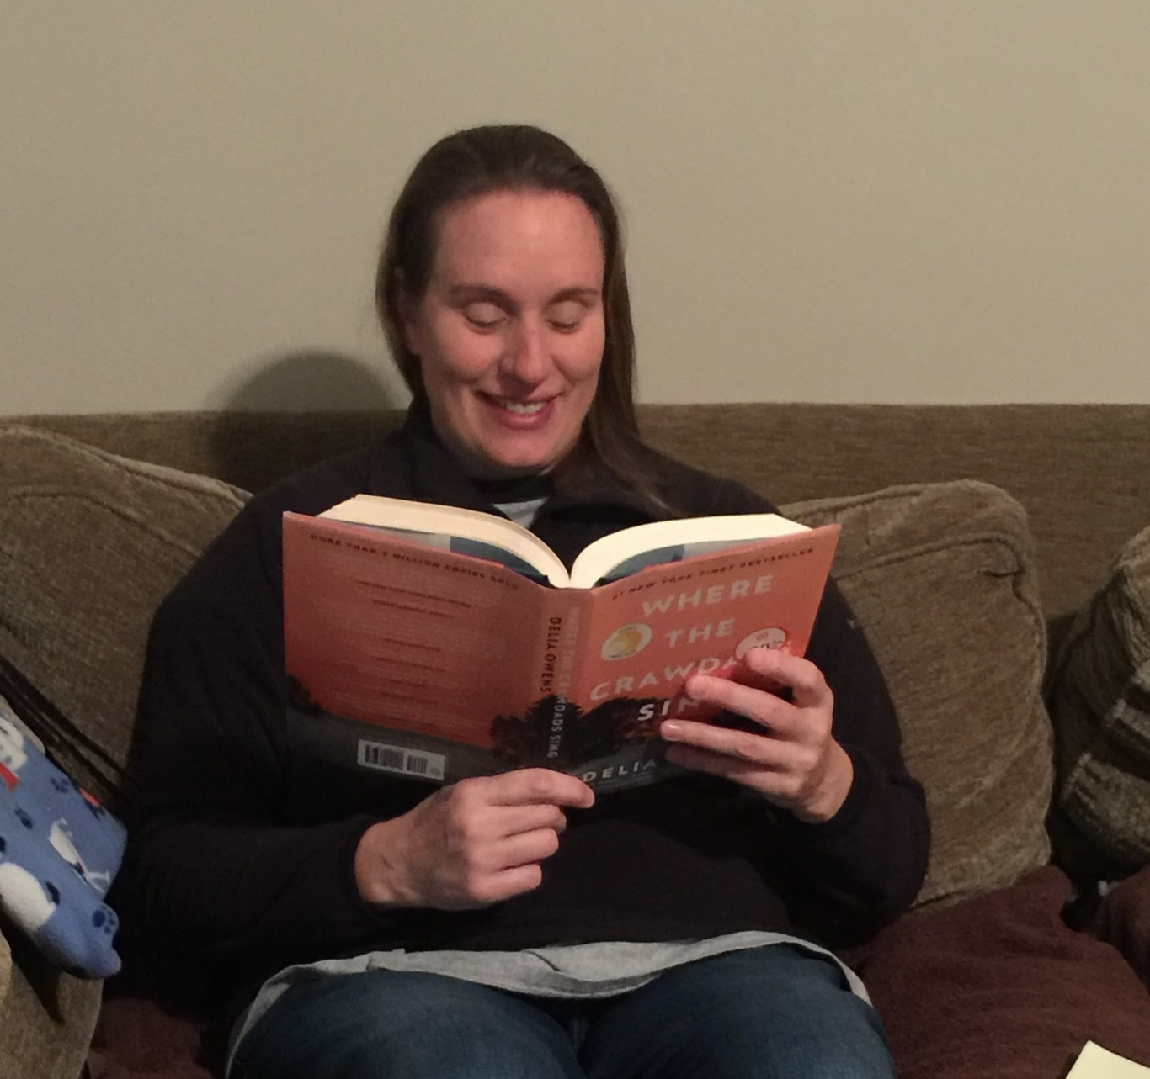
Some people like reading.
There are lots of different hobbies.

Slide 9
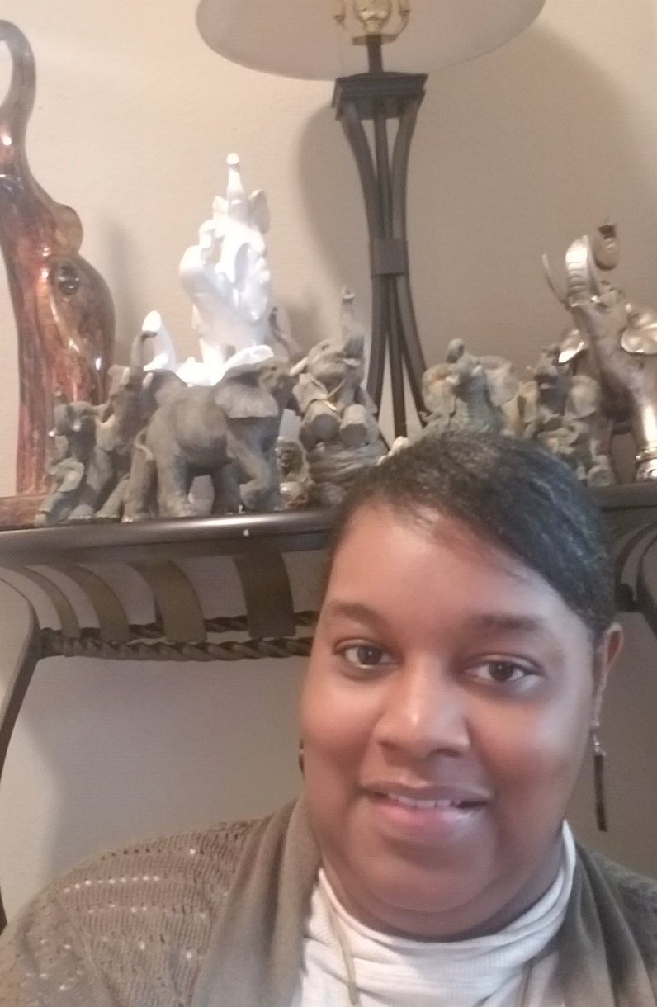
Some people like to collect things.
There are lots of different hobbies.

Slide 10
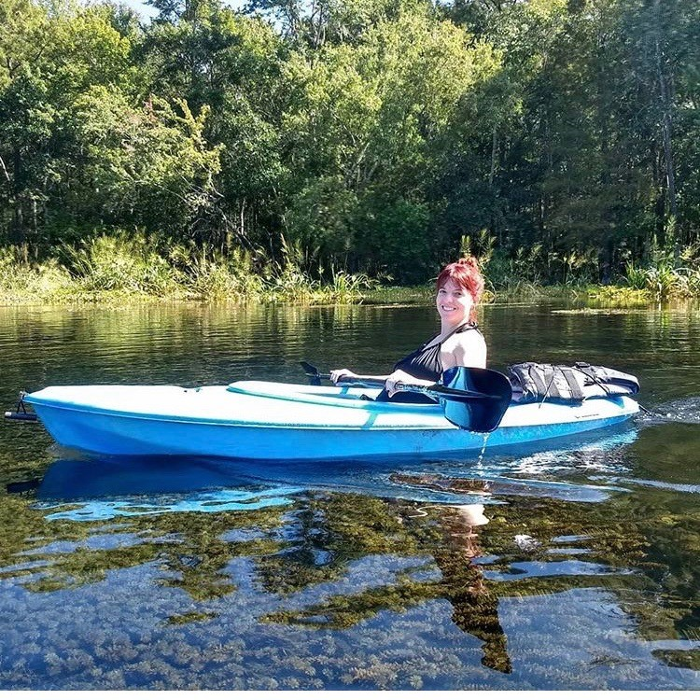
Some people like to go kayaking.
There are lots of different hobbies.

Slide 11
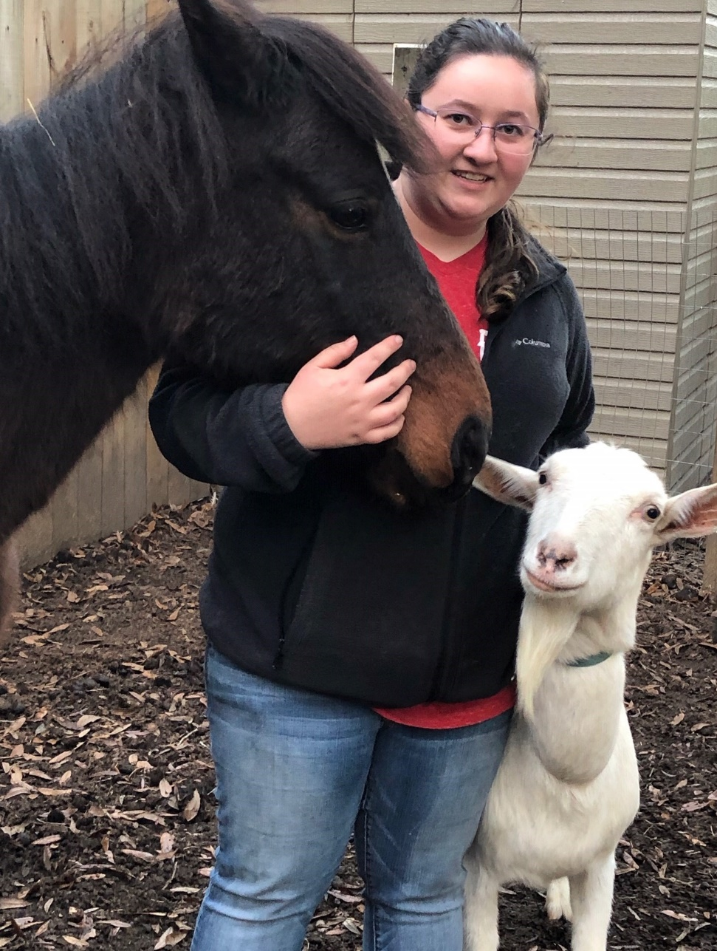
Some people like to take care of animals.
There are lots of different hobbies.

Slide 12
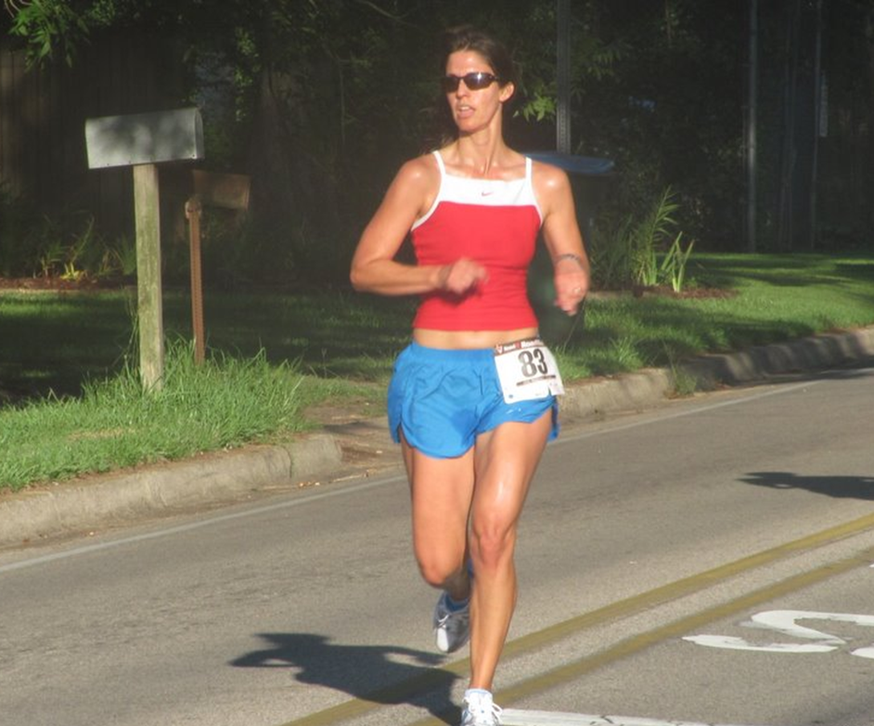
The End

