Slide 1
Let’s Make Croissant Sandwiches
Groupbygroup.wordpress.com

Slide 2
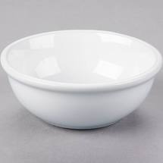
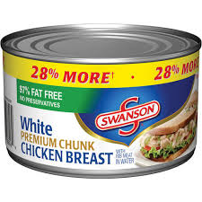
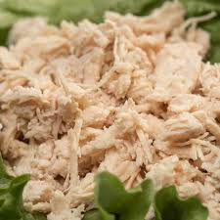
Put 3 cups of drained and dried canned chicken
into a bowl.

Slide 3
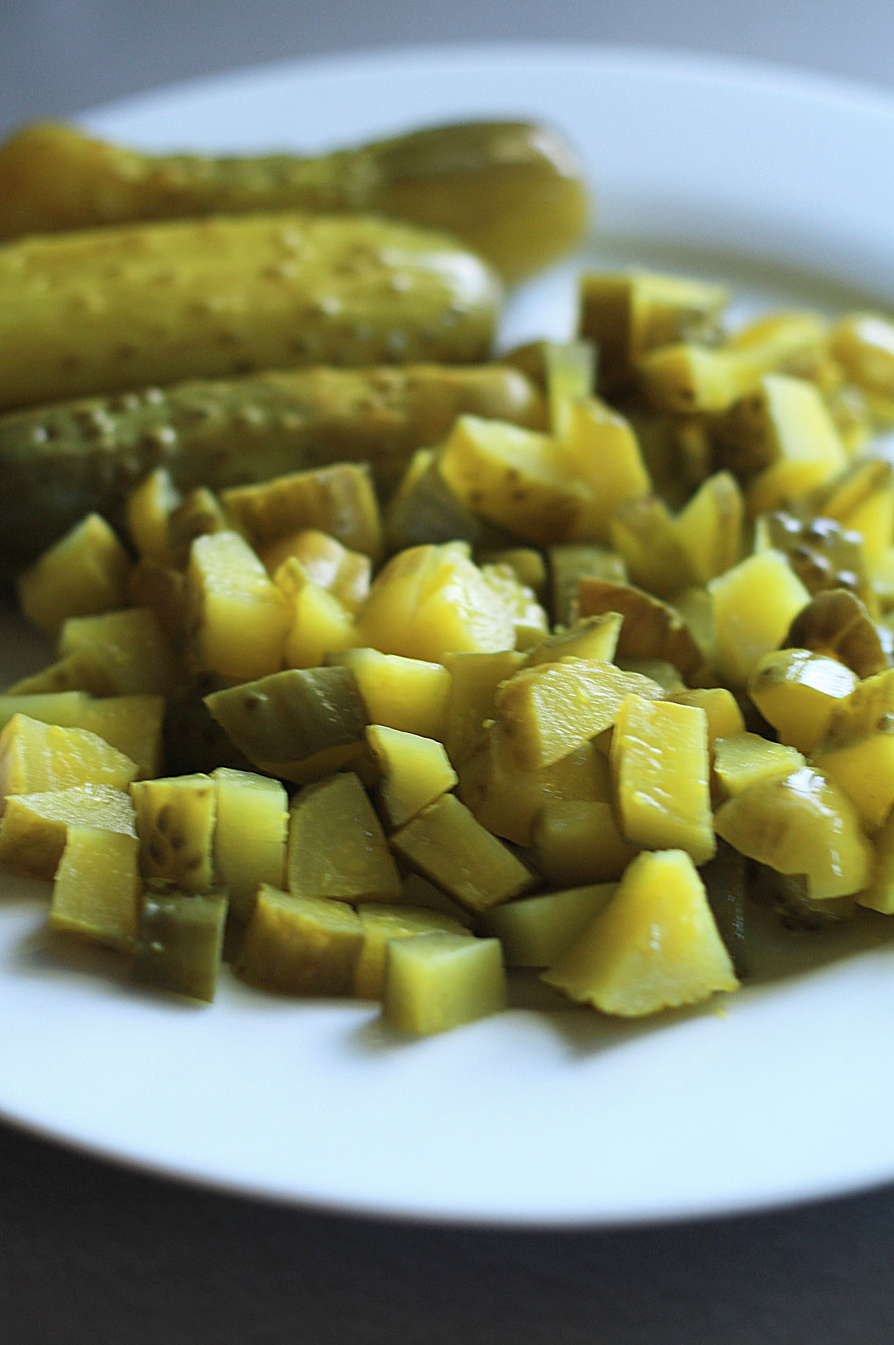
Put 1 cup of chopped dill pickles into the bowl.

Slide 4
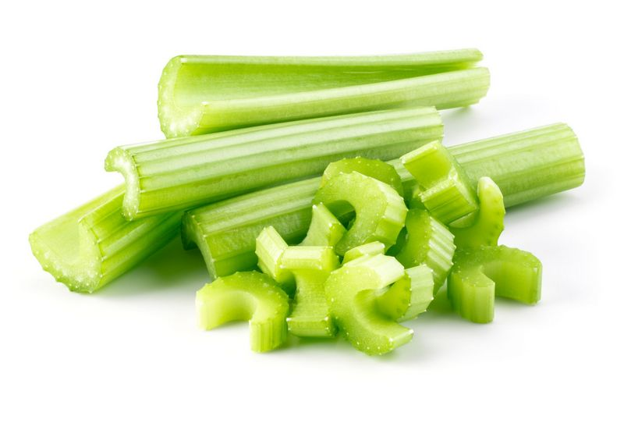
Put 4 chopped up stalks of celery into the bowl.

Slide 5
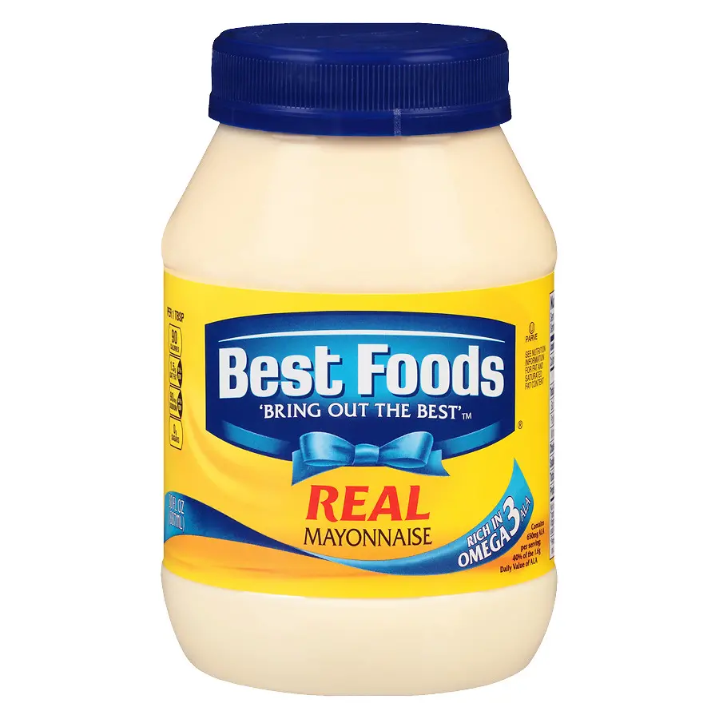
Put 1 cup of mayonnaise into the bowl.

Slide 6
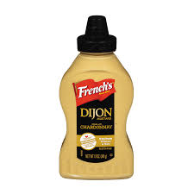
Put ¼ cup of Dijon mustard into the bowl.
Stir ingredients together until mixed.

Slide 7
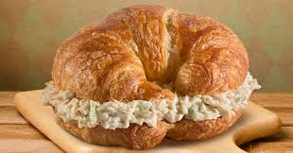
Put an open croissant on a plate.
Put some spoonfuls of chicken salad into the croissant.

Slide 8
Eat and Enjoy!

