Slide 1
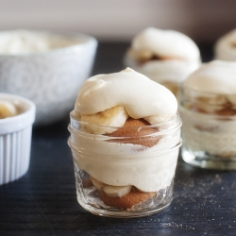
Let’s Make Banana Pudding Parfaits
Groupbygroup.wordpress.com

Slide 2
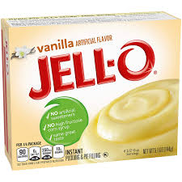
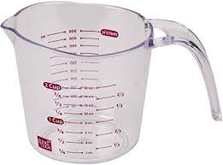
Put instant vanilla pudding mix and 2 cups of milk
into a bowl.

Slide 3
Mix ingredients until the pudding is set.

Slide 4
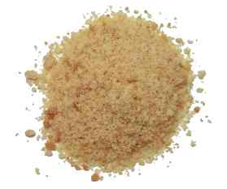
Crush up 30 vanilla wafers.

Slide 5
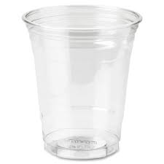
Put some crushed vanilla wafers in a cup.

Slide 6
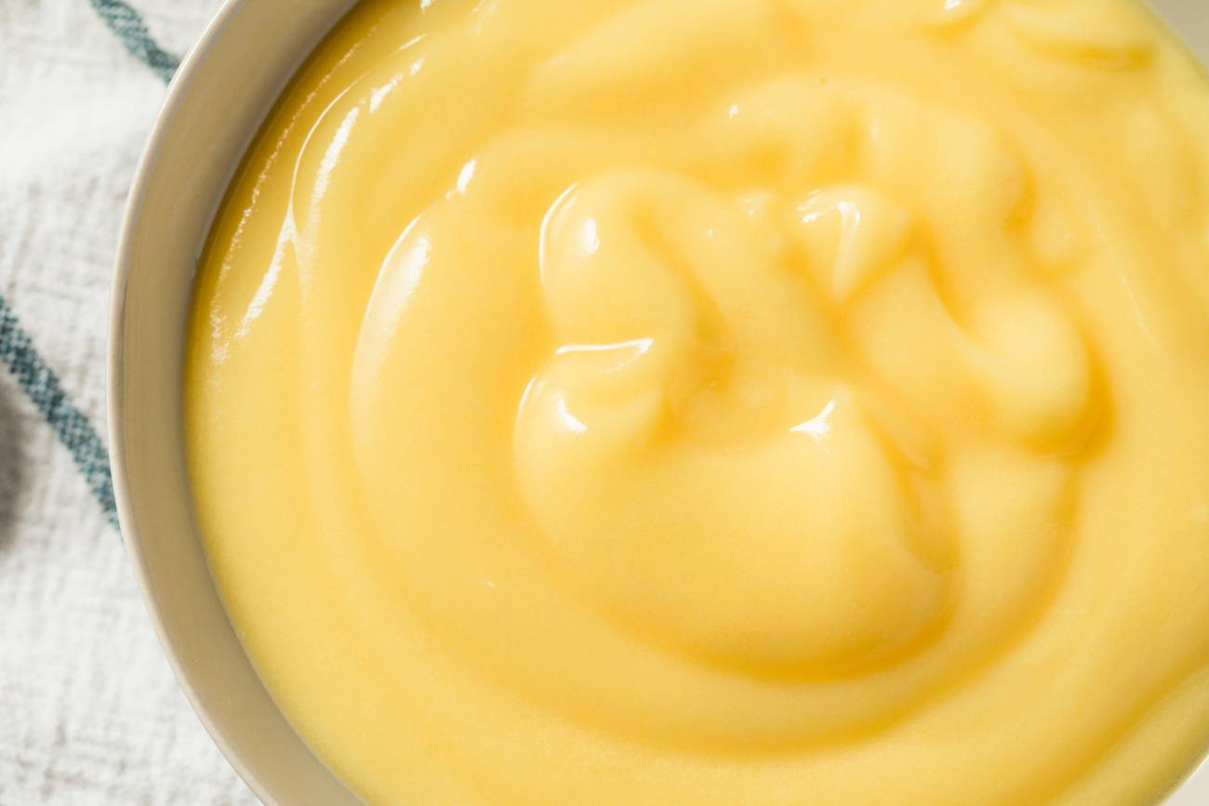
Put some pudding on top of the vanilla wafers.

Slide 7
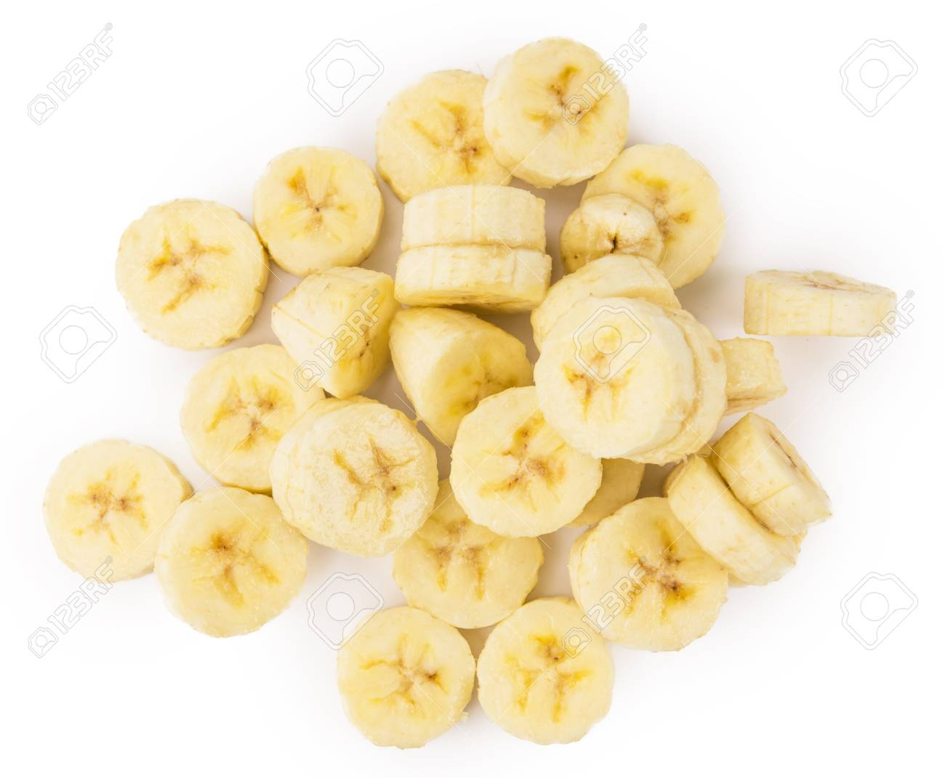
Put a few slices of banana on top of the pudding.
Repeat layers one more time.

Slide 8
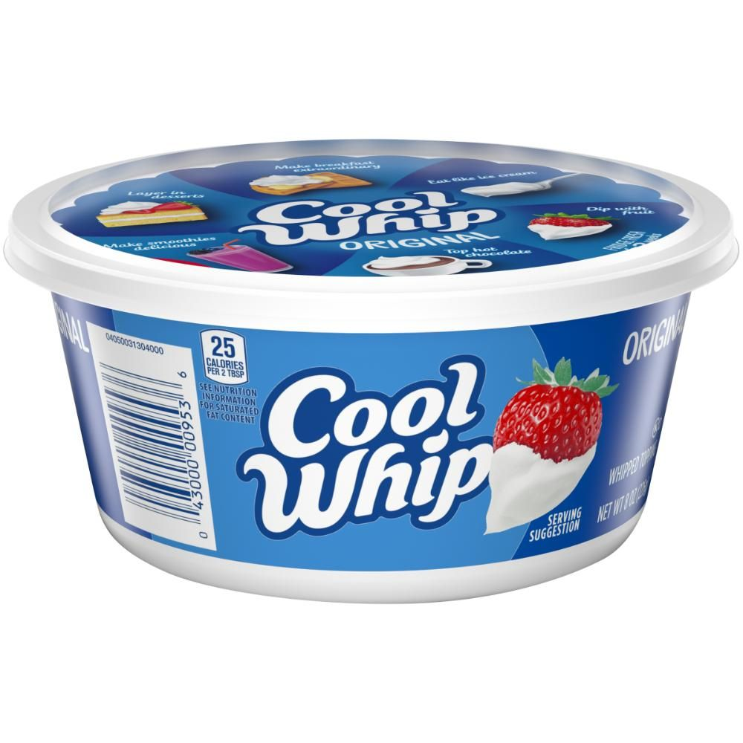
Add some cool whip.
Eat and enjoy!

