Slide 1
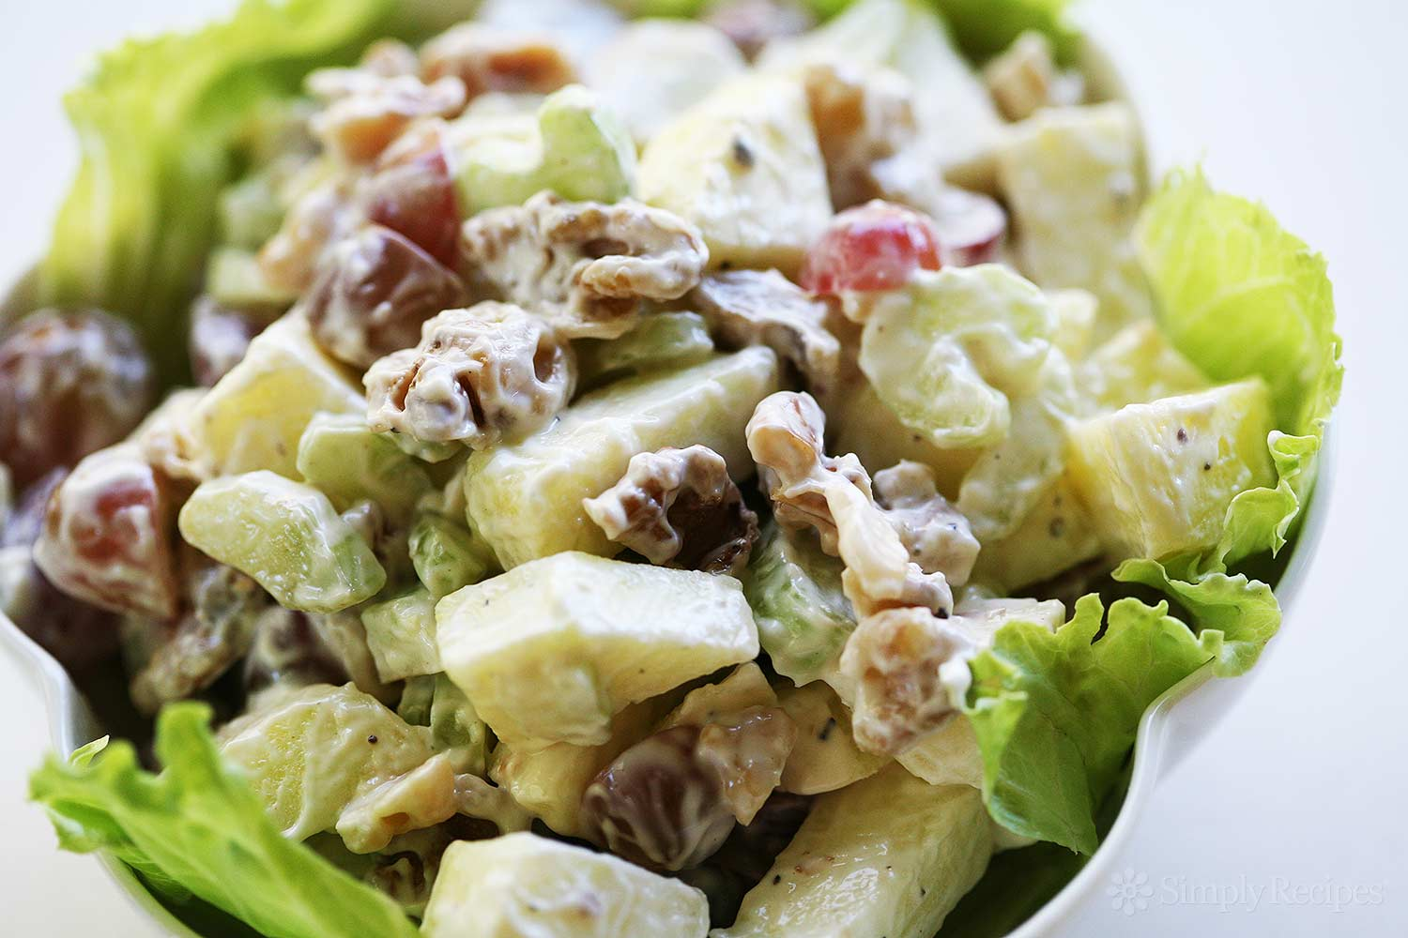
Let’s Make A Waldorf Salad
Groupbygroup.wordpress.com

Slide 2
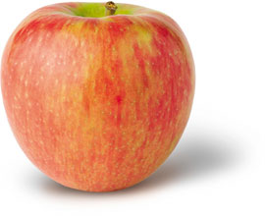
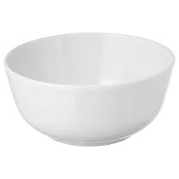
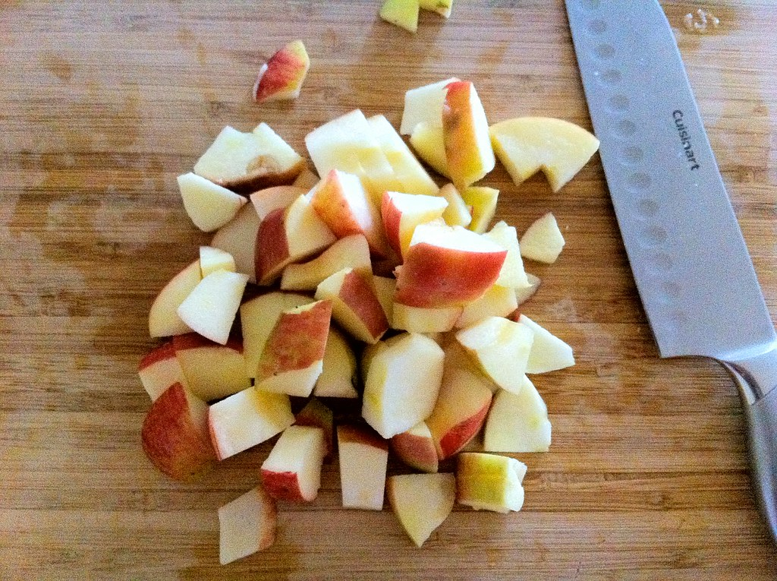
Put 1 diced honey crisp apple into a bowl.

Slide 3
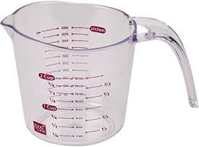
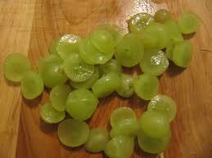
Put a cup of quartered grapes into the bowl.

Slide 4
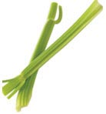
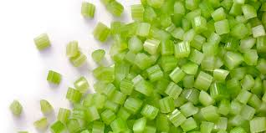
Put 2 stalks of diced celery into the bowl.

Slide 5
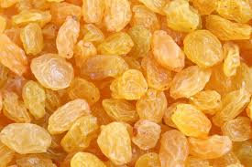
Put ¼ cup raisins into the bowl.

Slide 6
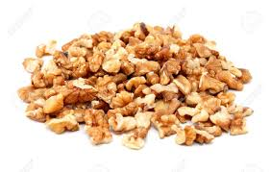
Put ¼ cup chopped walnuts into the bowl.

Slide 7
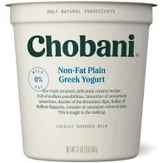
Put a ½ cup of plain Greek yogurt into the bowl.

Slide 8
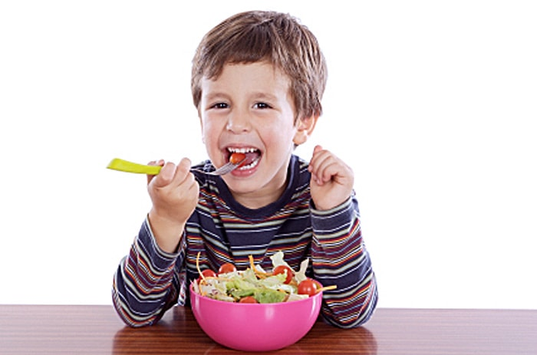
Stir ingredients together, serve, eat, and enjoy!

