Slide 1
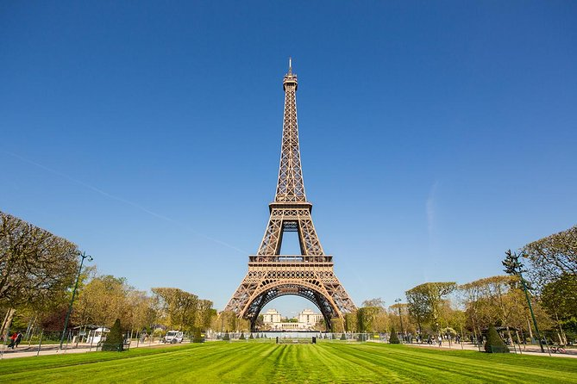
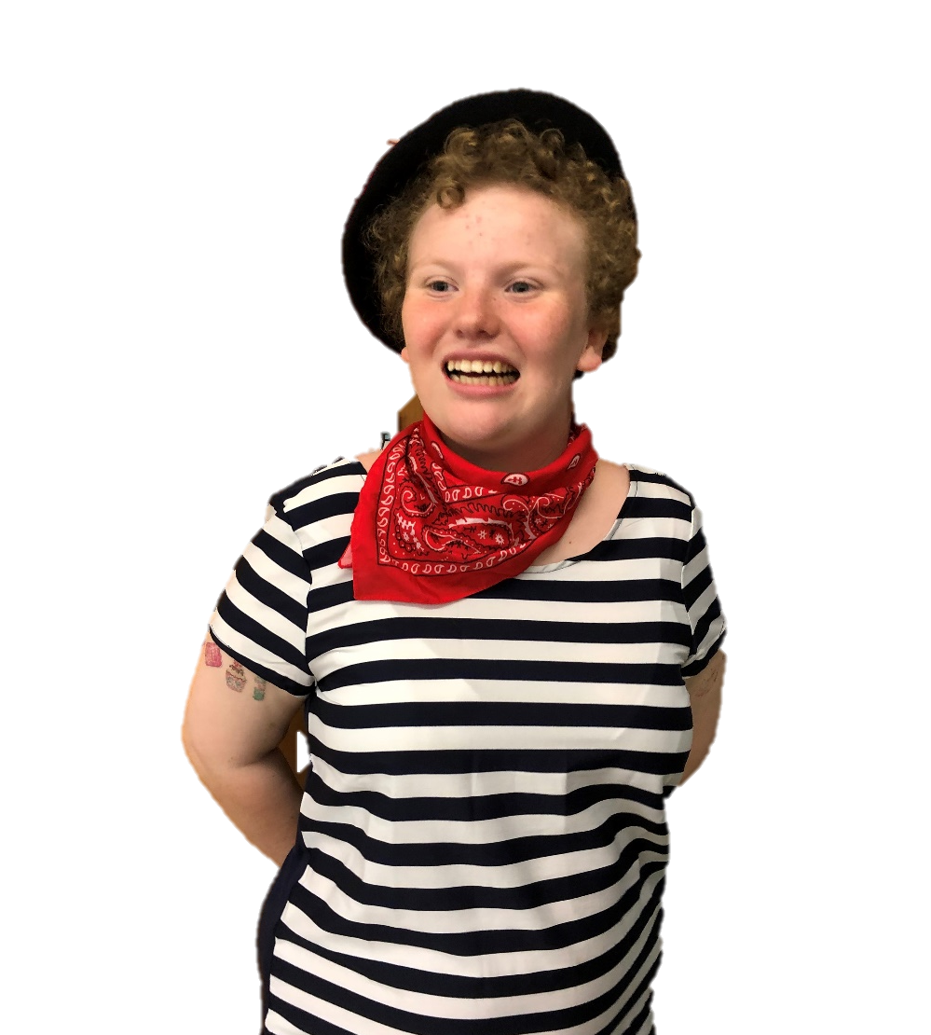
Let’s Learn About Famous People From France
By: Cara Edenfield and Joy Delaney
Groupbygroup.wordpress.com

Slide 2
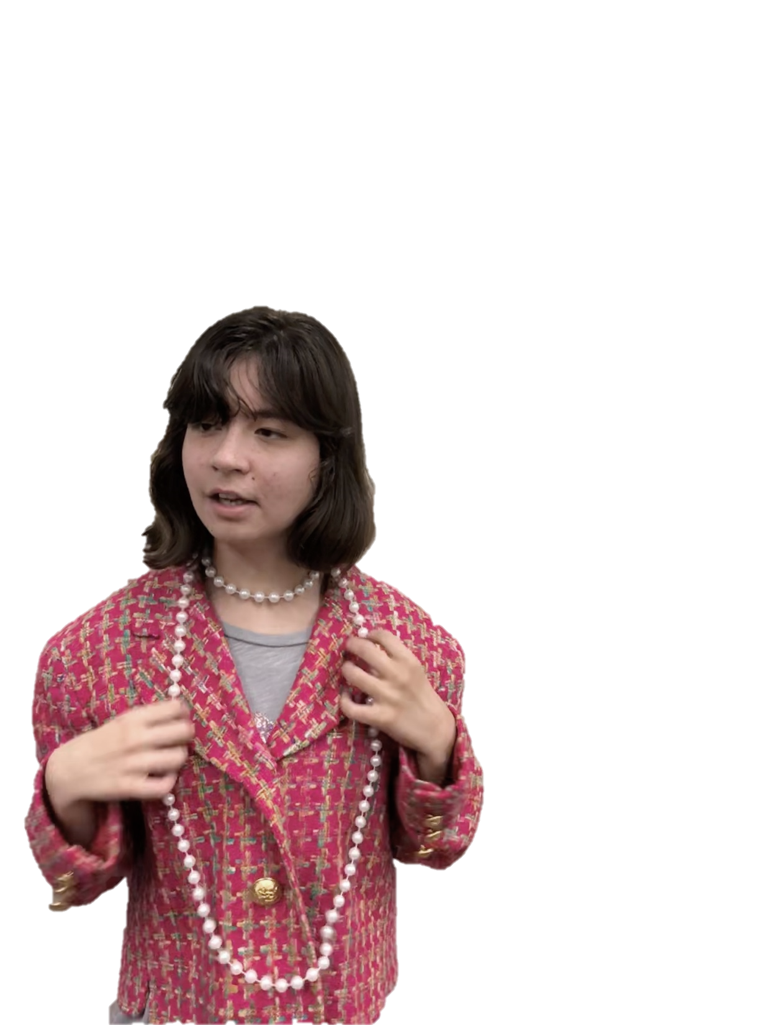
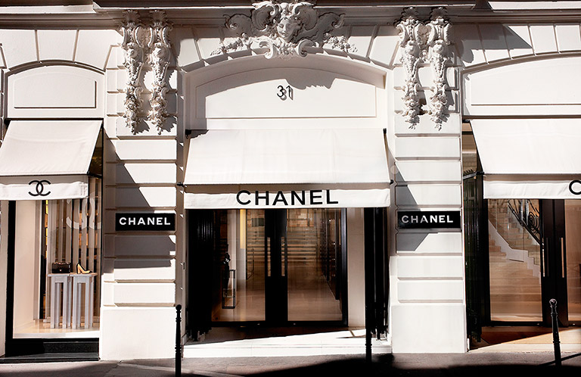
Coco Chanel is one of the most famous fashion designers in the world
and the founder of the Chanel brand of clothes and perfumes.
Let’s learn about famous people from France.

Slide 3
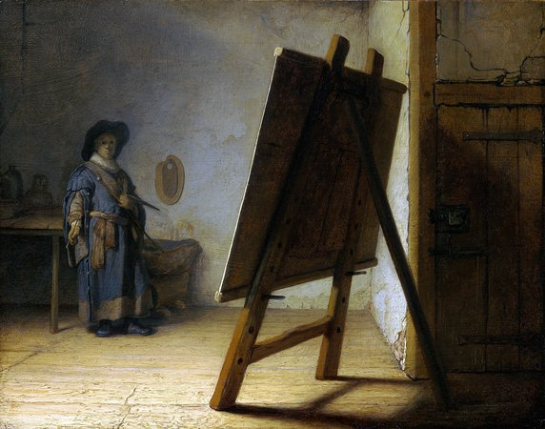
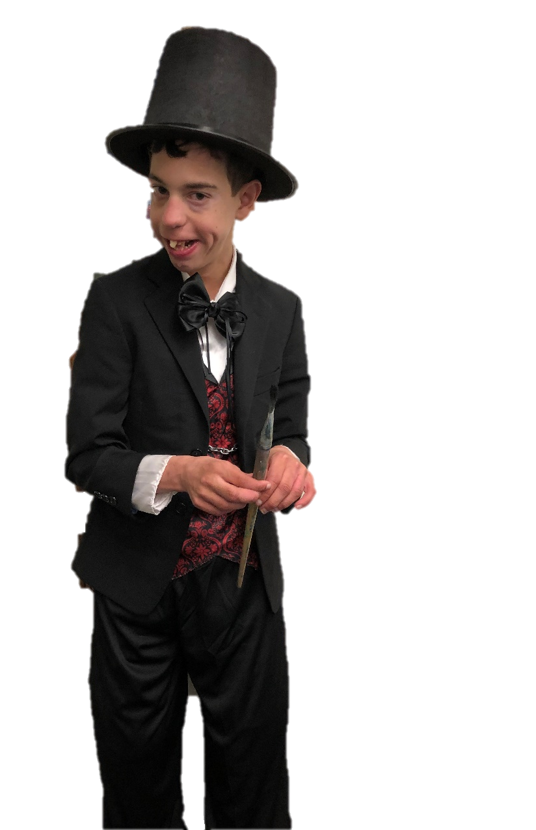
Edgar Degas was an artist famous for paintings and sculptures. He helped to start
Impressionism, although he rejected the term and preferred to be called a Realist.
Let’s learn about famous people from France.

Slide 4
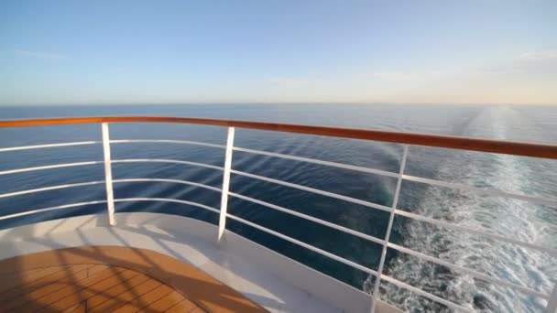
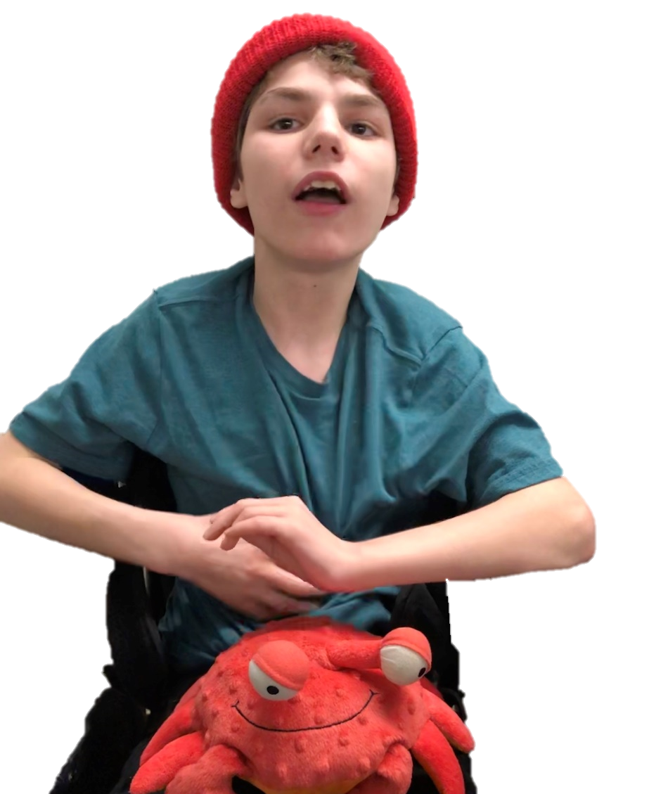
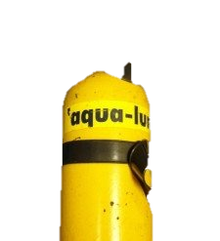
Jacques Cousteau was an underwater explorer. He helped invent
the Aqua-Lung which allows divers to breathe underwater.
Let’s learn about famous people from France.

Slide 5
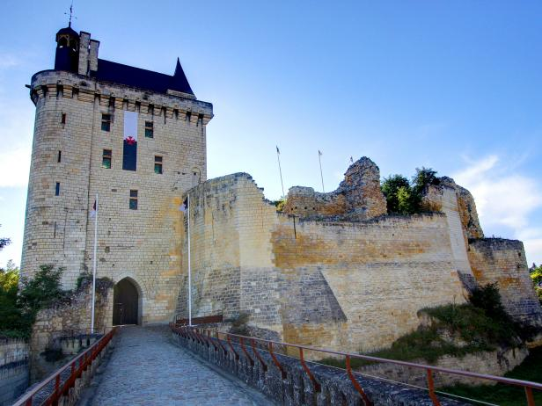
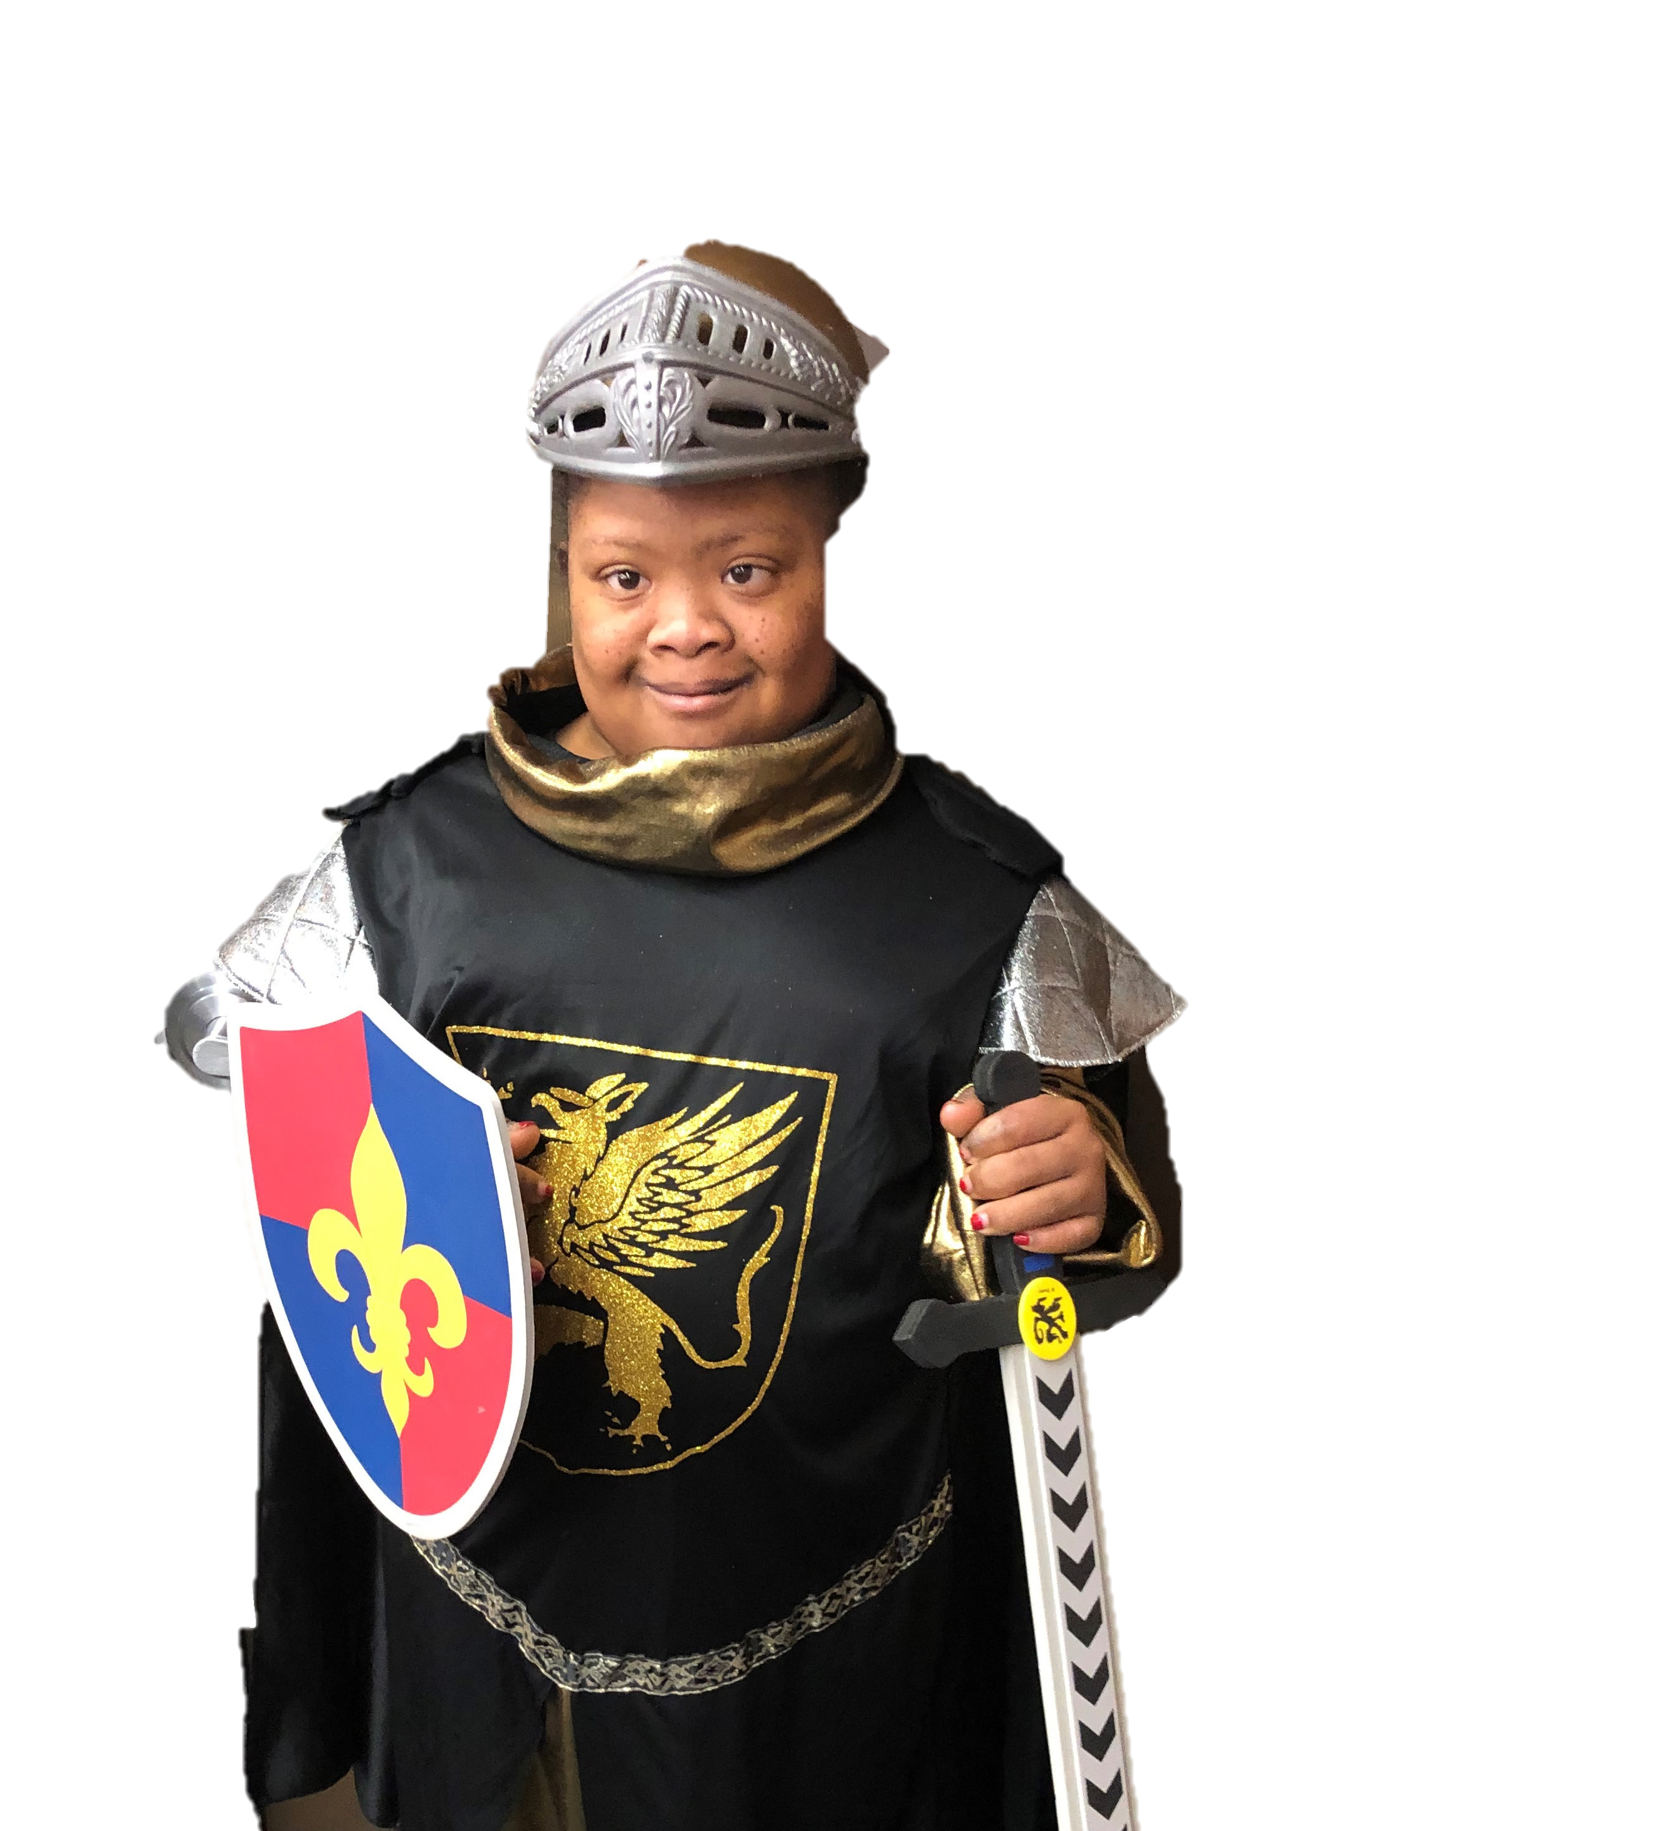
Joan of Arc helped France win a war against the English.
She was just a teenager.
Let’s learn about famous people from France.

Slide 6
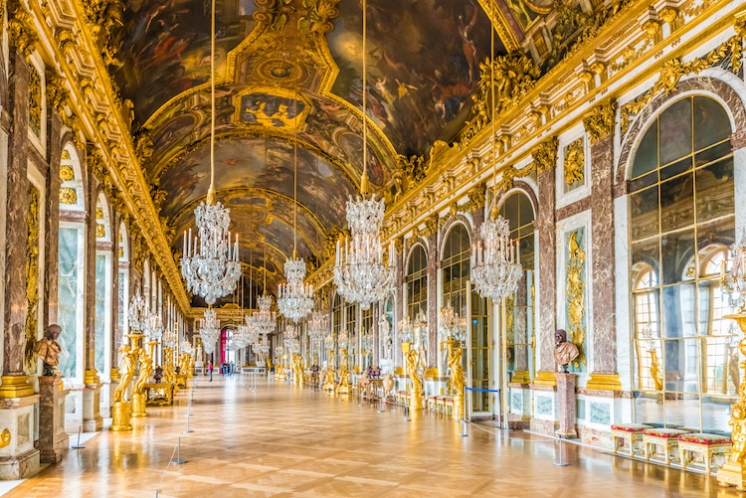
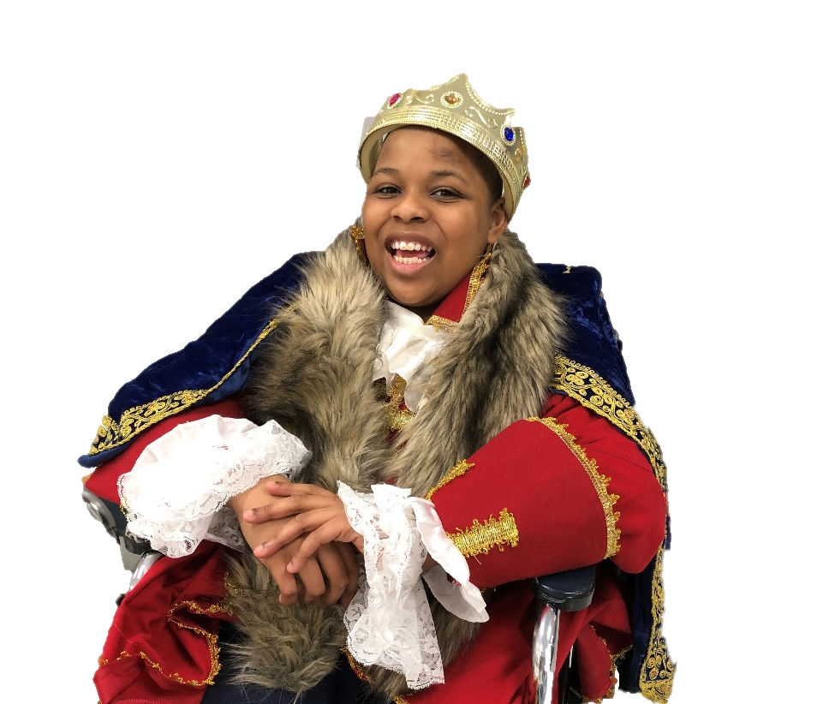
Louis XIV, also known as the Sun King, was King of France for 72 years.
This was the longest recorded rule of any European monarch.
Let’s learn about famous people from France.

Slide 7
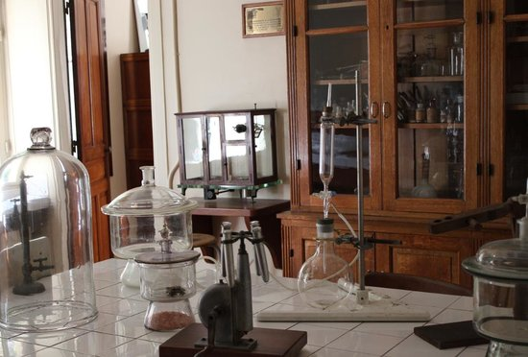
Madame Curie was a physicist and chemist who did research on
radioactivity. She was also the 1st woman to win a Nobel Prize.
Let’s learn about famous people from France.

Slide 8
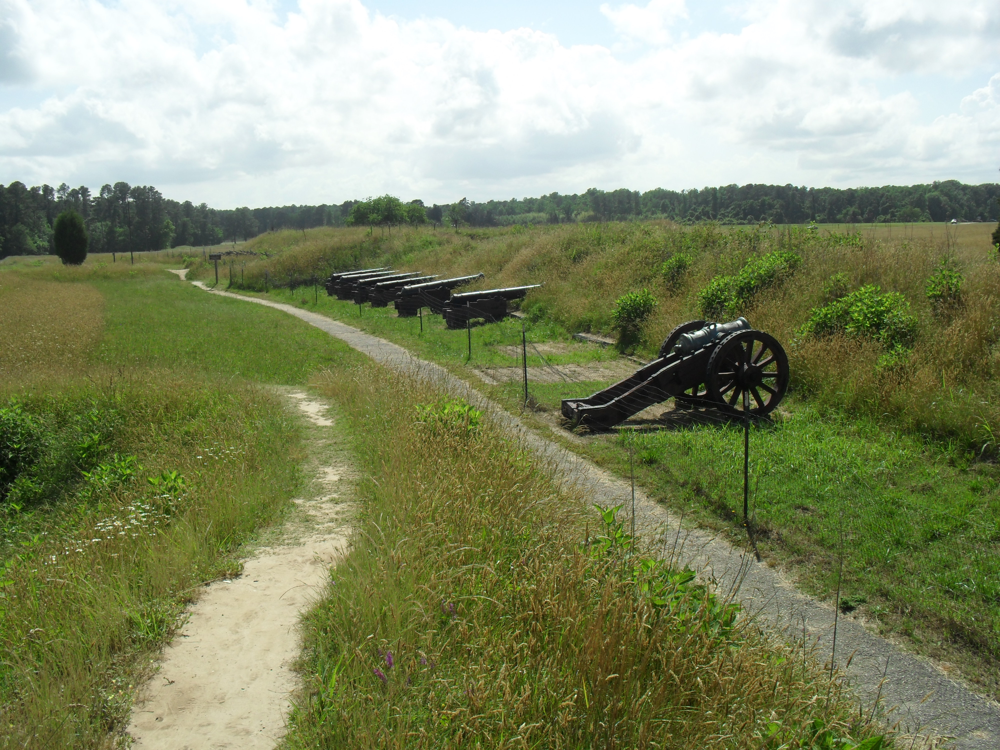
Marquise de Lafayette played an important role both in the
American War of Independence and the French Revolution.
Let’s learn about famous people from France.

Slide 9
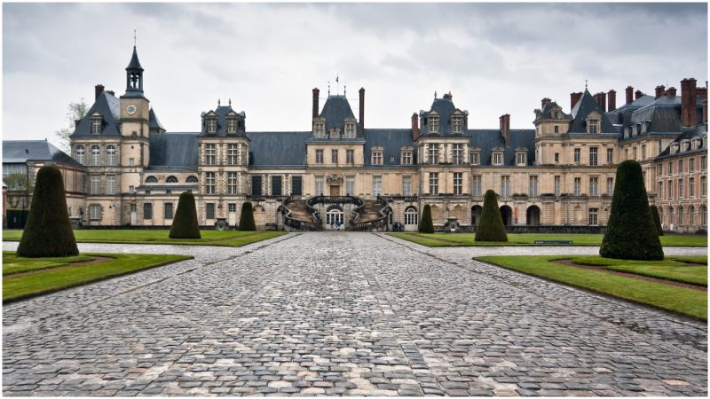
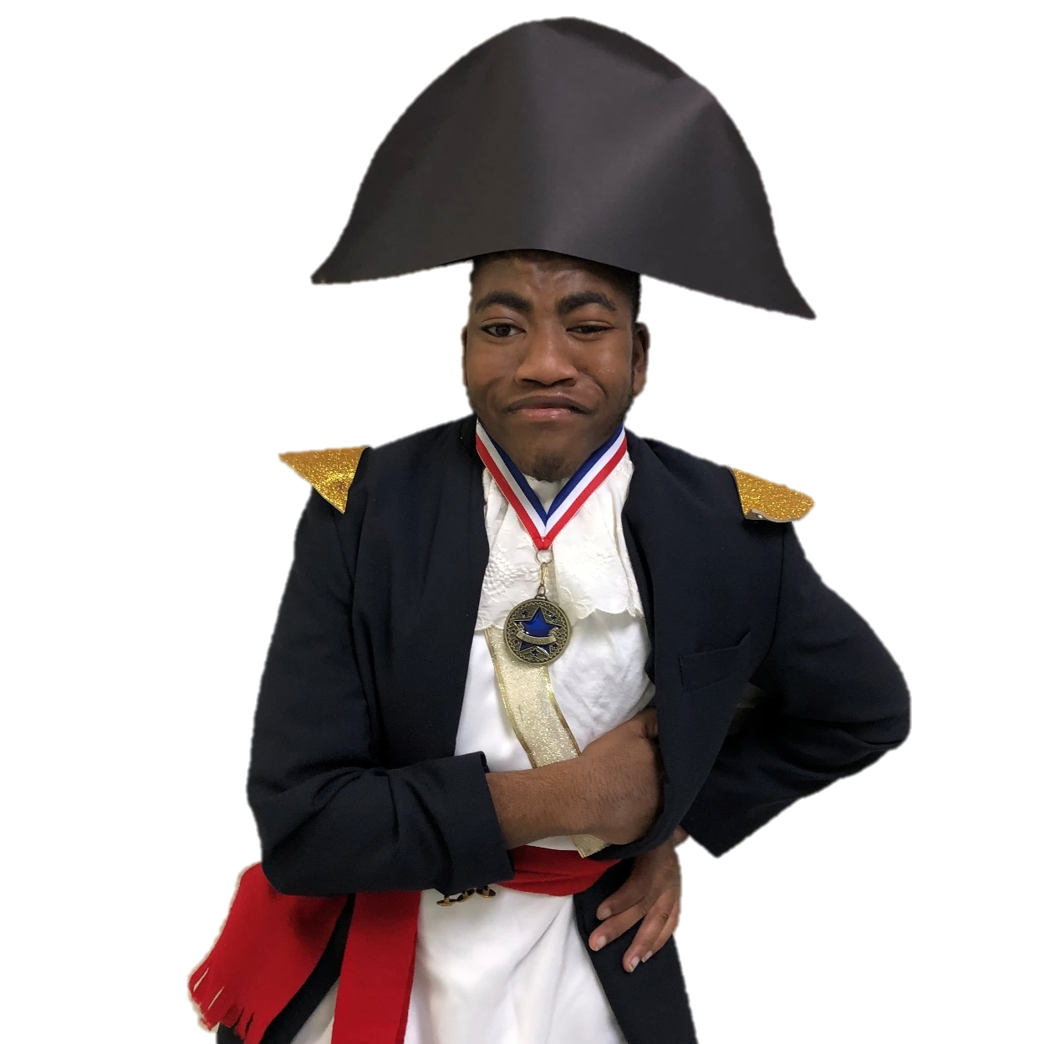
Napoleon Bonaparte was a great military commander.
He was military general and the first ever emperor of France.
Let’s learn about famous people from France.

Slide 10
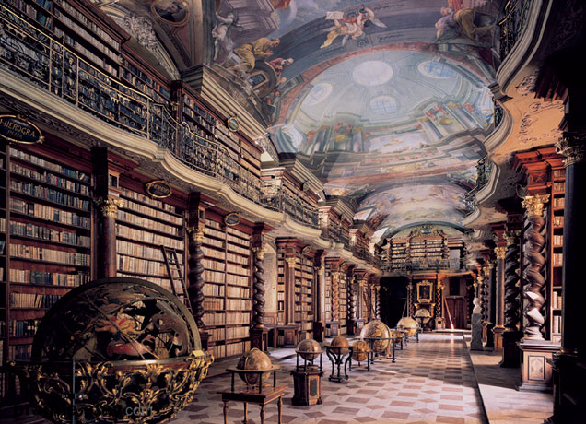
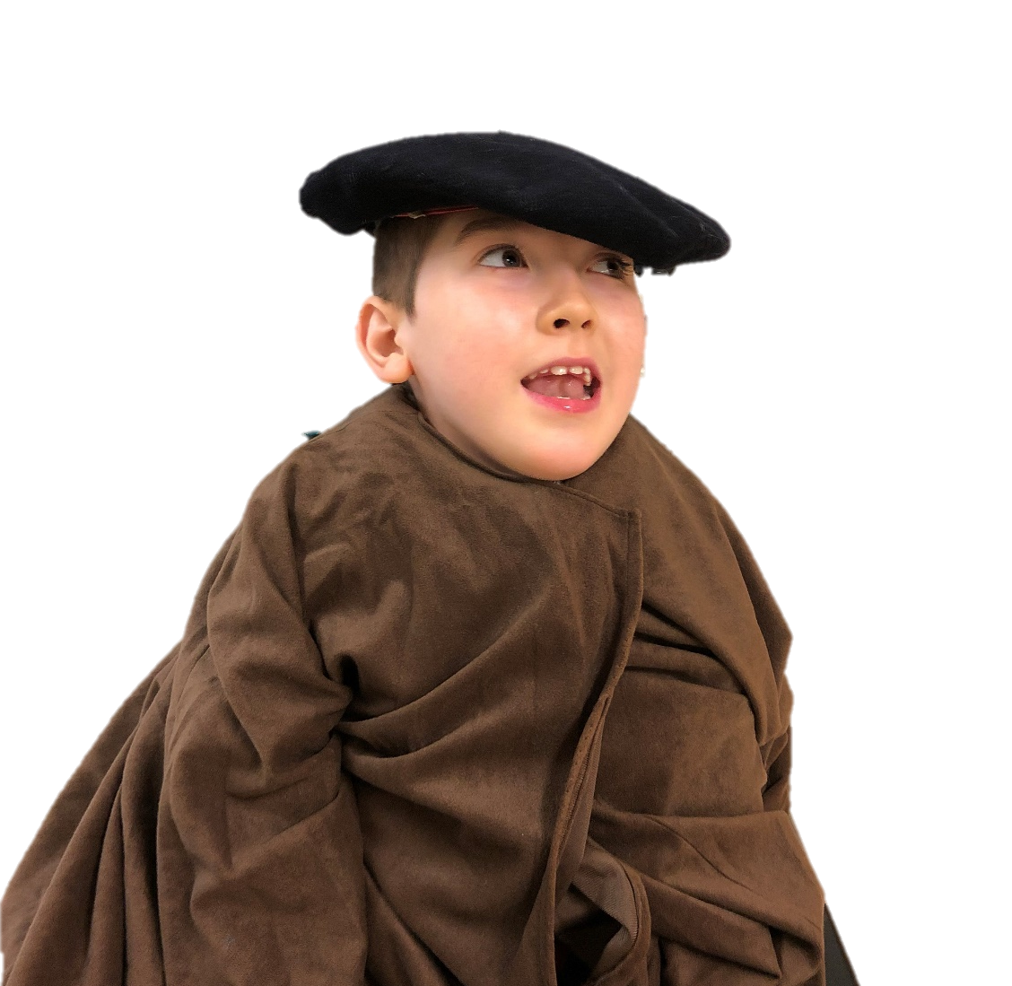
Nostradamus was a physician and astrologer who believed that the
future can be learned by studying the stars and planets.
He is remembered for the predictions he made of future events.
Let’s learn about famous people from France.

Slide 11
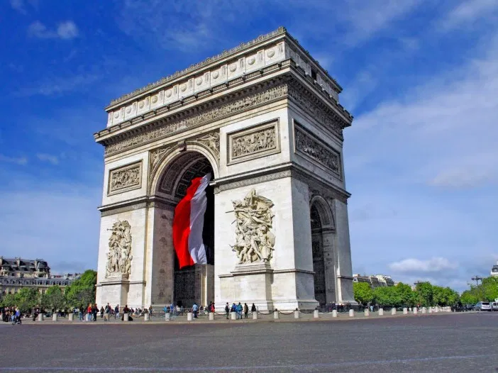
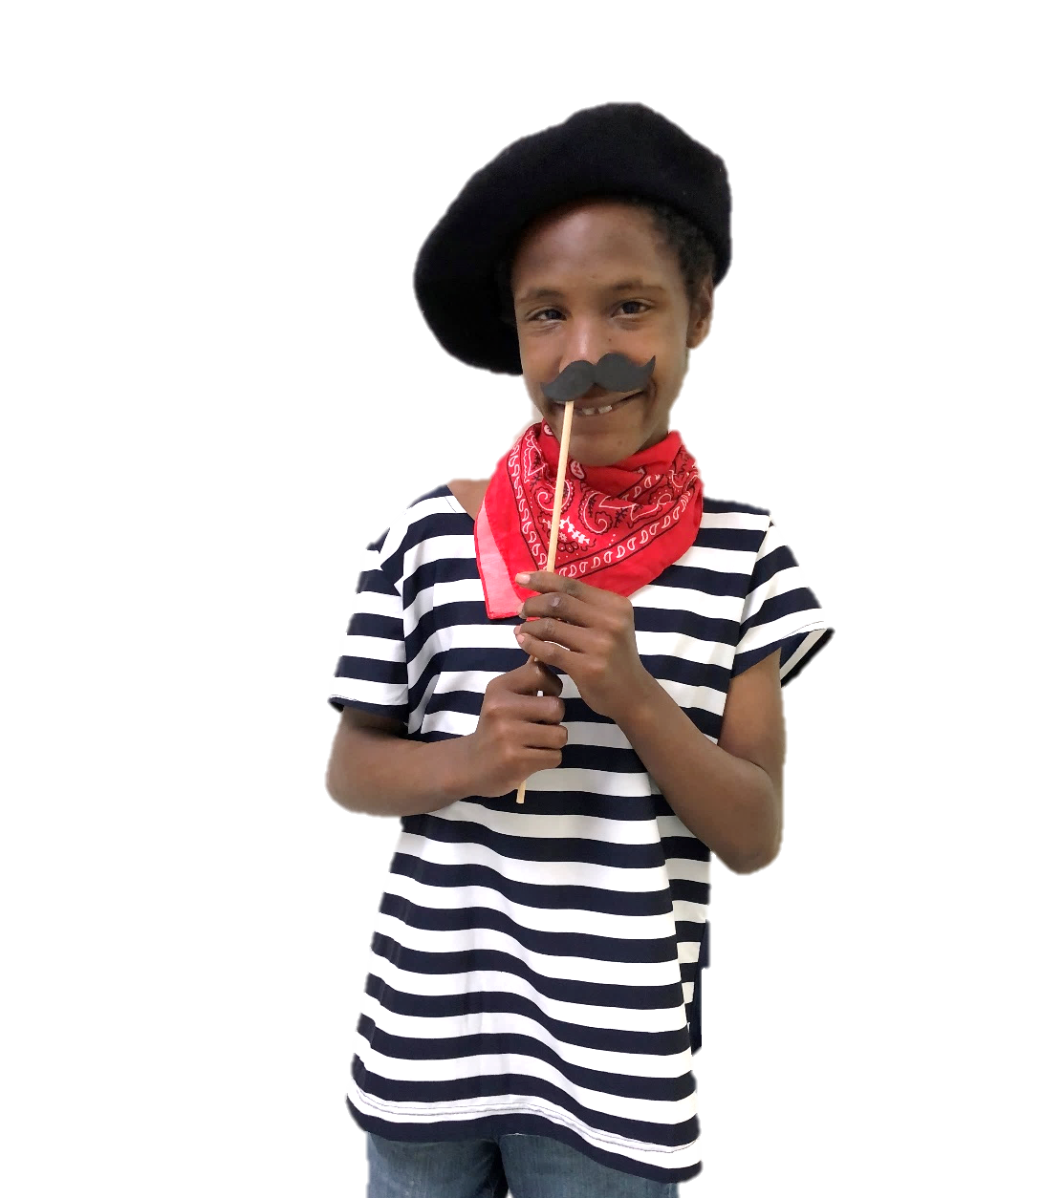
The End

