Slide 1
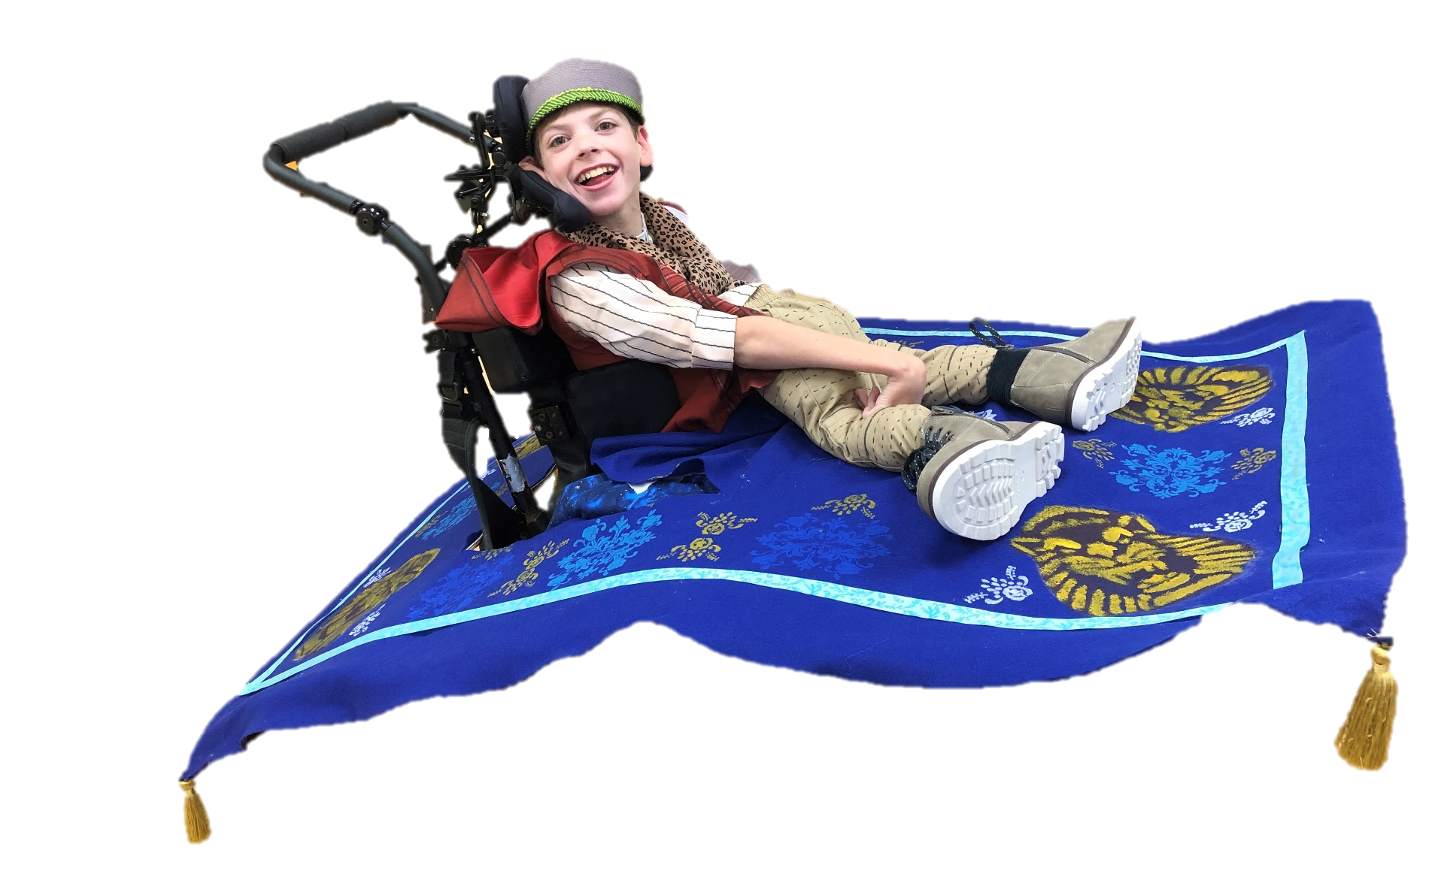
Let’s Go On An Adventure
By: Cara Edenfield and Joy Delaney
Groupbygroup.wordpress.com

Slide 2
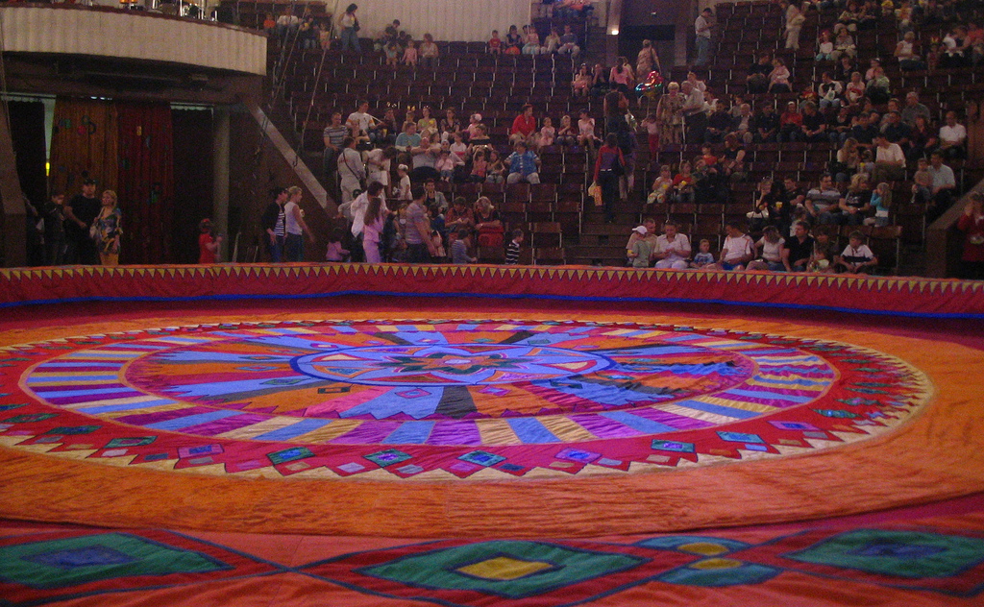
We can be in a circus and entertain people!
Let’s go on an adventure.

Slide 3
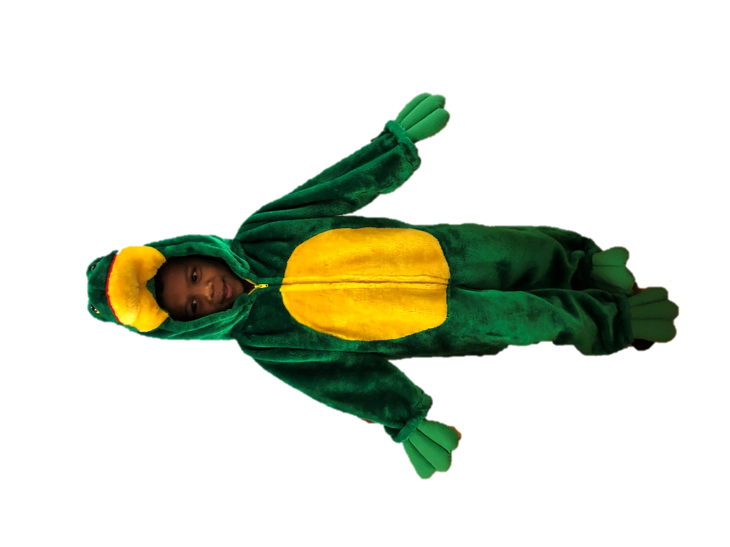
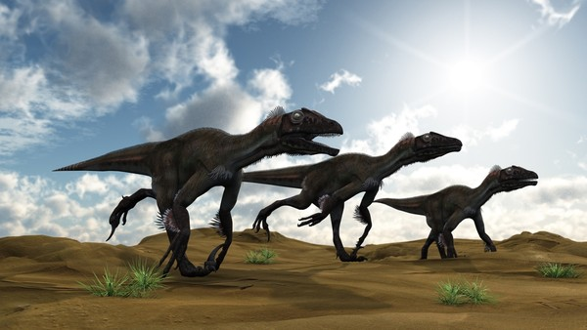
We can run with the dinosaurs!
Let’s go on an adventure.

Slide 4
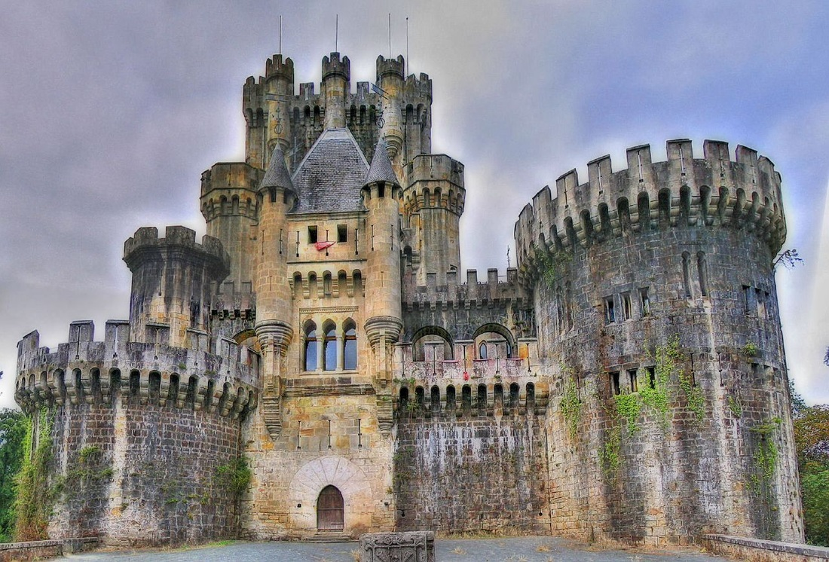
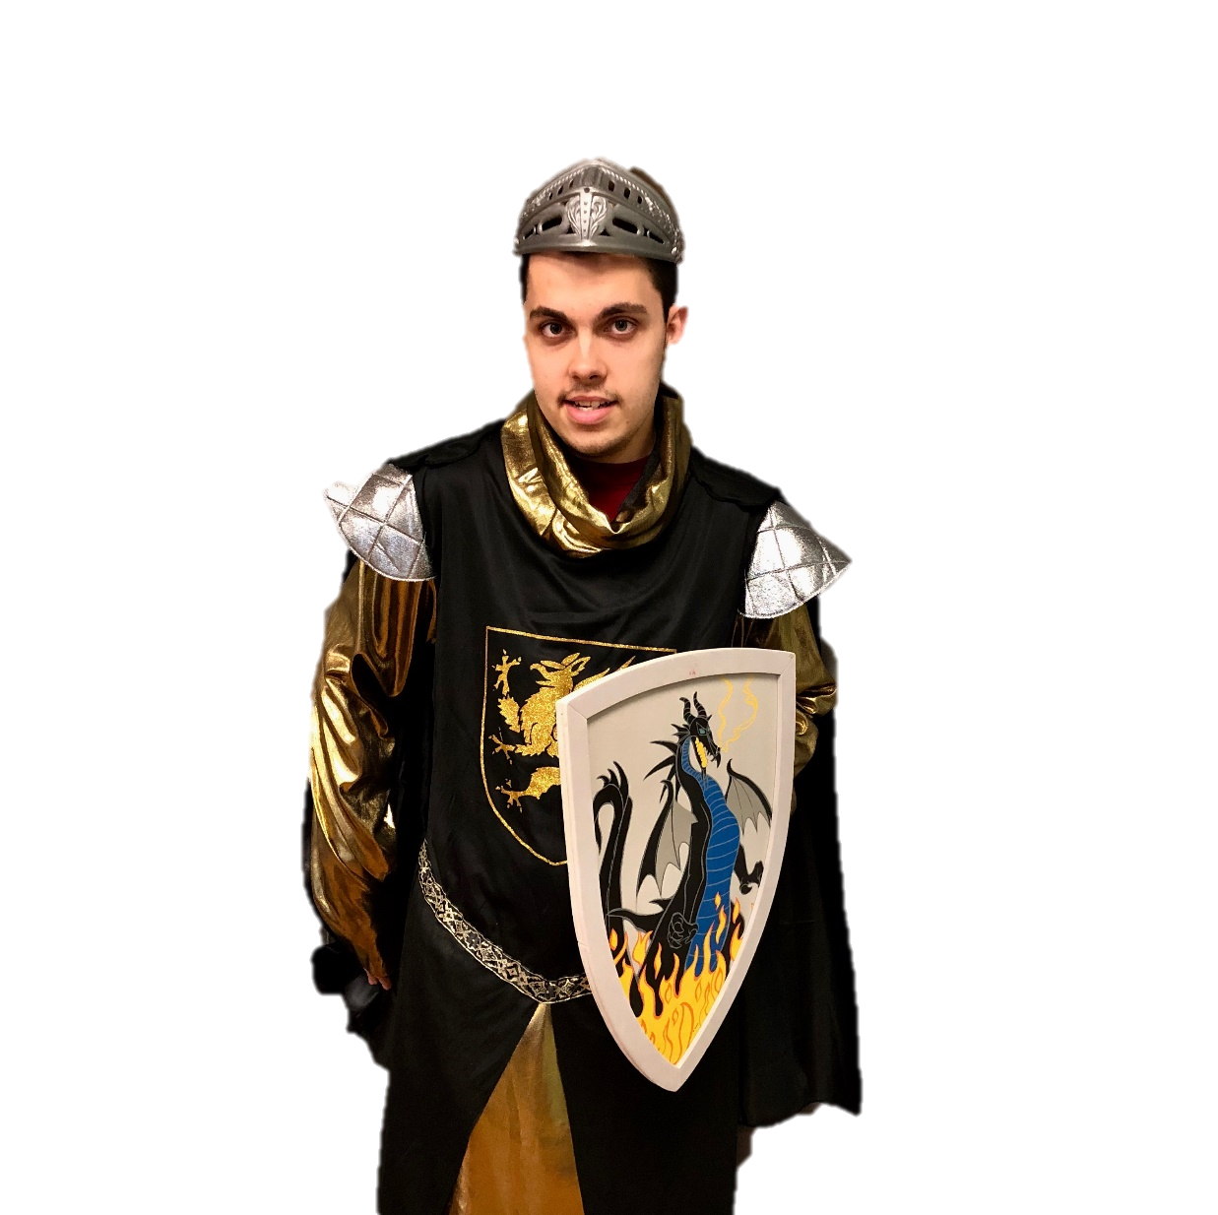
We can be knights in medieval times!
Let’s go on an adventure.

Slide 5
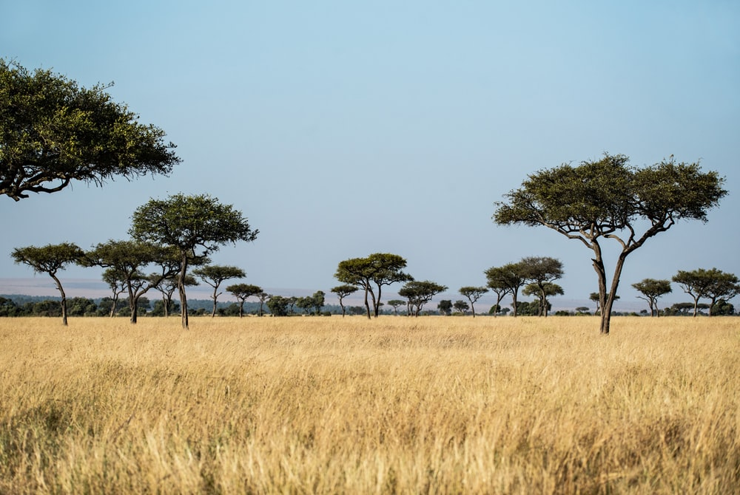
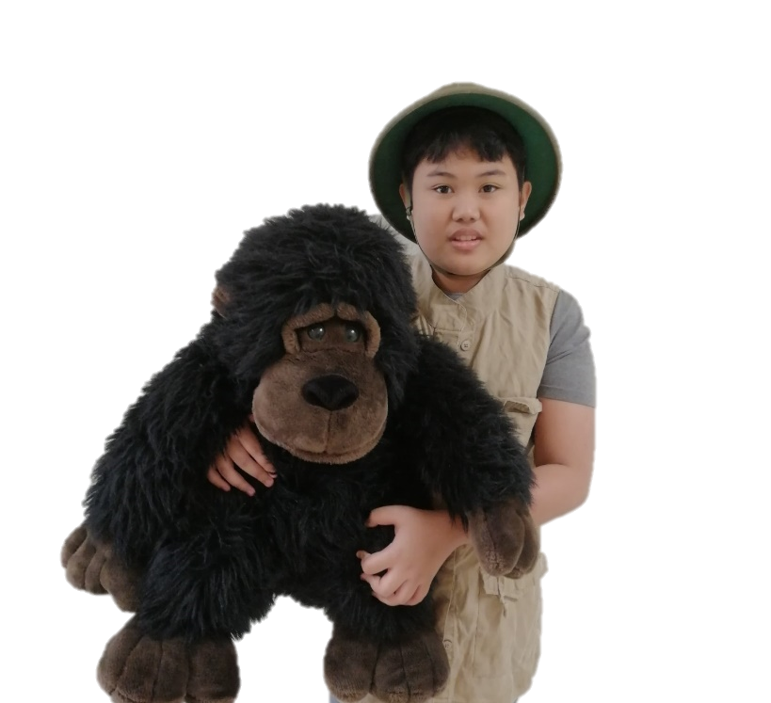
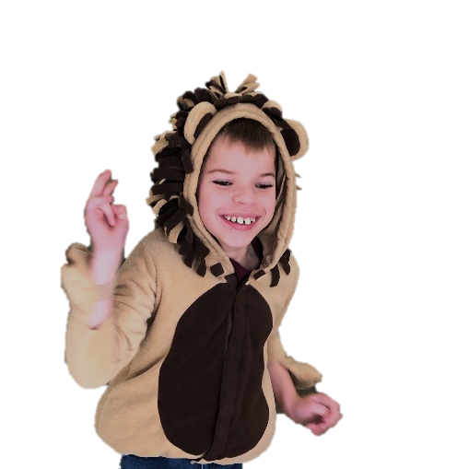
We can go on a safari!
Let’s go on an adventure.

Slide 6
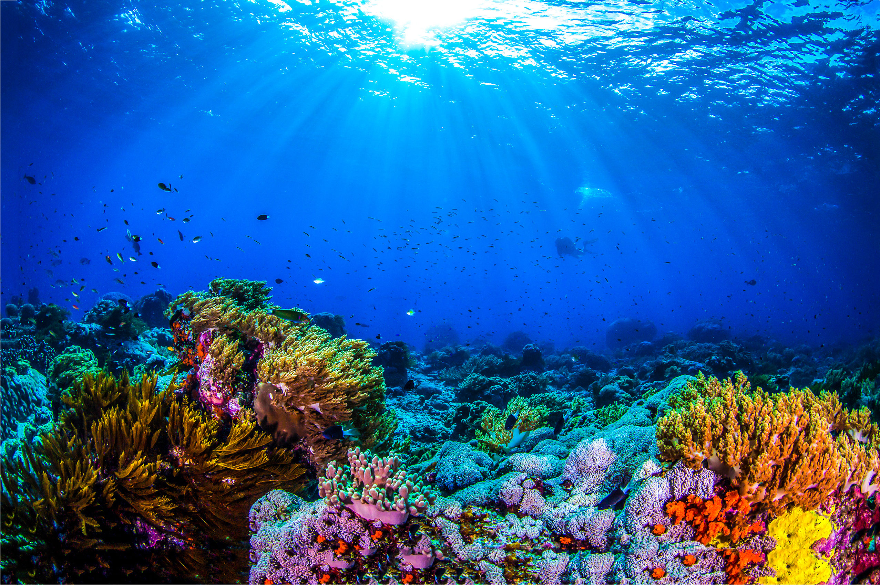
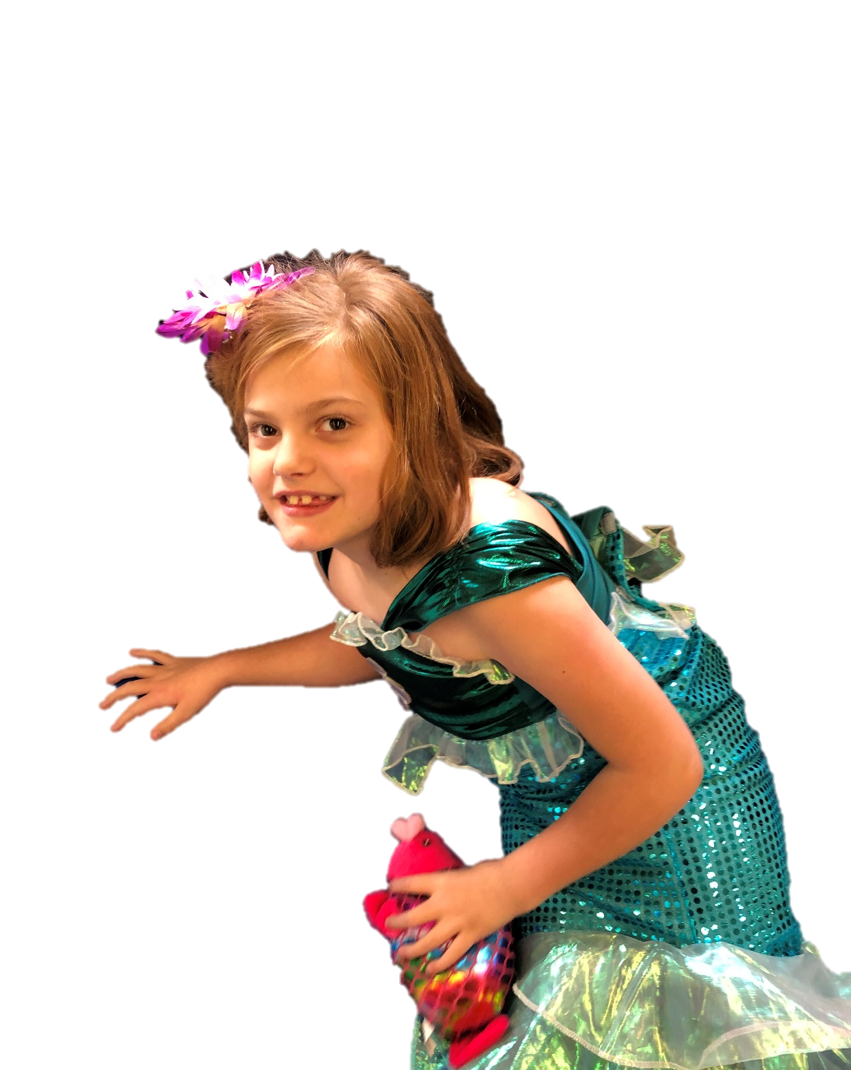
We can be mermaids under the deep sea!
Let’s go on an adventure.

Slide 7
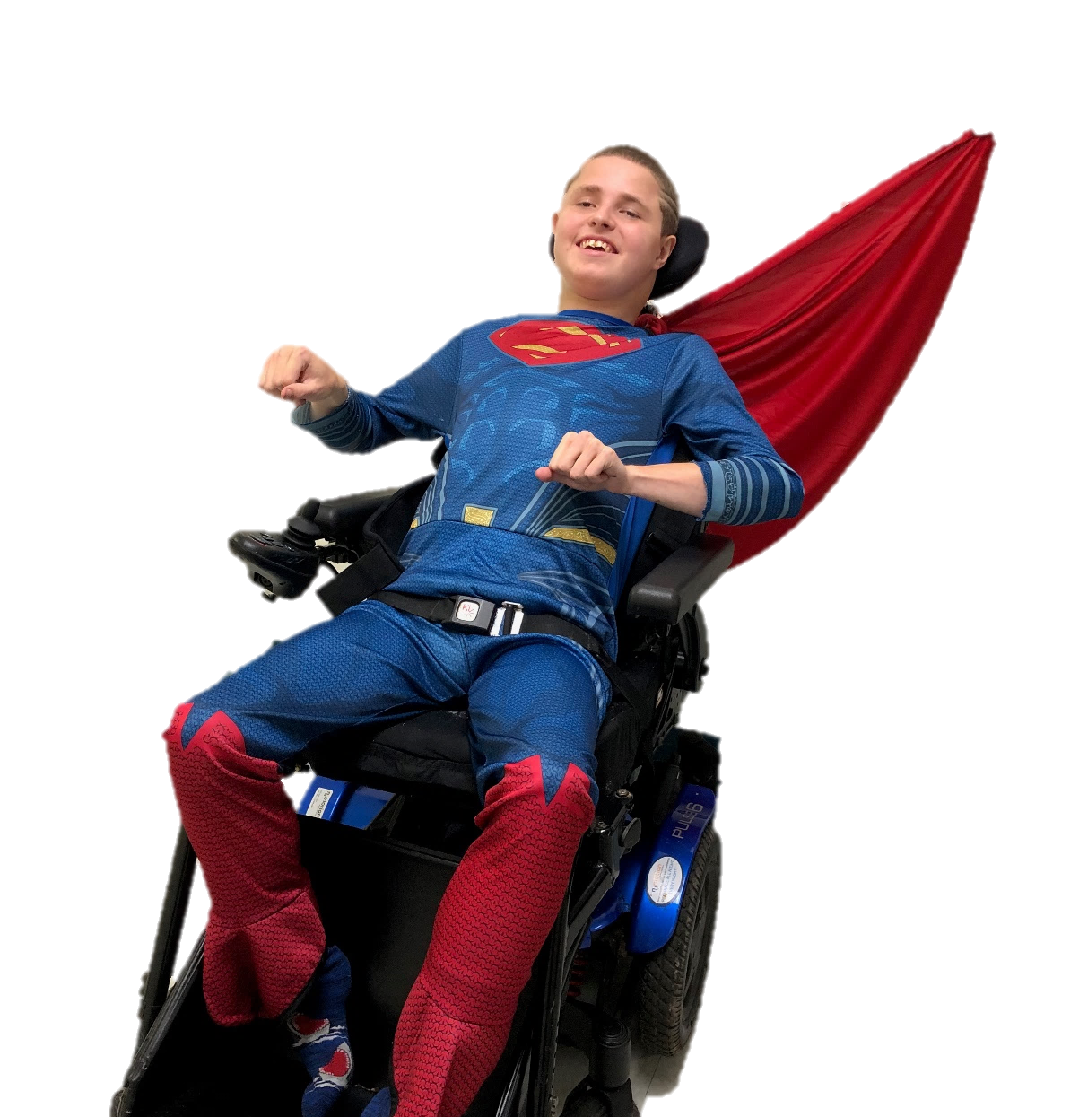
We can fly like a superhero!
Let’s go on an adventure.

Slide 8
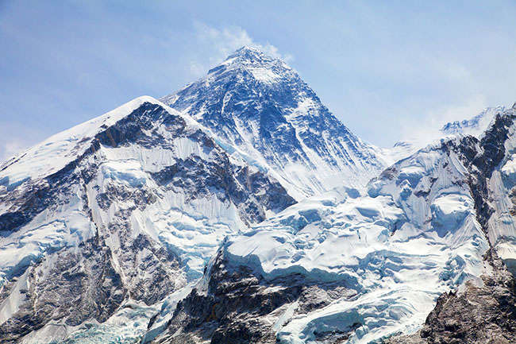
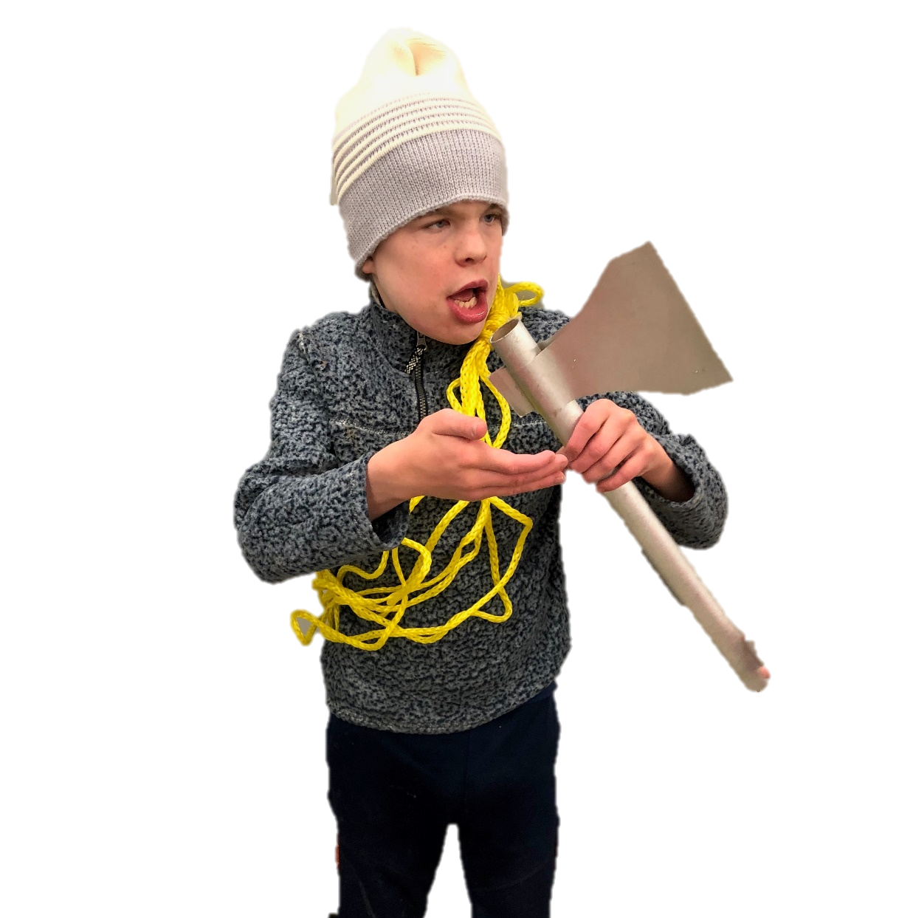
We can climb the tallest mountain!
Let’s go on an adventure.

Slide 9
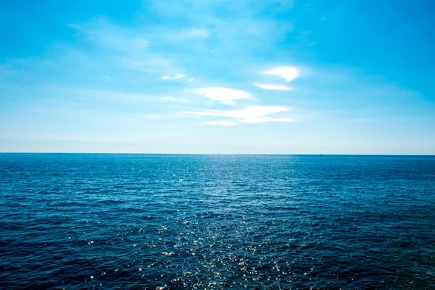
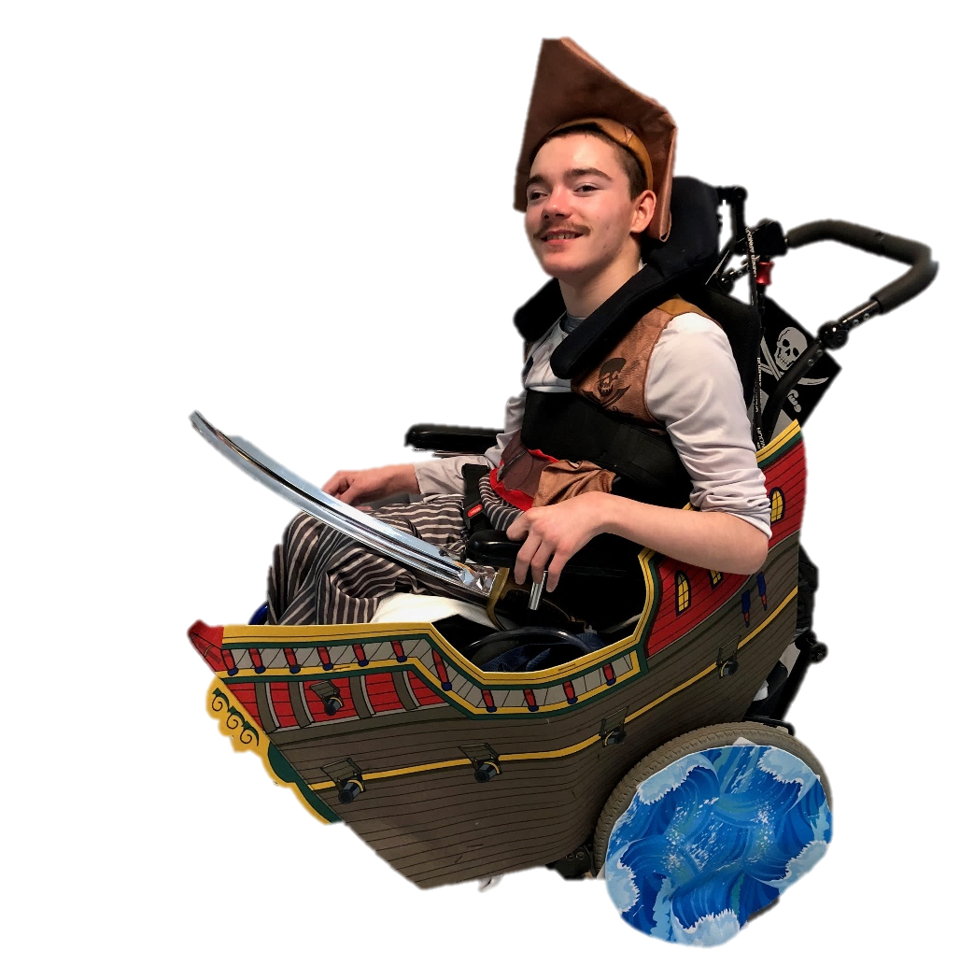
We can be pirates on the high seas!
Let’s go on an adventure.

Slide 10
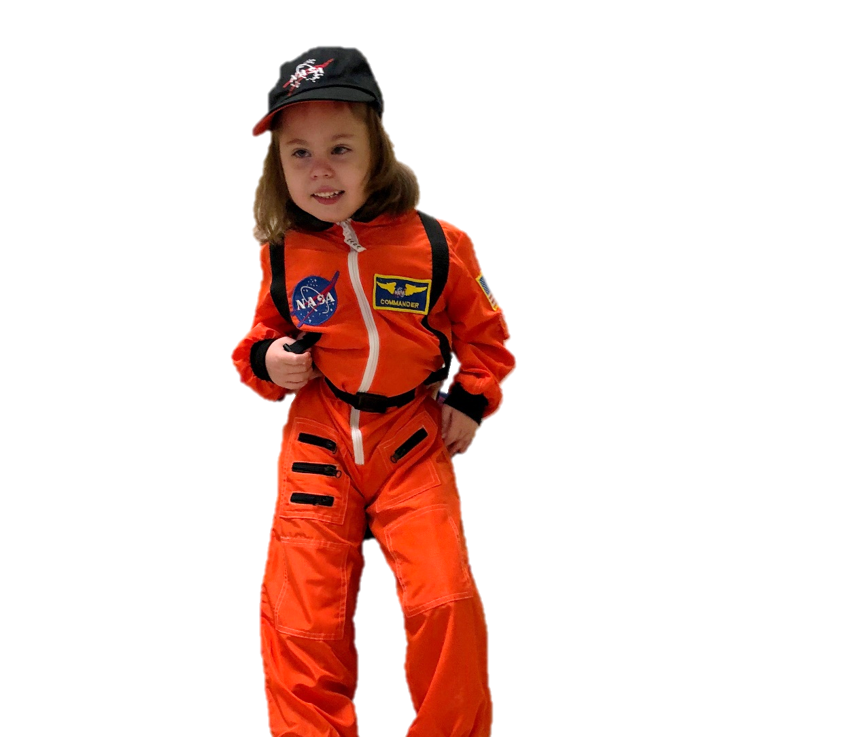
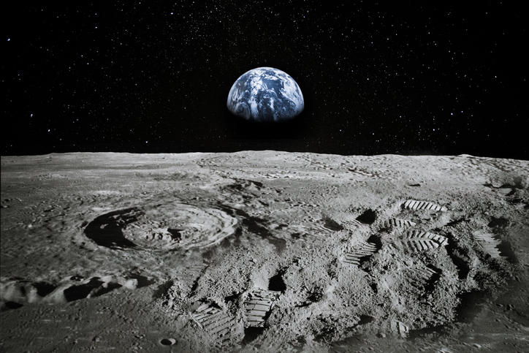
We can be astronauts who fly to the moon!
Let’s go on an adventure.

Slide 11
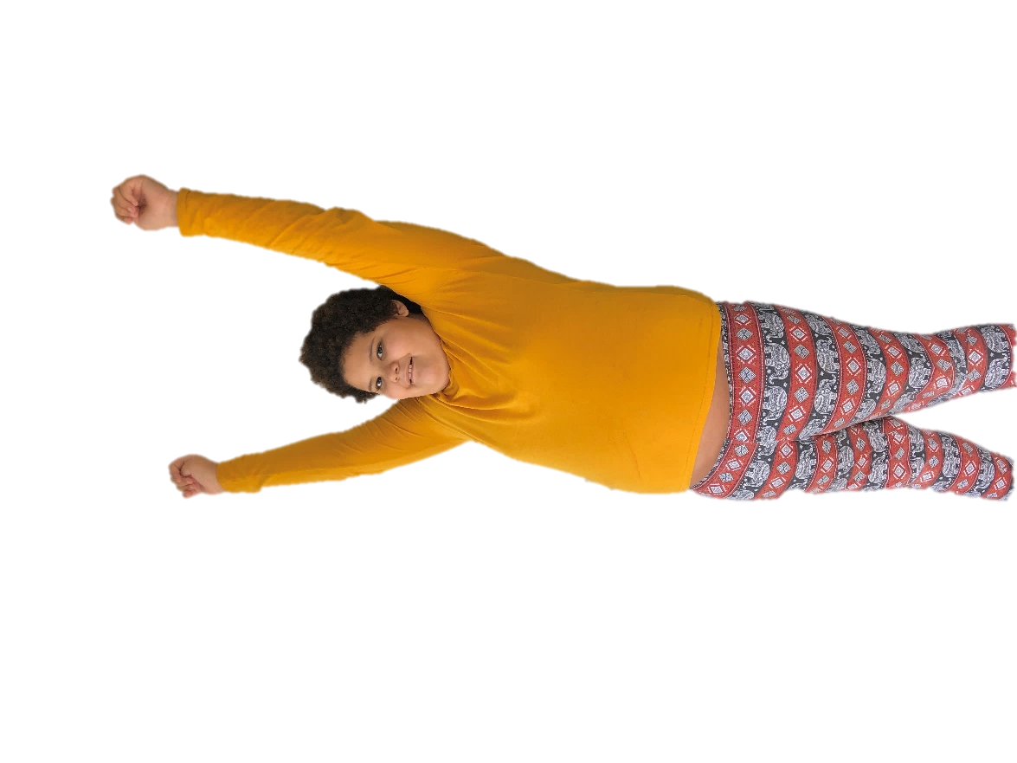
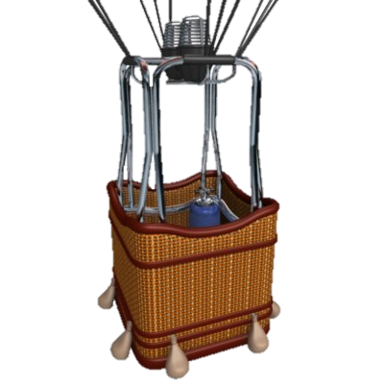
The End

