Slide 1
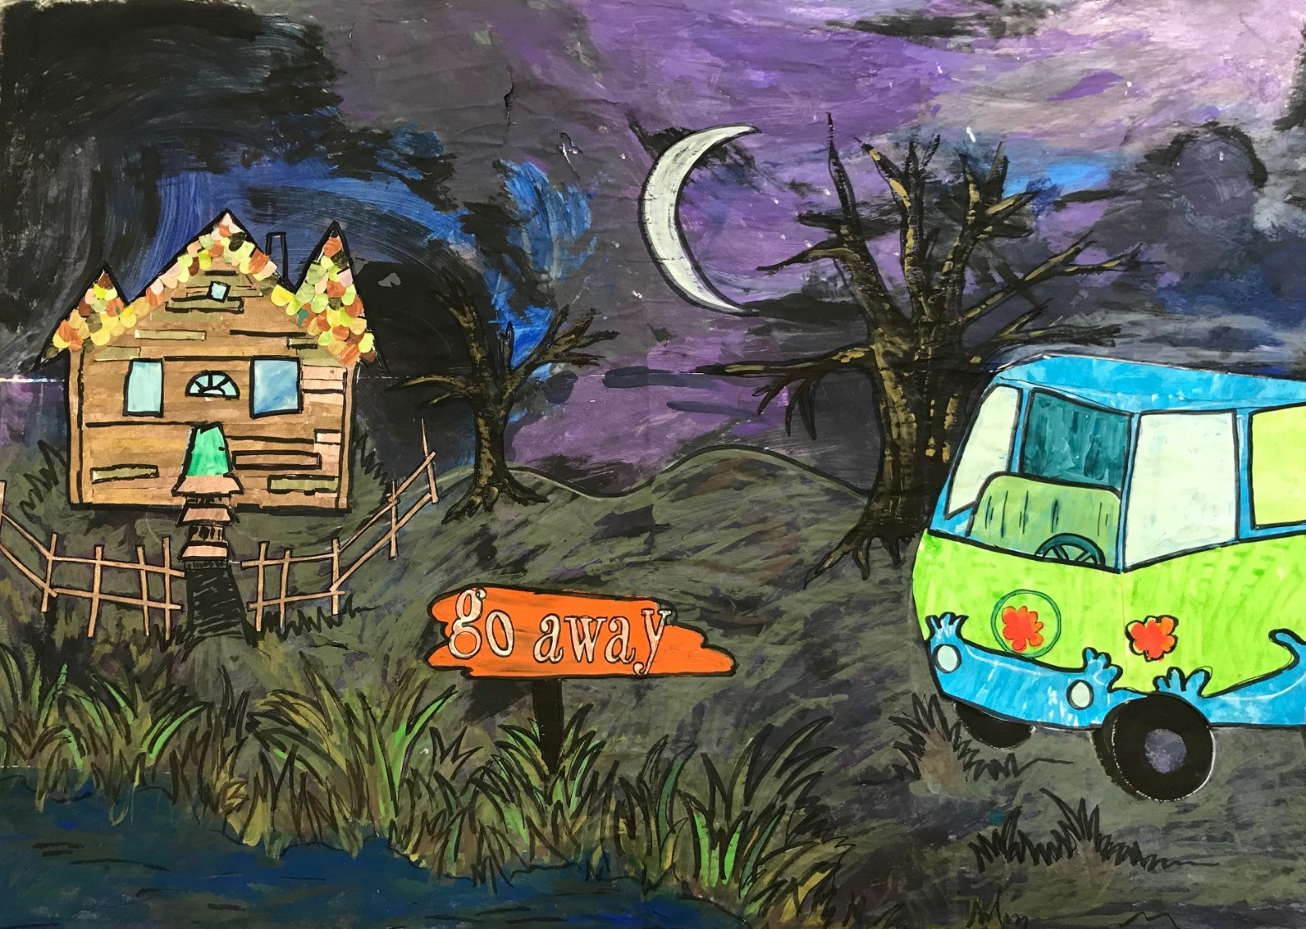
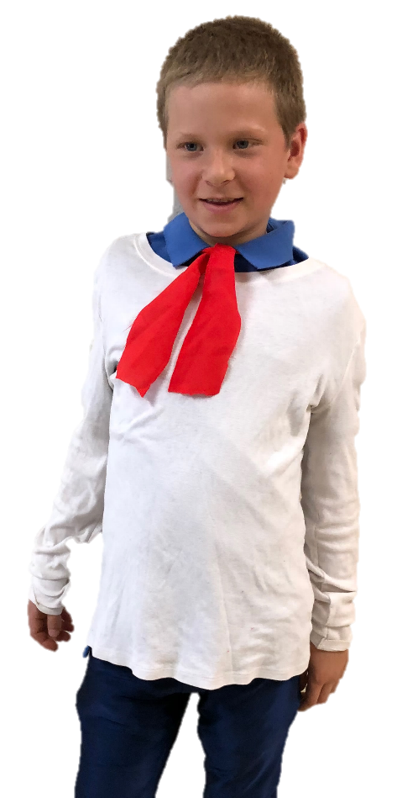
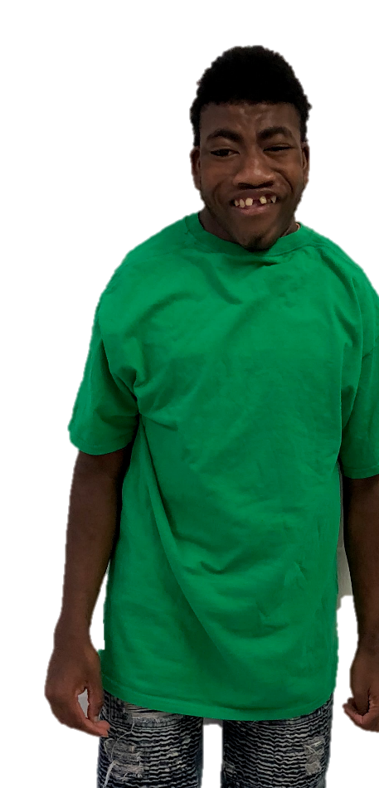
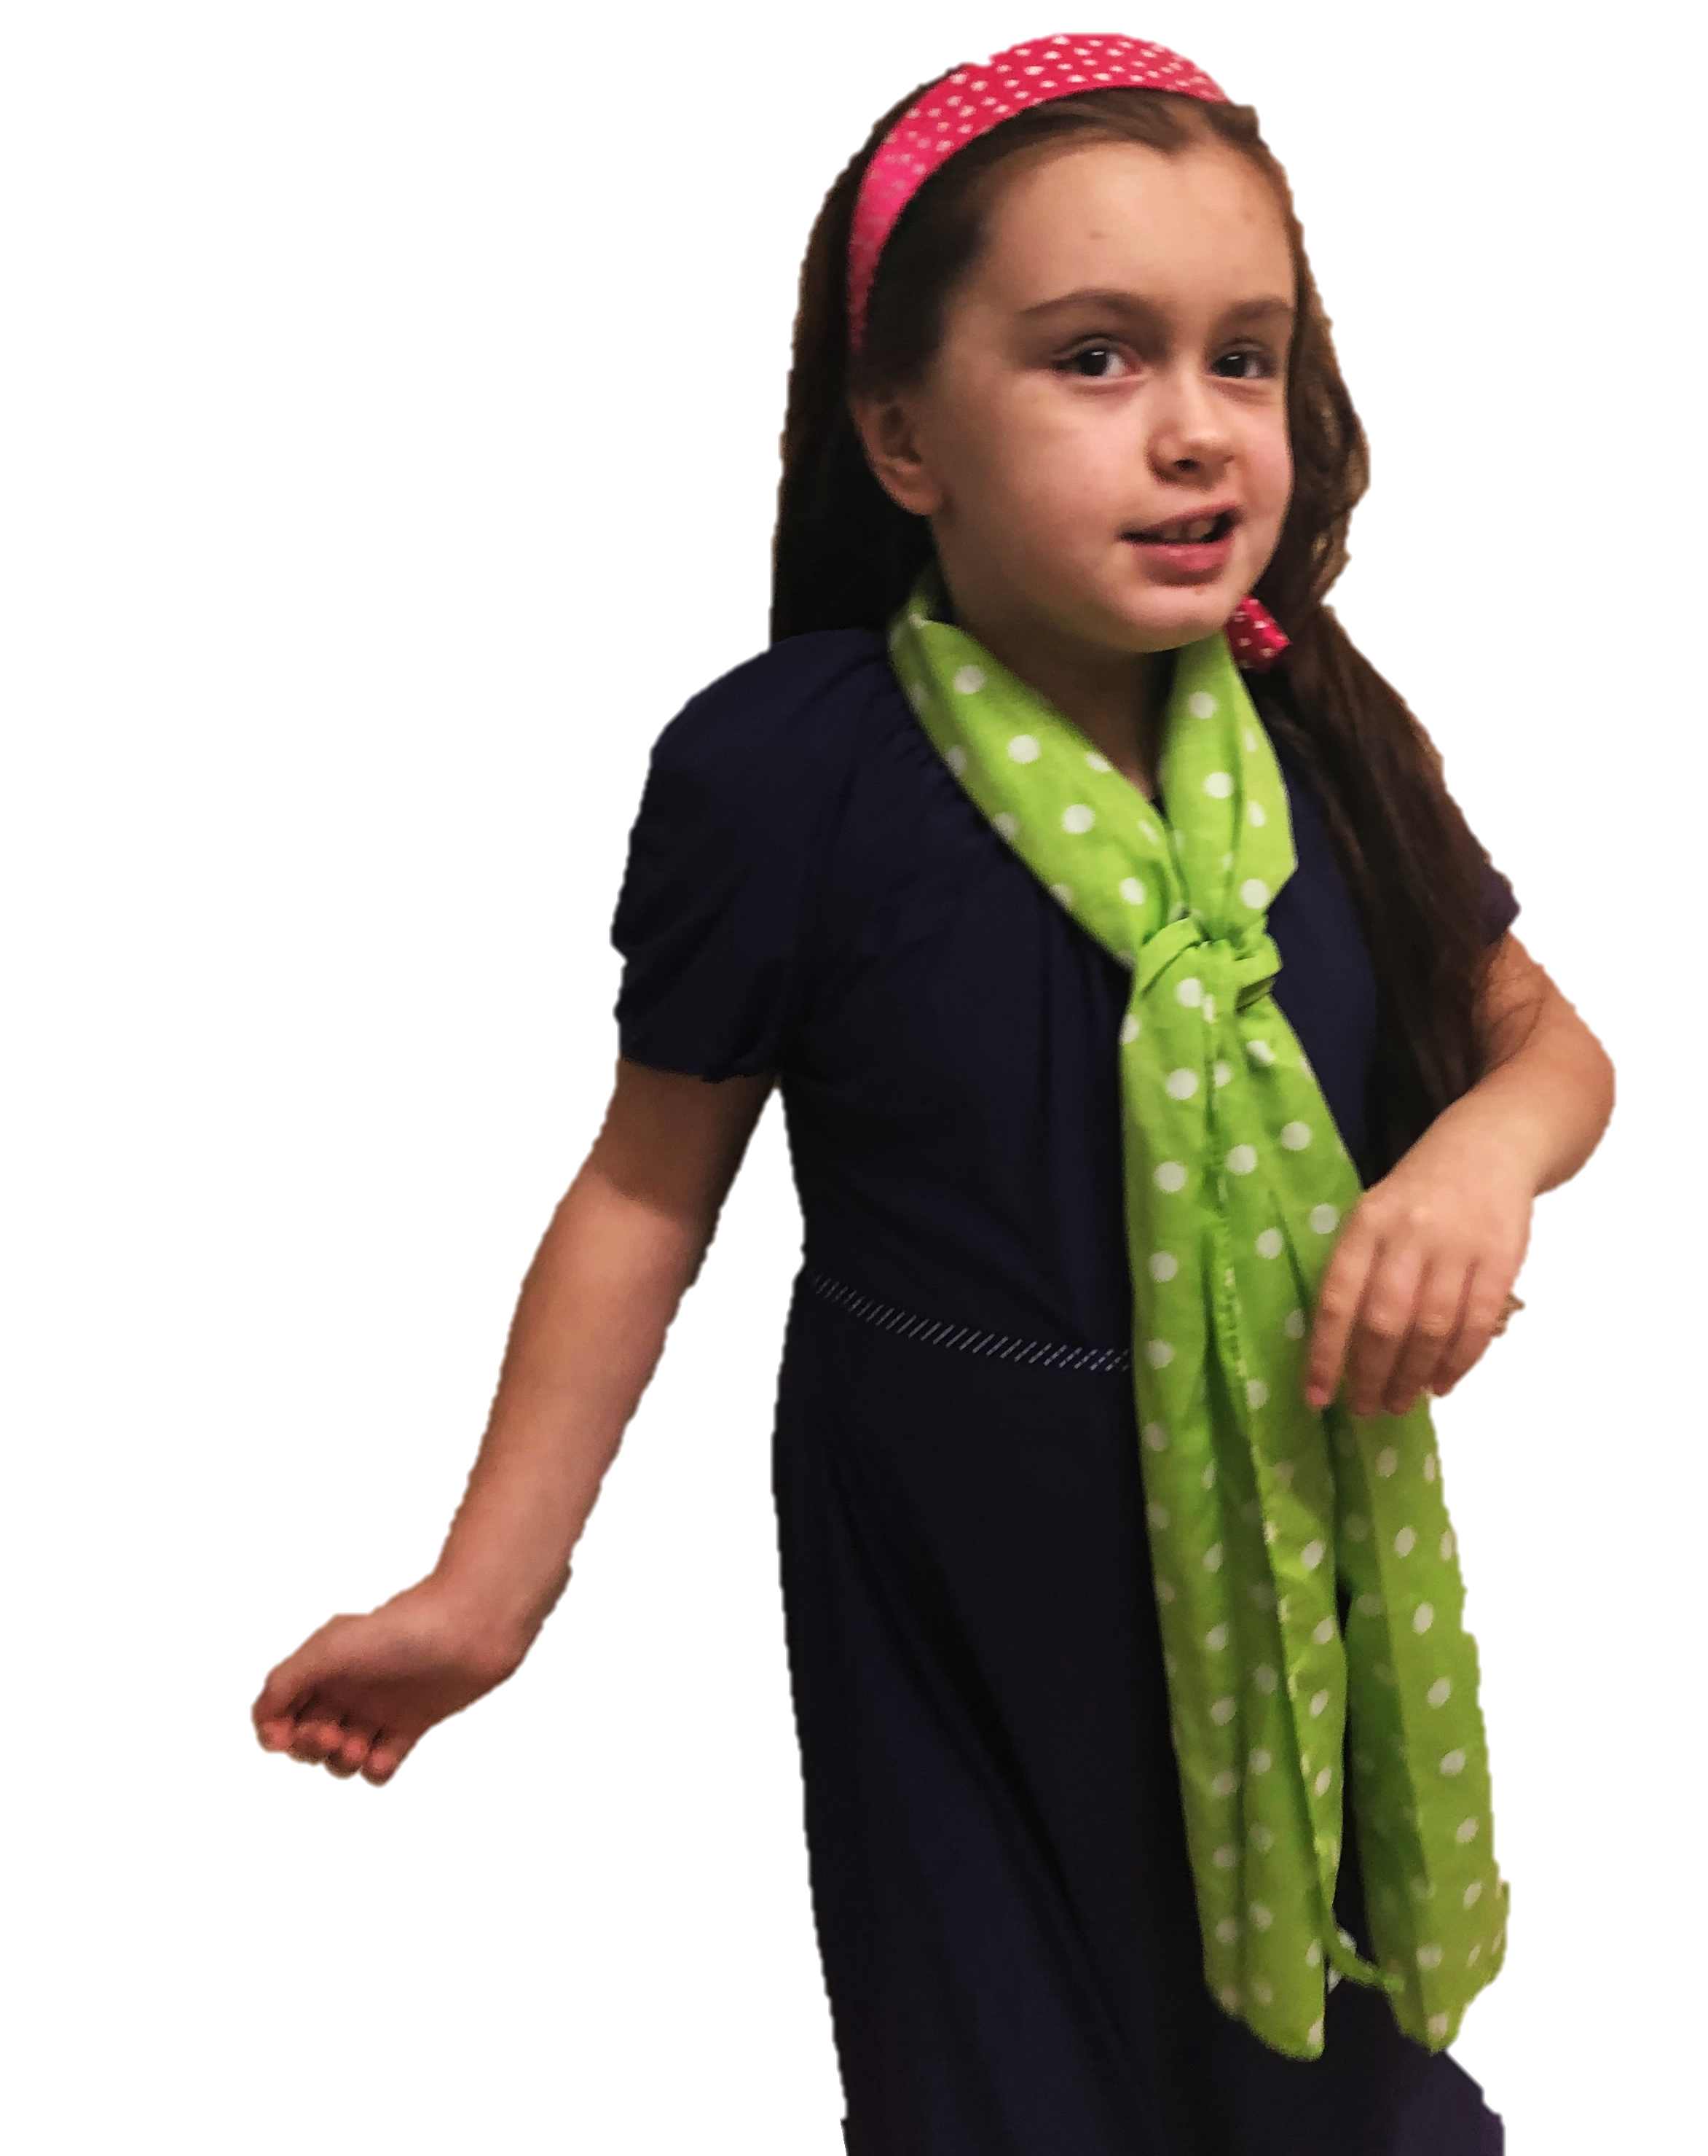
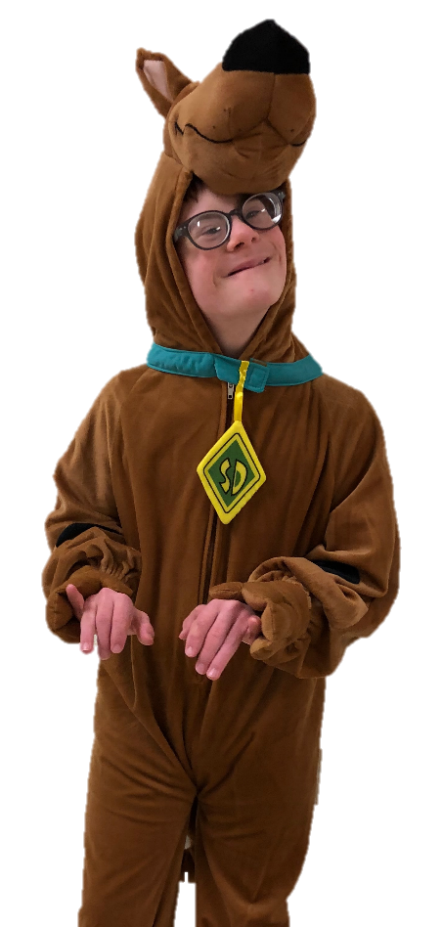
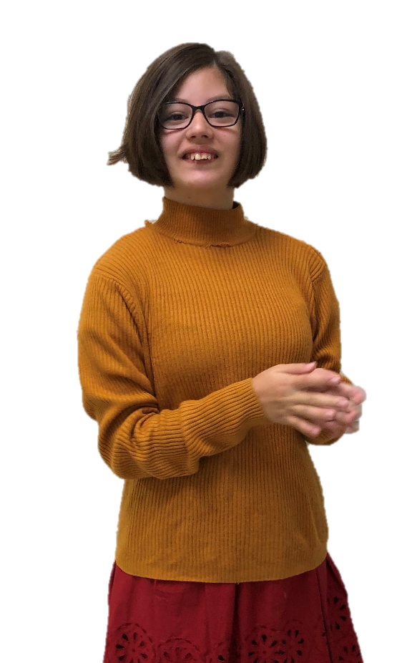
Watch Out For Monsters!
By: Cara Edenfield and Joy Delaney
Groupbygroup.wordpress.com

Slide 2
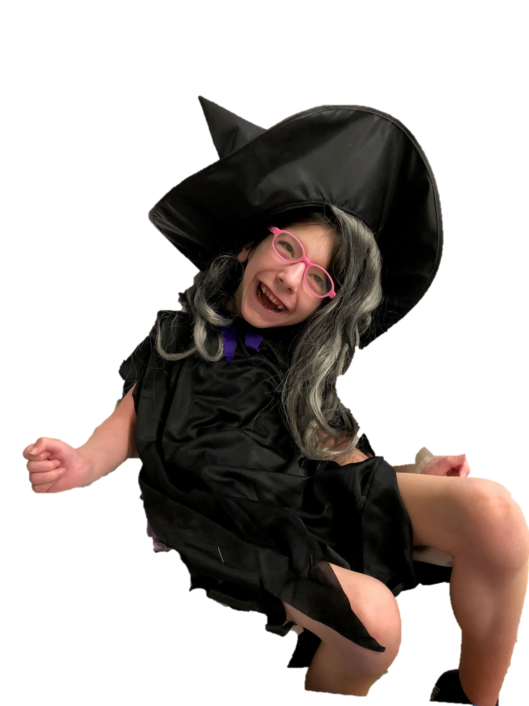
We may see a witch.
Watch out for monsters!

Slide 3
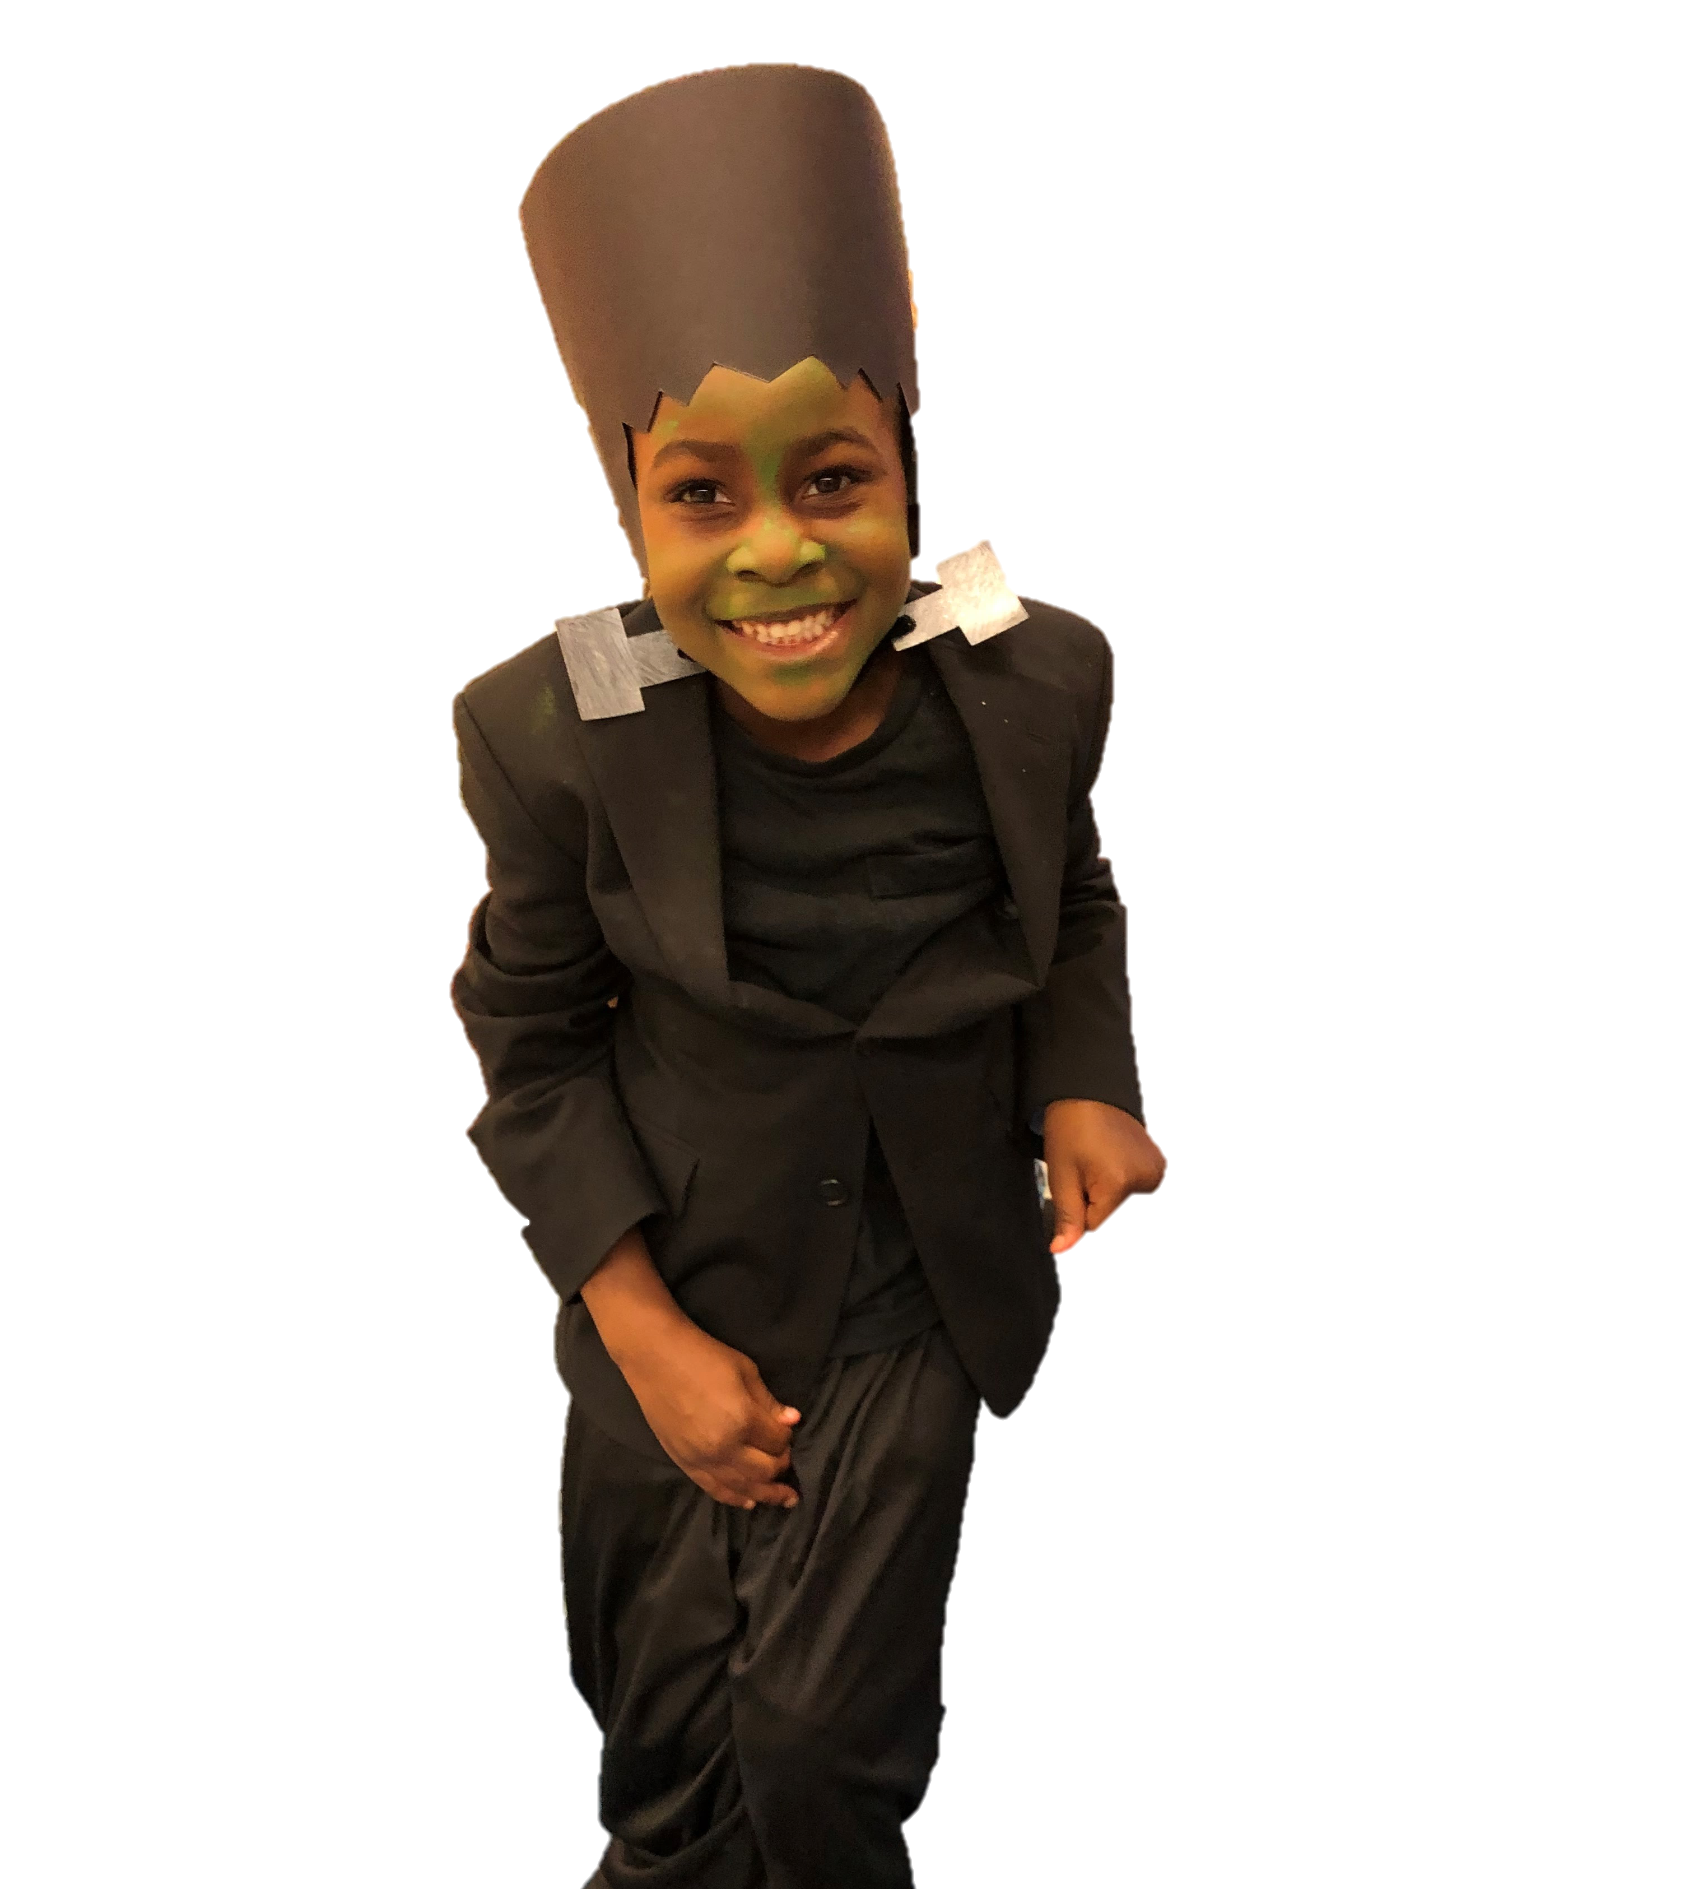
We may see Frankenstein.
Watch out for monsters!

Slide 4
We may see a werewolf.
Watch out for monsters!

Slide 5
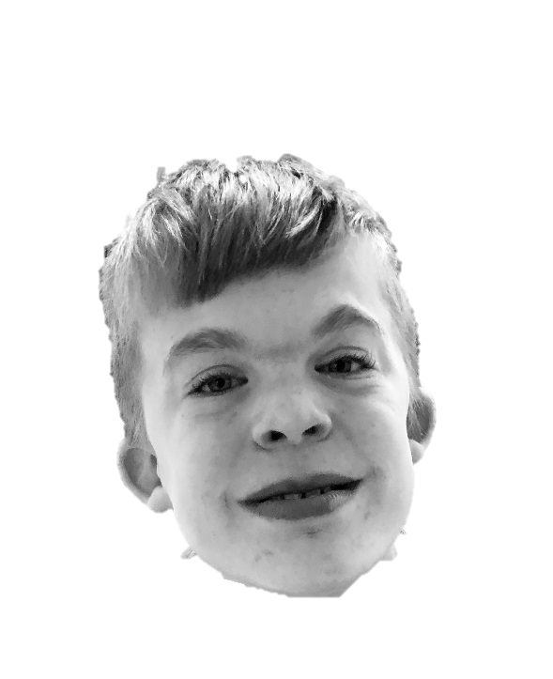
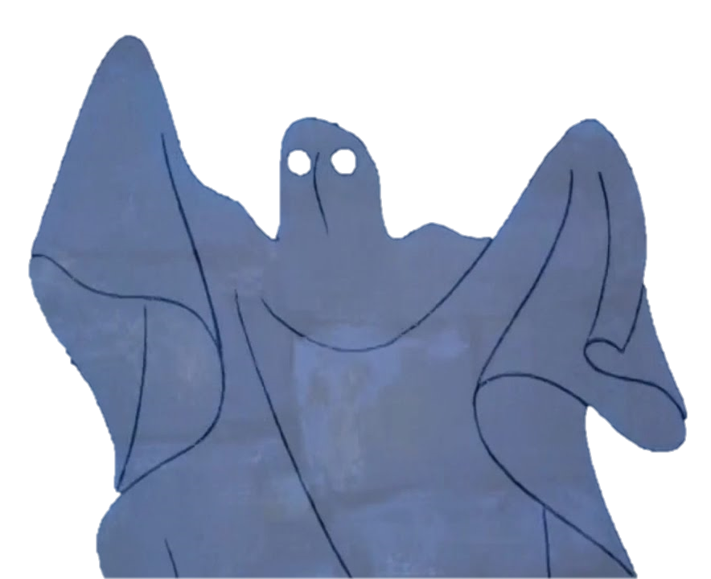
We may see a ghost.
Watch out for monsters!

Slide 6
We may see a vampire.
Watch out for monsters!

Slide 7
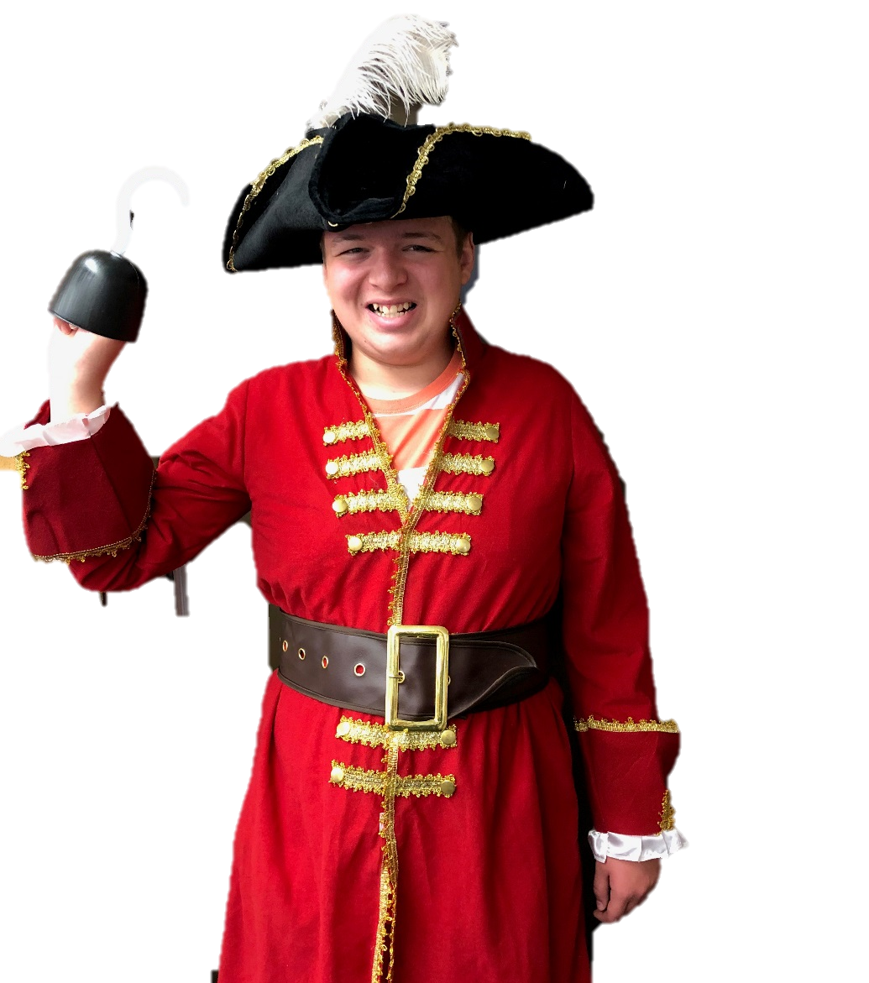
We may see a pirate.
Watch out for monsters!

Slide 8
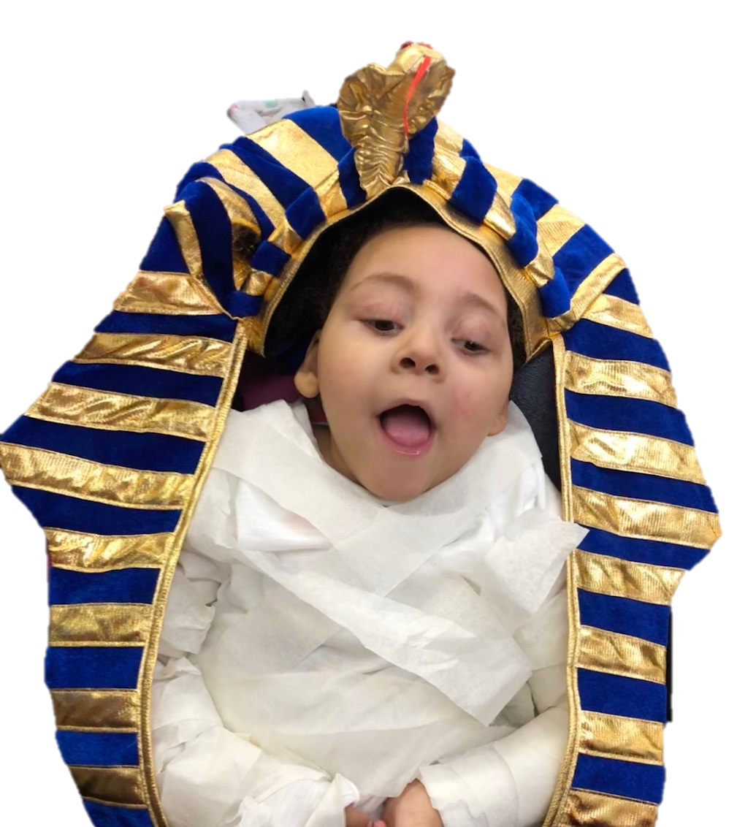
We may see a mummy.
Watch out for monsters!

Slide 9
The End

