Slide 1
Let’s Make Apple Pie In A Cup
Groupbygroup.wordpress.com

Slide 2
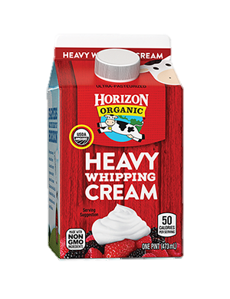
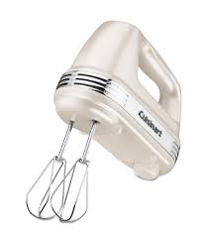
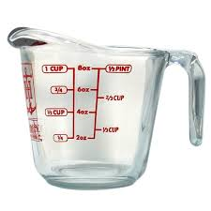
Put 1 cup of heavy whipping cream into a large bowl
and mix until stiff peaks are just about to form.

Slide 3
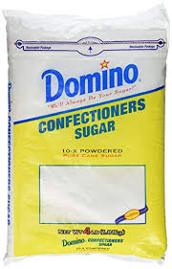
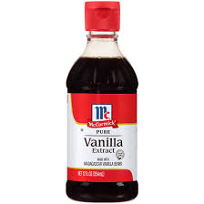
Put 1 tsp of vanilla and 1 tbsp. of confectioners’ sugar
in the bowl and mix until stiff peaks form.

Slide 4
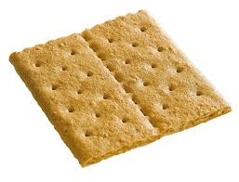
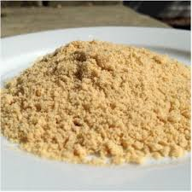
Put one graham cracker in a bag and crush it up.
Put the crumbs in a cup.

Slide 5
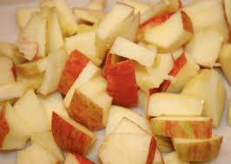
Put diced apples on top of the graham crackers in the cup.

Slide 6
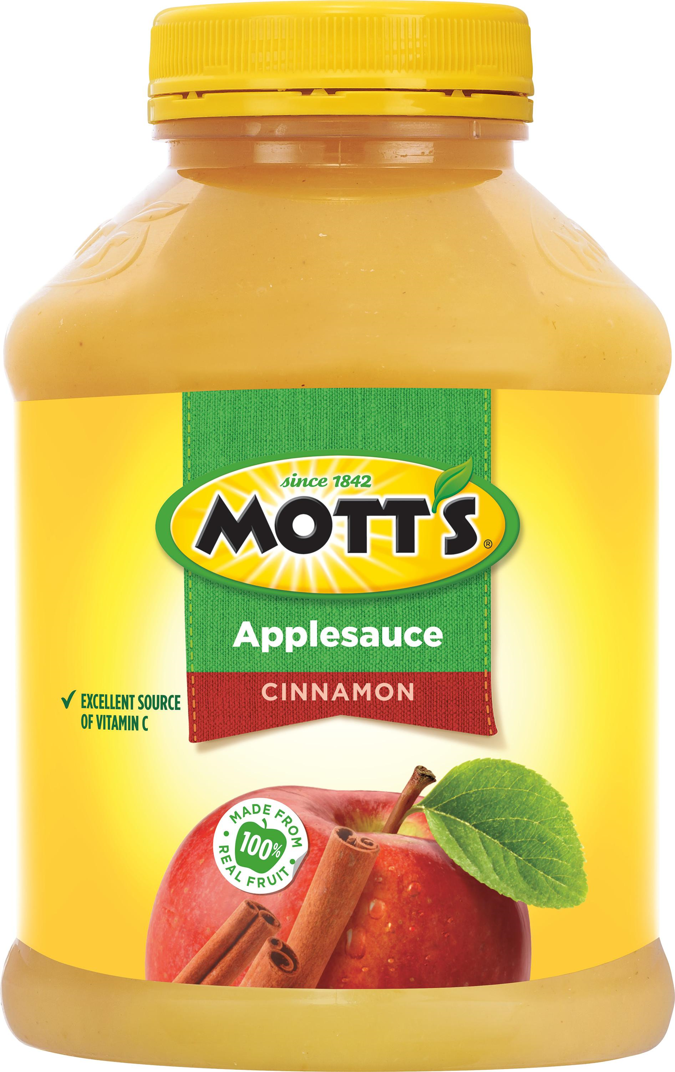
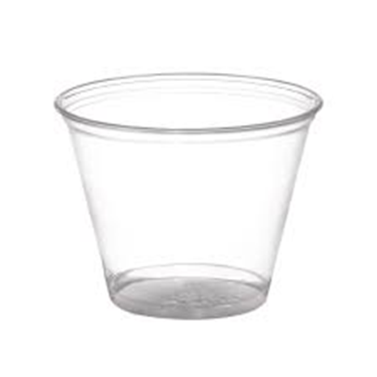
Put a couple of spoonfuls of cinnamon applesauce on top
of the diced apples in the cup.

Slide 7
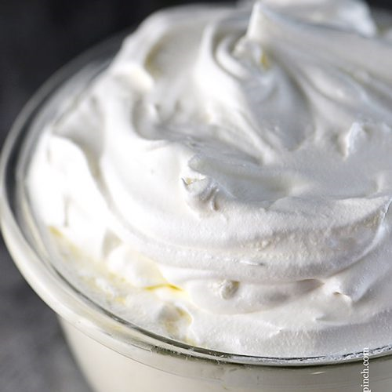
Top with whipped cream.
Eat and enjoy!

