Slide 1
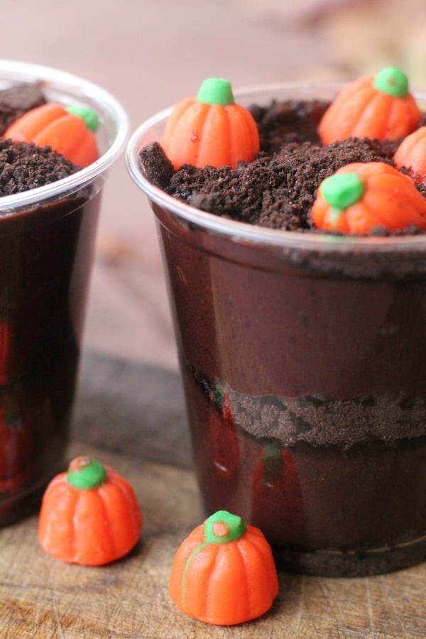
Let’s Make An Edible Pumpkin Patch
Groupbygroup.wordpress.com

Slide 2
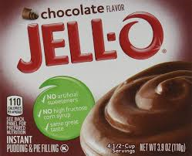
Put chocolate pudding mix into a bowl.

Slide 3
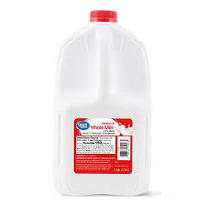
Put 2 cups of milk into the bowl and mix until
well blended.

Slide 4
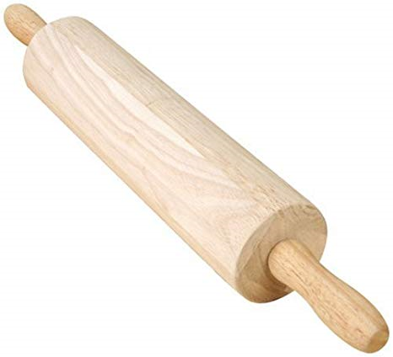
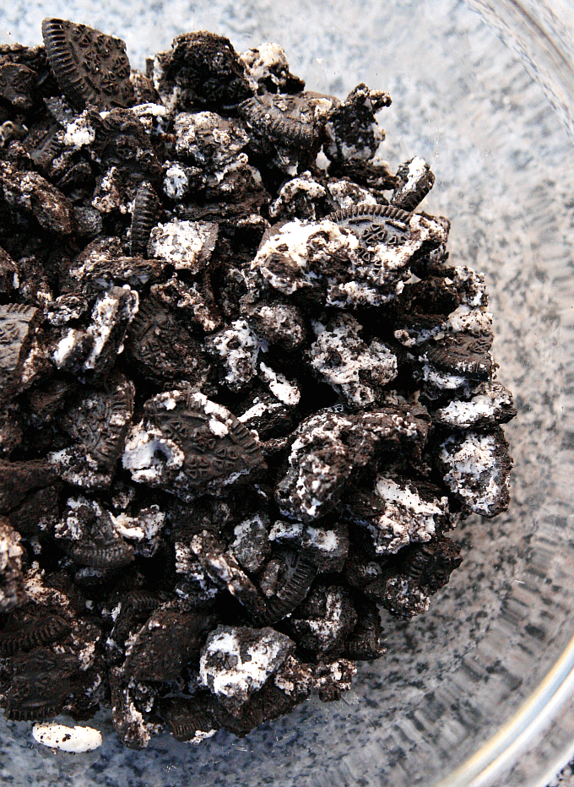
Put 10 Oreos in a bag and crush them up.

Slide 5
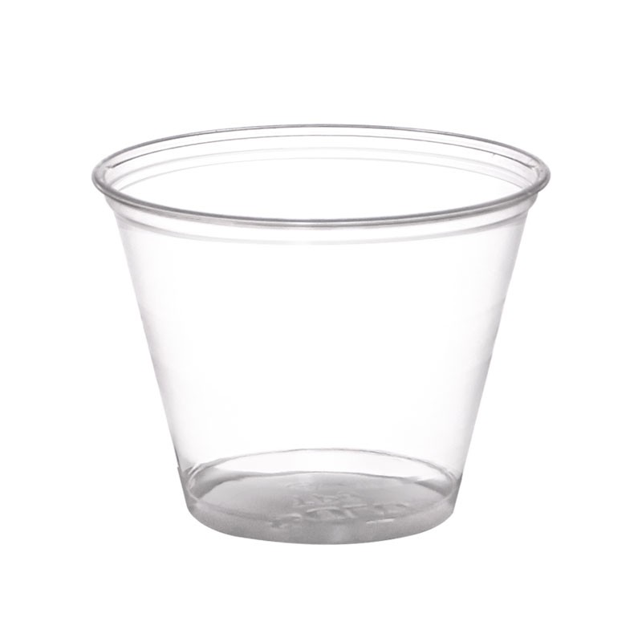
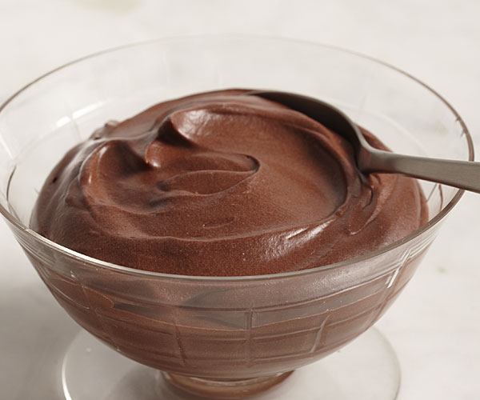
Put a couple of spoonfuls of chocolate pudding
into cups.

Slide 6
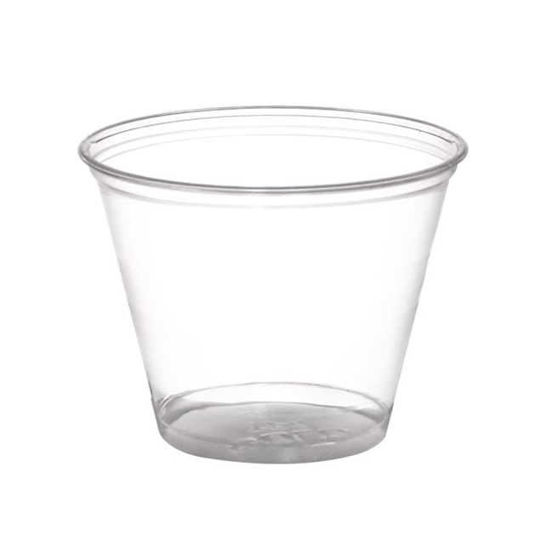
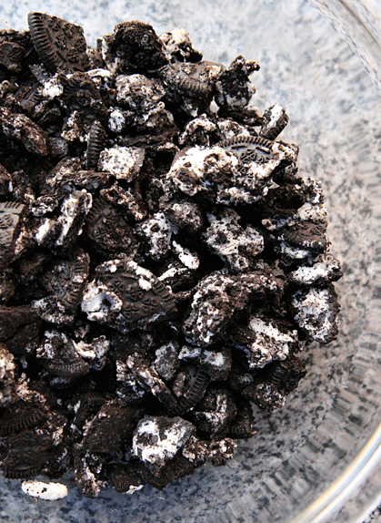
Put some crushed up Oreos on top of the pudding.

Slide 7
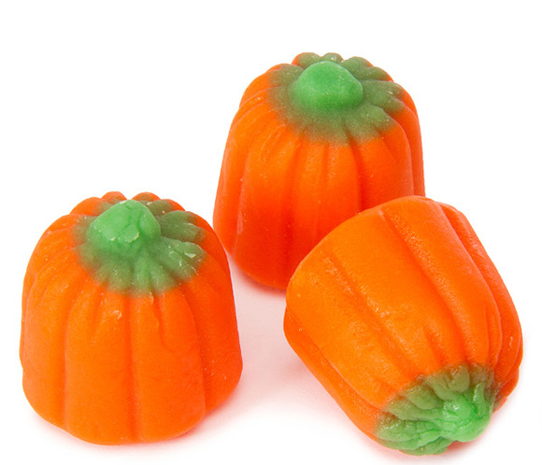
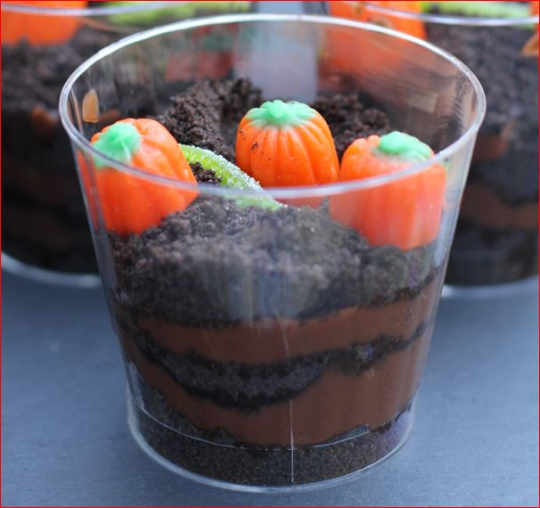
Put 3 pumpkin candies on top.
Eat and enjoy!

