Slide 1
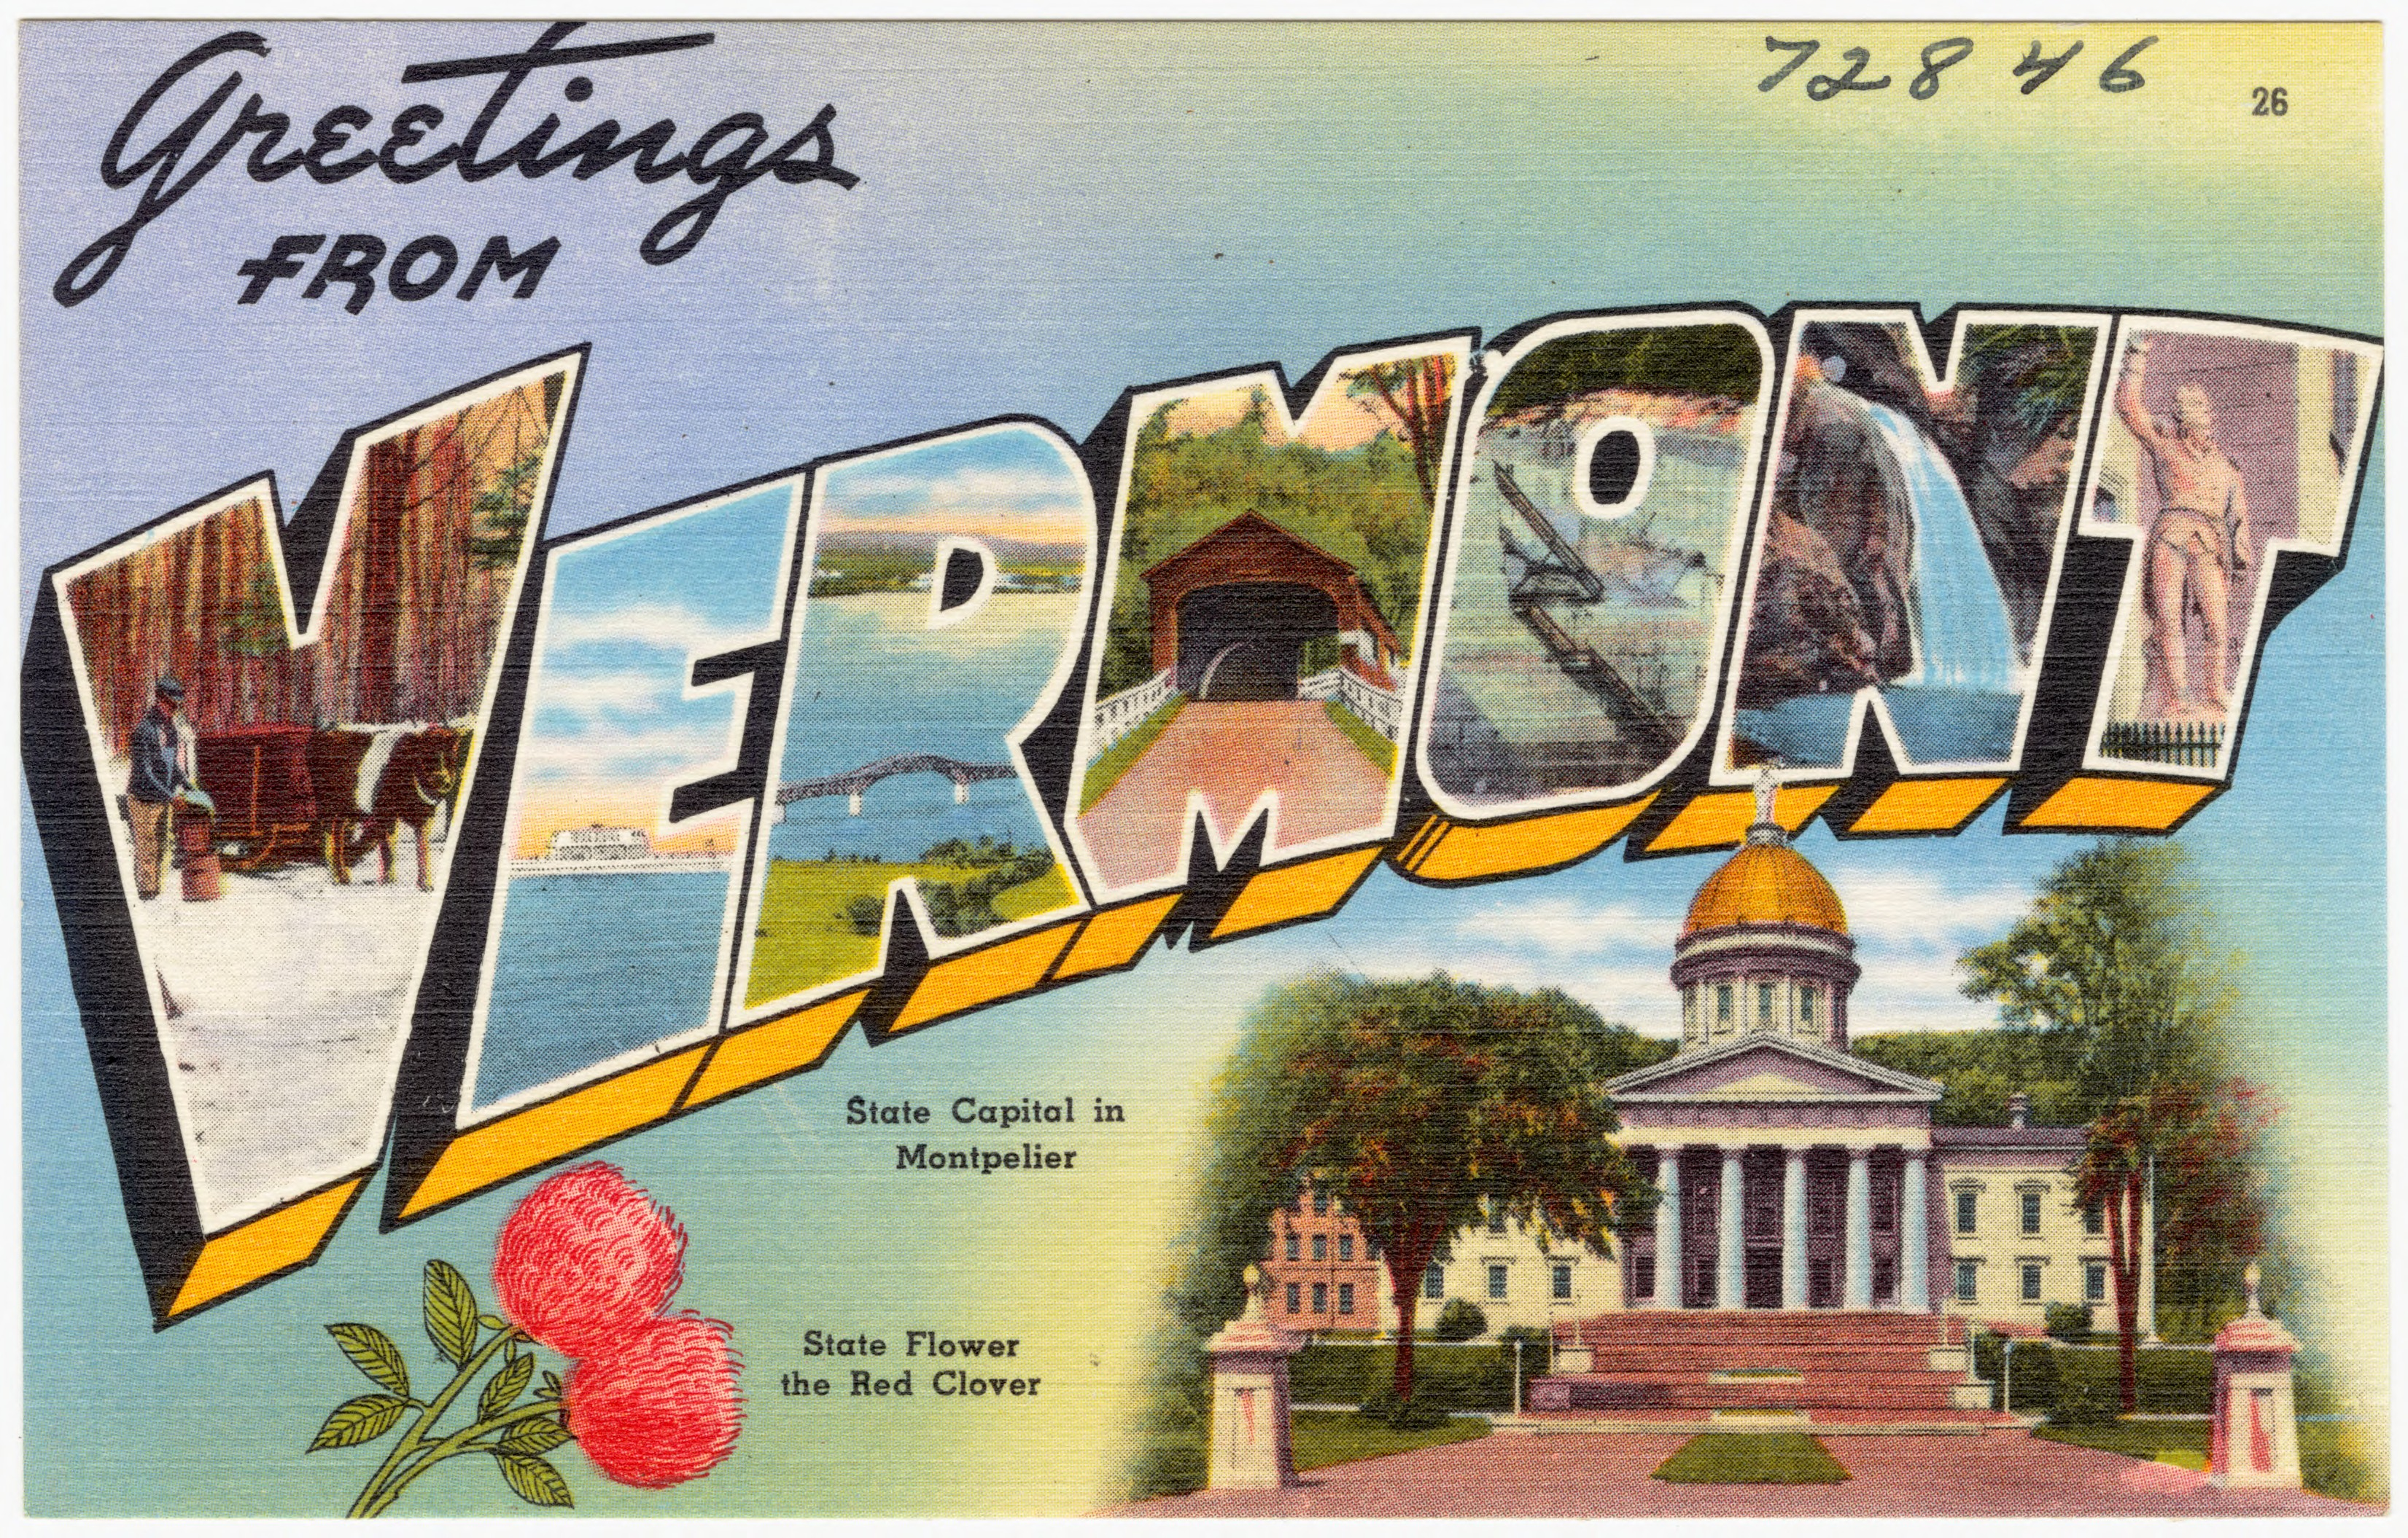
Let’s Learn About Vermont
By: Cara Edenfield and Joy Delaney
Groupbygroup.wordpress.com

Slide 2
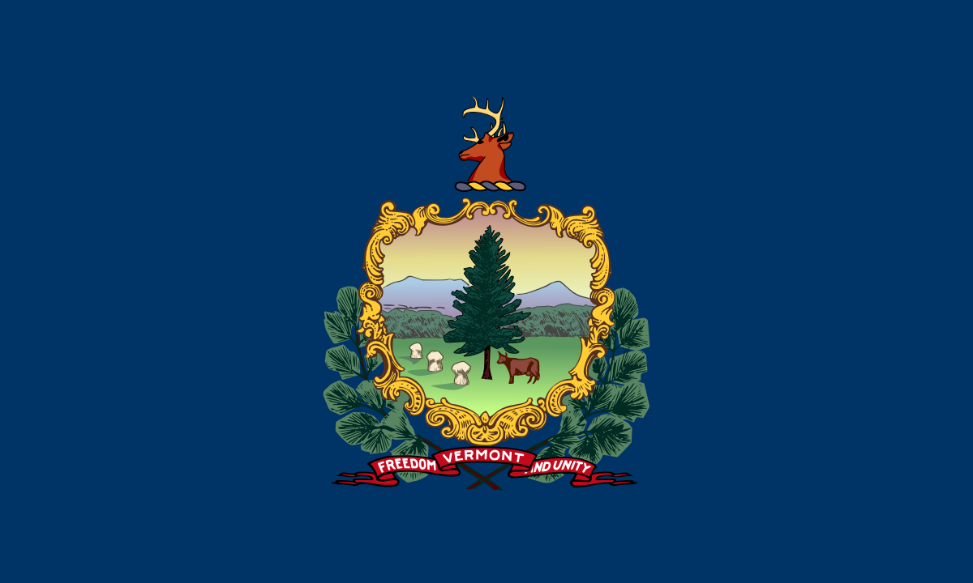
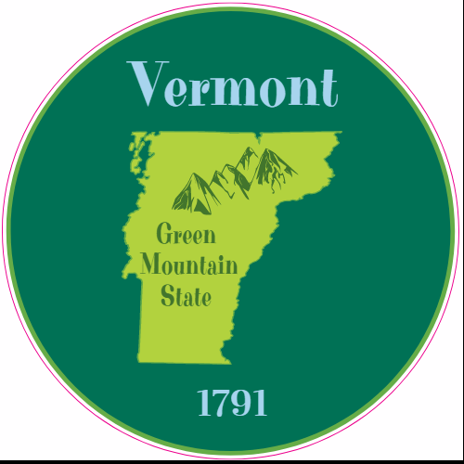
Vermont is a north eastern state in the U.S.
It’s name is derived from two French words, vert and mont,
meaning “green mountain”.
Let’s learn about Vermont.

Slide 3
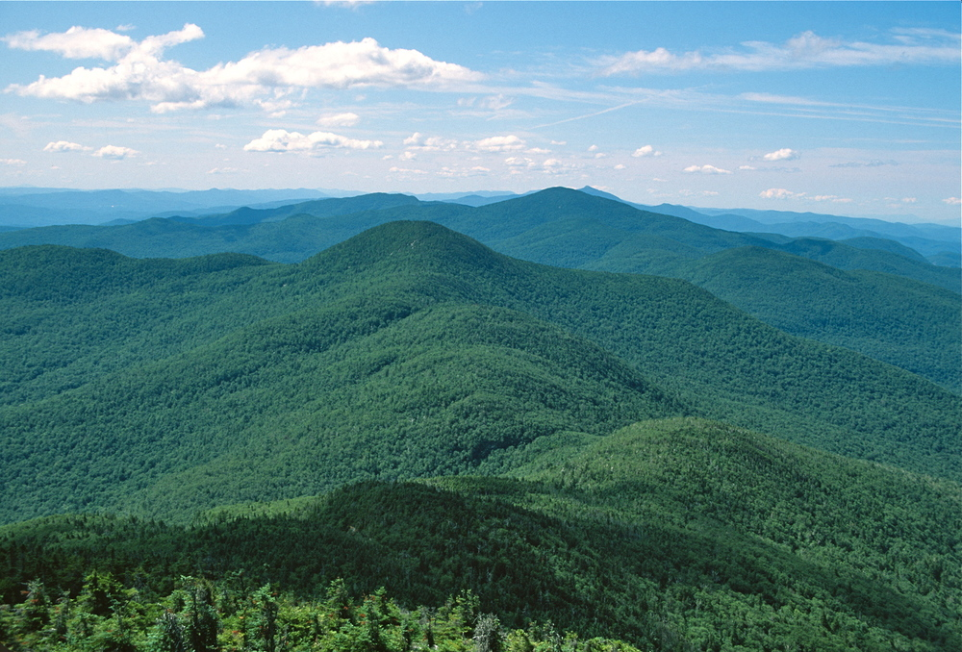
In the center of the state, the most famous range is the
Green Mountains. Formed over 400 million years ago,
the rocks are thought to be some of the oldest in the world.
Let’s learn about Vermont.

Slide 4
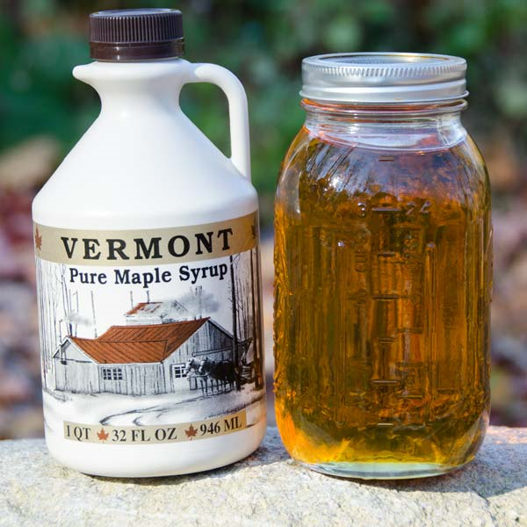
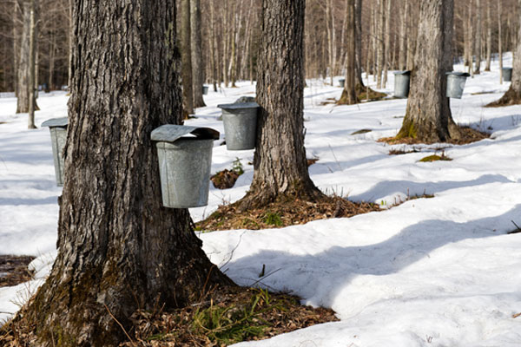
Vermont is the number one producer of maple syrup in the U.S.,
producing over 500,000 gallons a year!
Let’s learn about Vermont.

Slide 5
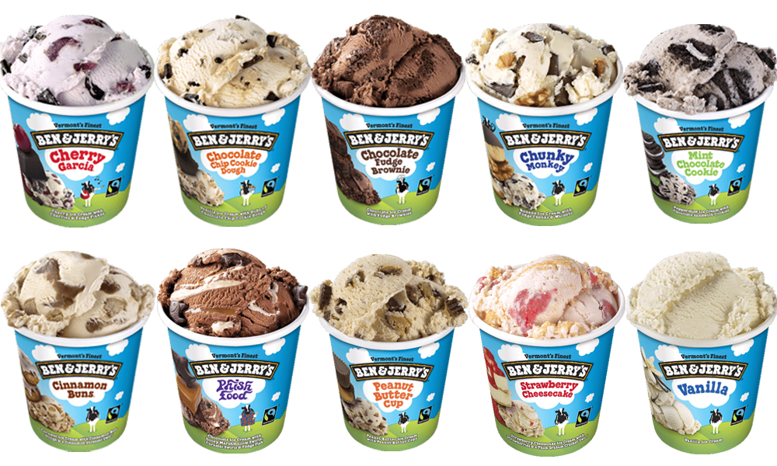
The popular ice cream, Ben & Jerry’s,
was founded in 1978 in Burlington, Vermont.
Let’s learn about Vermont.

Slide 6
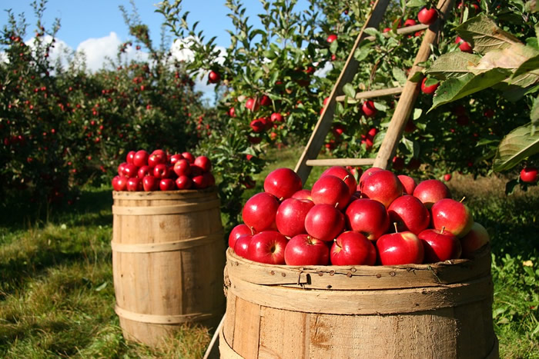
The state fruit of Vermont is the apple.
Let’s learn about Vermont.

Slide 7
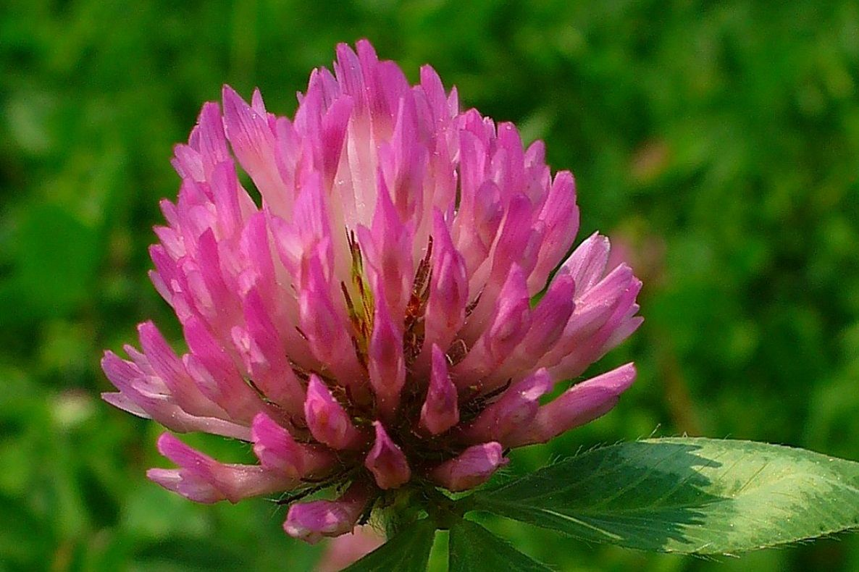
The state flower of Vermont is the red clover.
Let’s learn about Vermont.

Slide 8
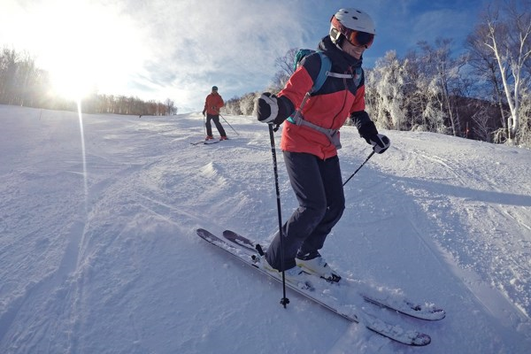
Vermont is a winter destination with something for skiers and
snowboarders of all levels.
Let’s learn about Vermont.

Slide 9
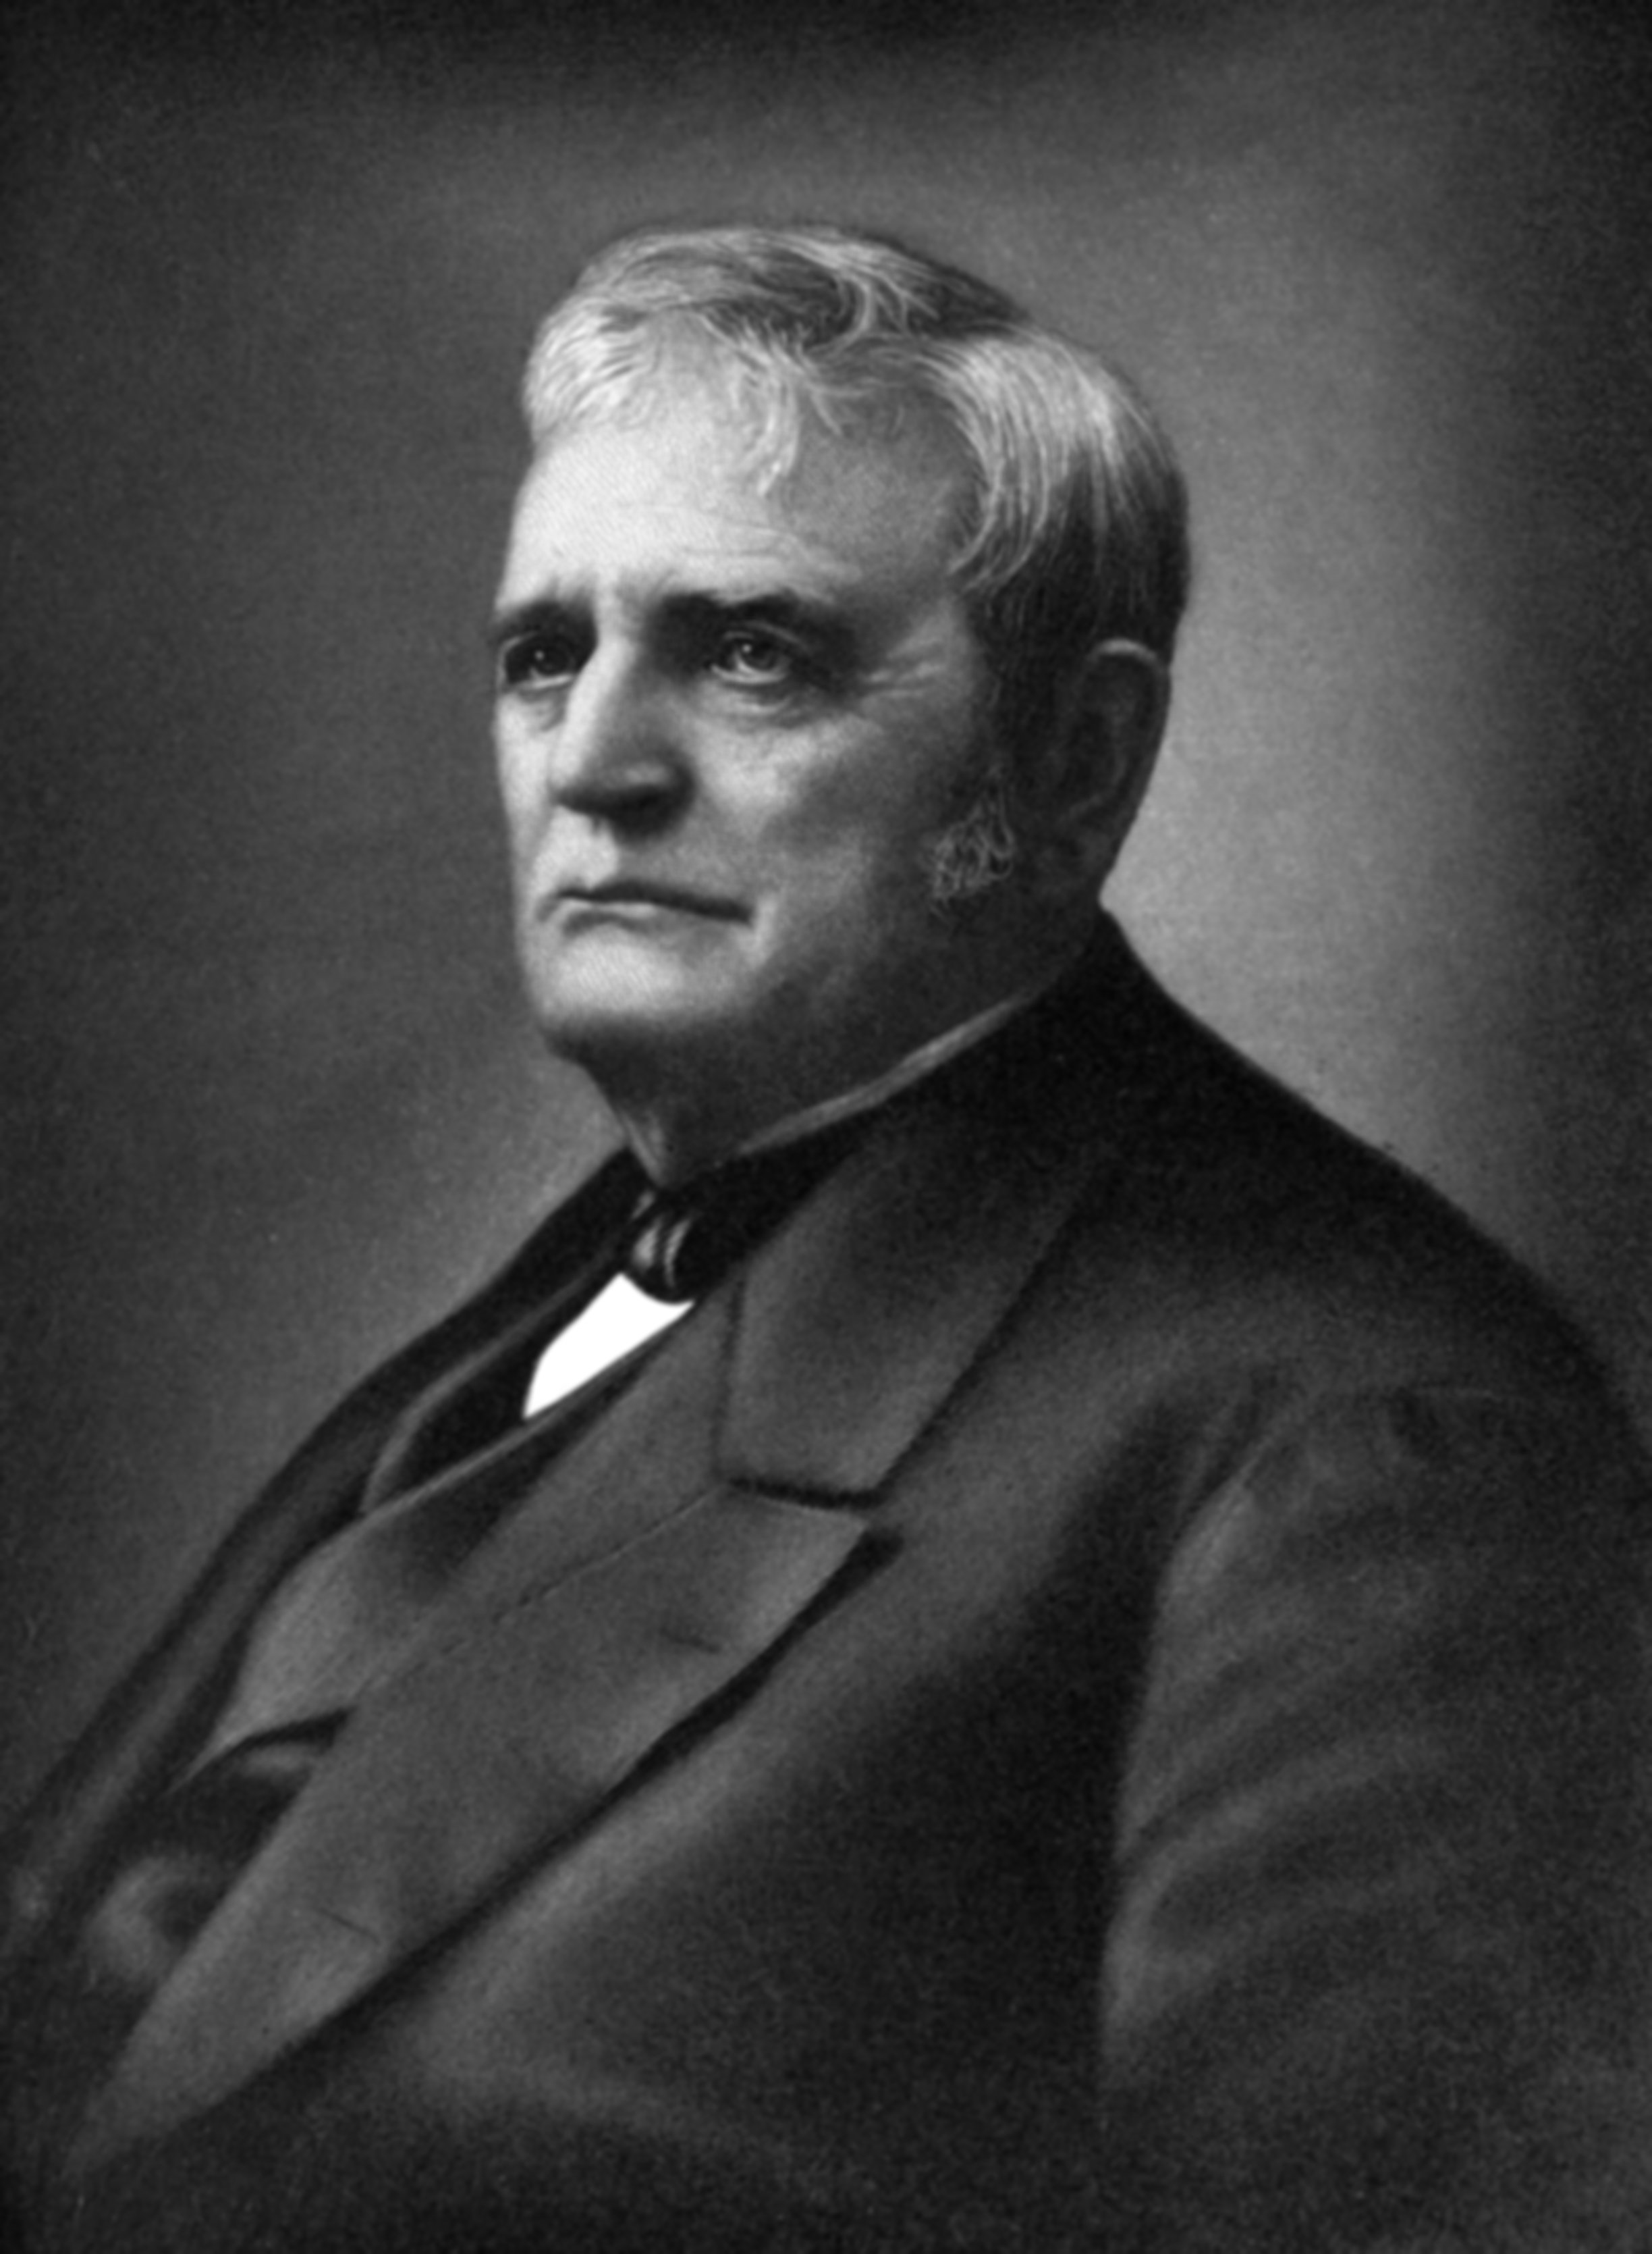
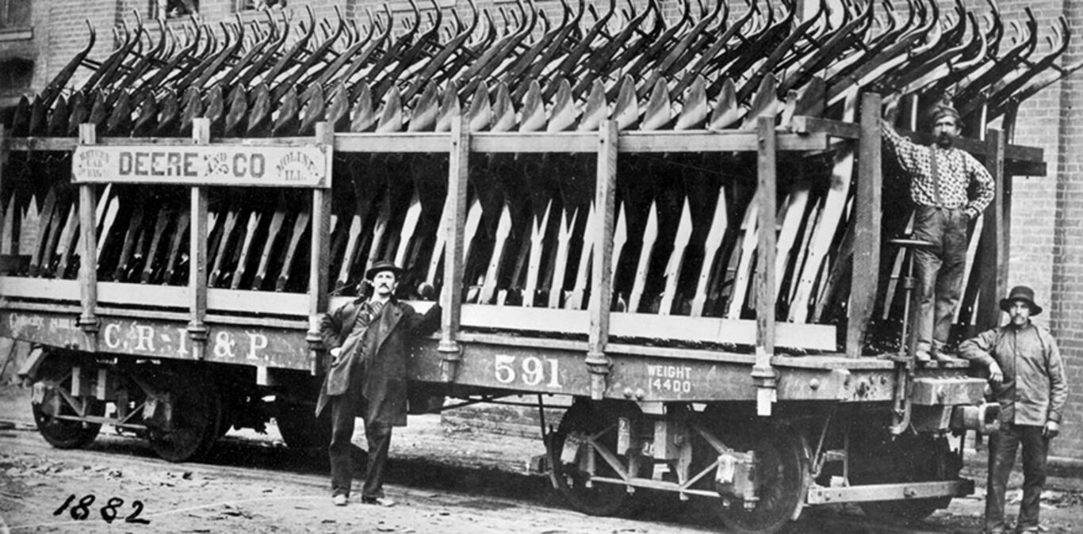
John Deere, who developed the first commercially successful,
self-scouring steel plow, was born in Vermont in 1804.
Let’s learn about Vermont.

Slide 10
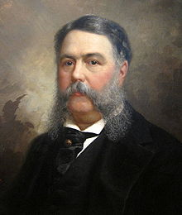
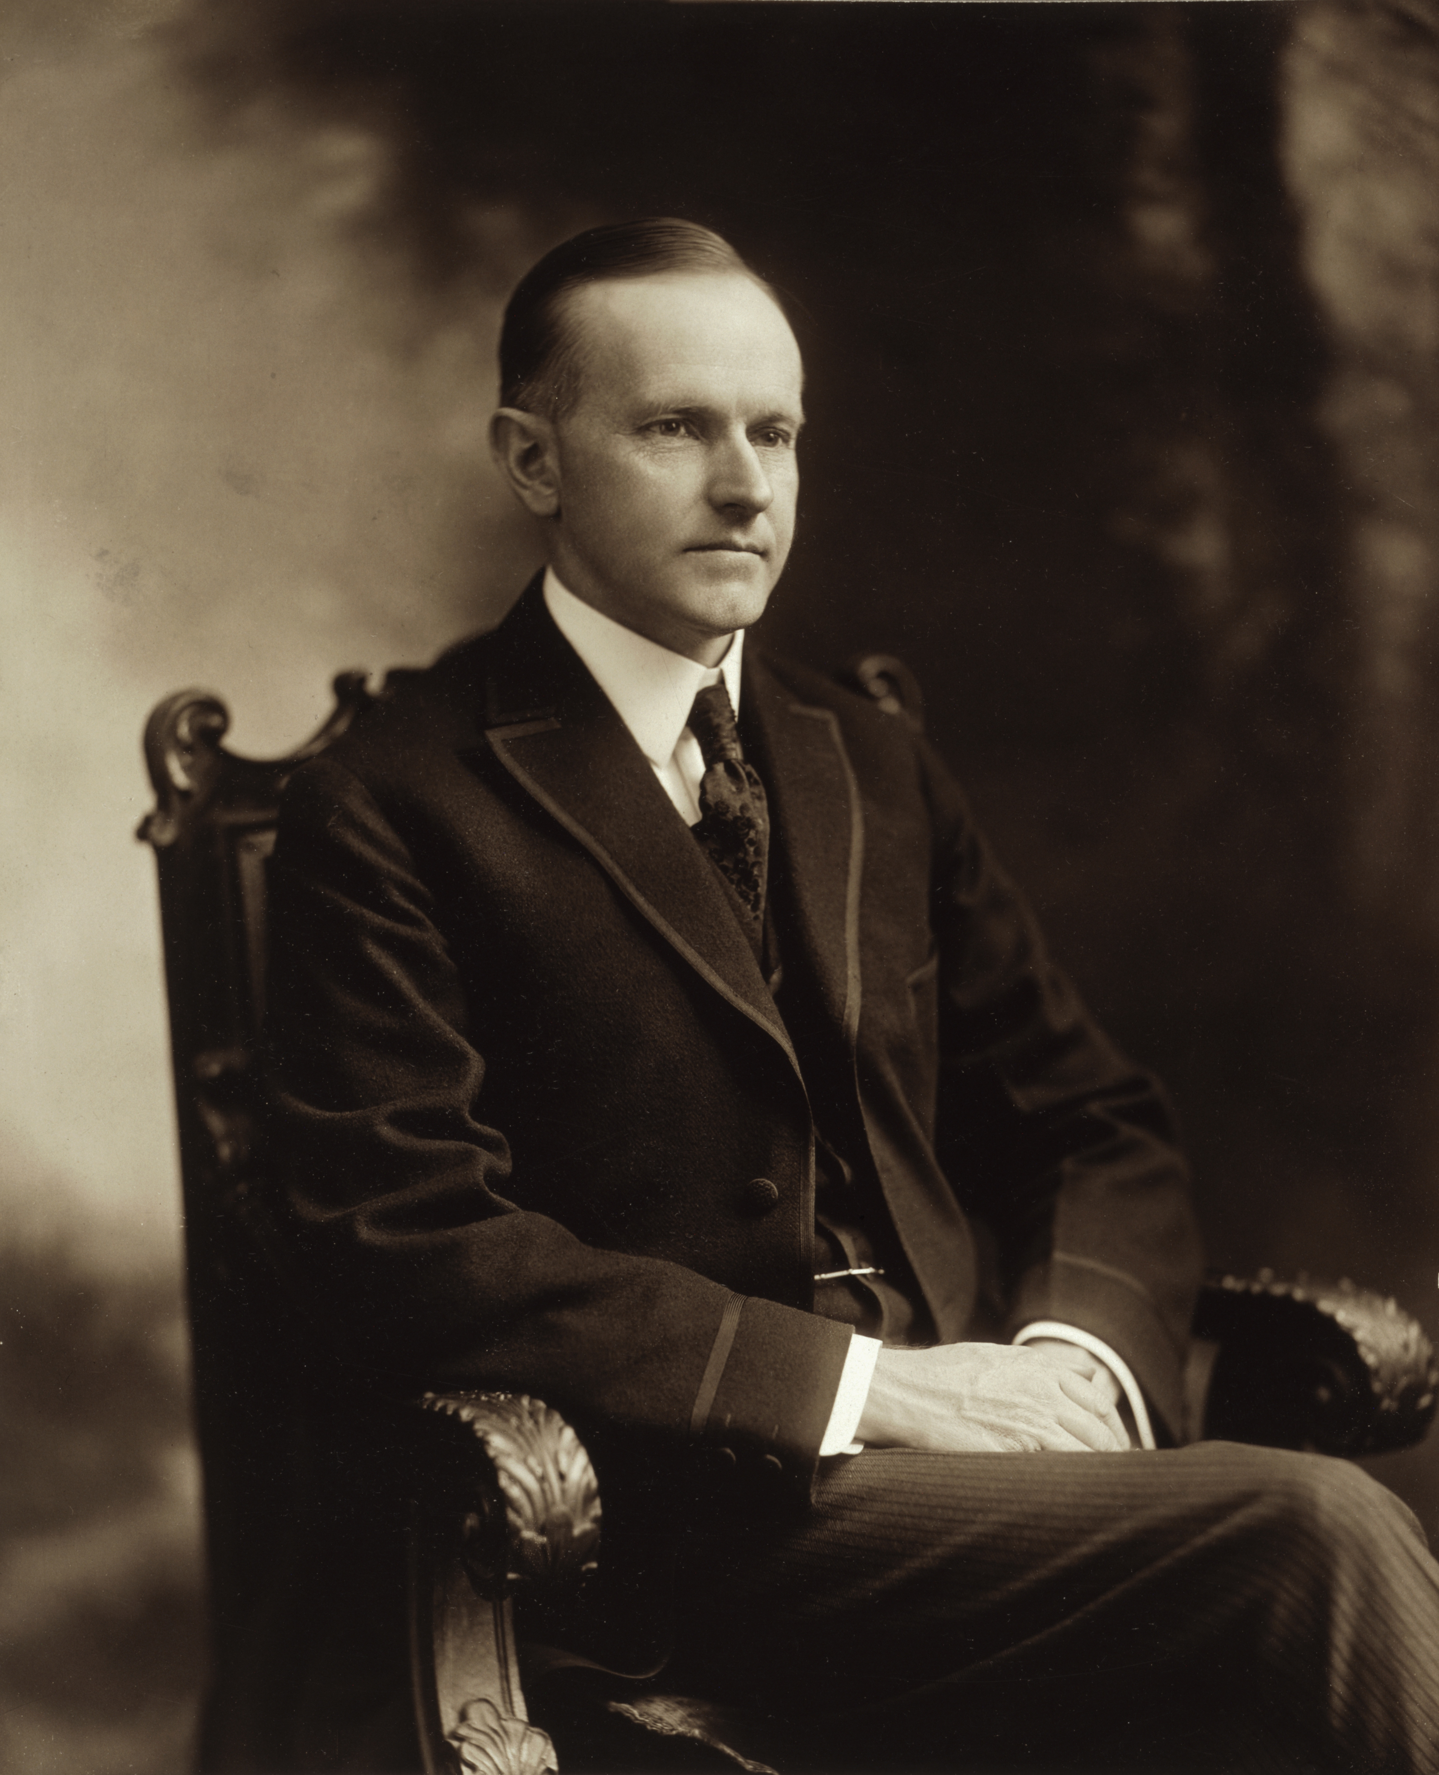
Two U.S. Presidents are from Vermont:
Chester A. Arthur (21st President) and
Calvin Coolidge (30th President).
Let’s learn about Vermont.

Slide 11
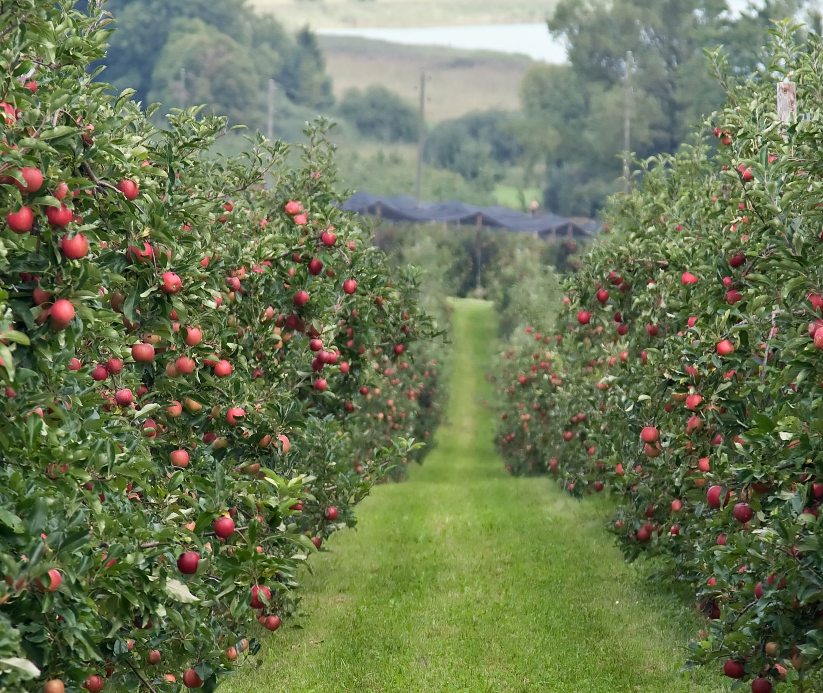
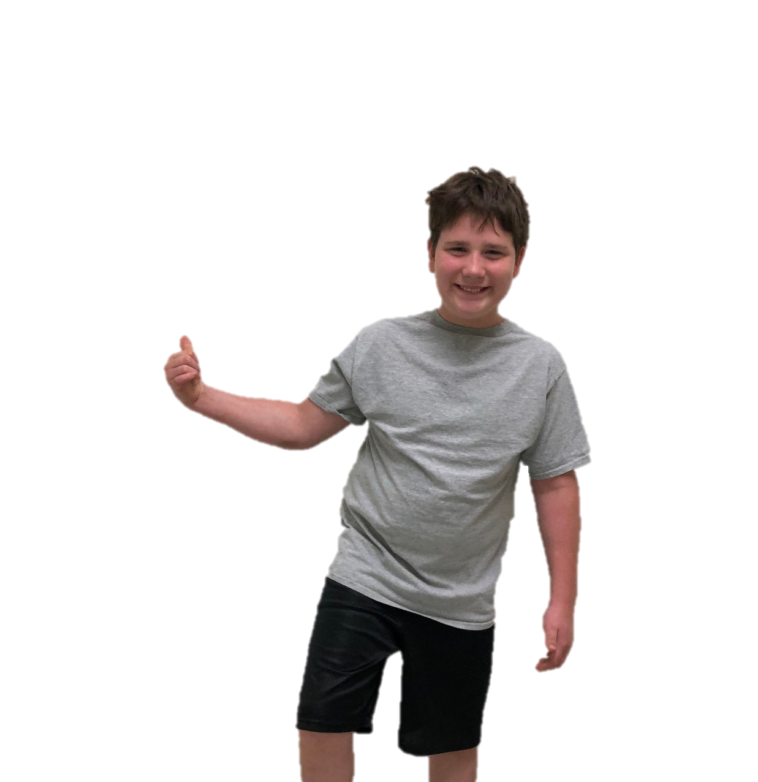
The End

