Slide 1
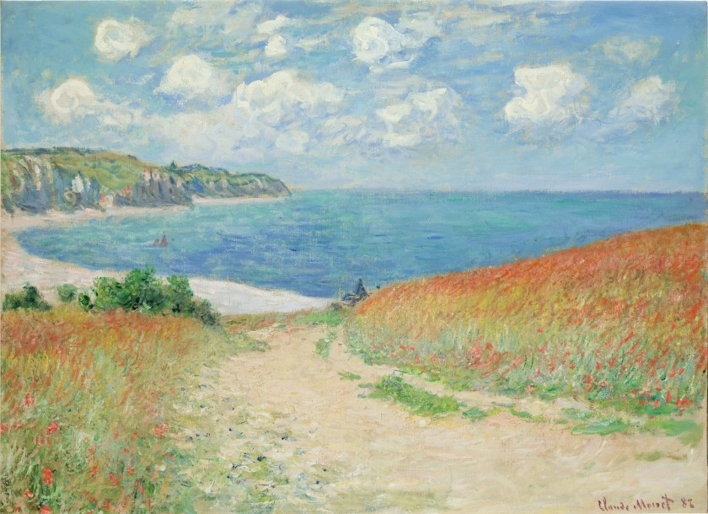
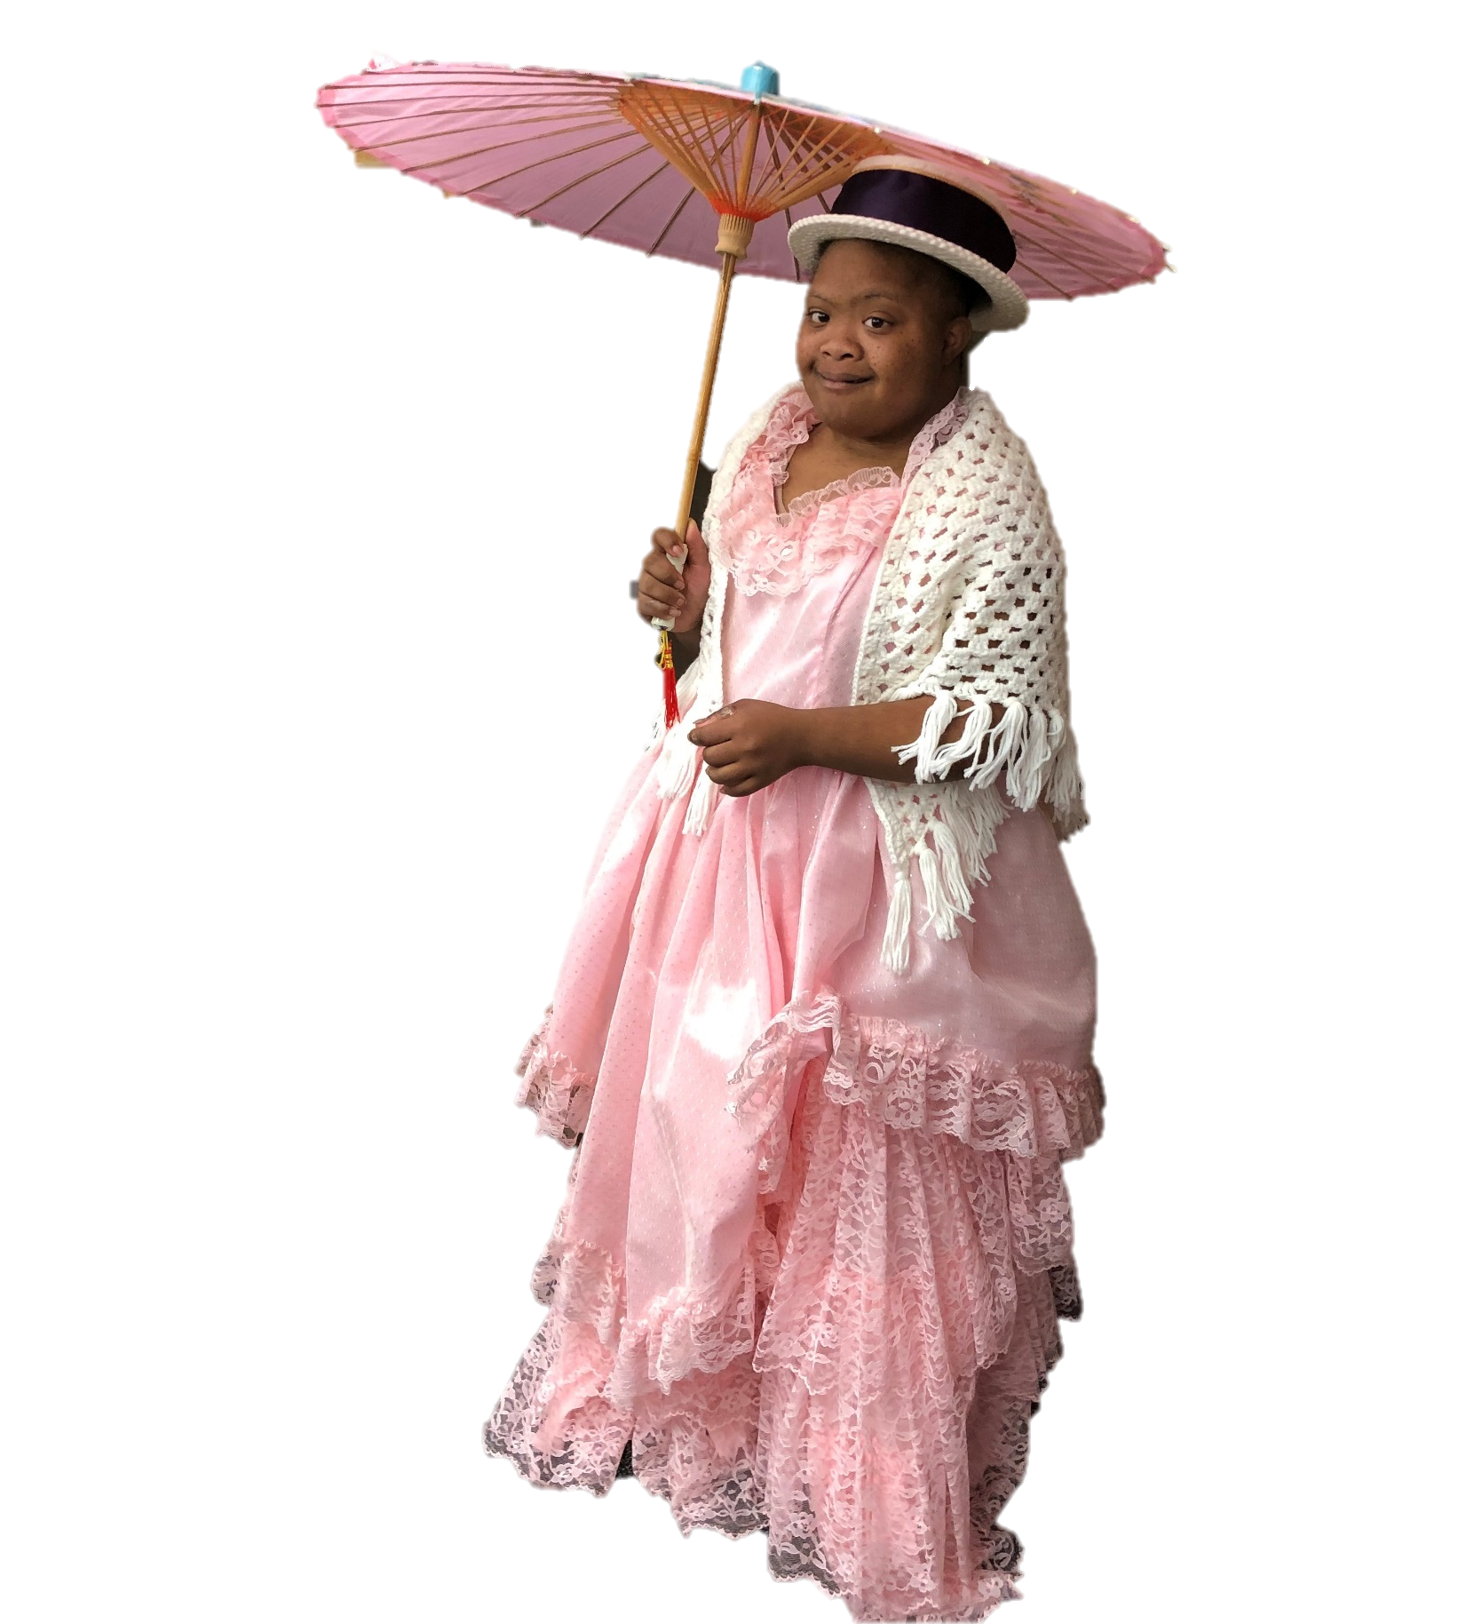
Let’s Learn About Monet
By: Cara Edenfield and Joy Delaney
Groupbygroup.wordpress.com

Slide 2
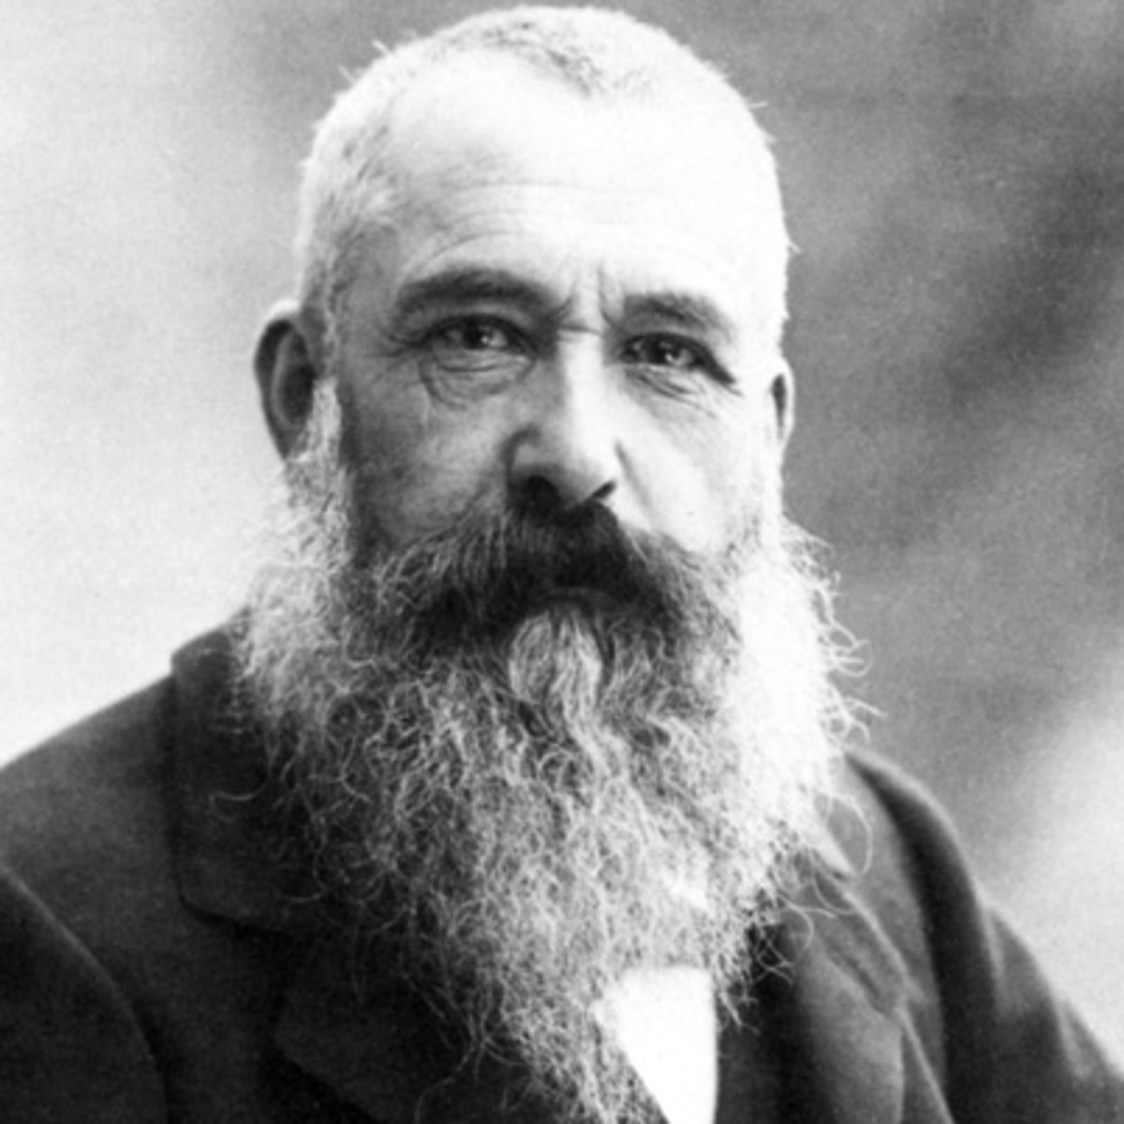
Claude Monet was a famous painter.
He was born in Paris, France in 1840.
Let’s learn about Monet

Slide 3
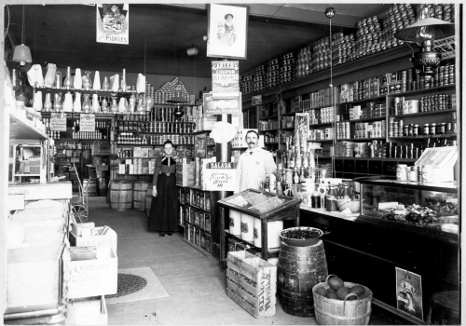
Monet entered a school for the arts.
His mother supported his becoming an artist, but his father
wanted him to take over the family grocery business.
Let’s learn about Monet

Slide 4
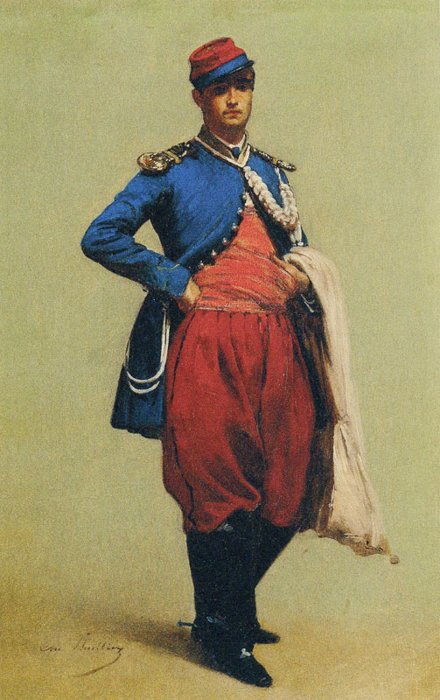
In 1861 Monet was elected for military service and
served as a soldier in Algeria for 2 years until he got
sick with typhoid fever and left the army.
Let’s learn about Monet

Slide 5
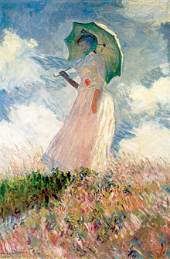
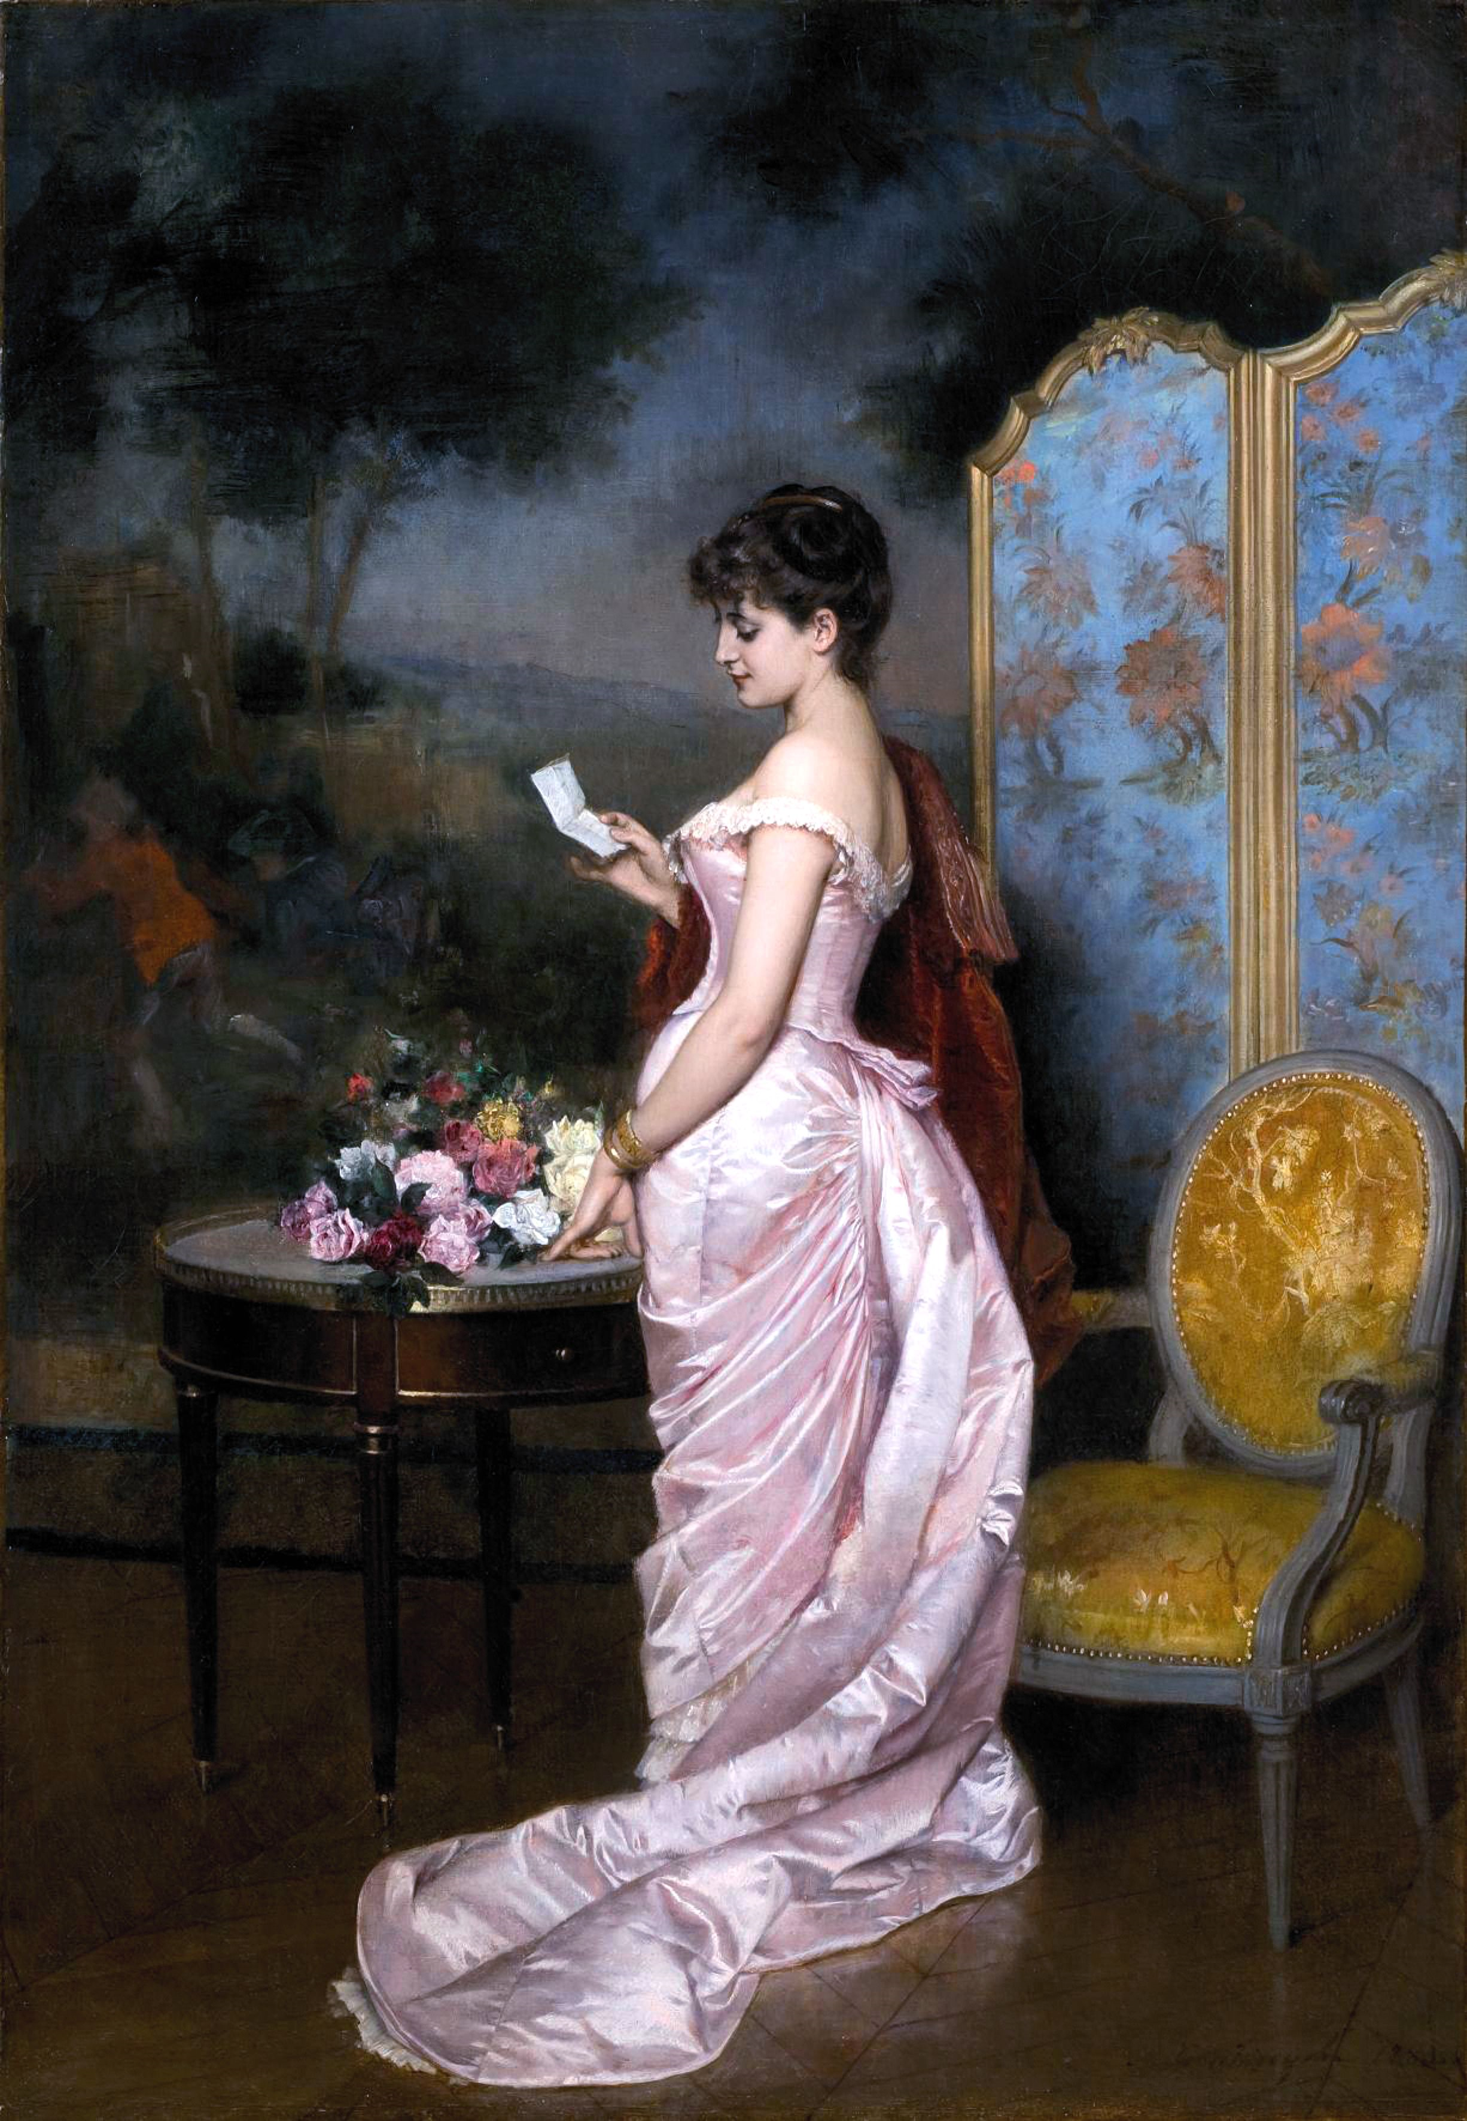
Monet liked to paint outdoor scenes.
He wanted to experiment with art and not do the same
classical art that art critics of Paris wanted.
Let’s learn about Monet

Slide 6
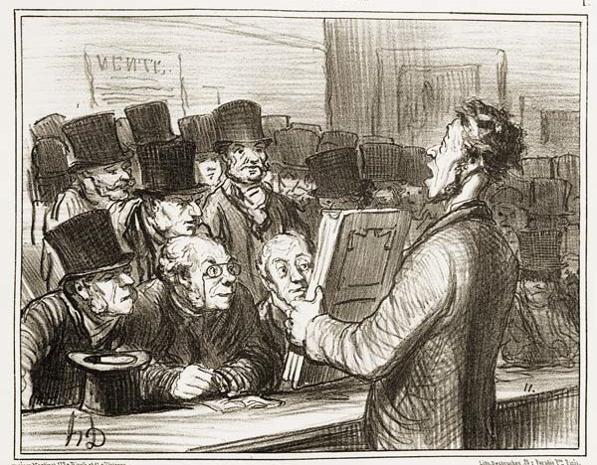
A critic used the term “impressionist” to imply that Monet’s
art was just an impression of something and not completed.
It was meant as an insult.
Let’s learn about Monet

Slide 7
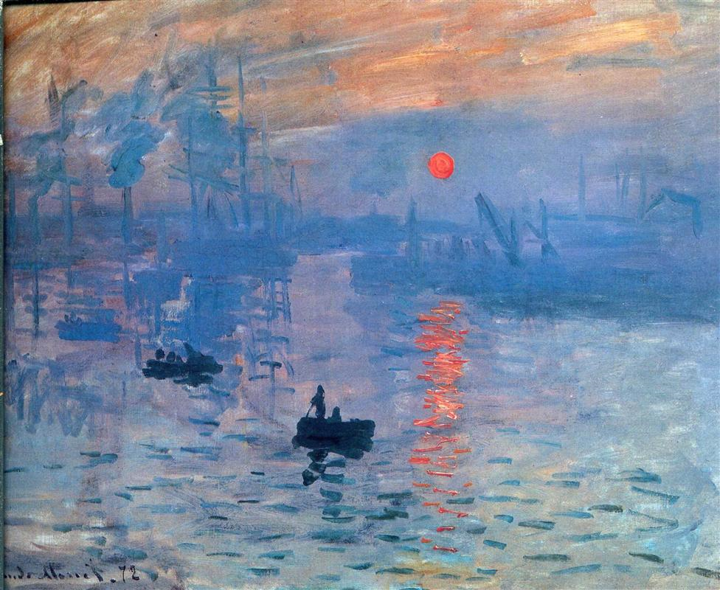
The critic got the word "impression" from one of Monet's works.
It is called Impression: Sunrise. The lighting gives the viewer
the feeling or "impression" that the sun is just rising.
Let’s learn about Monet

Slide 8
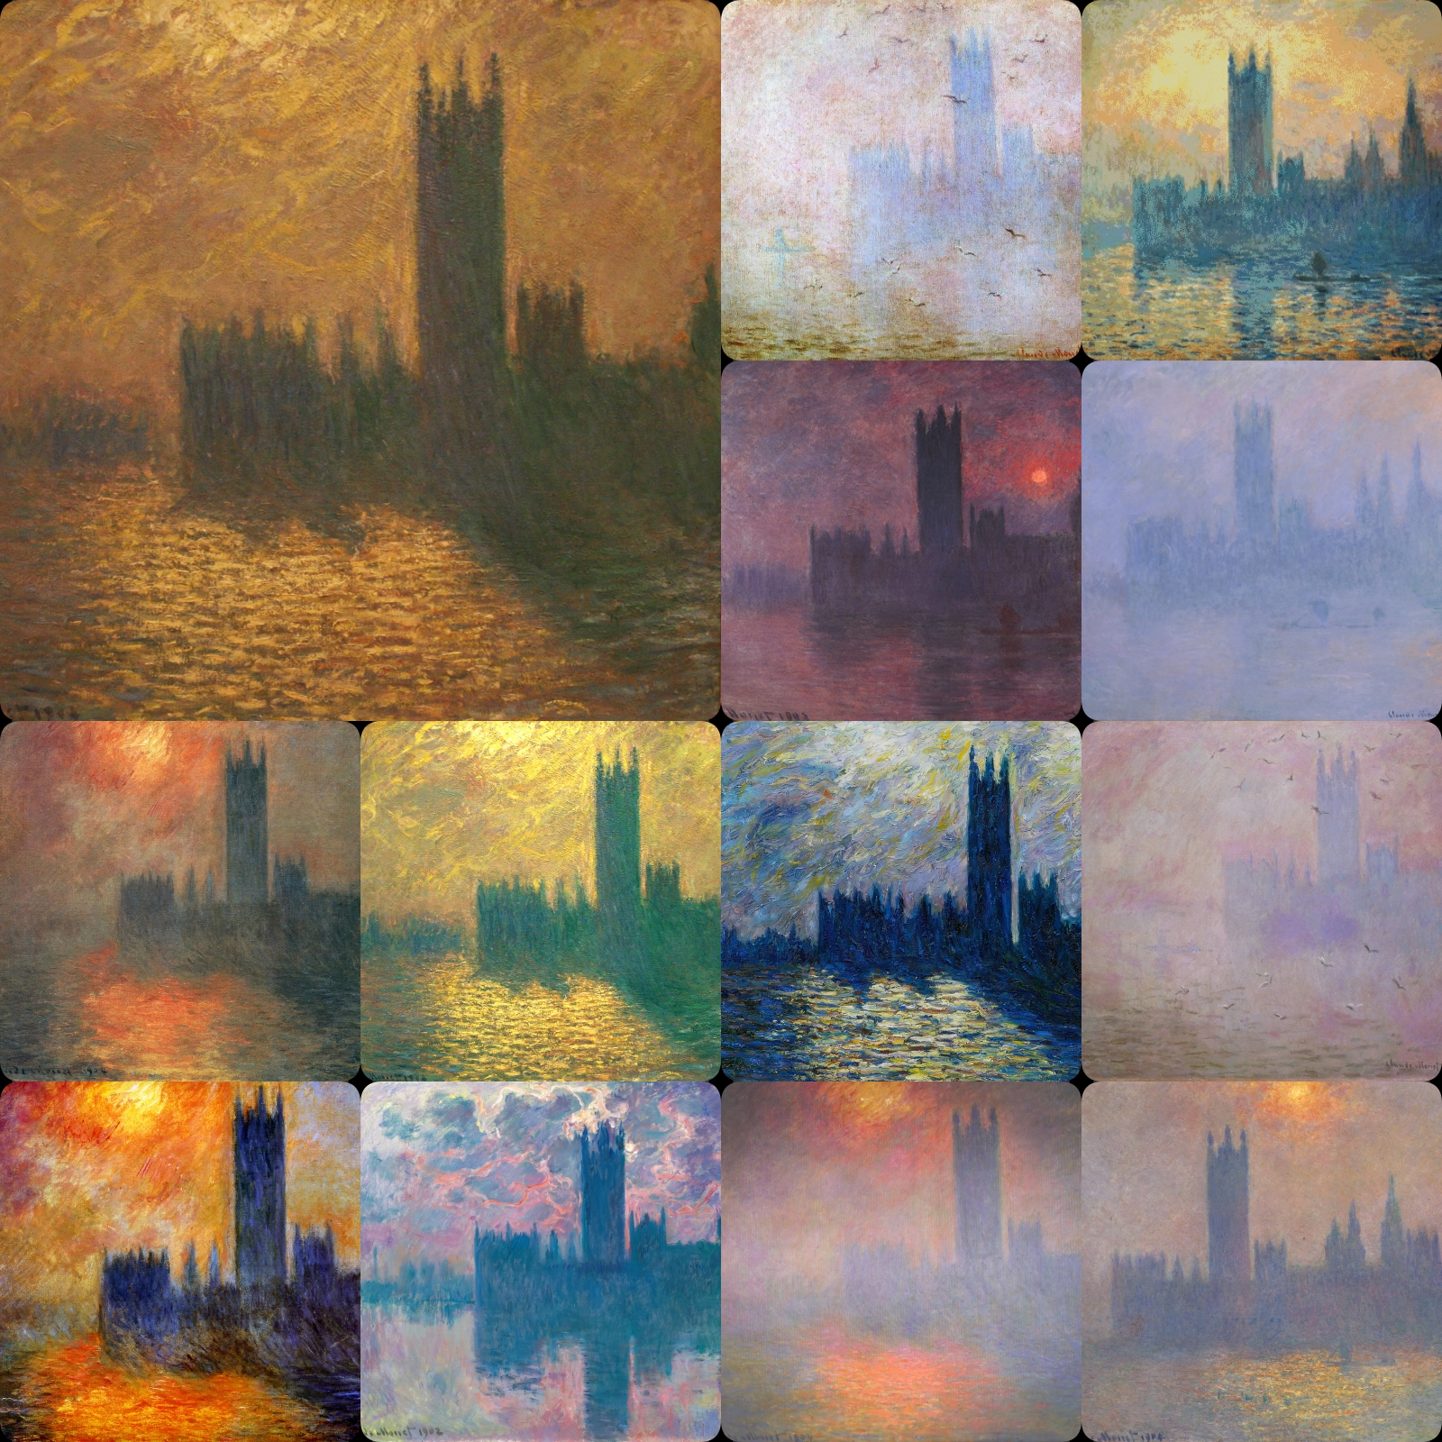
Monet would experiment with light in his art. He began to
paint series of the same scenes at different times of day
and in different types of weather.
Let’s learn about Monet

Slide 9
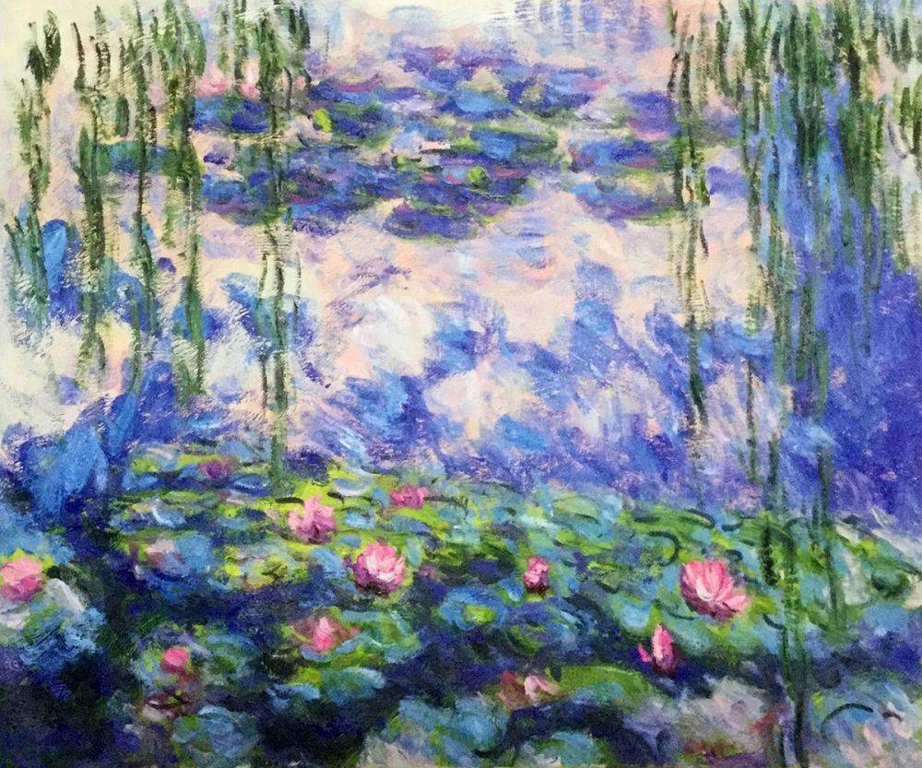
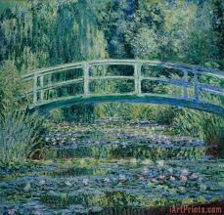
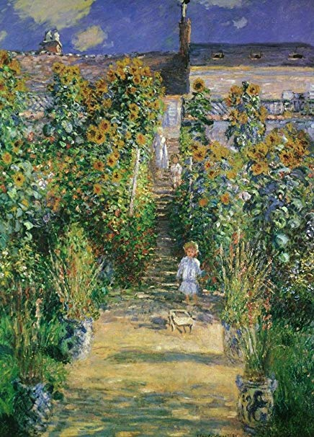
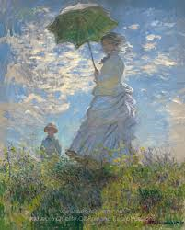
Claude Monet is still considered
one of the great French artists of all time.
Let’s learn about Monet

Slide 10
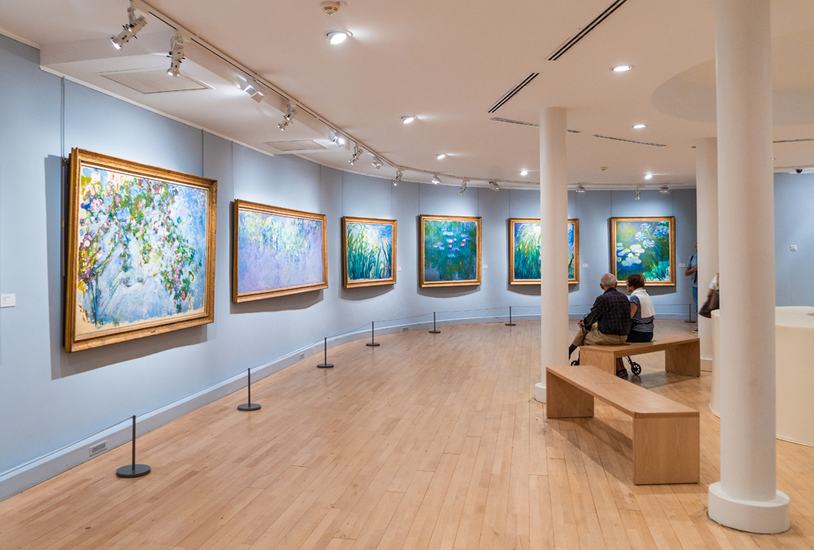
The End

