Slide 1
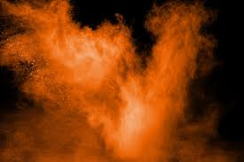
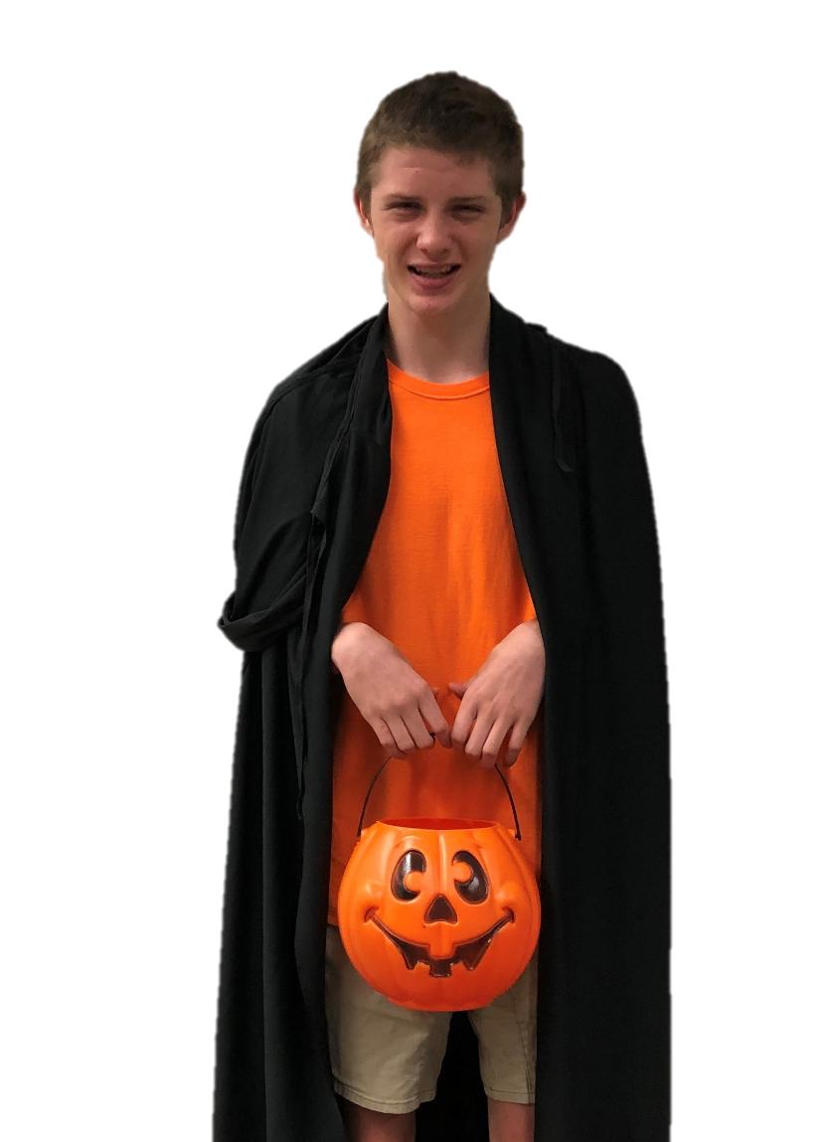
I Can Look For Orange And Black
By: Cara Edenfield and Joy Delaney
Groupbygroup.wordpress.com

Slide 2
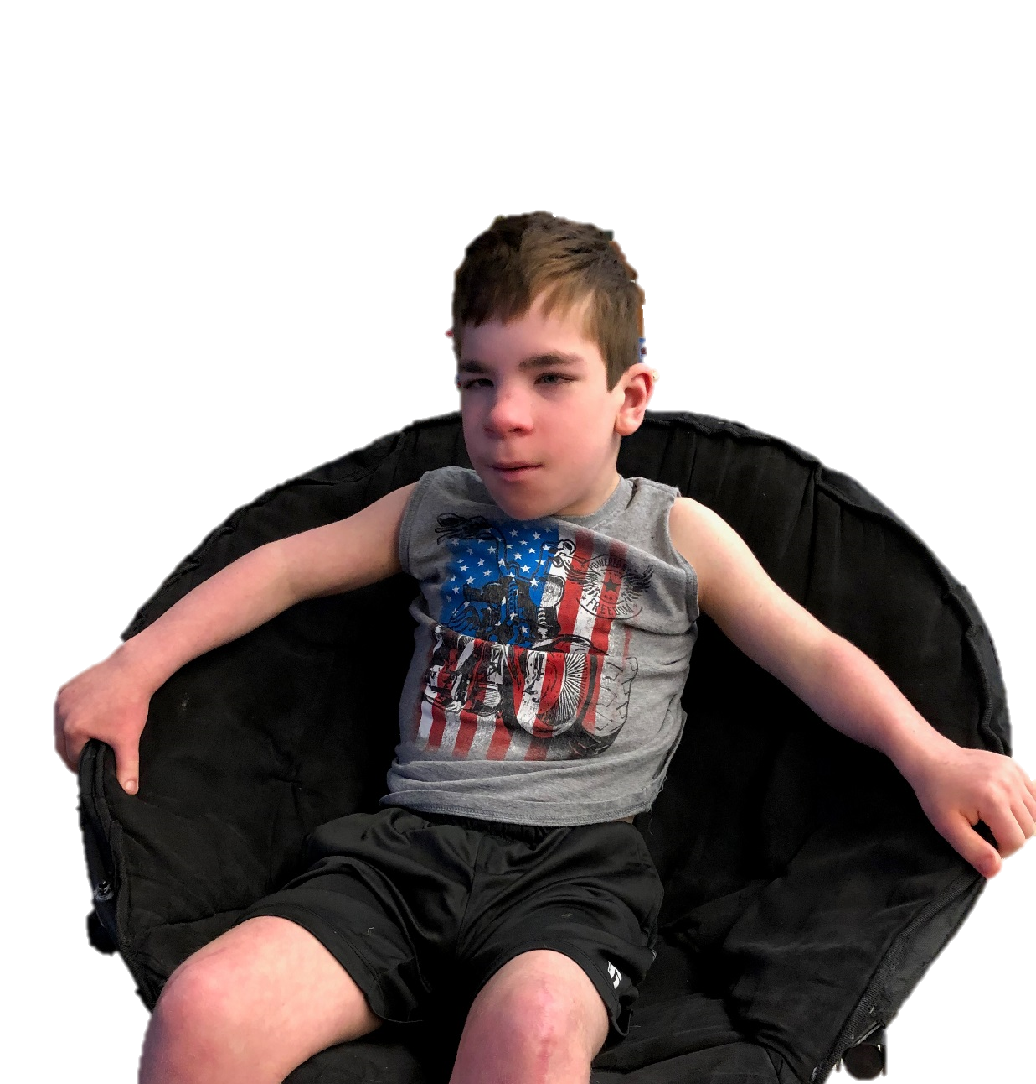
I see a black chair.
I can look for orange and black.

Slide 3
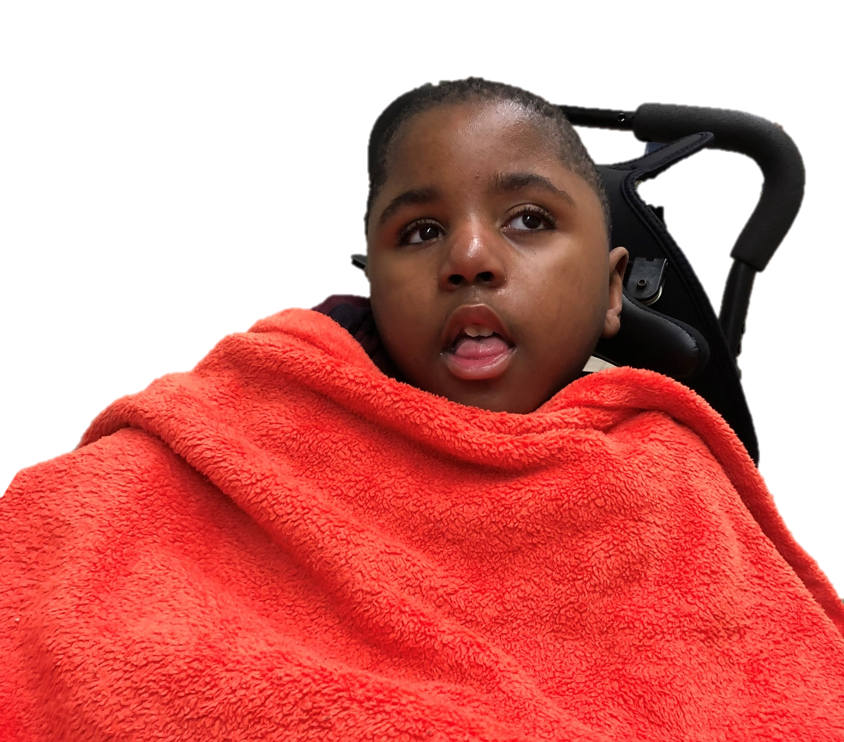
I see an orange blanket.
I can look for orange and black.

Slide 4
I see a black hat.
I can look for orange and black.

Slide 5
I see an orange shirt.
I can look for orange and black.

Slide 6
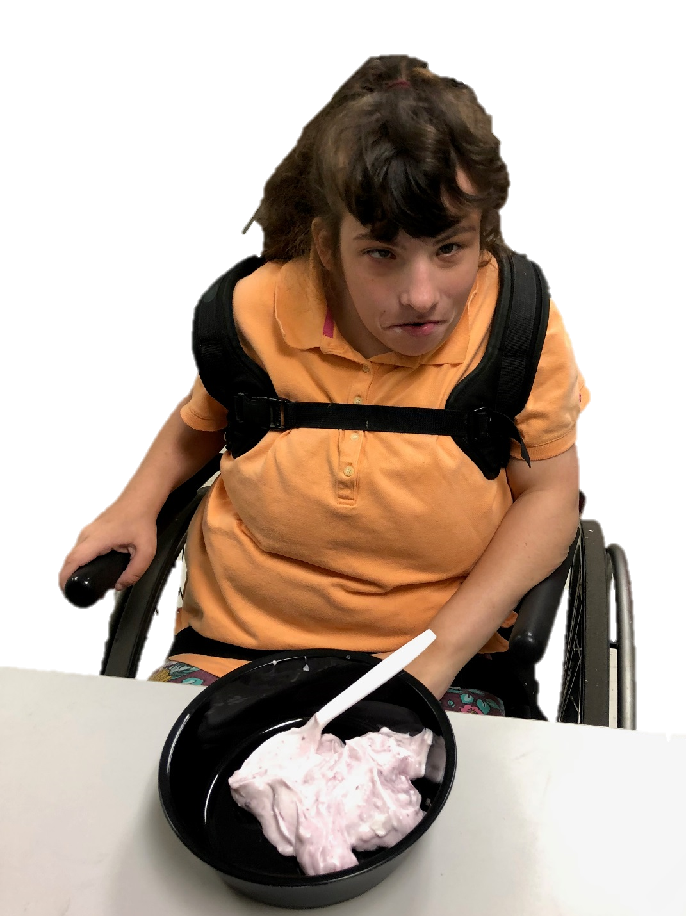
I see a black plate.
I can look for orange and black.

Slide 7
I see an orange cup.
I can look for orange and black.

Slide 8
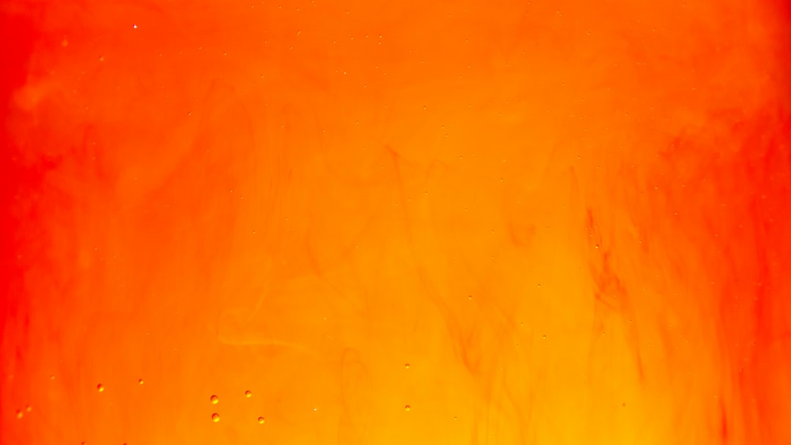
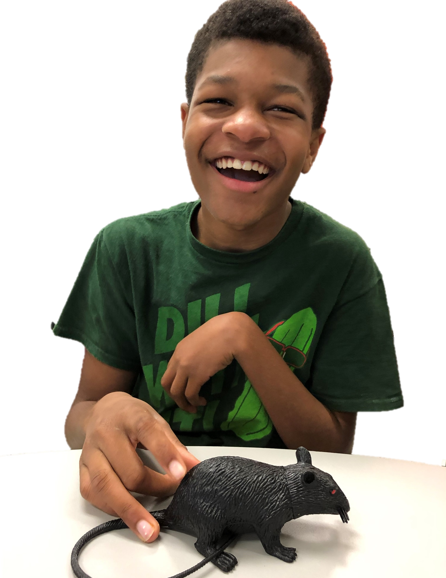
I see a black rat.
I can look for orange and black.

Slide 9
I see an orange pumpkin.
I can look for orange and black.

Slide 10
The End

