Slide 1
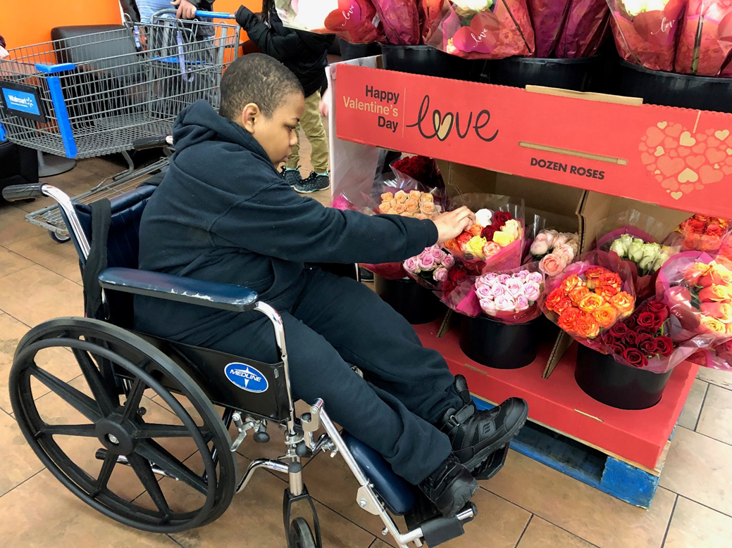
Let’s Show Random Acts of Kindness
By: Cara Edenfield and Joy Delaney
Groupbygroup.wordpress.com

Slide 2
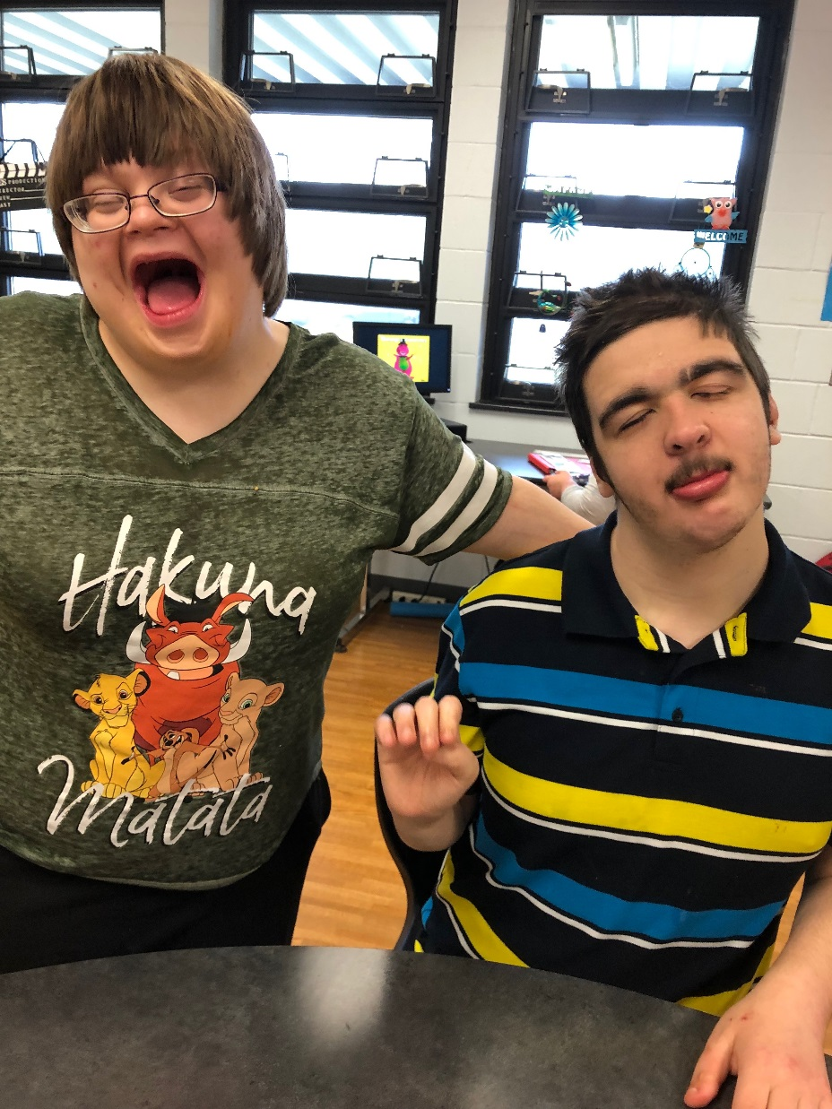
You can smile at someone.
Let’s show random acts of kindness.

Slide 3
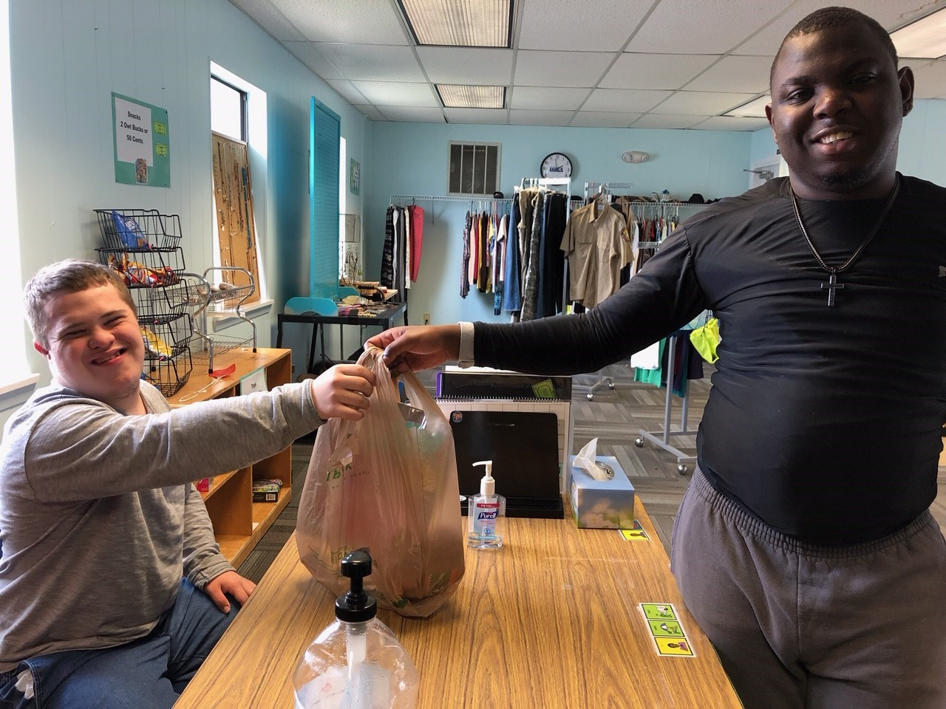
You can buy someone a gift.
Let’s show random acts of kindness.

Slide 4
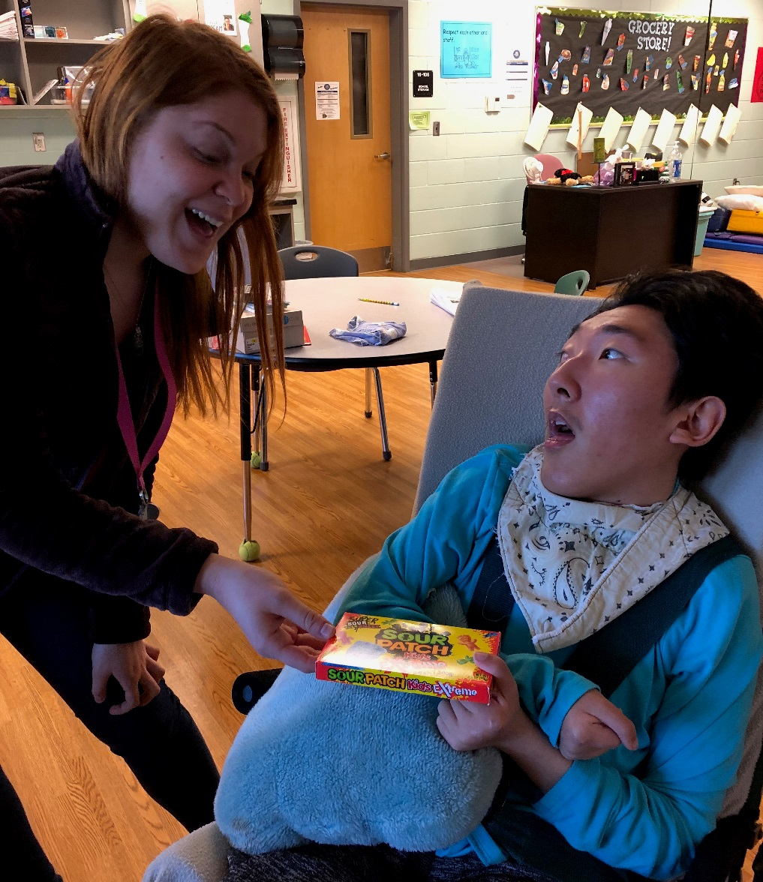
You can give candy to someone.
Let’s show random acts of kindness.

Slide 5
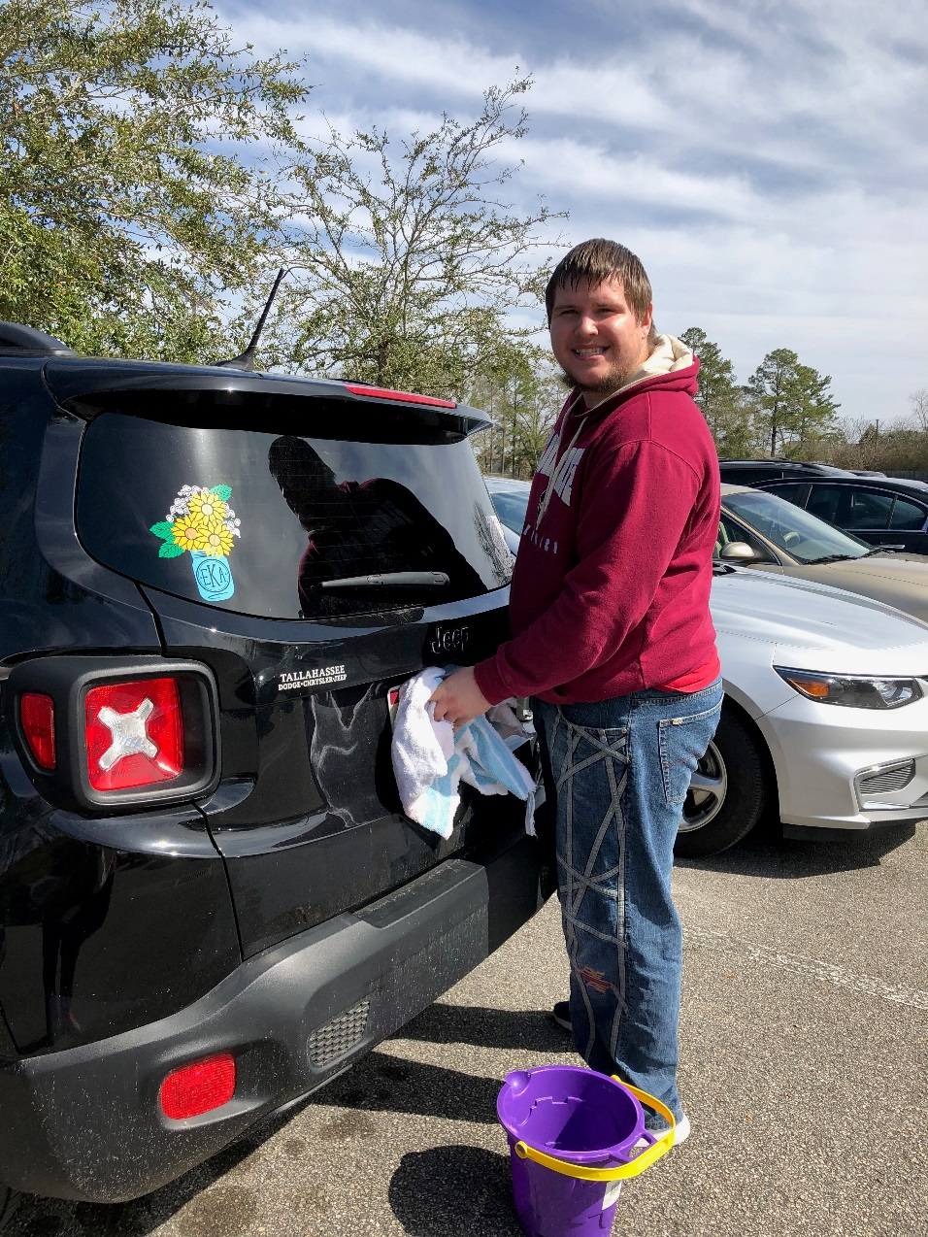
You can wash someone’s car.
Let’s show random acts of kindness.

Slide 6
You can give someone flowers.
Let’s show random acts of kindness.

Slide 7
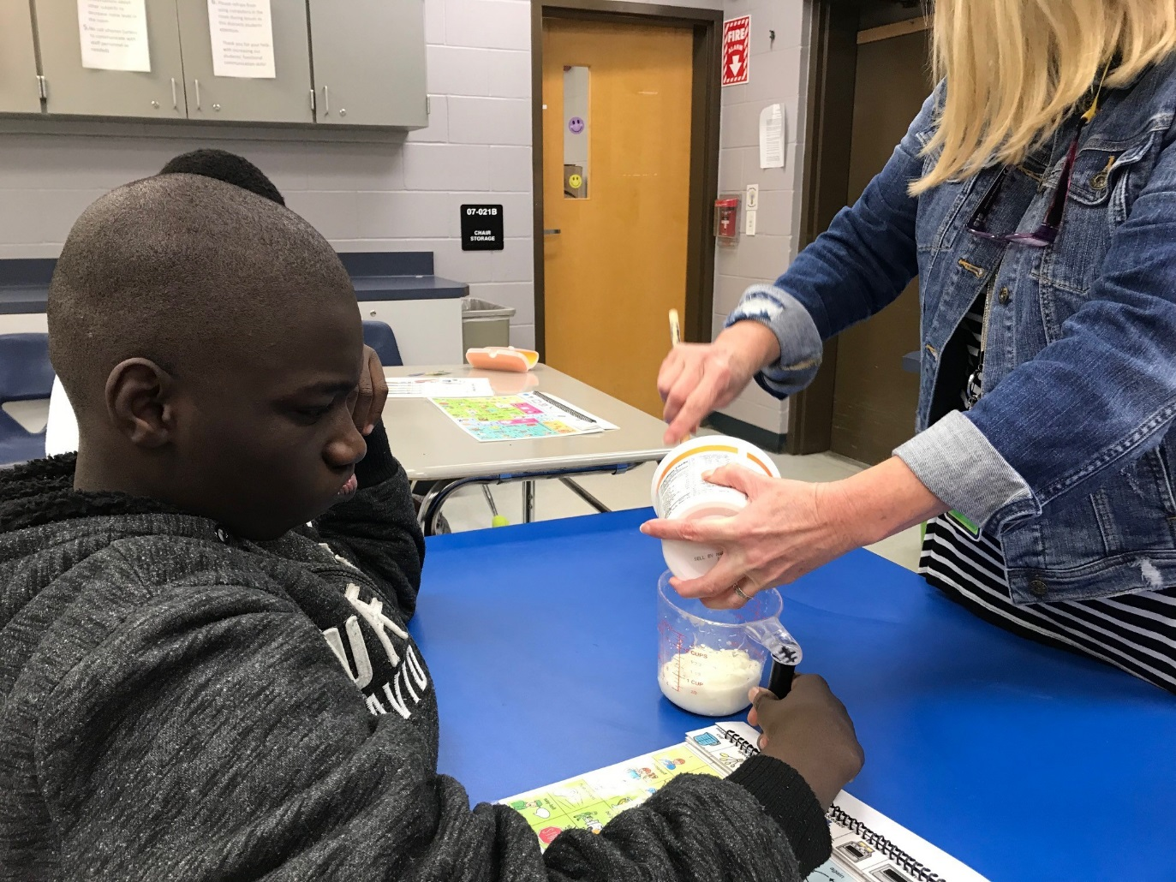
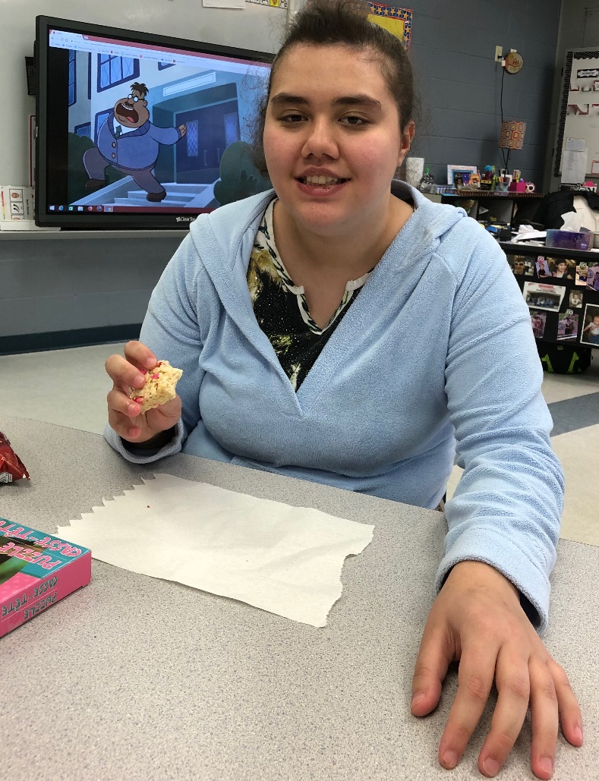
You can help cook for someone.
Let’s show random acts of kindness.

Slide 8
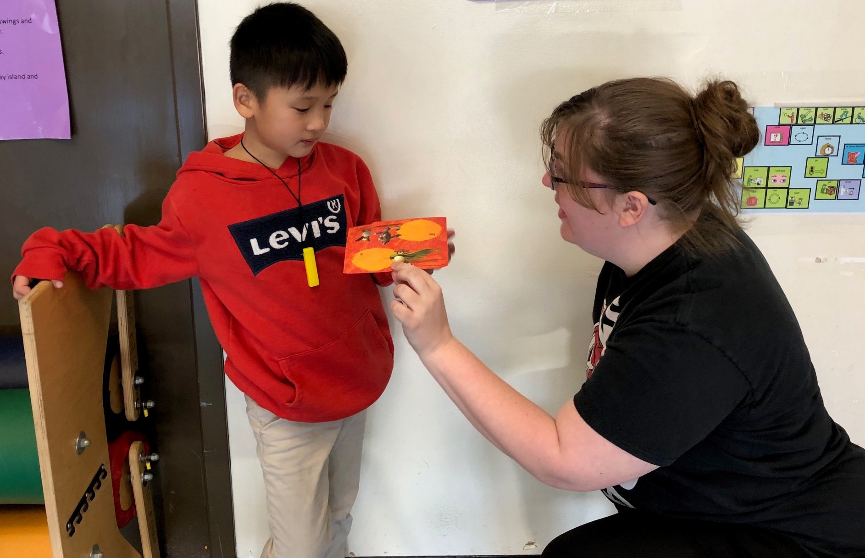
You can give a card to someone.
Let’s show random acts of kindness.

Slide 9
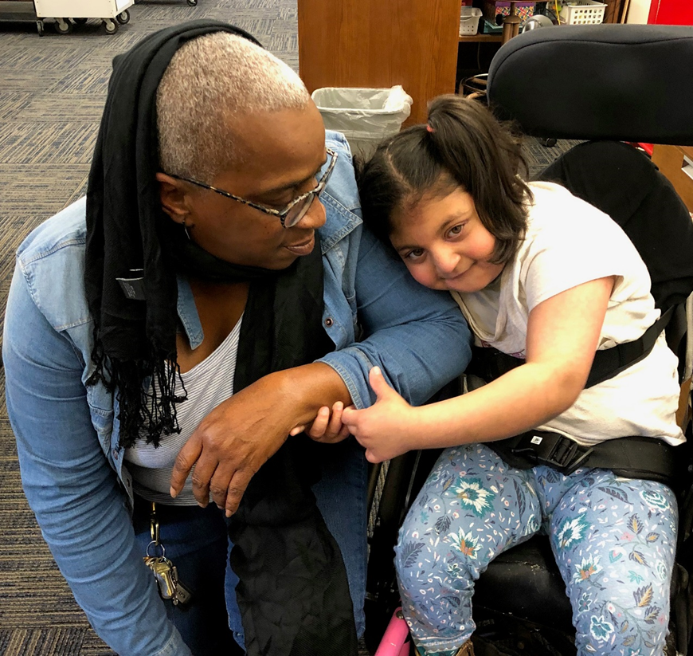
The End

