Slide 1
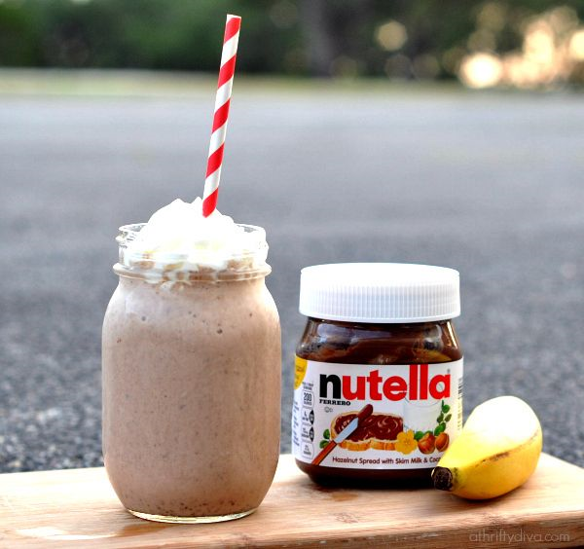
Let’s Make A Banana Nutella Smoothie
Groupbygroup.wordpress.com

Slide 2
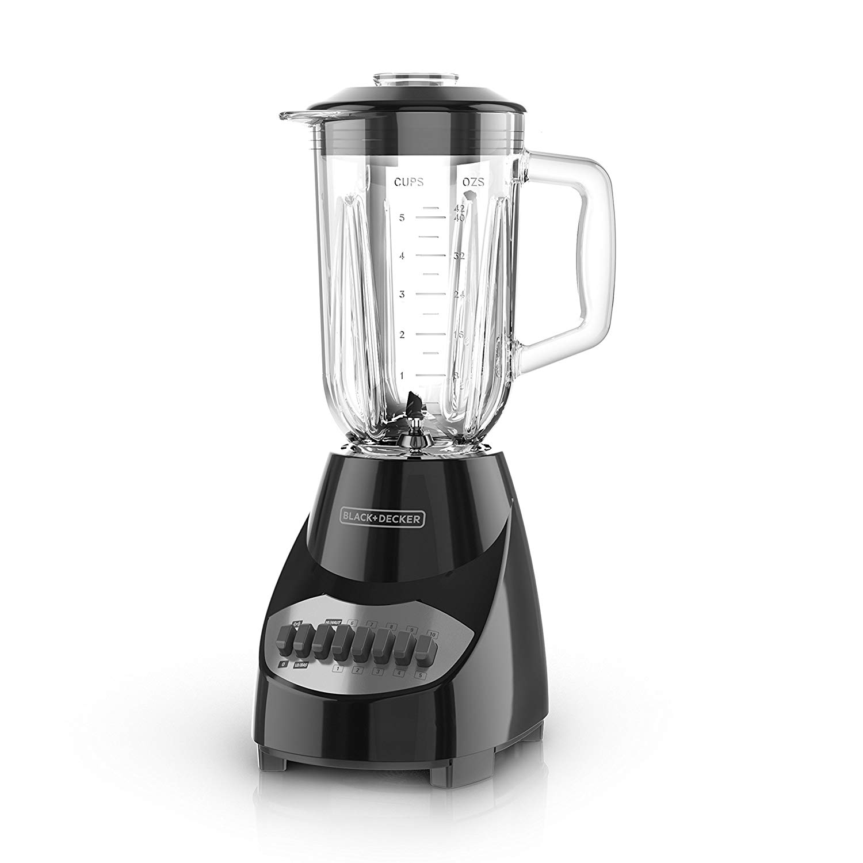
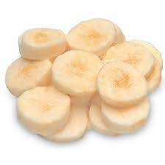
Put 2 frozen sliced bananas into a blender.

Slide 3
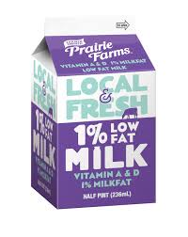
Put 2 cups of milk into the blender.

Slide 4
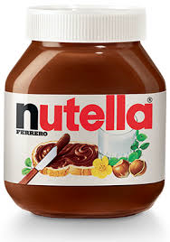
Put 2 tbsp. of Nutella into the blender.

Slide 5
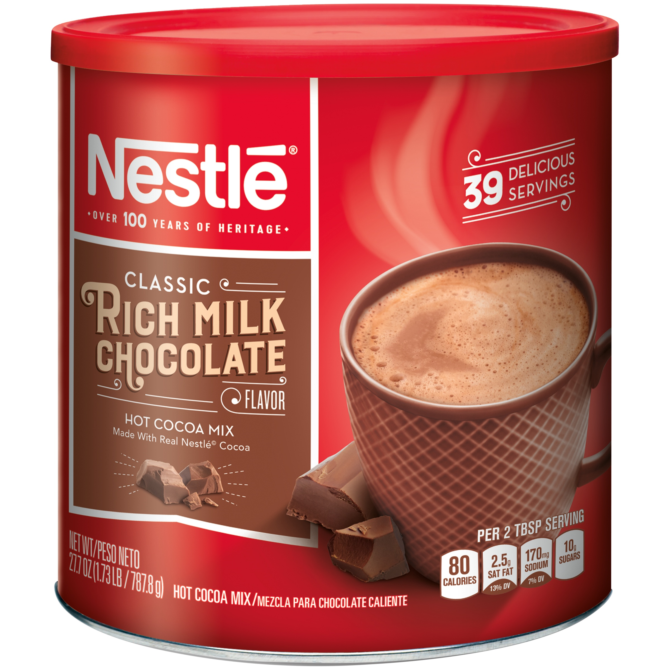
Put 2 tsp of hot cocoa mix into the blender.

Slide 6
Blend until smooth.

Slide 7
Drink and enjoy!

