Slide 1
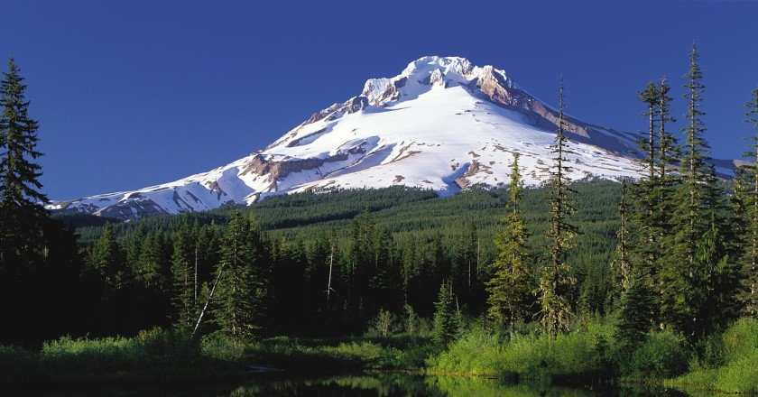
Let’s Learn About Oregon
By: Cara Edenfield and Joy Delaney
Groupbygroup.wordpress.com

Slide 2
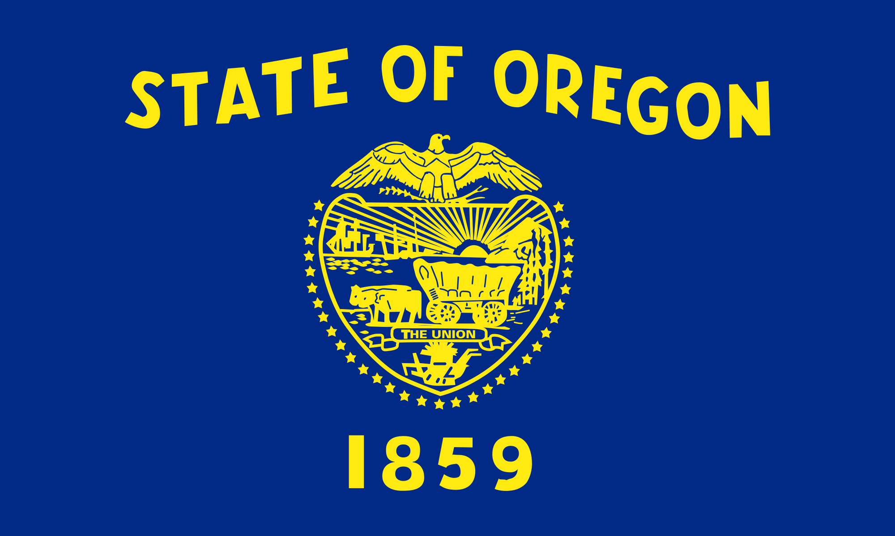
Oregon became a U.S. state on February 14, 1859.
It’s nicknamed the “Beaver State”.
Let’s learn about Oregon

Slide 3
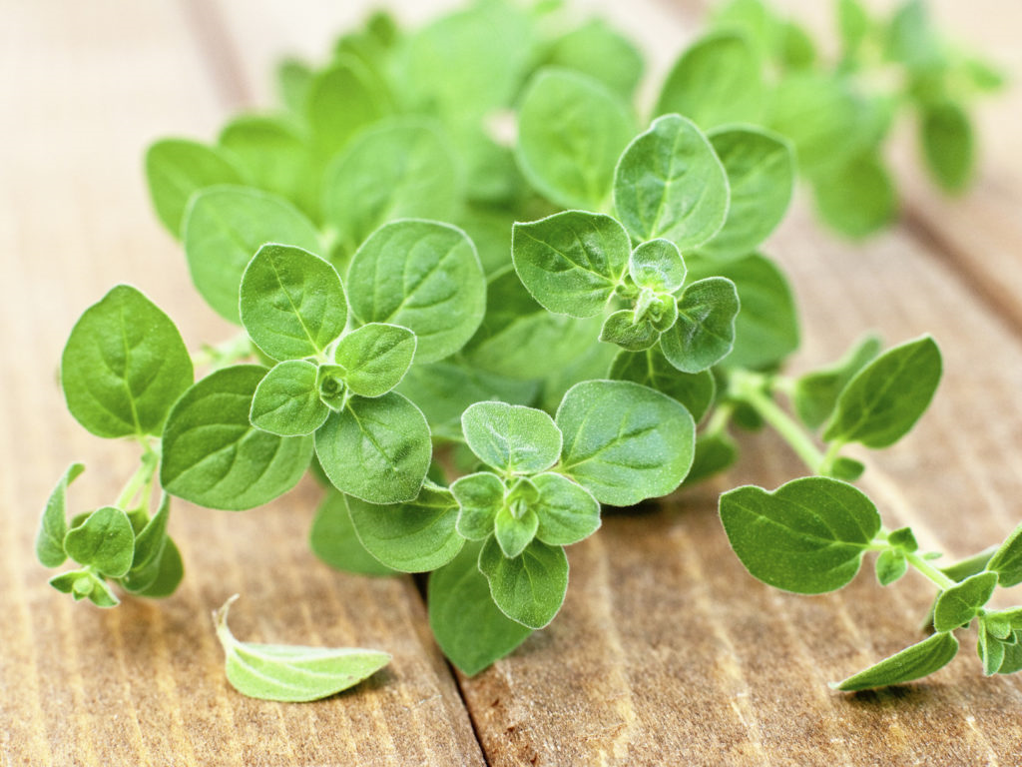
The origin of the name Oregon is not certain, but one idea
suggests that the name of this state comes from the Spanish
word "orégano" for the wild sage which grows in eastern Oregon.
Let’s learn about Oregon

Slide 4
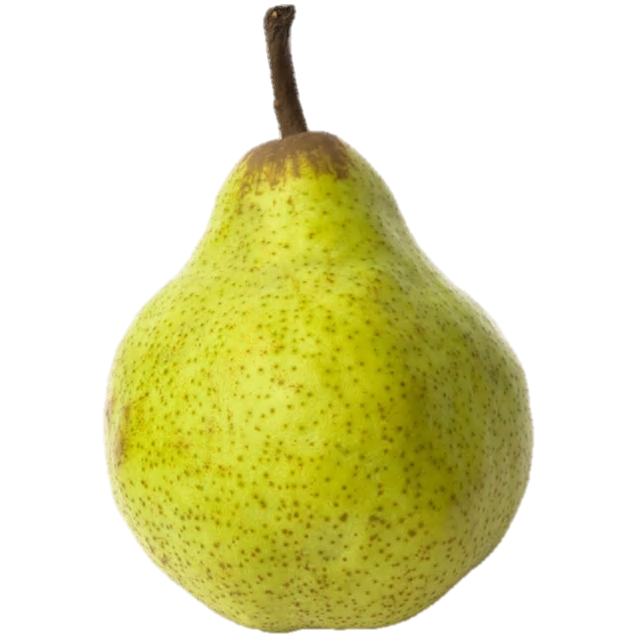
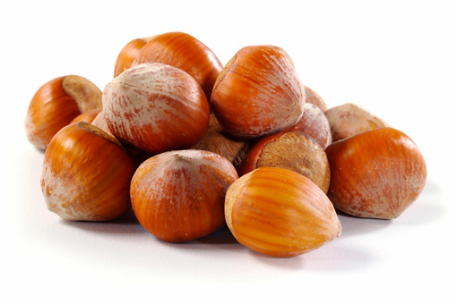
State foods of Oregon are pears and hazelnuts.
Let’s learn about Oregon

Slide 5
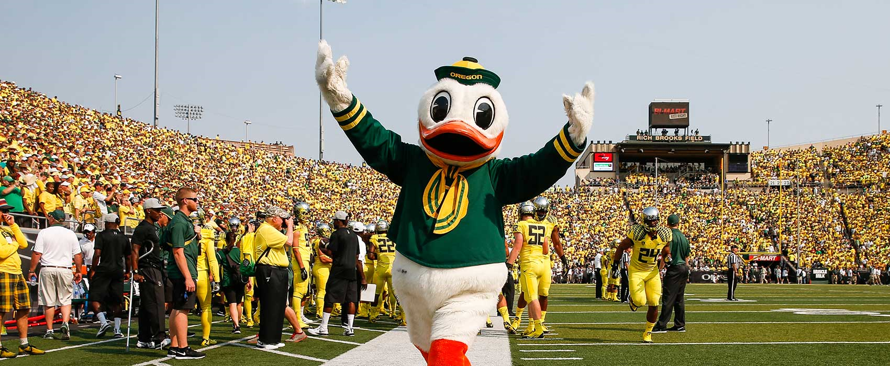
The University of Oregon is located in Eugene, OR
and is home of the Oregon Ducks.
Let’s learn about Oregon

Slide 6
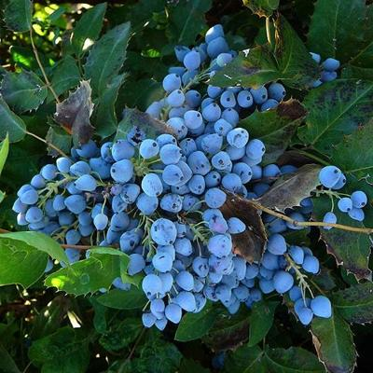
Oregon’s state flower is the Oregon grape.
Let’s learn about Oregon

Slide 7
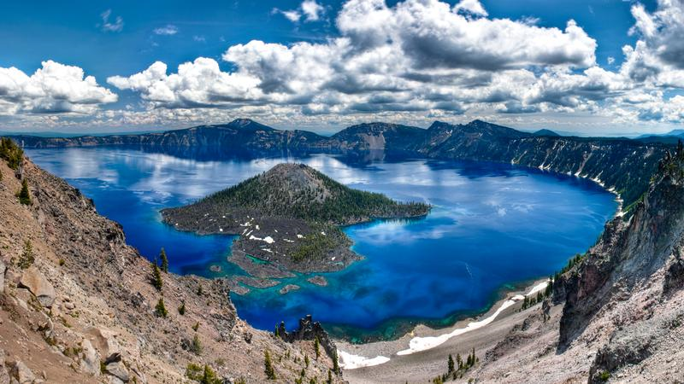
The deepest lake in the U.S. is Oregon’s Crater Lake,
which is also one of the ten deepest lakes in the world.
Let’s learn about Oregon

Slide 8
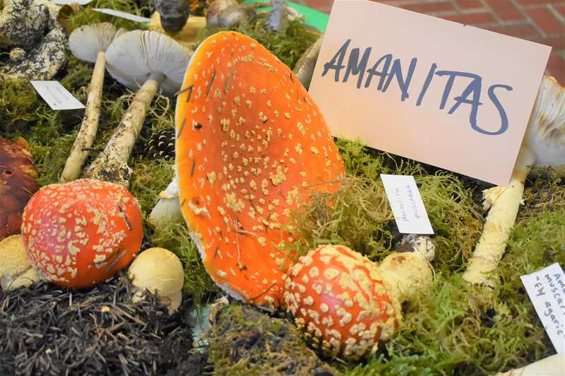
Mushroom hunting is a popular activity in Oregon, and the
state even holds the annual Estacada Festival of the Fungus.
Let’s learn about Oregon

Slide 9
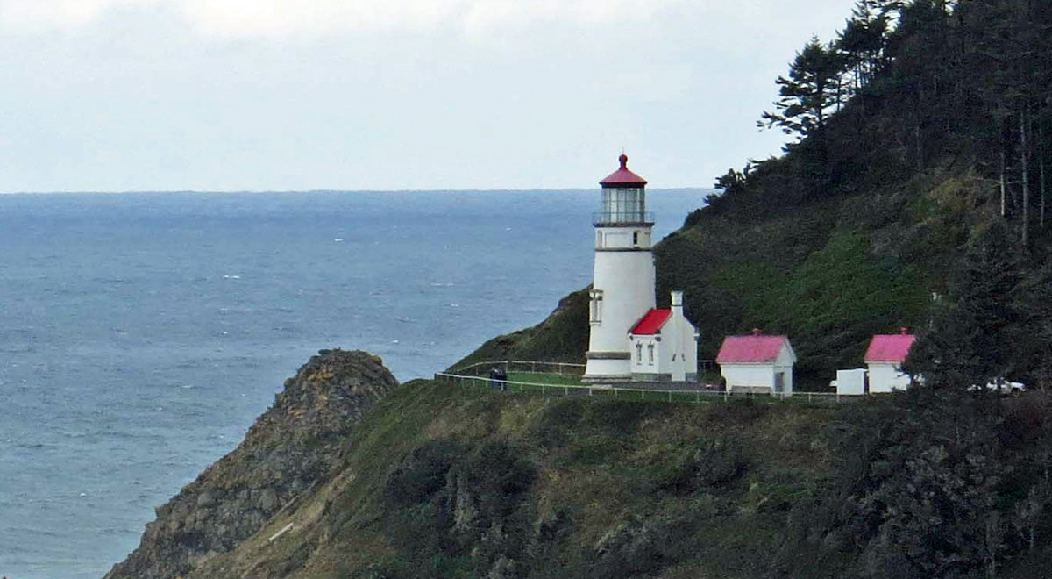
There are nine lighthouses along Oregon’s scenic coastline.
4 are now historic monuments, while the other 5 are still in use.
Let’s learn about Oregon

Slide 10
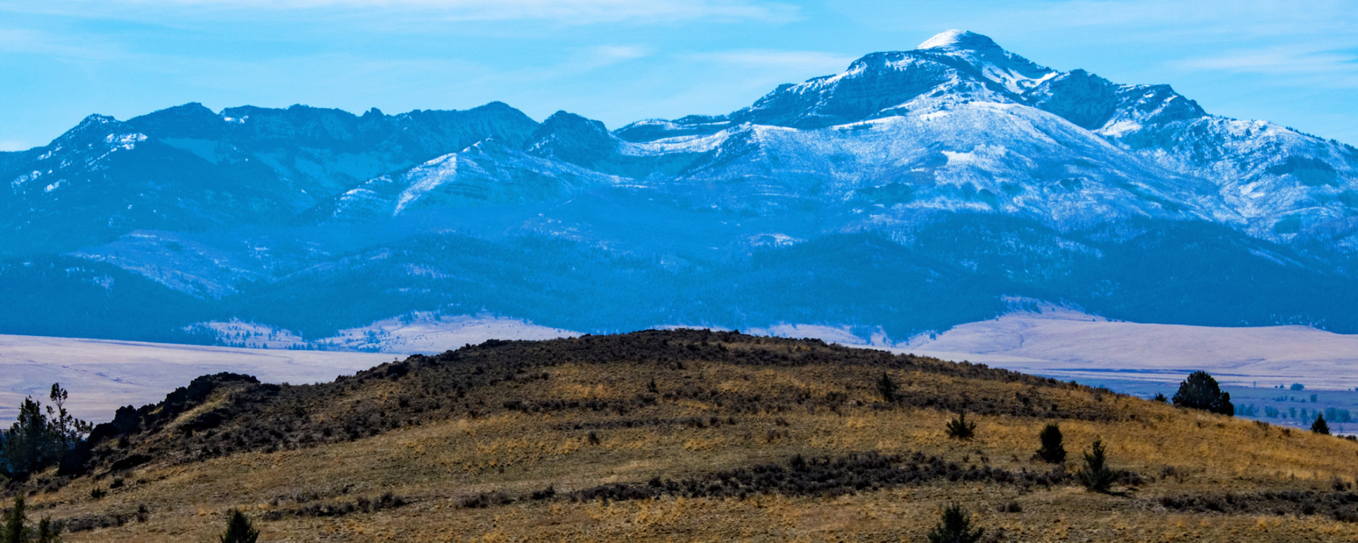
The Blue Mountains are a mountain range
located largely in northeastern Oregon.
Let’s learn about Oregon

Slide 11
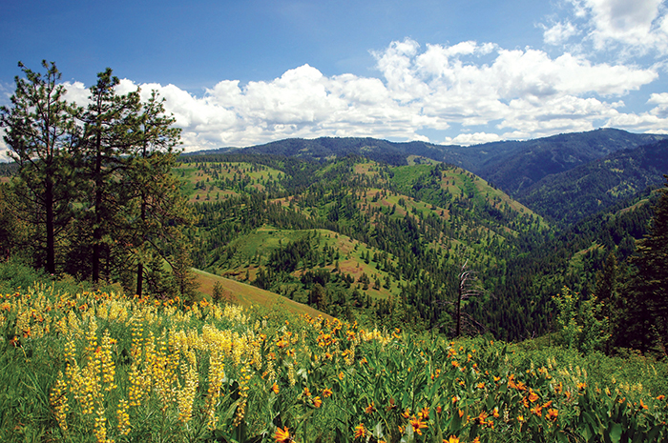
The End

