Slide 1
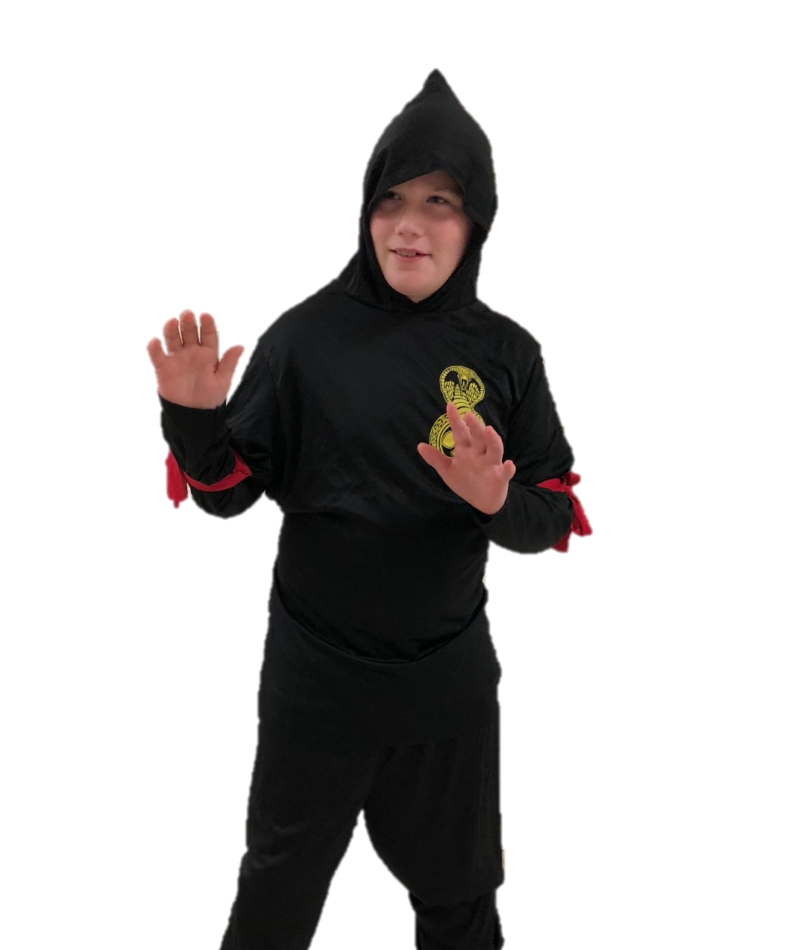
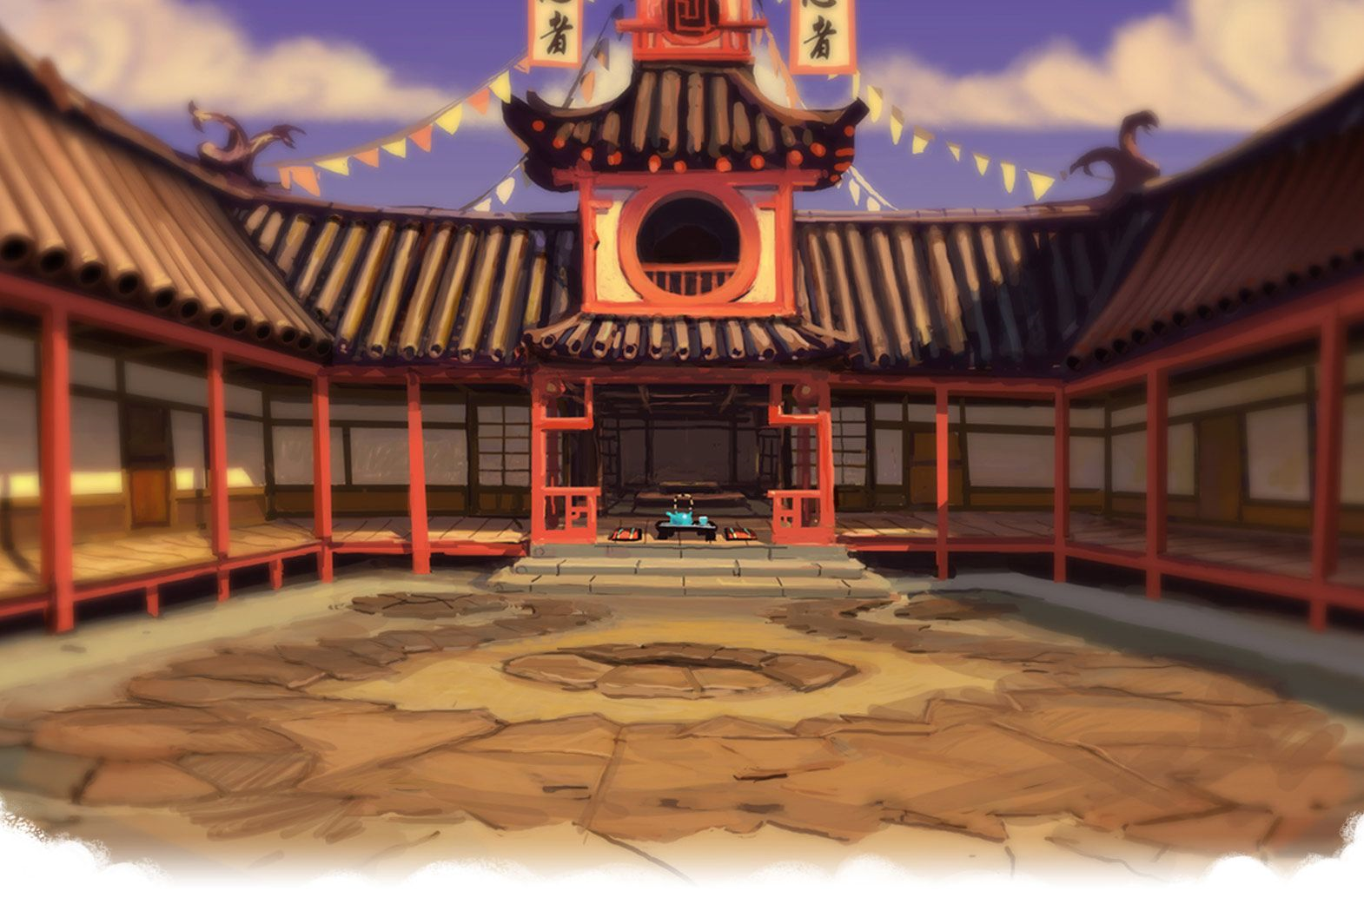
Let’s Learn About Ninjas
By: Cara Edenfield and Joy Delaney
Groupbygroup.wordpress.com

Slide 2
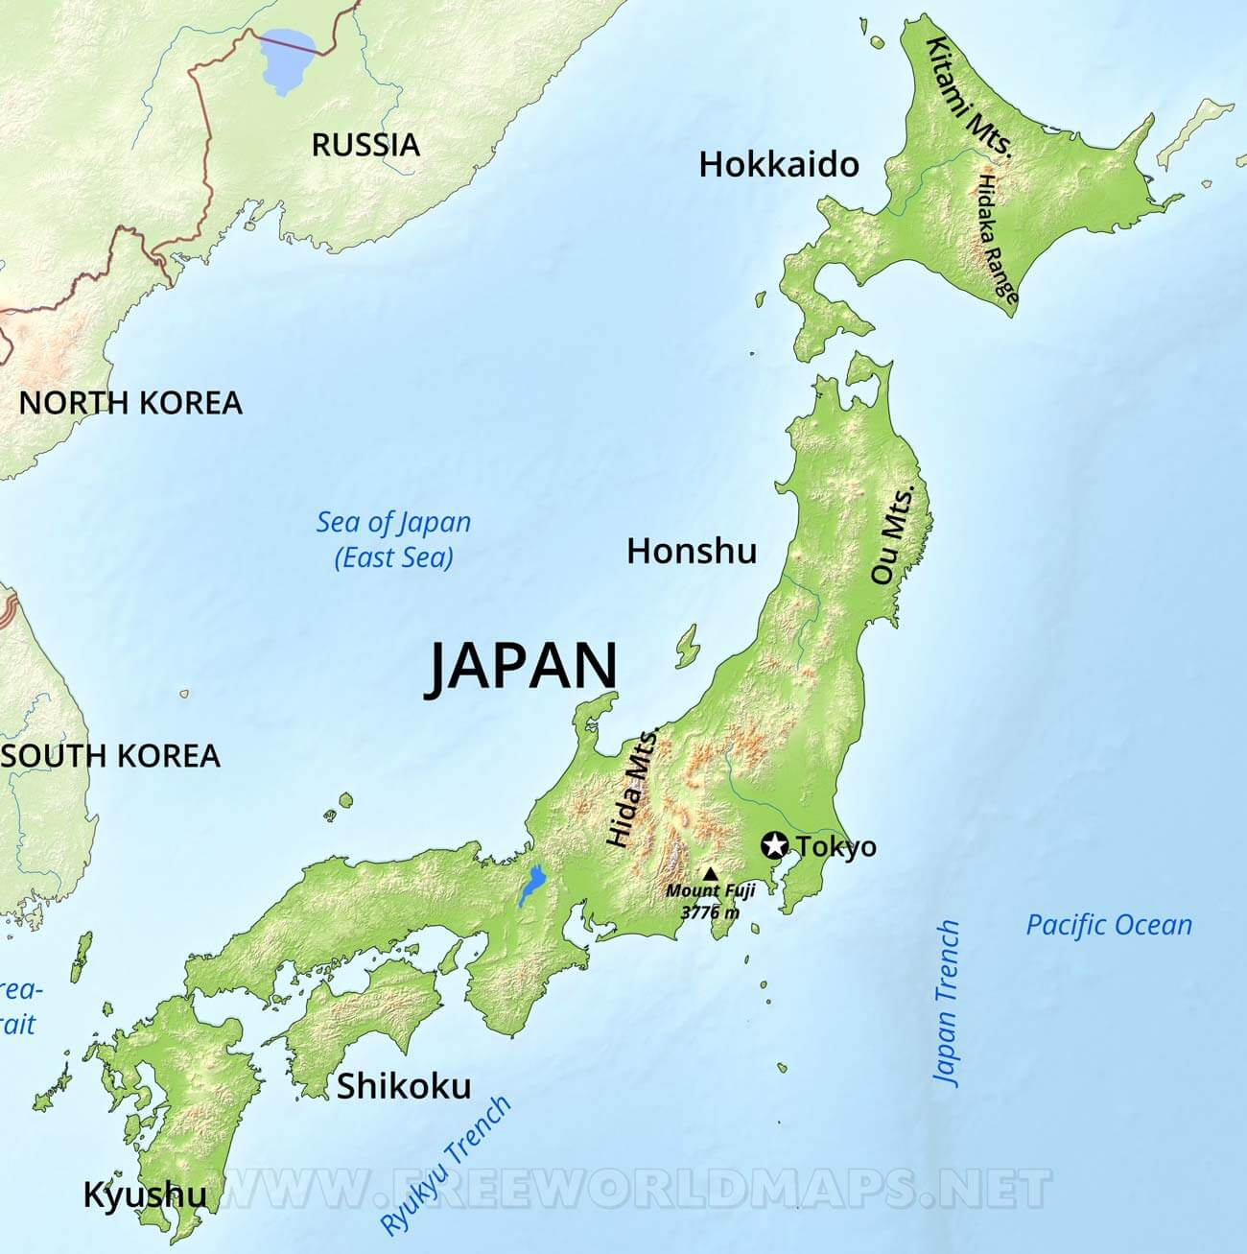
A ninja is a kind of spy who lived in Japan
beginning in the 14th century.
Let’s learn about ninjas

Slide 3
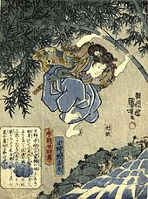
Ninjas were considered more than ordinary men who
were able to fly and who had supernatural skills.
Let’s learn about ninjas

Slide 4
The most skilled ninja clans were from the Iga and Koga
(Koka) regions in Japan. They were isolated between two
mountain ranges, which helped them be protected.
Let’s learn about ninjas

Slide 5
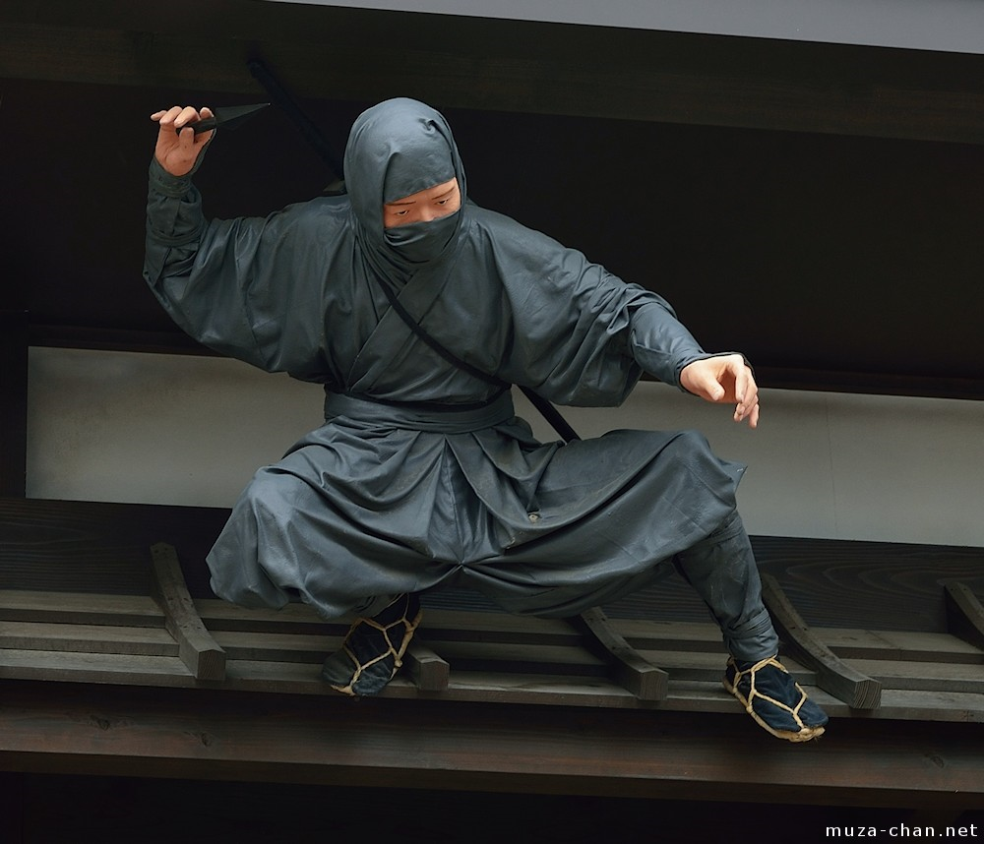
Ninjas wear dark clothing to help them hide in the dark.
Let’s learn about ninjas

Slide 6
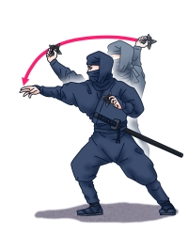
One of the tools that ninjas use are throwing stars.
Let’s learn about ninjas

Slide 7
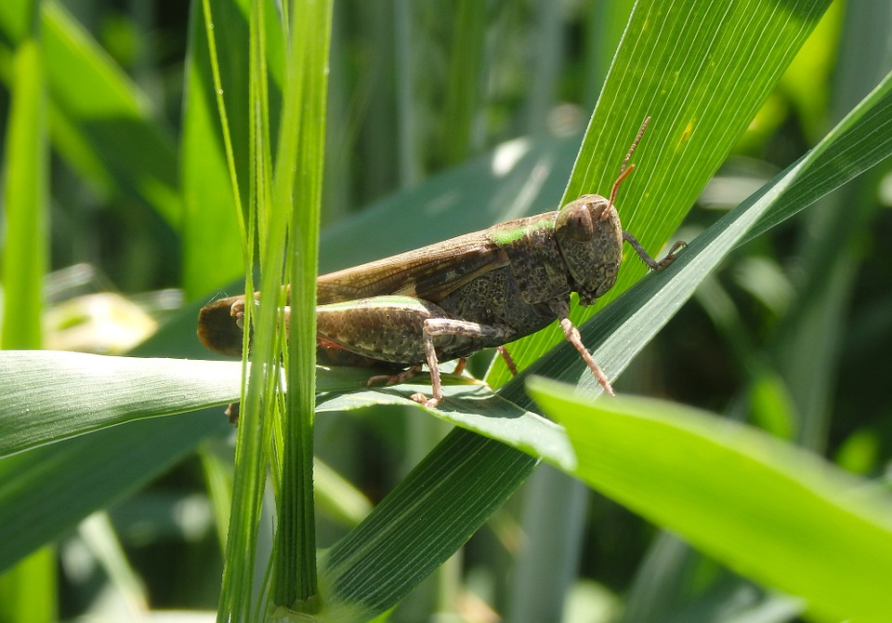
One of the most important tools a ninja used was a cricket.
The chirping of a cricket would mask the footsteps of a ninja.
Let’s learn about ninjas

Slide 8
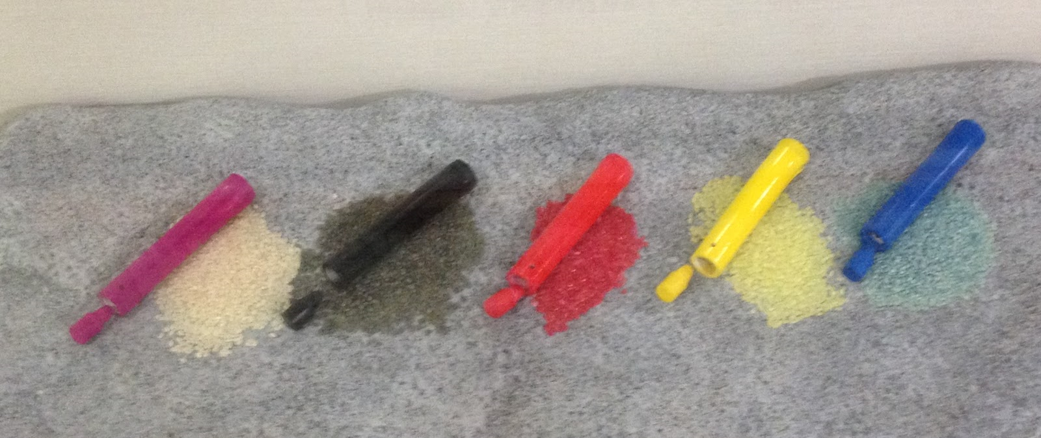
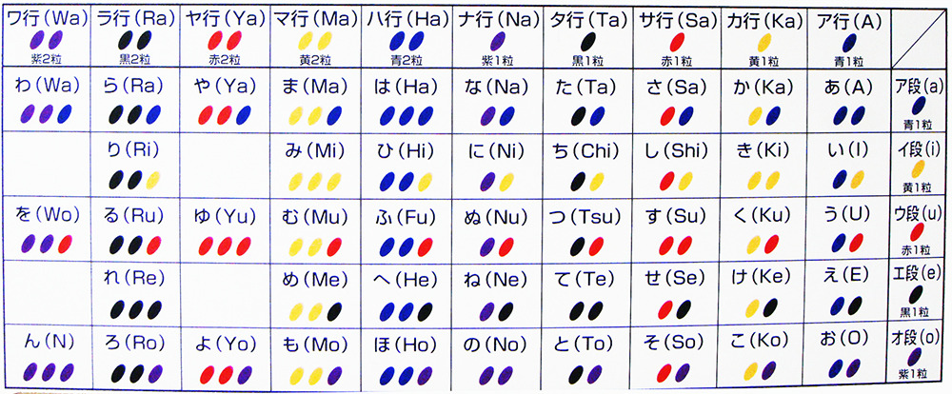
Ninjas created a system of passing secret messages
using colored rice. Each color had a different meaning.
Let’s learn about ninjas

Slide 9
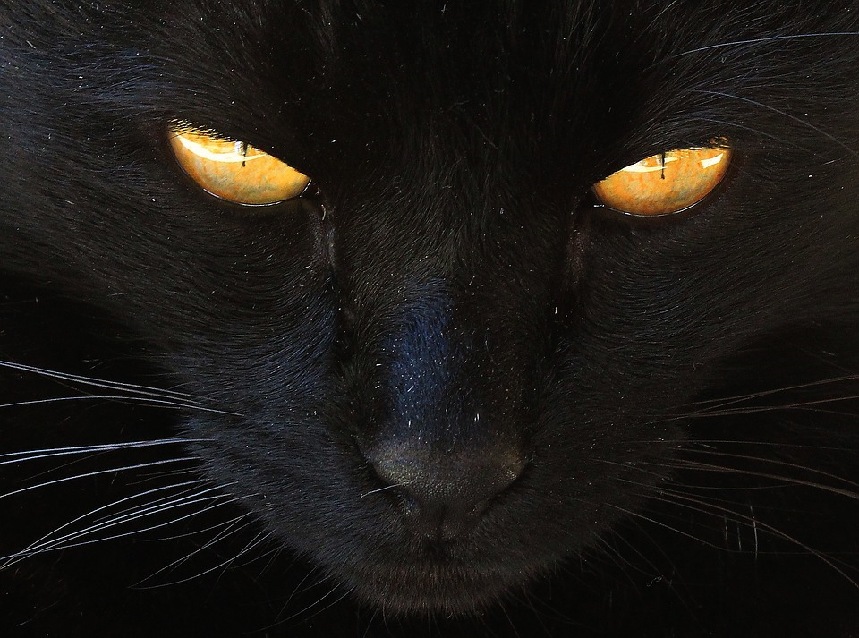
Ninjas often used nekome-jutsu, which is the ability to tell
time by looking at a cat’s eyes because their pupils change
shape at different times of the day.
Let’s learn about ninjas

Slide 10
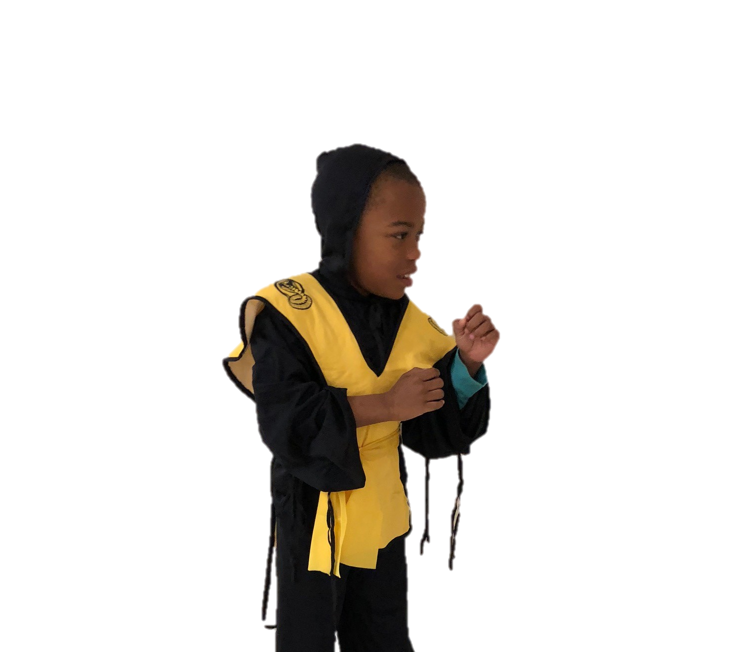
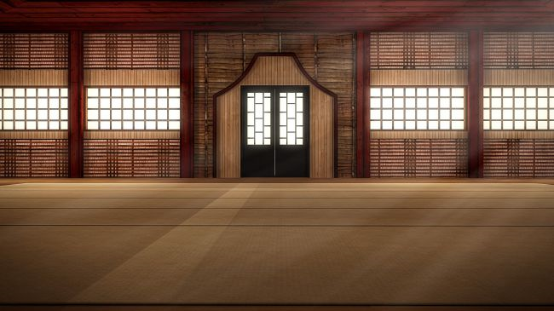
The End

