Slide 1
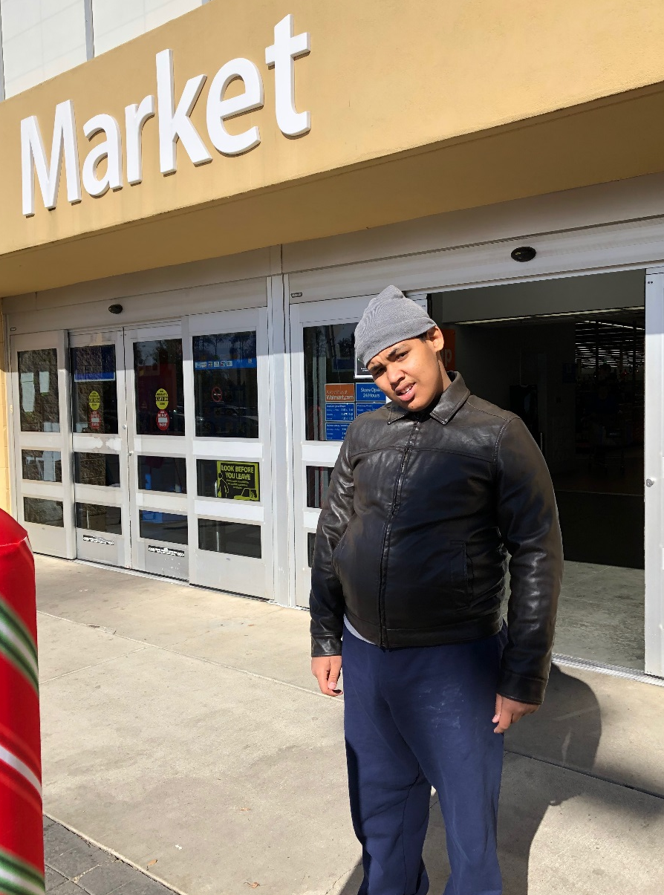
Let’s Go Shopping
By: Cara Edenfield and Joy Delaney
groupbygroup.wordpress.com

Slide 2
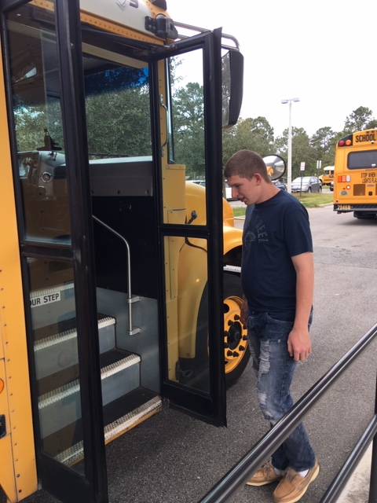
We’re going shopping! We need to get on the bus.
Let’s go shopping!

Slide 3
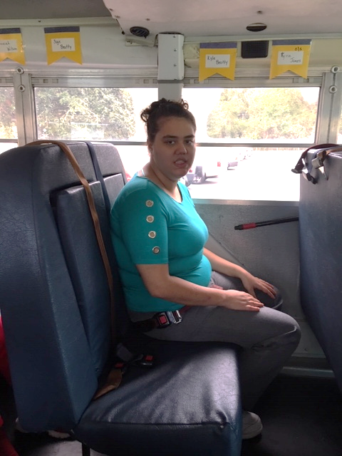
We sit nicely while the bus drives us to the store.
Let’s go shopping!

Slide 4
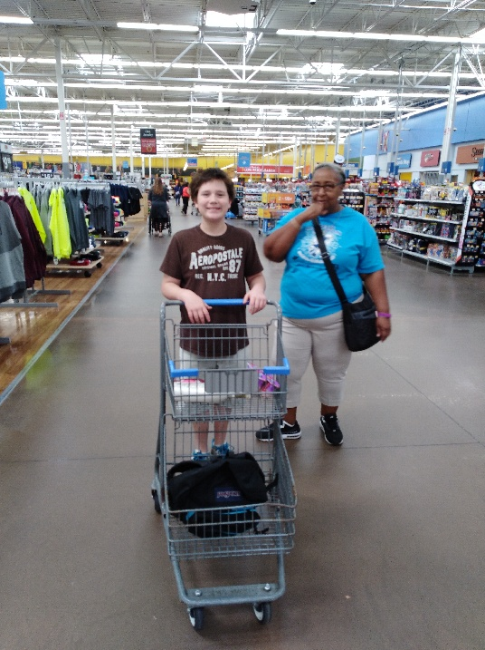
We walk down the aisles to find what we need.
Let’s go shopping!

Slide 5
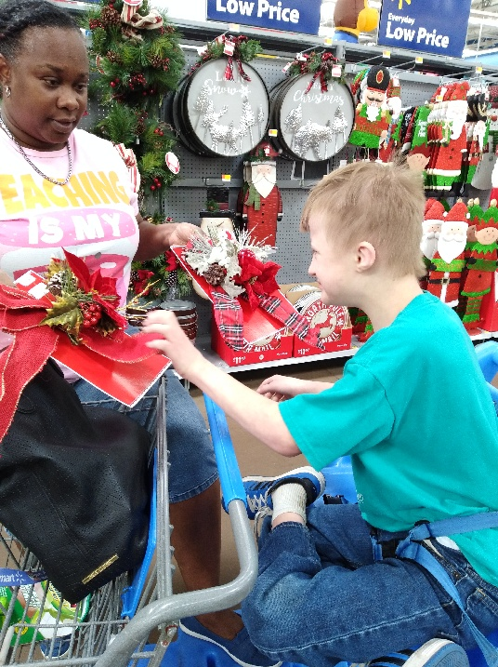
We make choices and pick what we like.
Let’s go shopping!

Slide 6
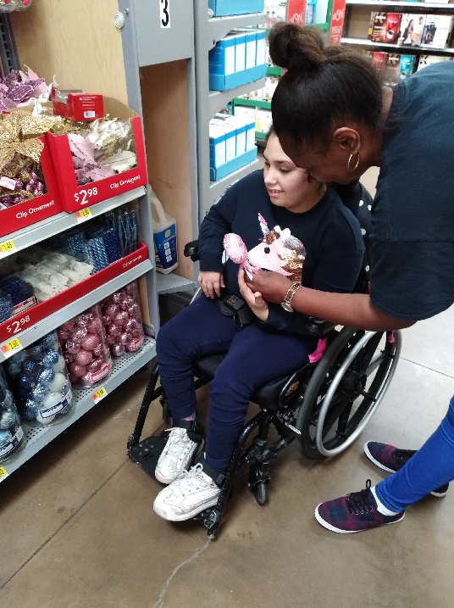
We can shop for Christmas decorations.
Let’s go shopping!

Slide 7
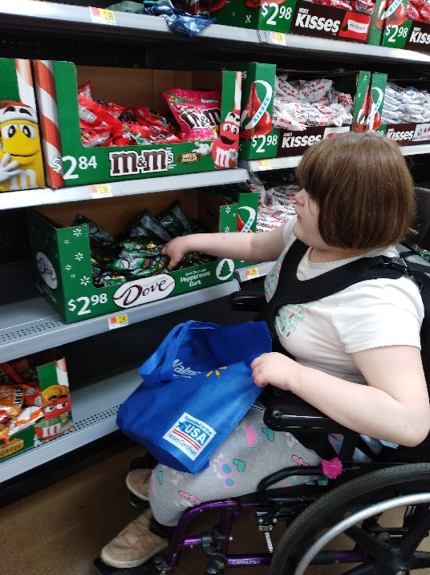
We can shop for candy we like.
Let’s go shopping!

Slide 8
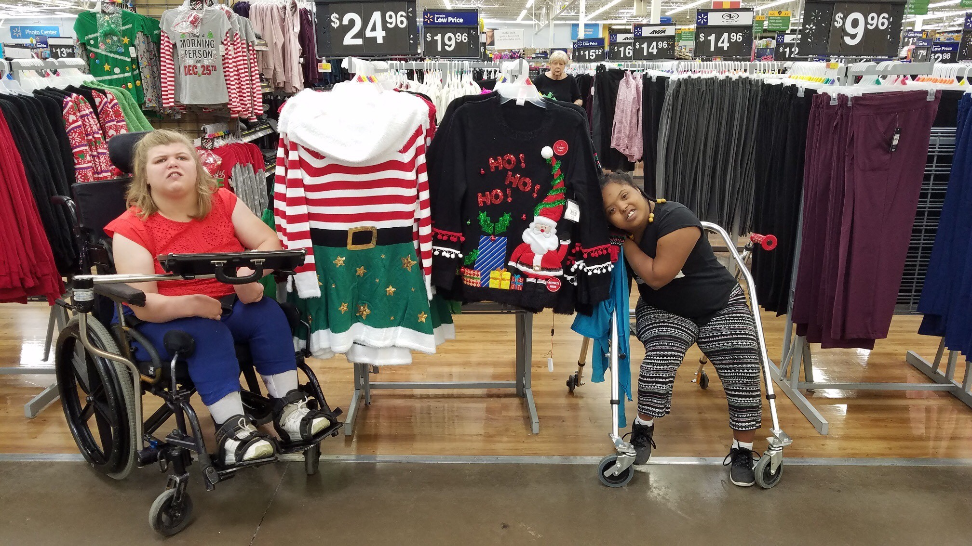
We can buy some new clothes.
Let’s go shopping!

Slide 9
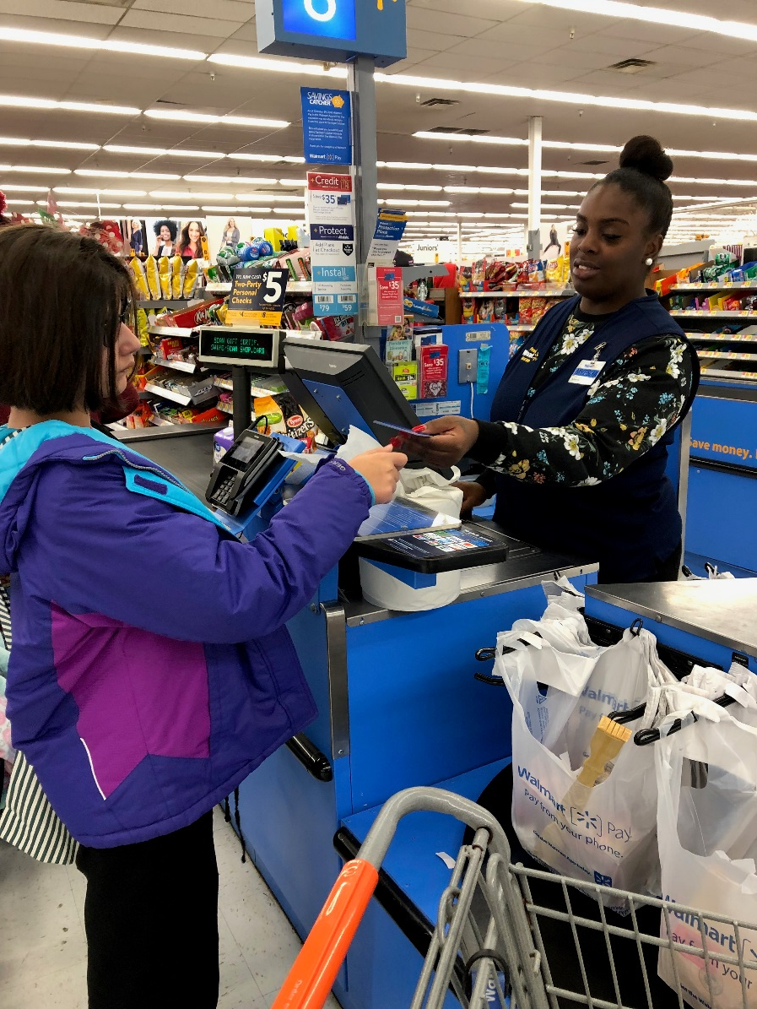
We have to pay for what we want.
Let’s go shopping!

Slide 10
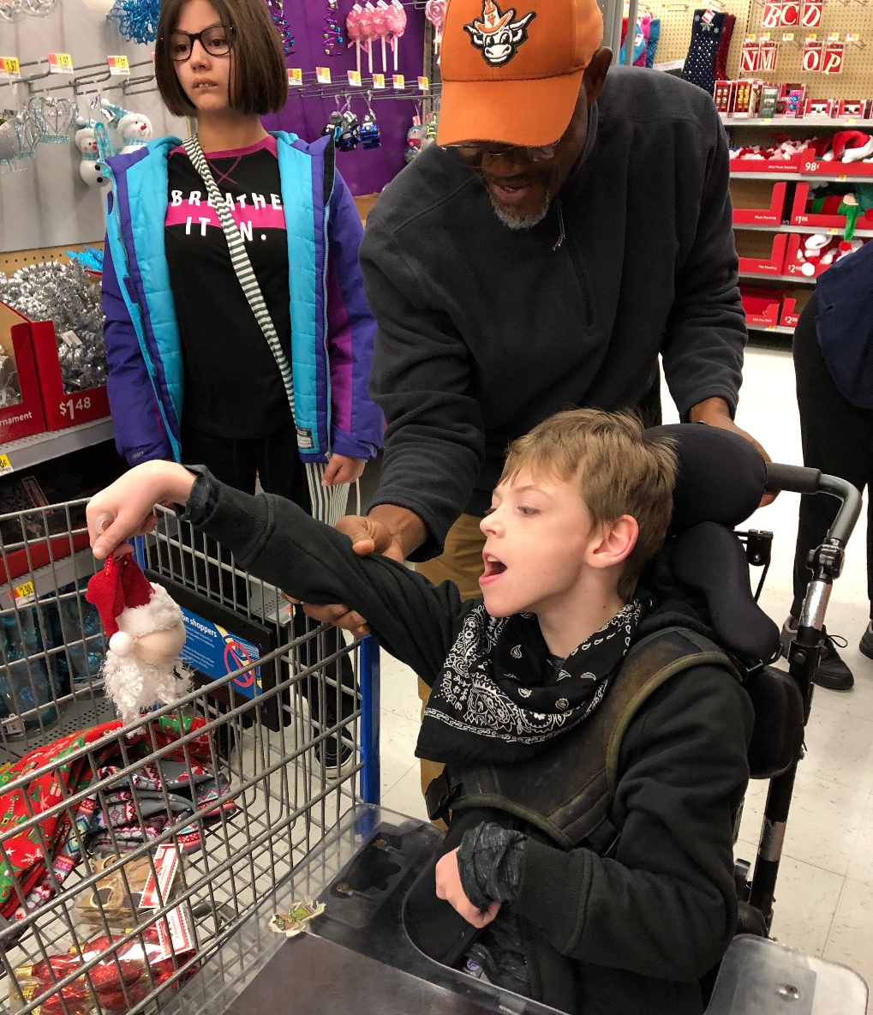
We have fun shopping.
Let’s go shopping!

Slide 11
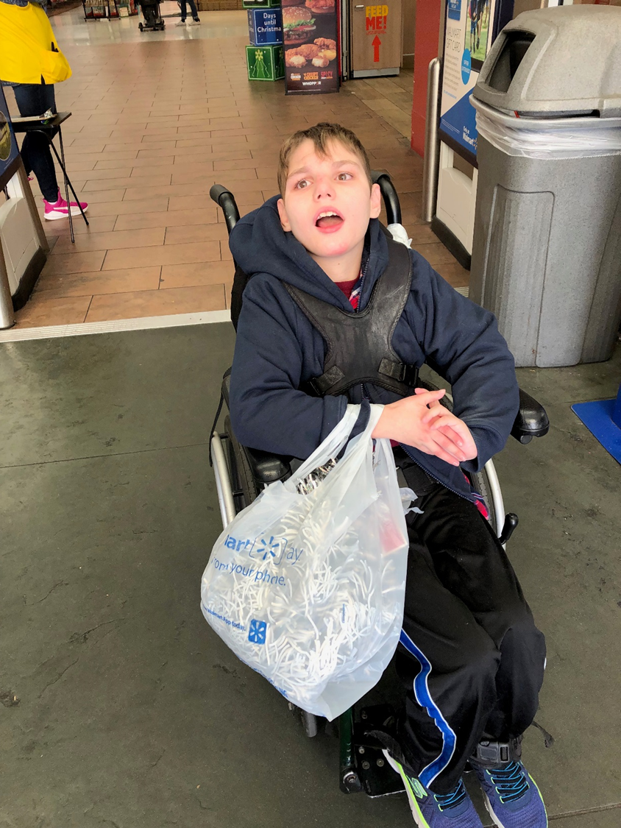
The End

