Slide 1
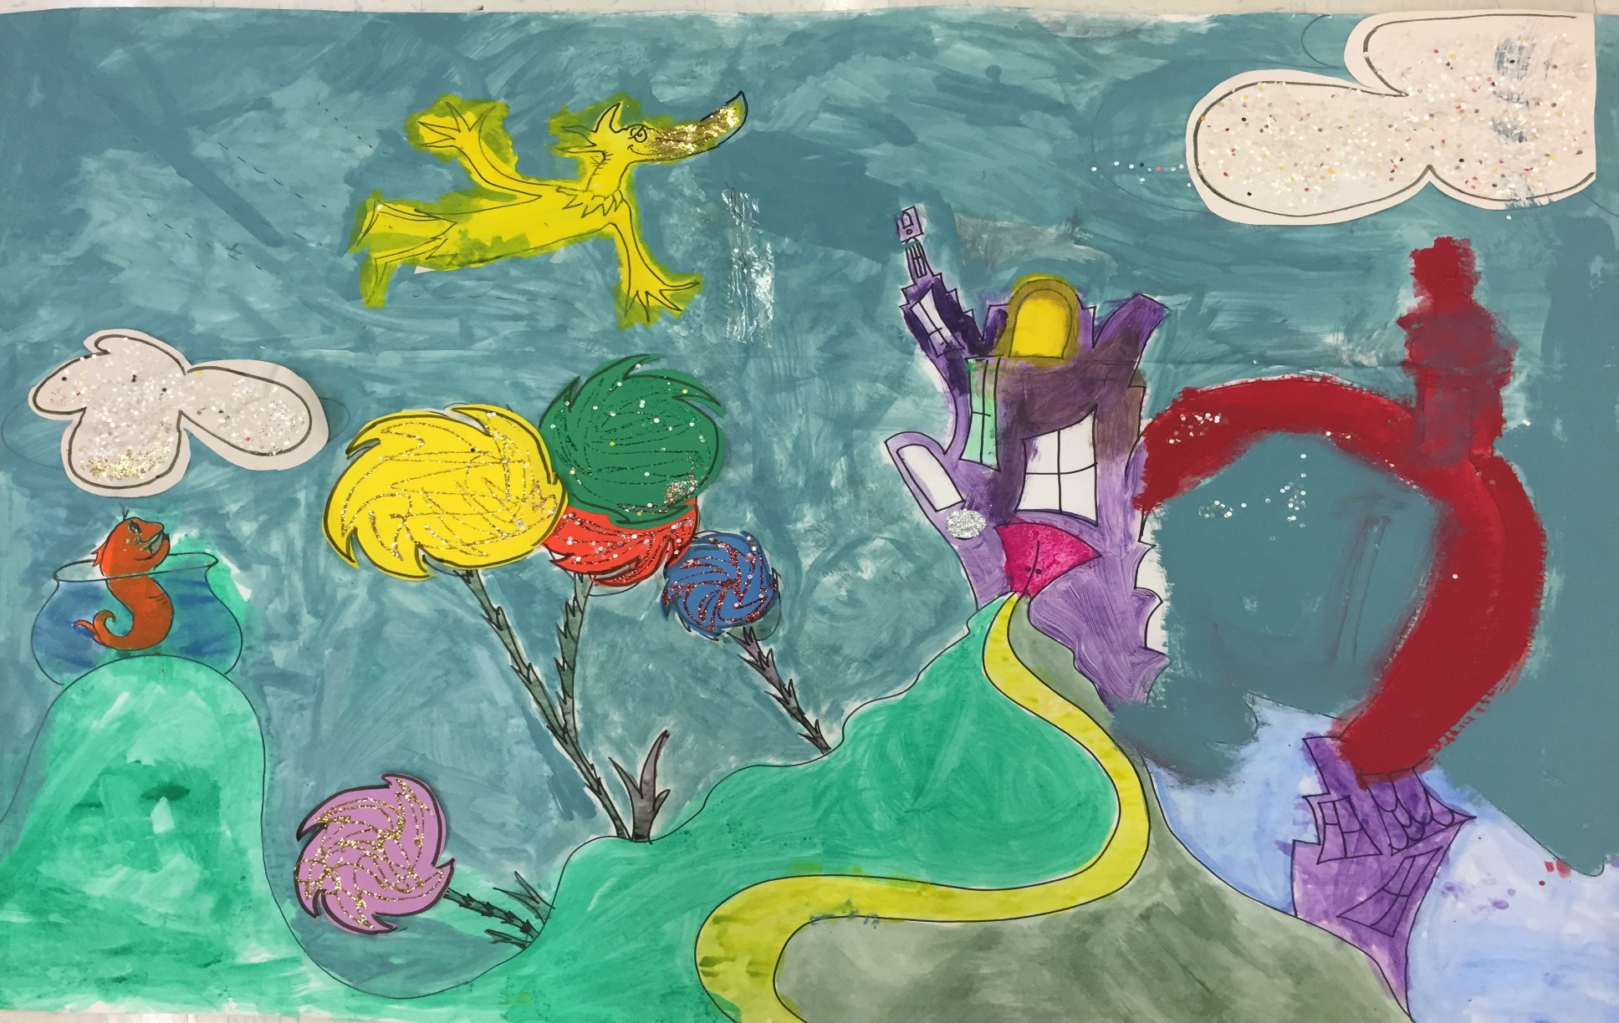
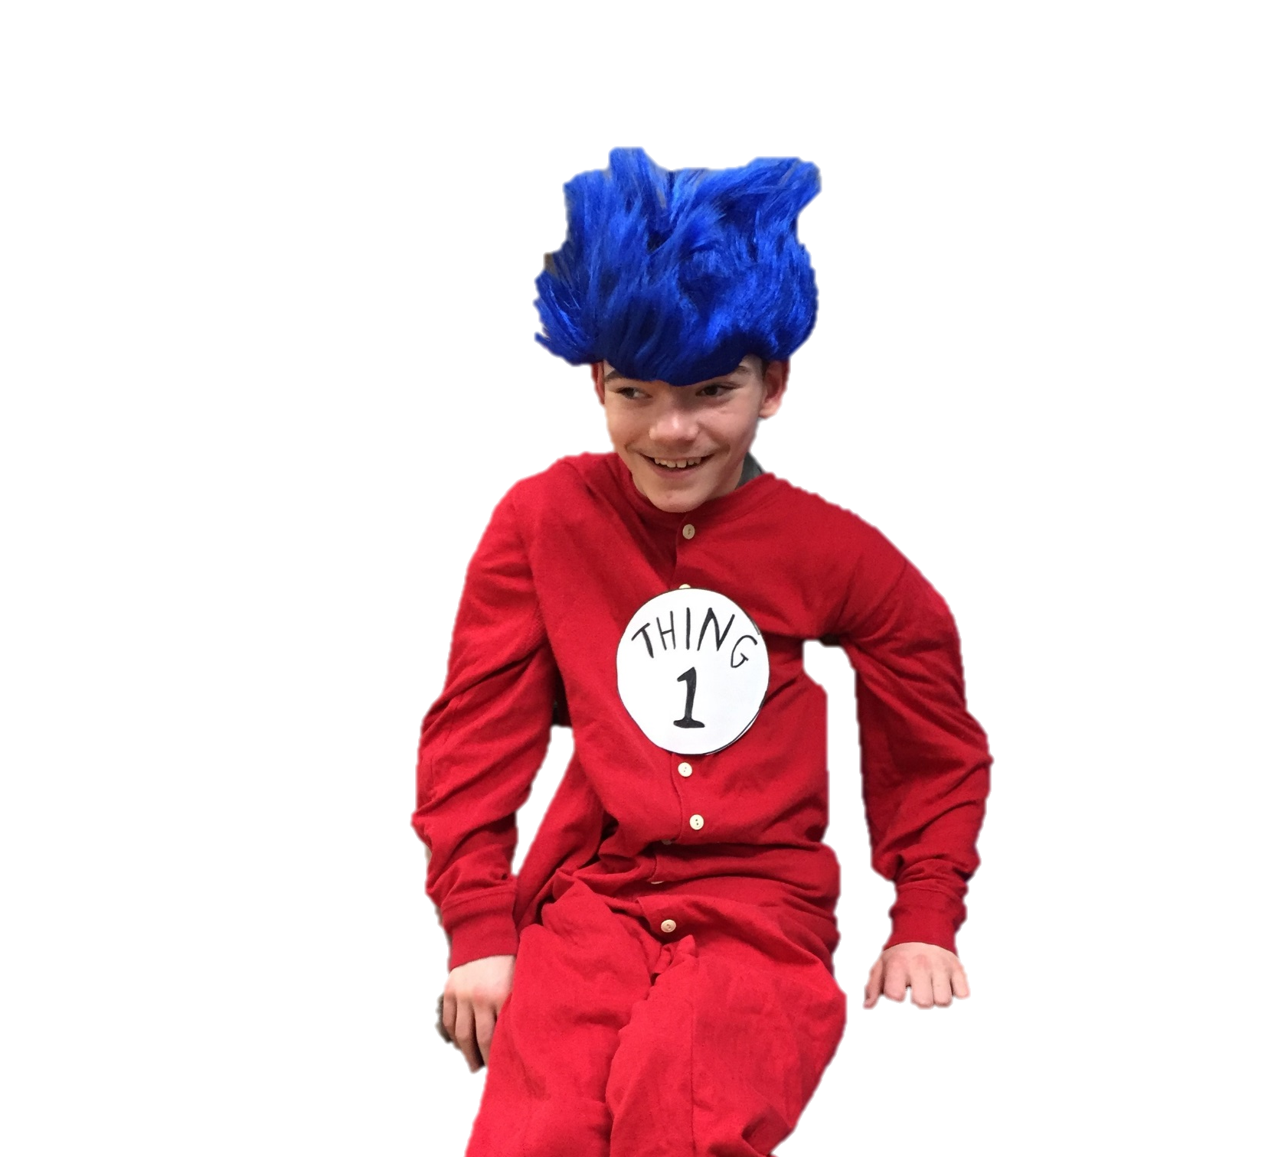
We Introduce Dr. Seuss!
By: Cara Edenfield
Photos by: Joy Delaney
Groupbygroup.wordpress.com

Slide 2
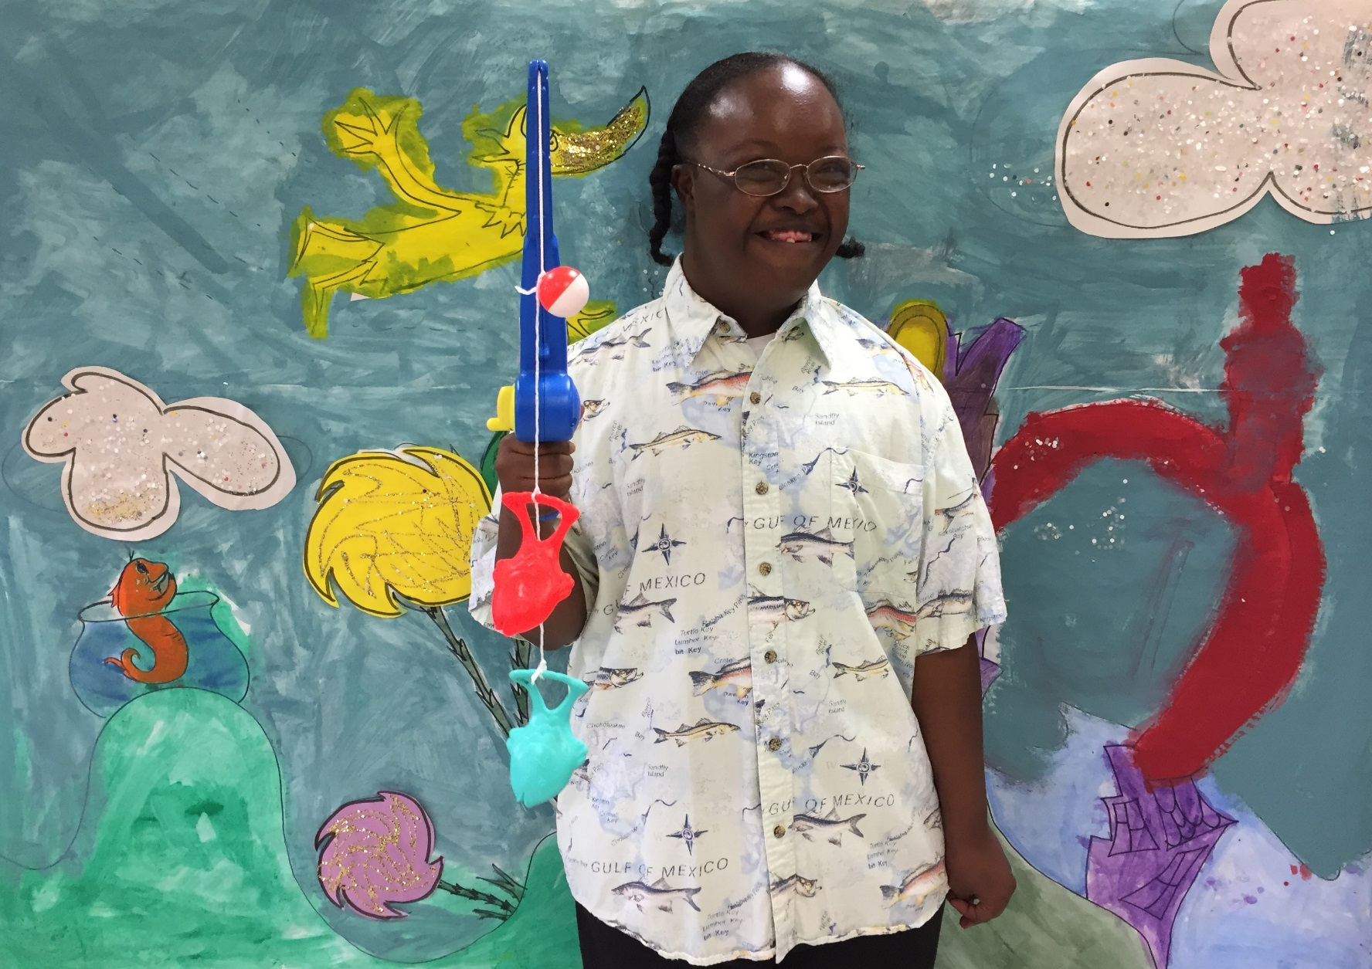
1 fish, 2 fish, red fish, blue
I like fishing. How about you?
We introduce Dr. Seuss!

Slide 3
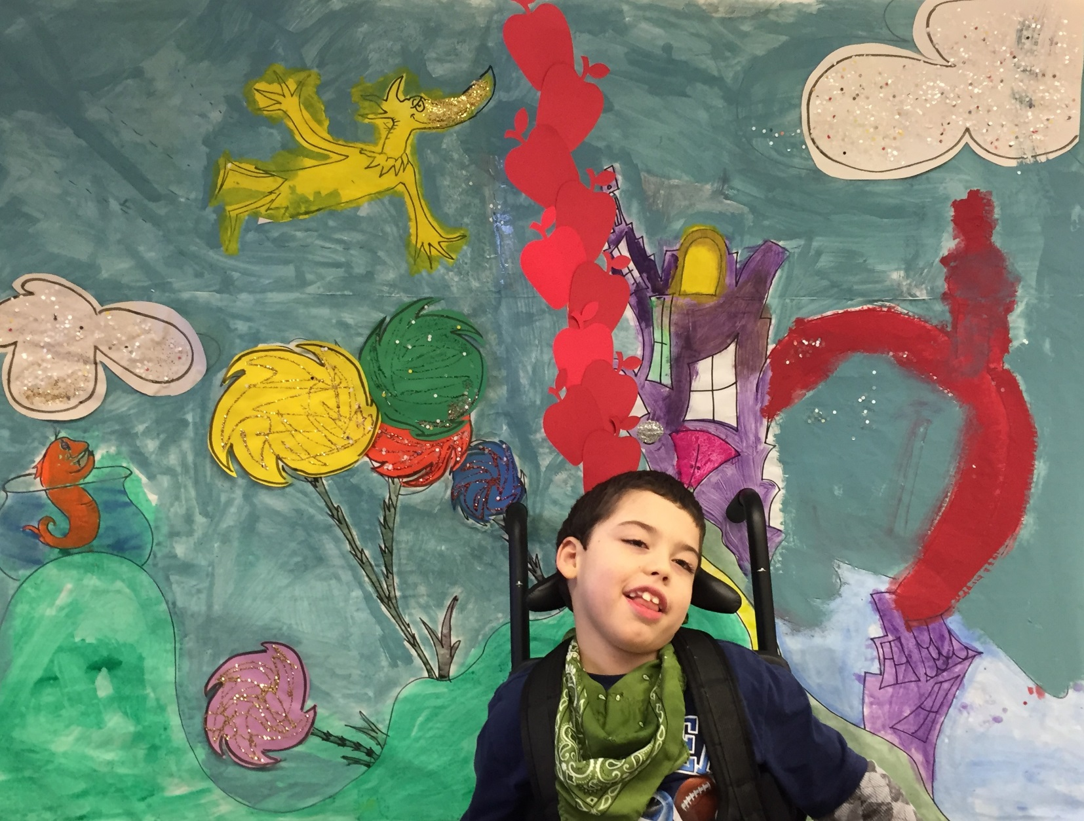
I have 10 apples up on top.
I really hope that they don’t drop!
We introduce Dr. Seuss!

Slide 4
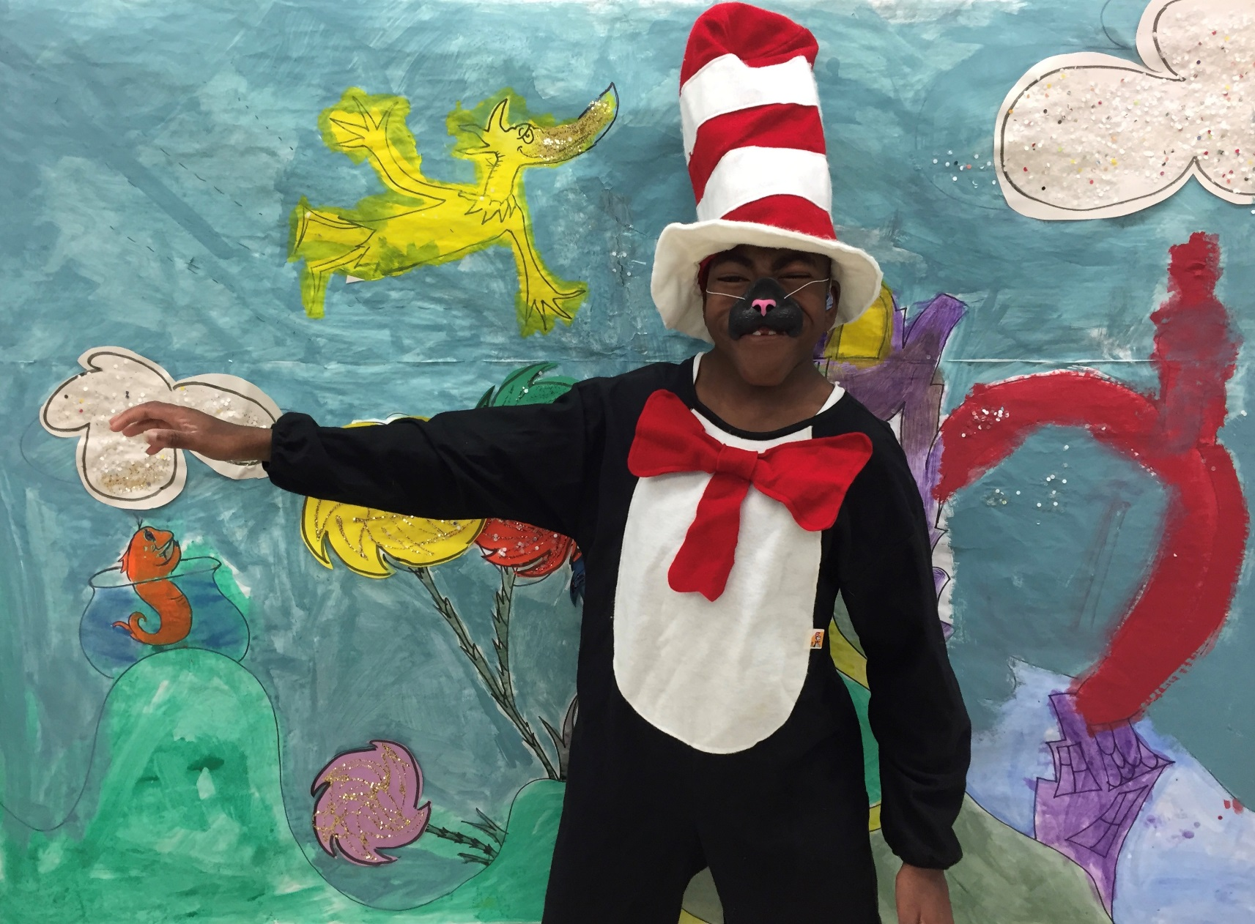
Here we have the Cat in the Hat.
Always up to mischief, and you can believe that!
We introduce Dr. Seuss!

Slide 5
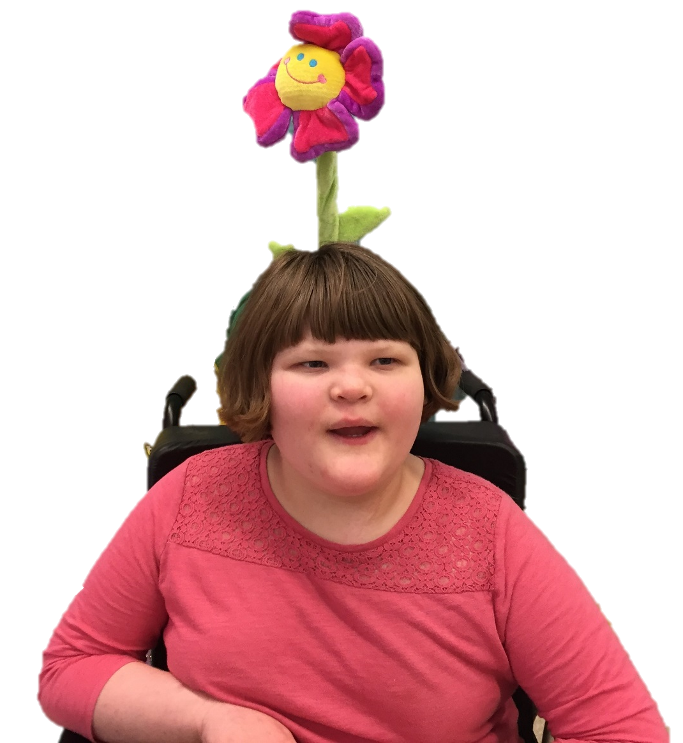
Daisy-Head Mayzie was at first filled with dread
When she saw a flower had sprouted from her head.
We introduce Dr. Seuss!

Slide 6
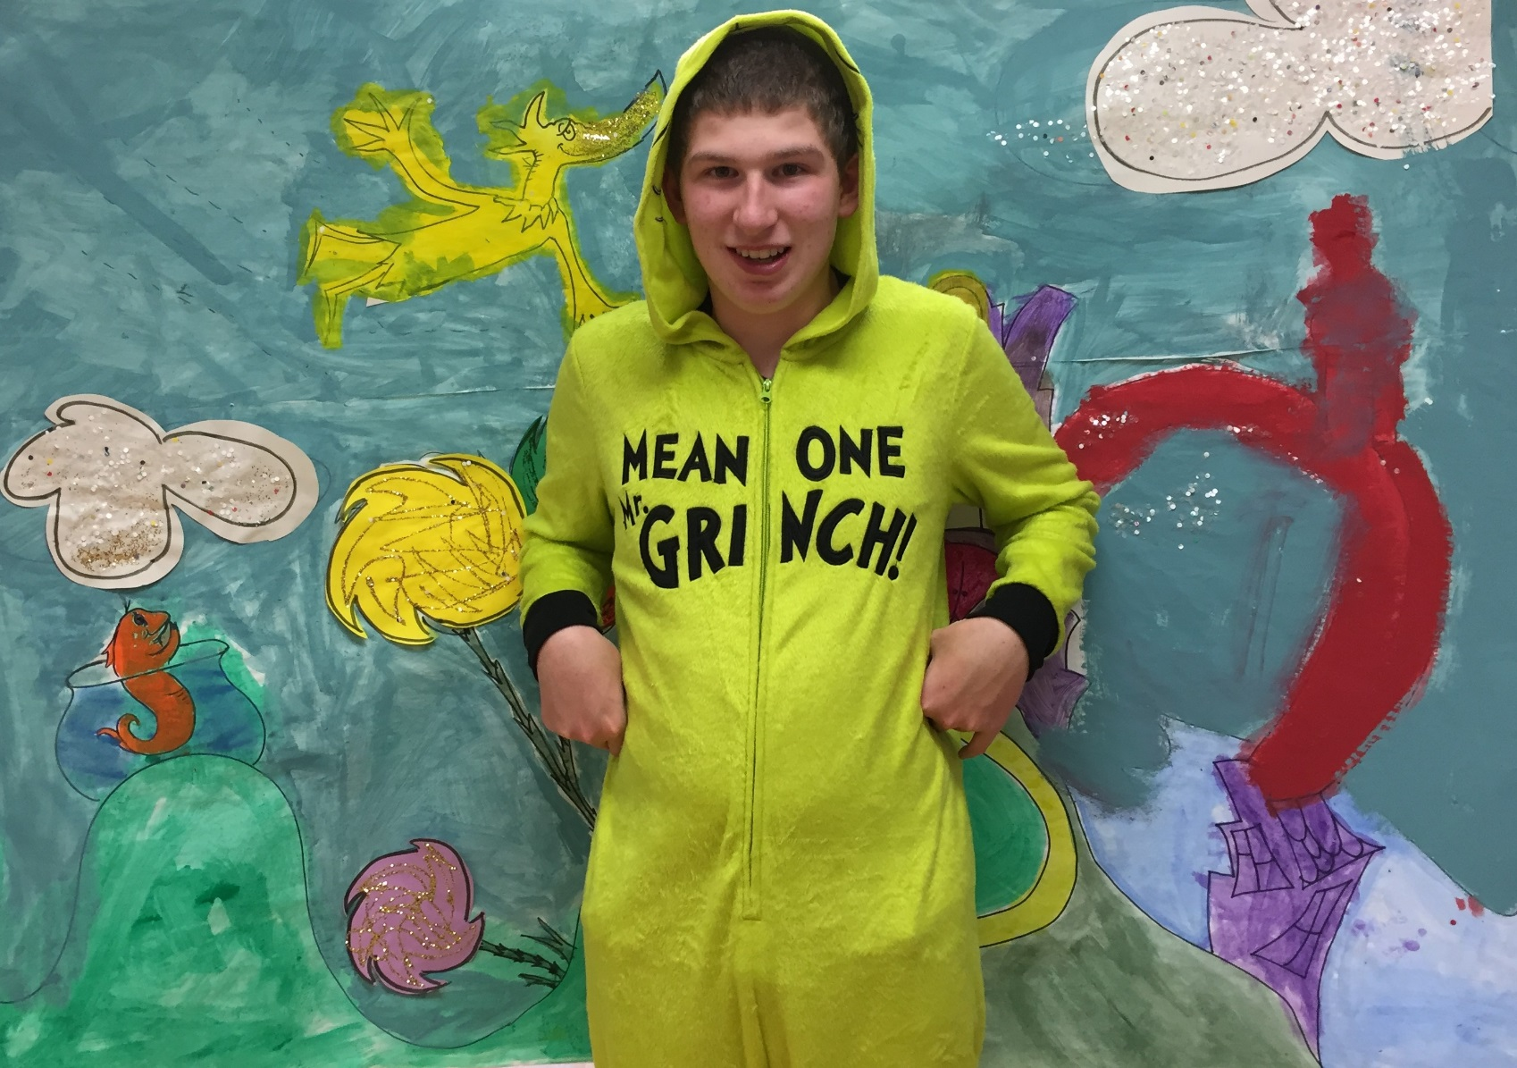
The Grinch started out as mean and unkind
But ended up having a complete change of mind.
We introduce Dr. Seuss!

Slide 7
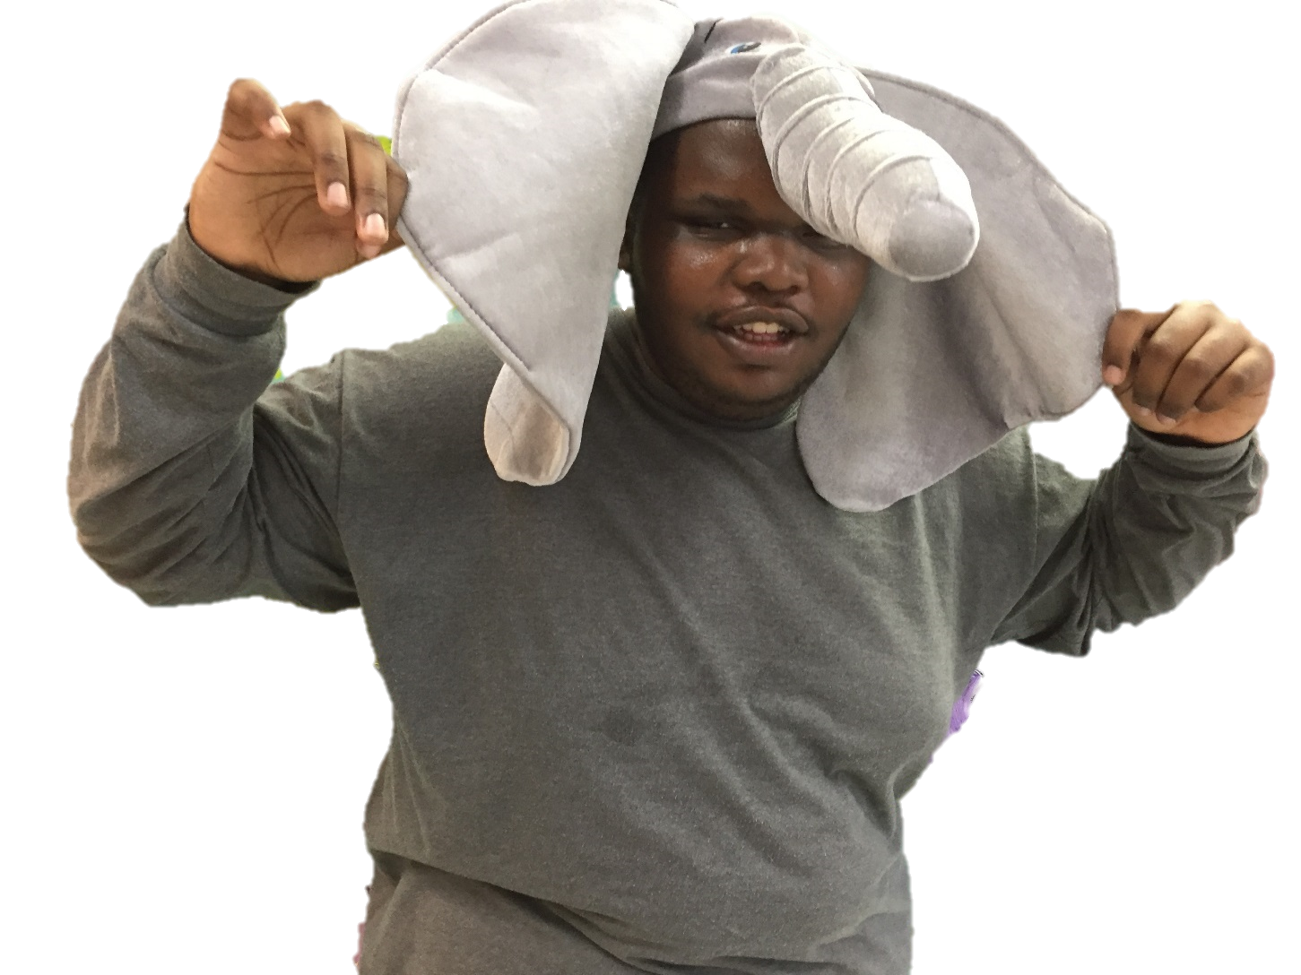
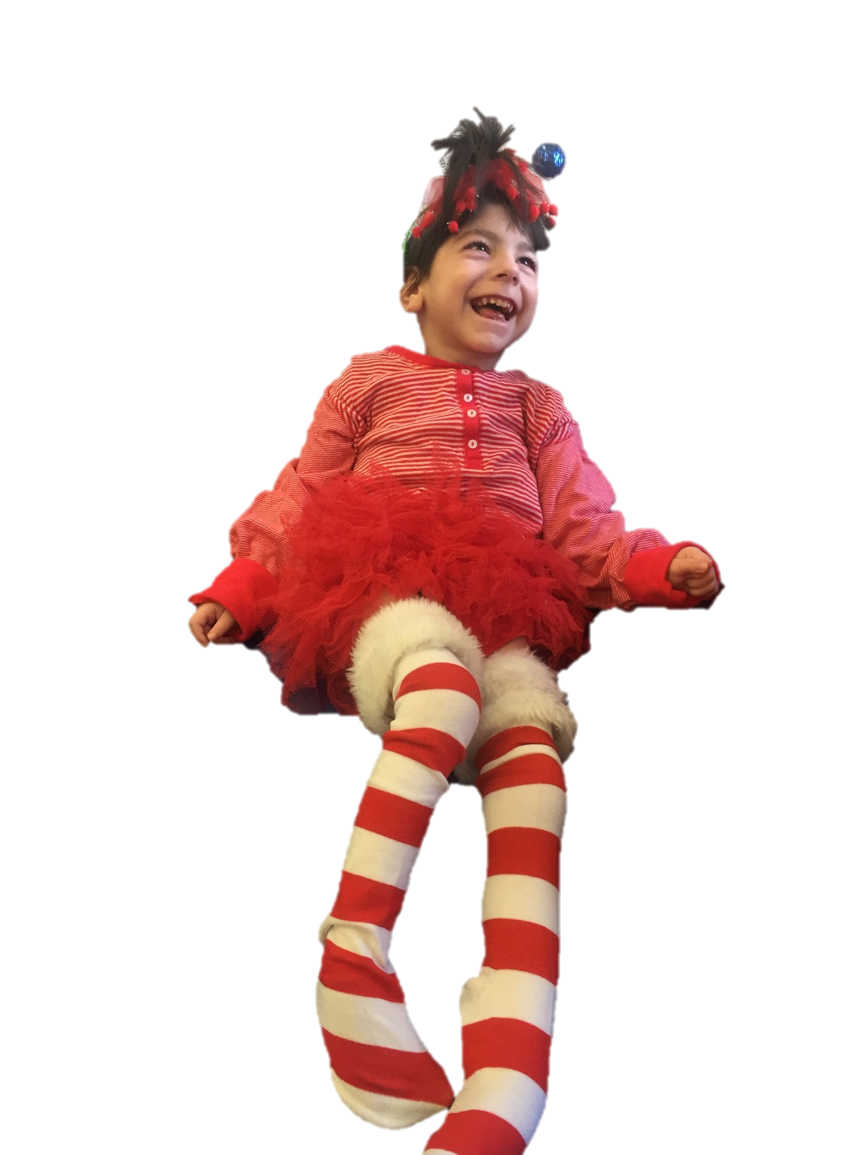
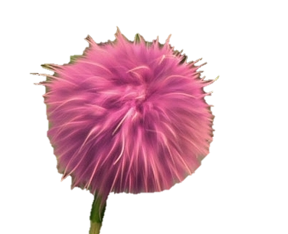
Horton discovered a place called Whoville.
He kept it safe always, spreading his goodwill.
We introduce Dr. Seuss!

Slide 8
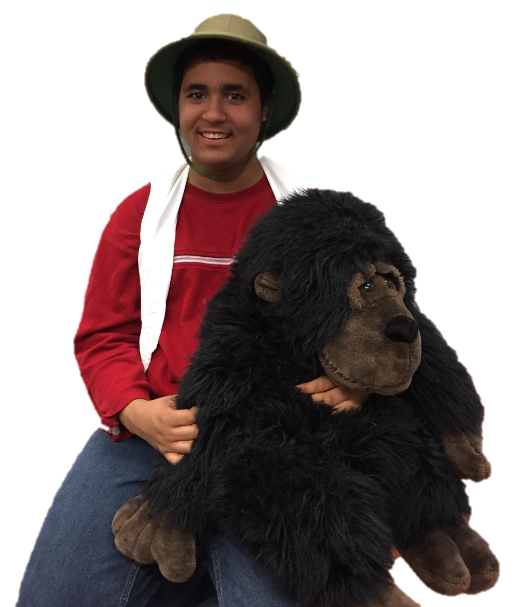
If I ran the zoo, what would I do, you ask?
I’d play with gorillas! That’d be my first task.
We introduce Dr. Seuss!

Slide 9
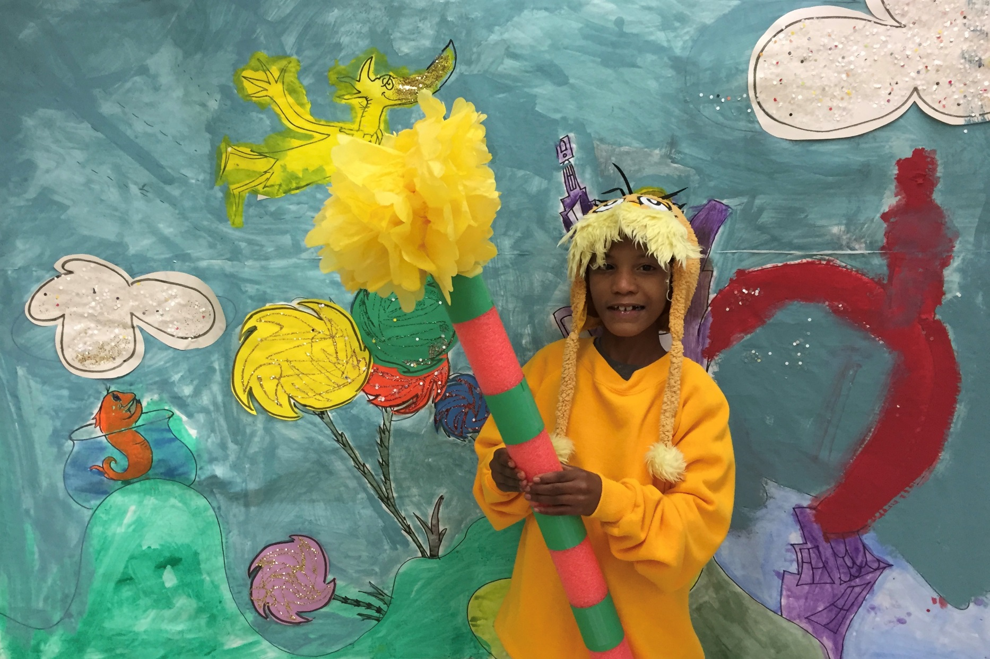
Here is the Lorax: the Keeper of Trees.
Making it safe for the bears and honeybees.
We introduce Dr. Seuss!

Slide 10
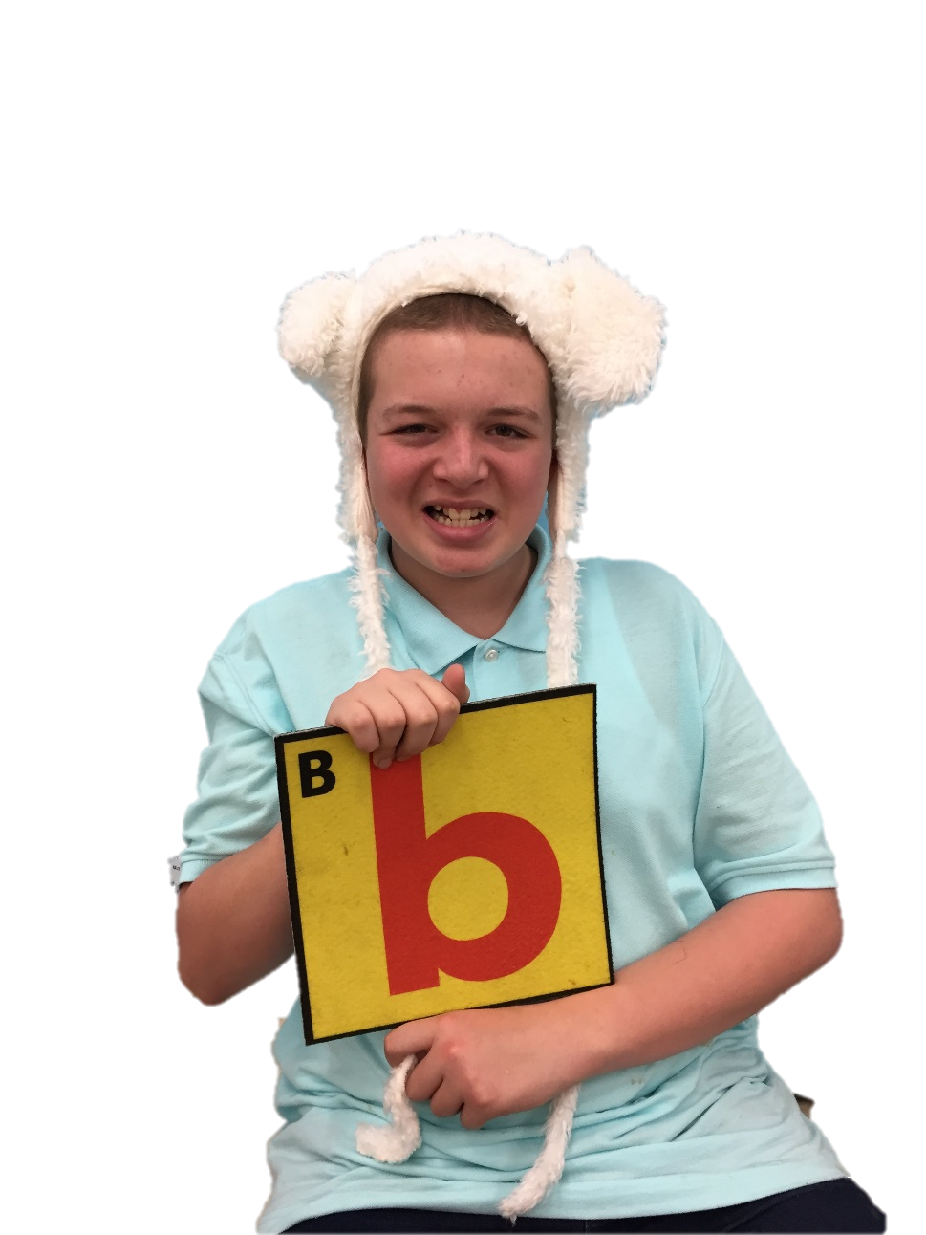
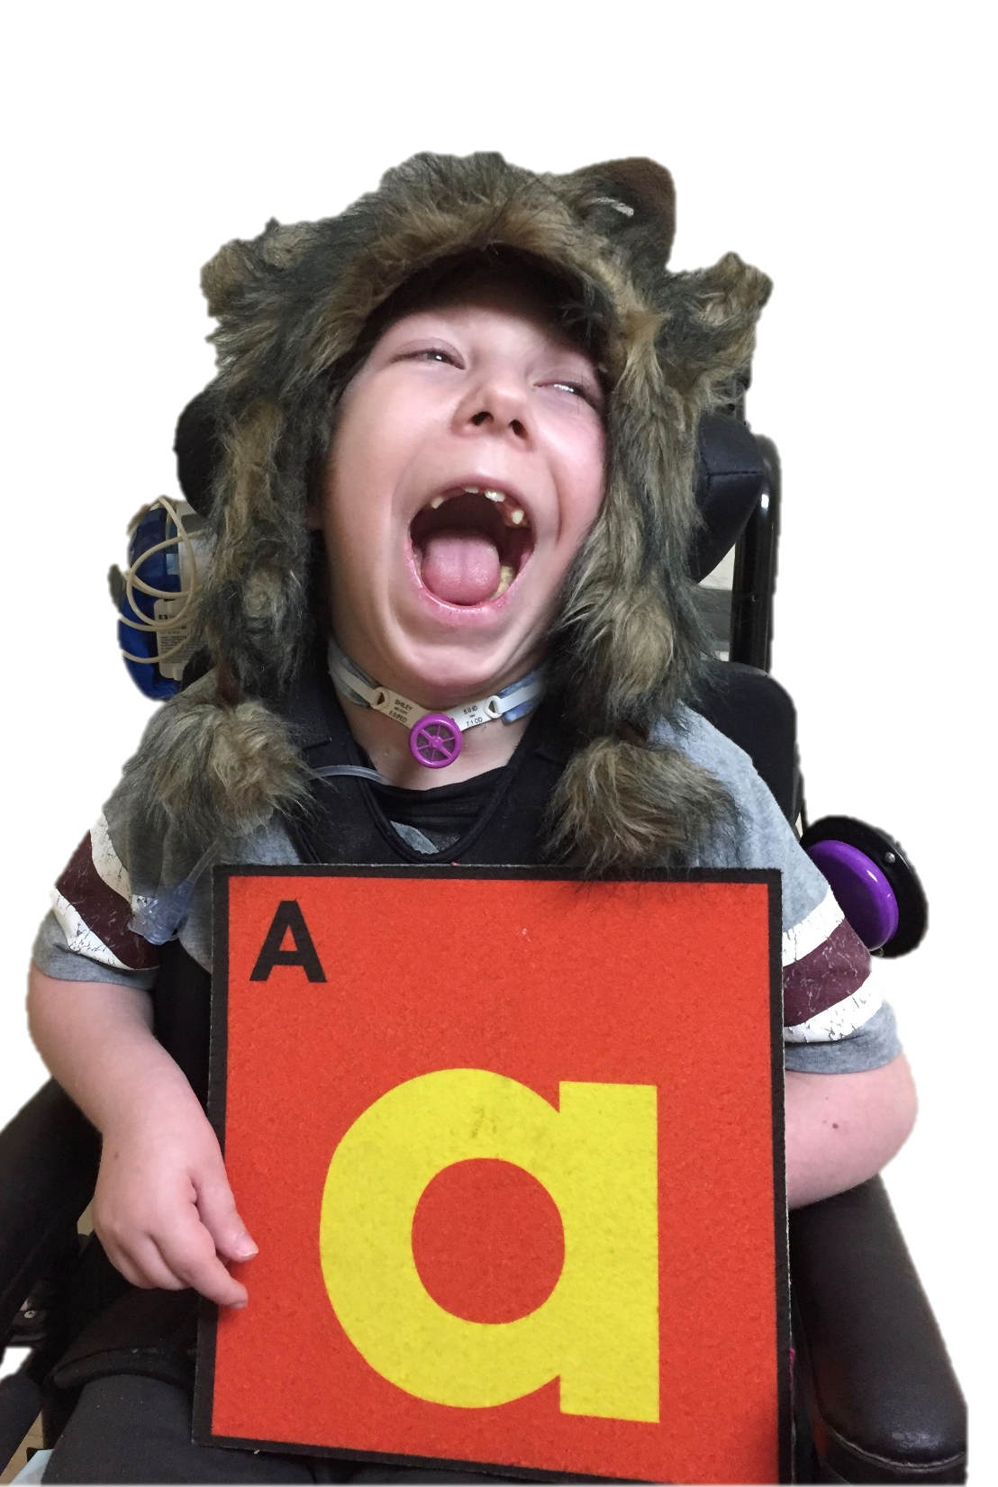
Some words that begin with A, B, and C
Are Apples, Bananas, and Cherry candy
We introduce Dr. Seuss!

Slide 11
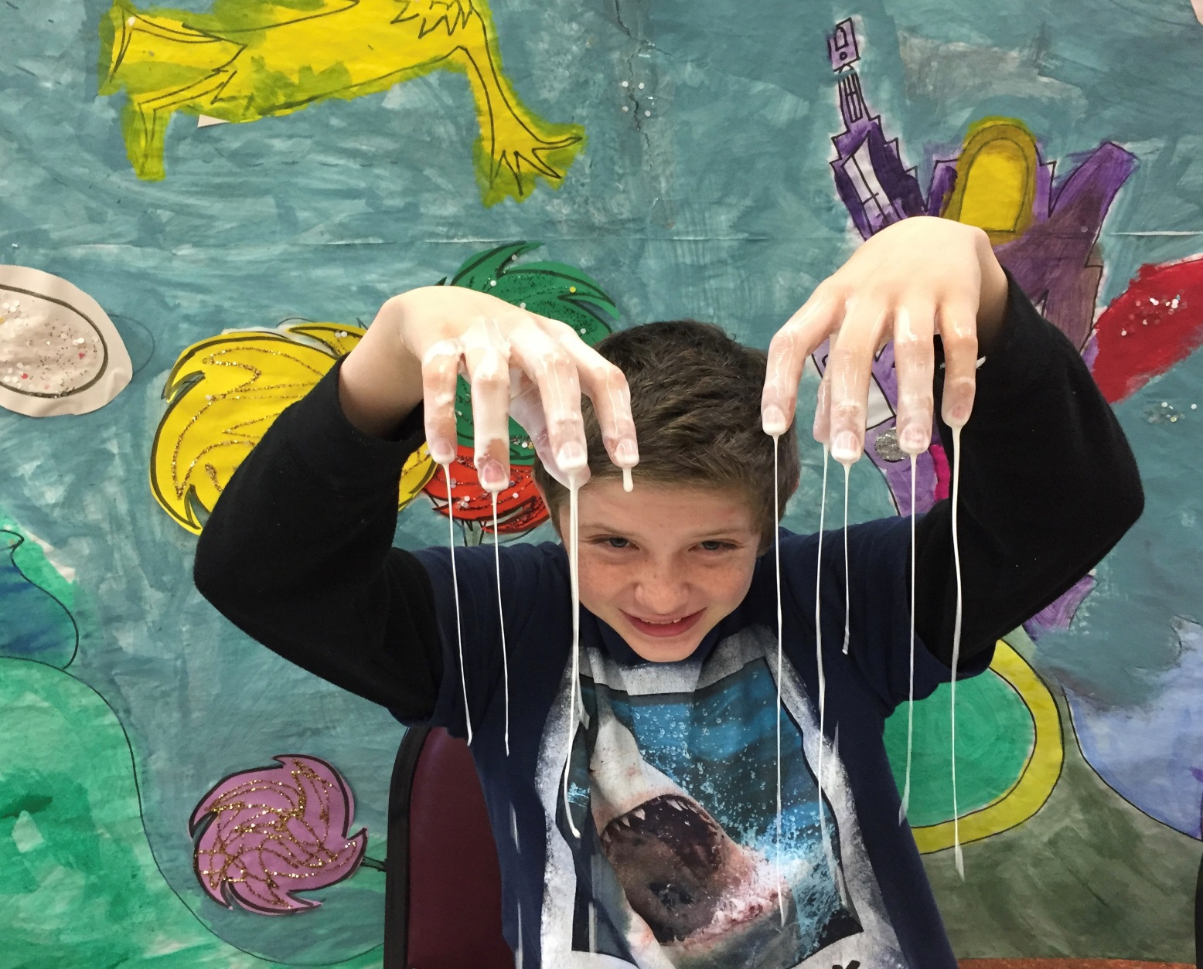
Bartholomew thinks that oobleck is fun!
He watches it drip from his fingers and thumbs.
We introduce Dr. Seuss!

Slide 12
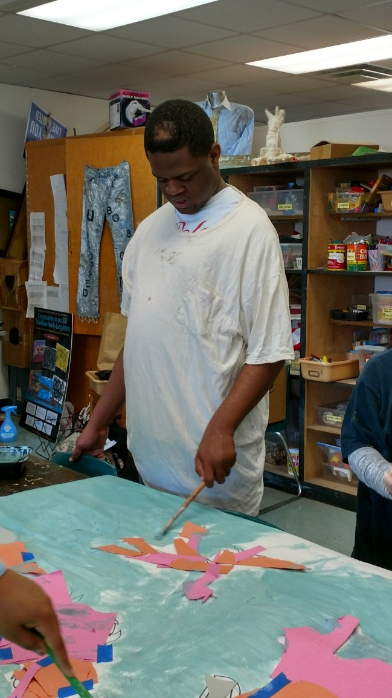
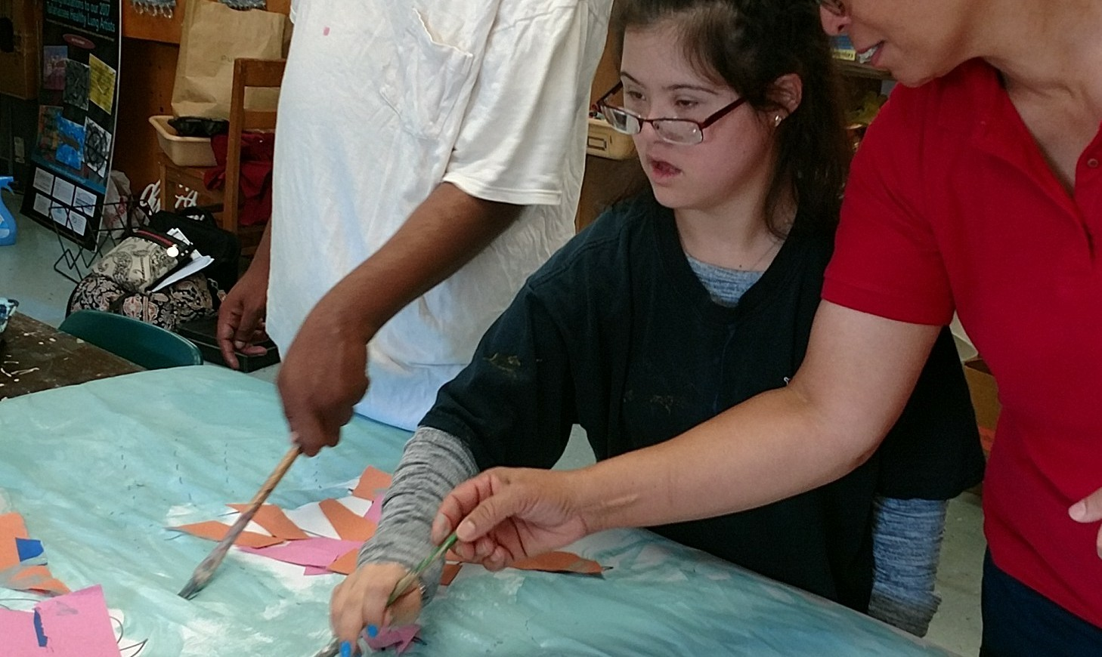
The End
**A special THANK YOU to our art teacher, Judy, and her amazing students for painting
this incredible background for us!

