Slide 1
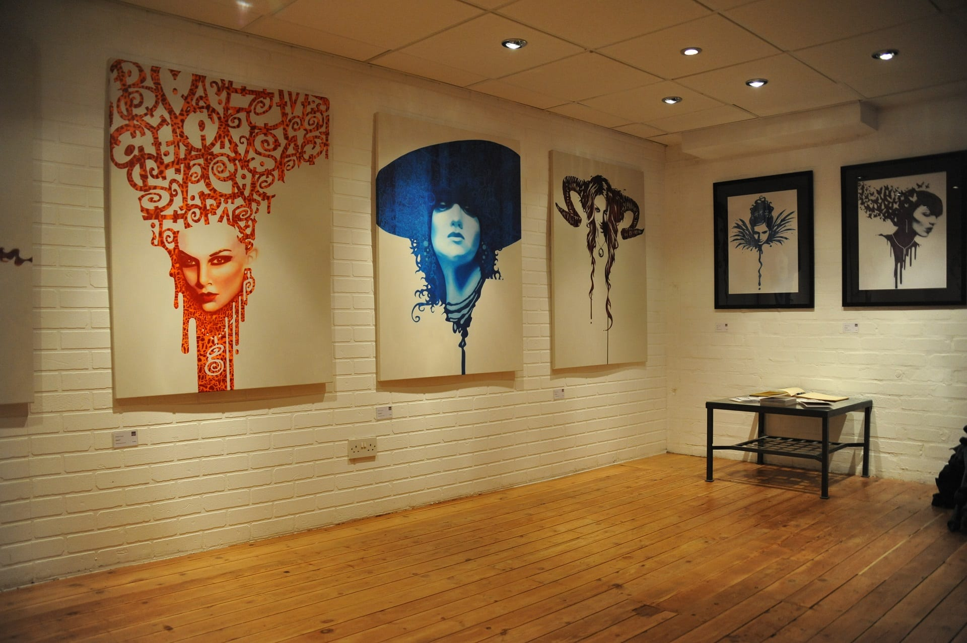
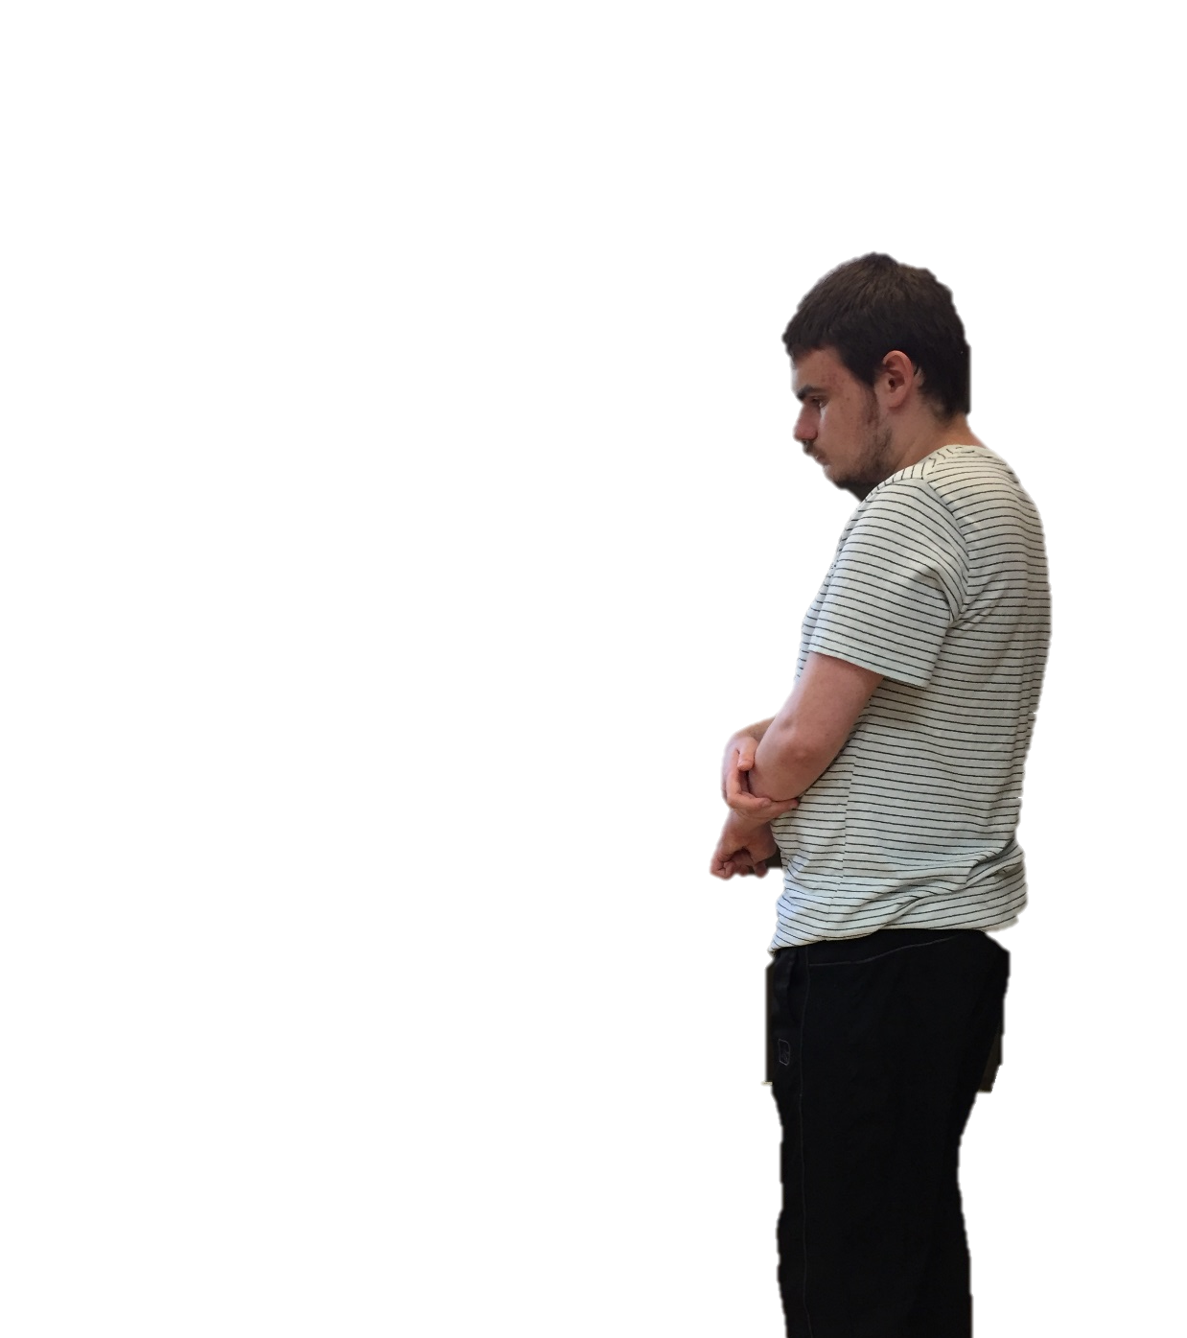
We Celebrate Youth Art Month
By: Cara Edenfield
Groupbygroup.wordpress.com

Slide 2
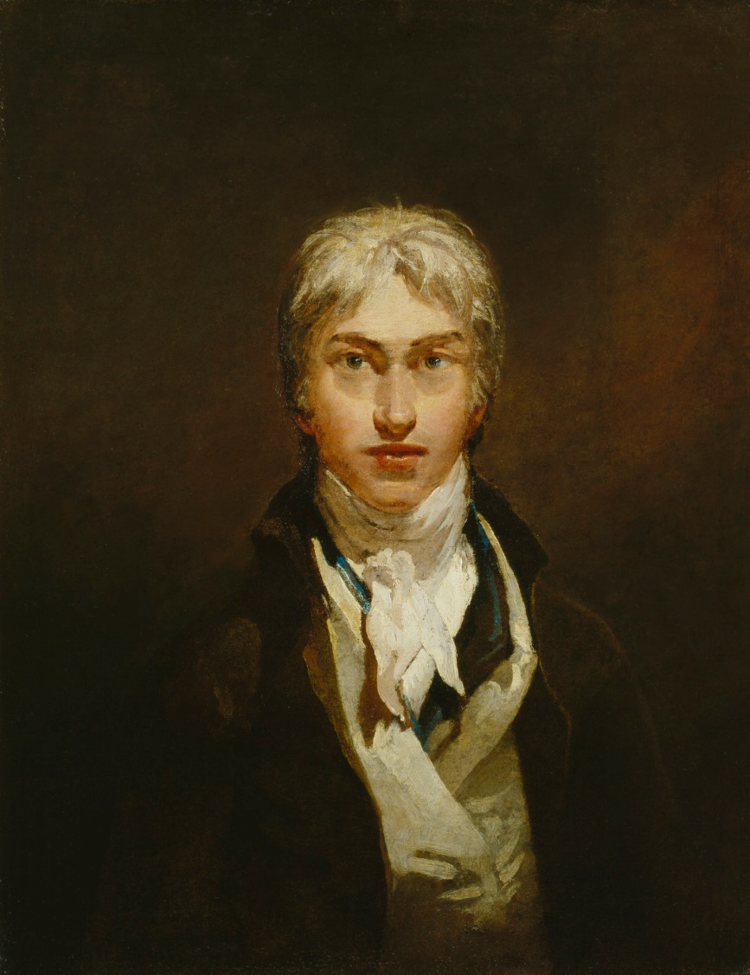
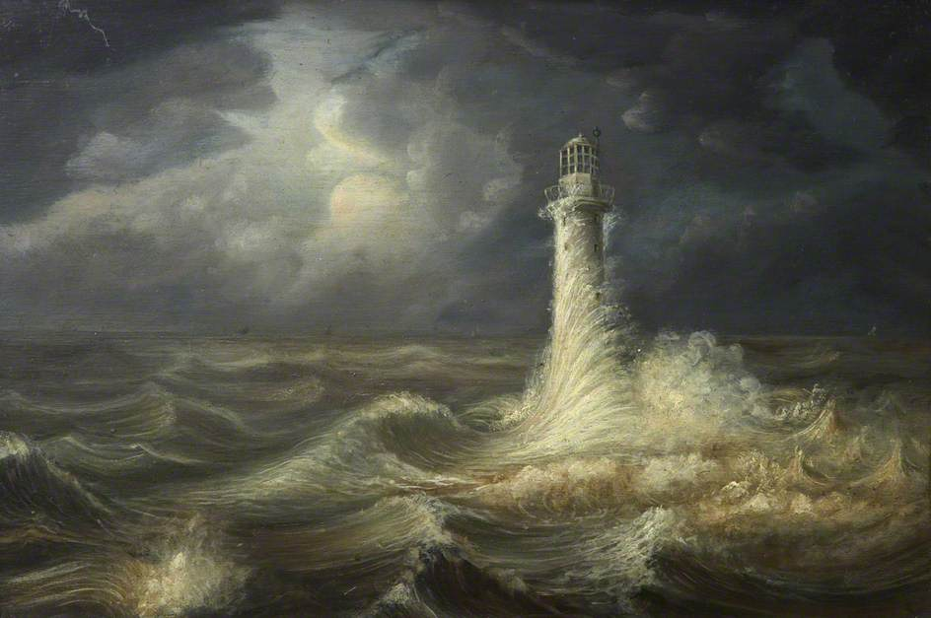
J.M.W. Turner was an English Romanticist artist
who liked to paint seascapes.
We celebrate Youth Art Month

Slide 3
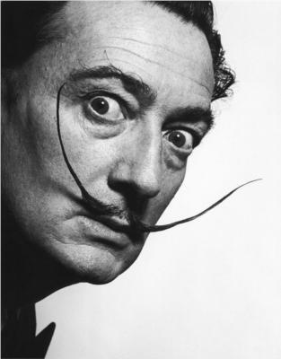
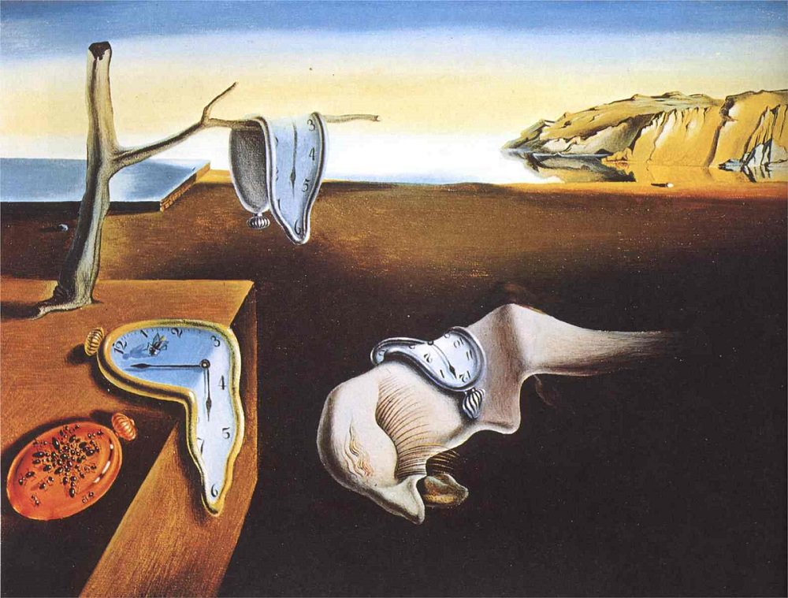
Salvador Dali was a Spanish surrealist painter
who painted unusual scenes.
We celebrate Youth Art Month

Slide 4
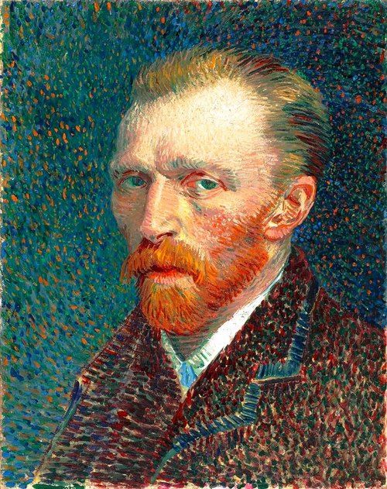
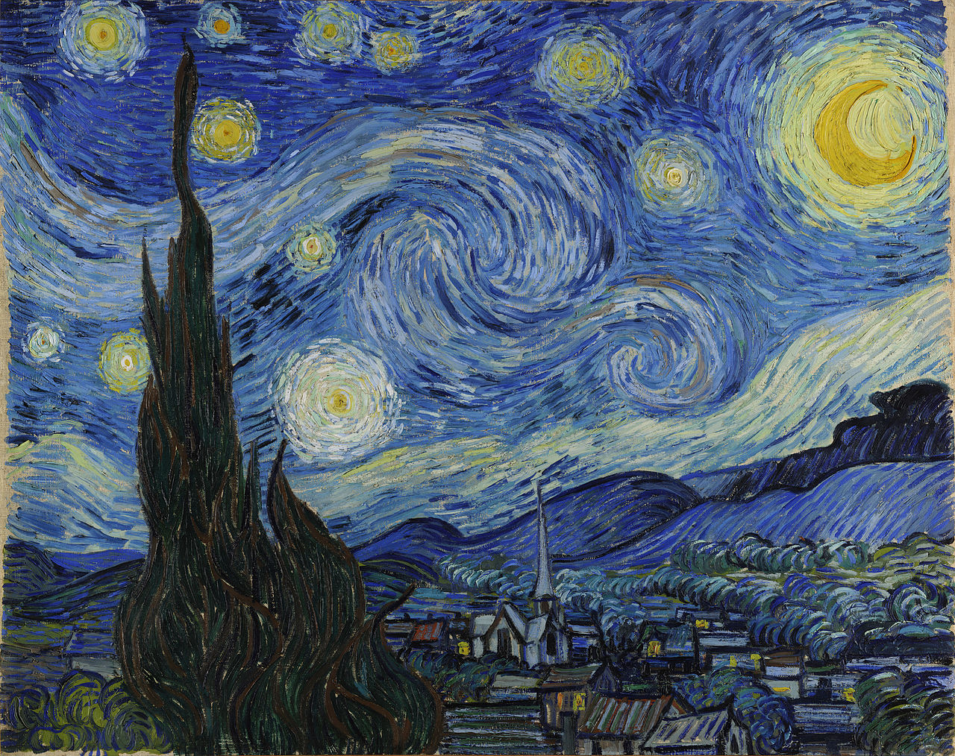
Vincent van Gogh was a Dutch Post-Impressionist painter
who painted landscapes, still lifes, portraits and self-portraits.
We celebrate Youth Art Month

Slide 5
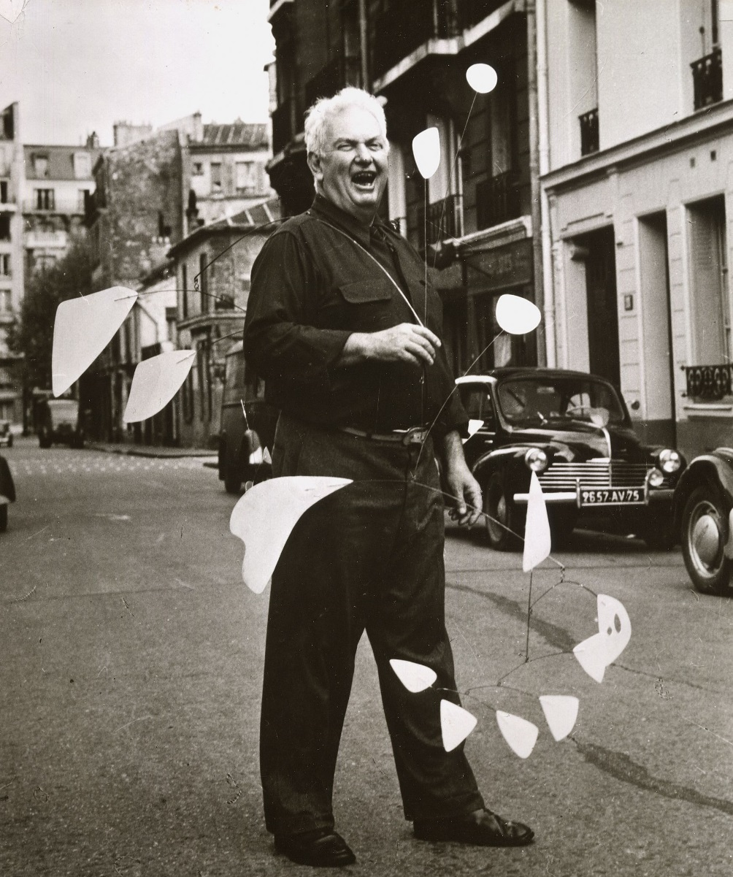
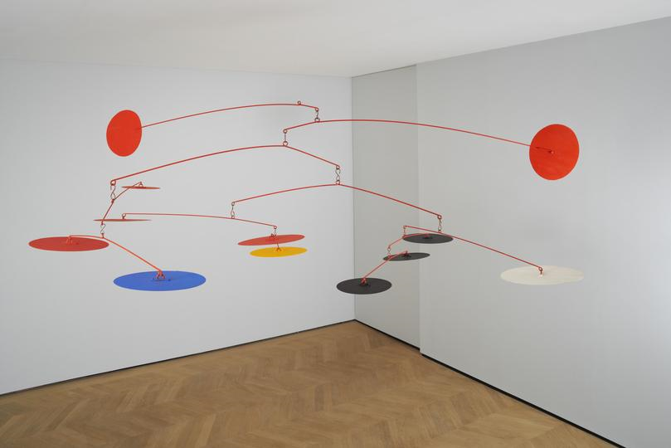
Alexander Calder was an American sculptor known as
the originator of the mobile.
We celebrate Youth Art Month

Slide 6
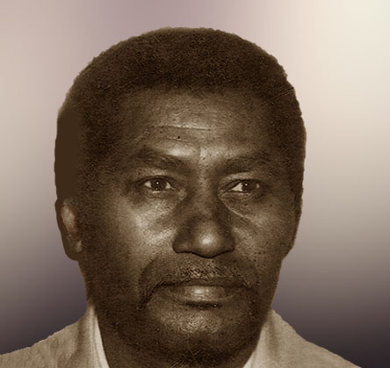
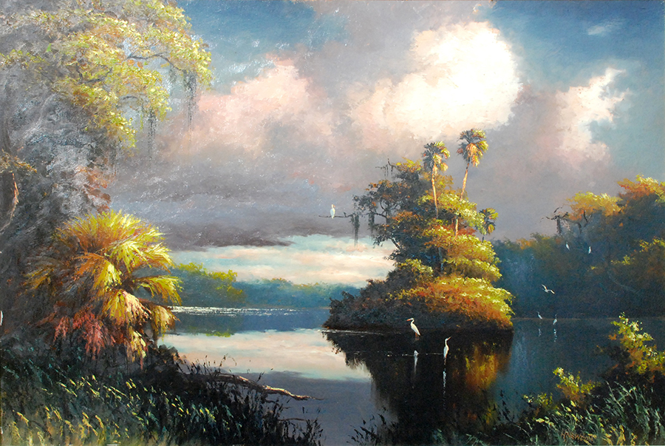
Harold Newton was a central and founding member of the group
of African-American artists known as the Florida Highwaymen.
We celebrate Youth Art Month

Slide 7
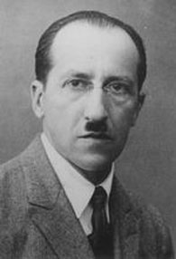
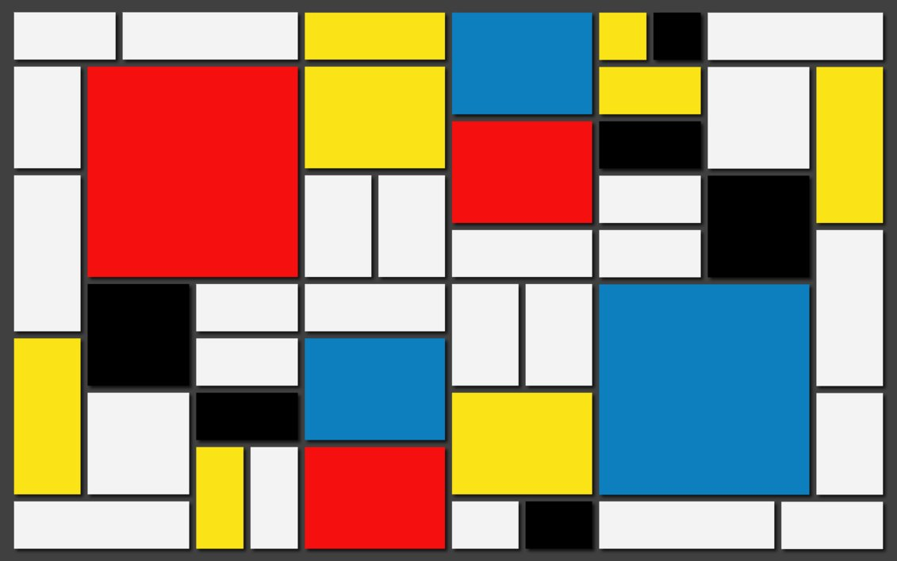
Piet Mondrian was a Dutch painter who painted grids of
vertical and horizontal black lines and the three primary colors.
We celebrate Youth Art Month

Slide 8
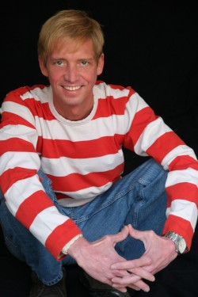
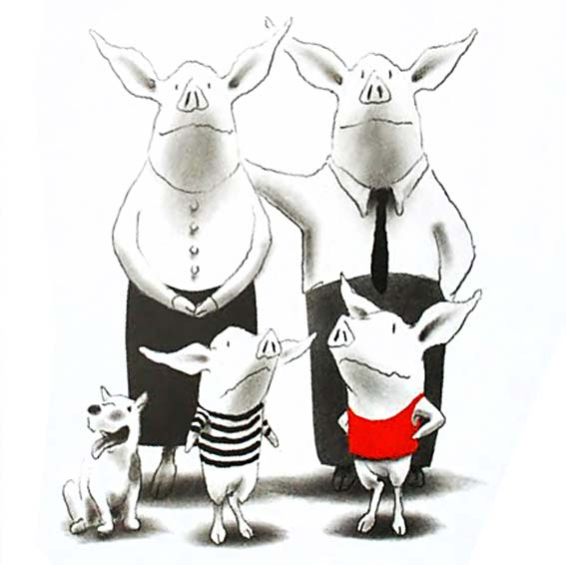
Ian Falconer is an American illustrator who
illustrates the pictures in the Olivia the Pig books.
We celebrate Youth Art Month

Slide 9
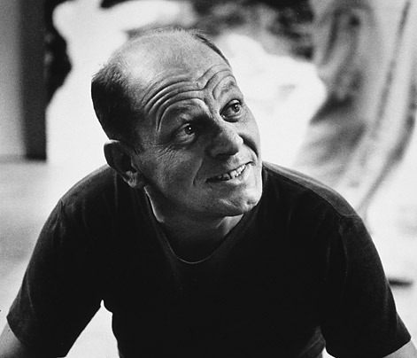
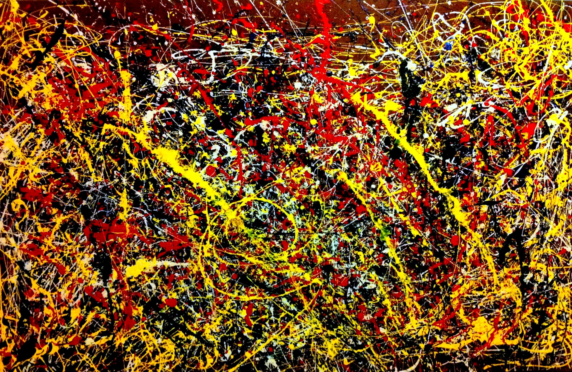
Jackson Pollock was an American painter and a major figure
in the abstract expressionist movement
We celebrate Youth Art Month

Slide 10
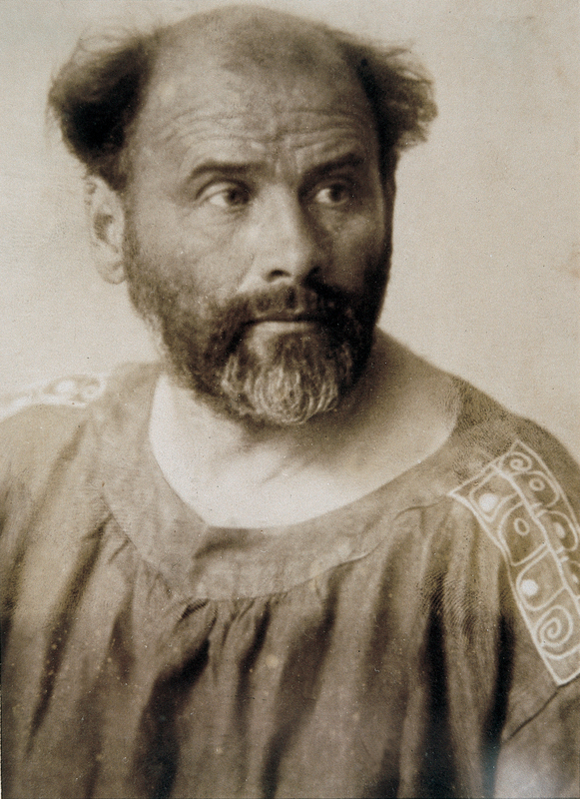
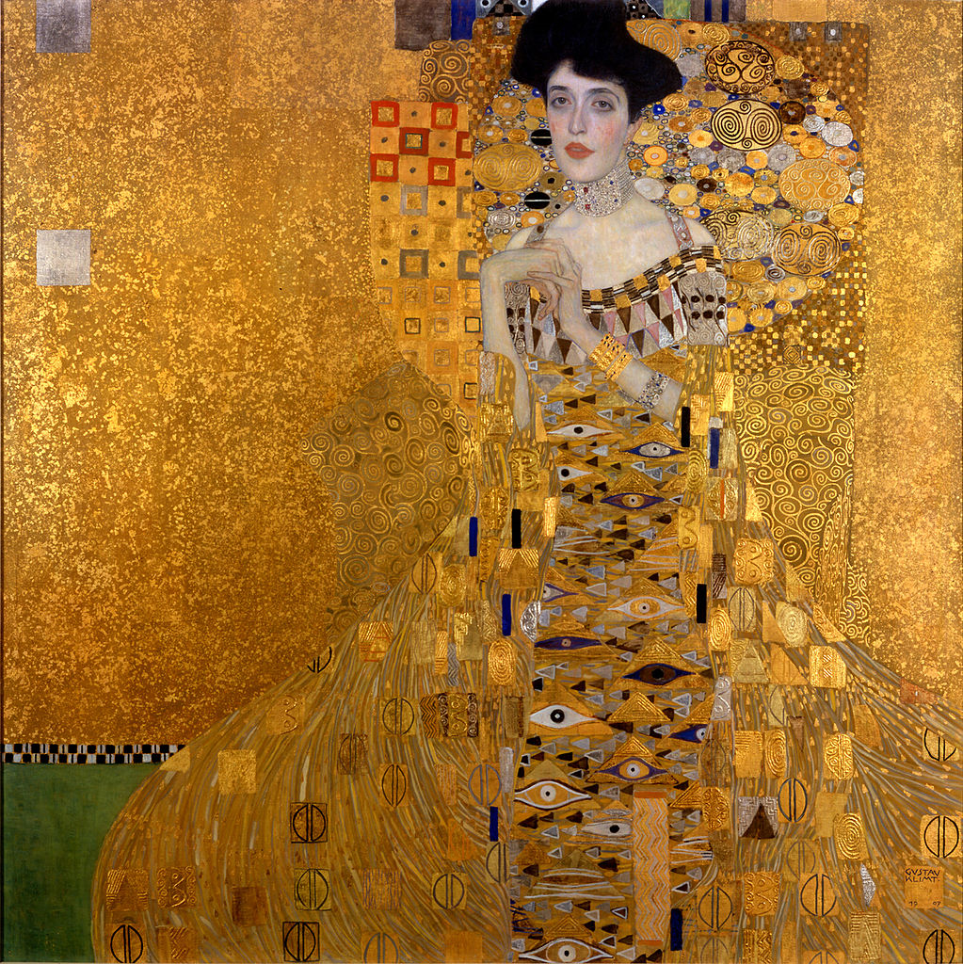
Gustav Klimt was an Austrian symbolist painter who
used metallic gold leaf in his art.
We celebrate Youth Art Month

Slide 11
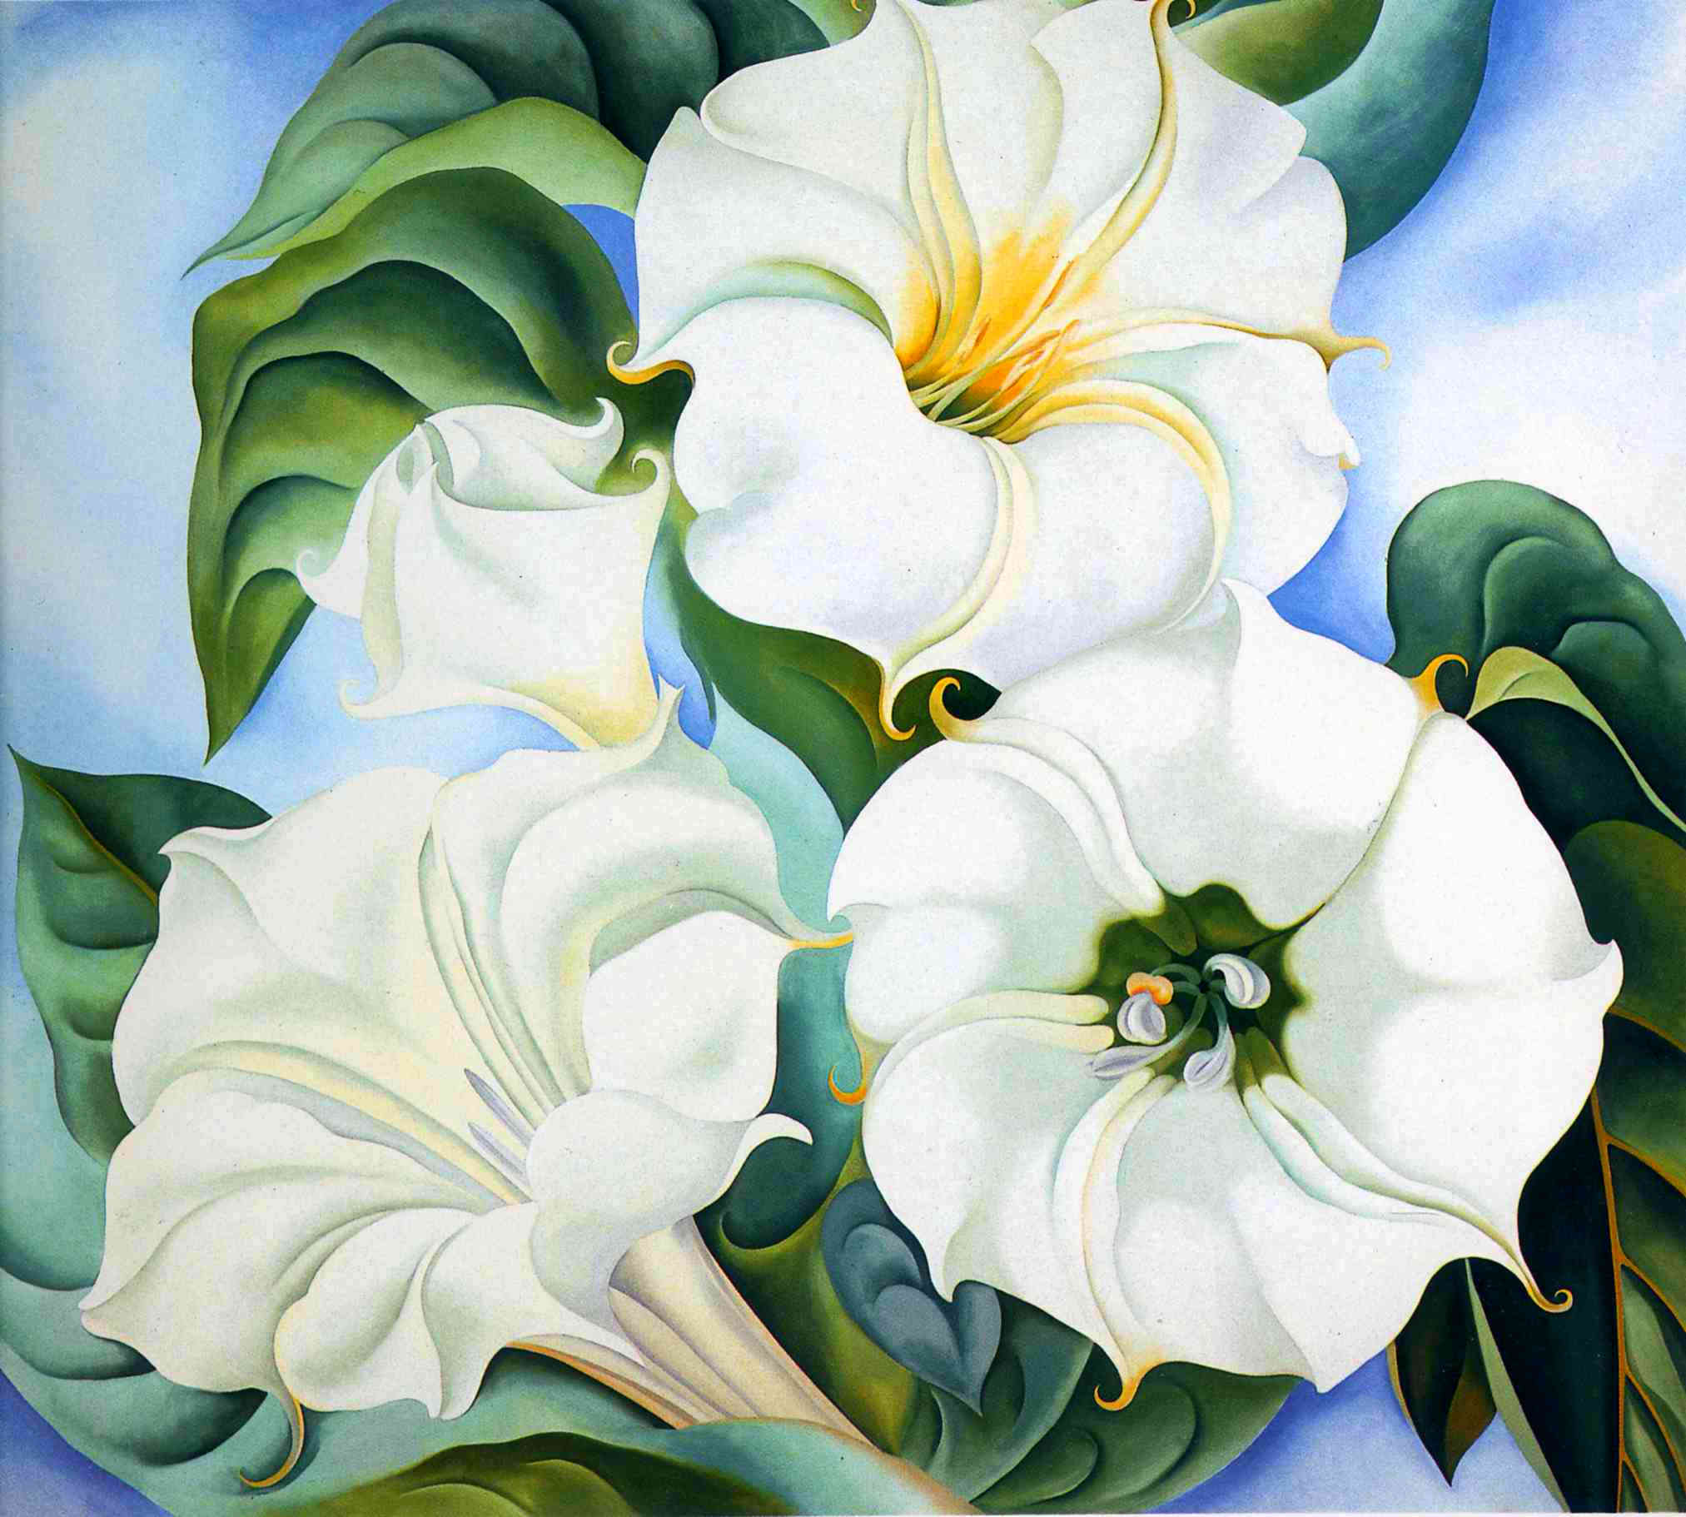
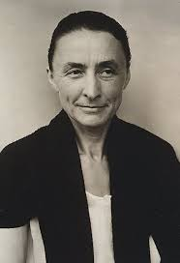
Georgia O'Keeffe was an American artist who
was best known for her paintings of enlarged flowers
We celebrate Youth Art Month

Slide 12
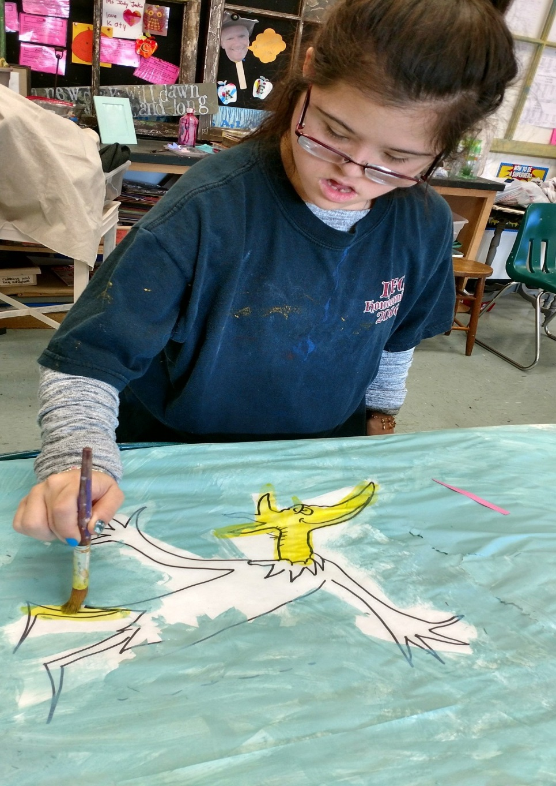
The End

