Slide 1
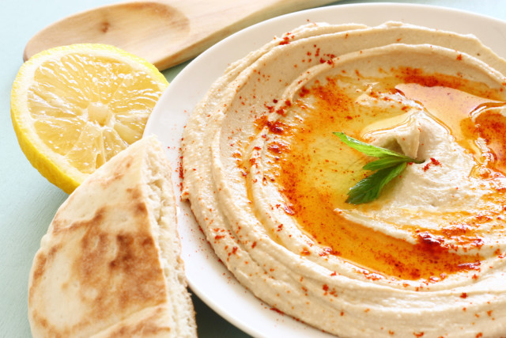
Let’s Make Hummus!

Slide 2
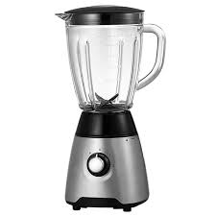
Put 2 tbsp. of olive oil into a blender.

Slide 3
Add 4 tbsp. of lemon juice to the blender.

Slide 4
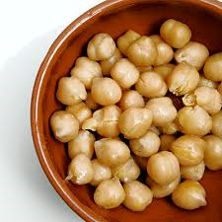
Put 1 can of drained and rinsed garbanzo beans into the blender.

Slide 5
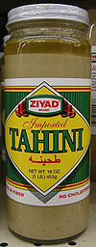
Add 2 tbsp. of tahini to the blender.

Slide 6
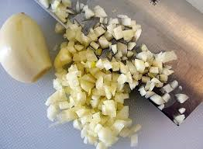
Add 1 tsp. of chopped garlic to the food processor.

Slide 7
Add ½ tsp of salt to the blender.

Slide 8
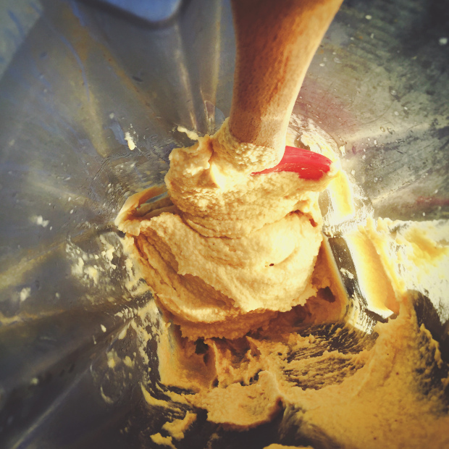
Blend all of the ingredients up until they are mixed and smooth.
Add water to the blender as needed.

Slide 9
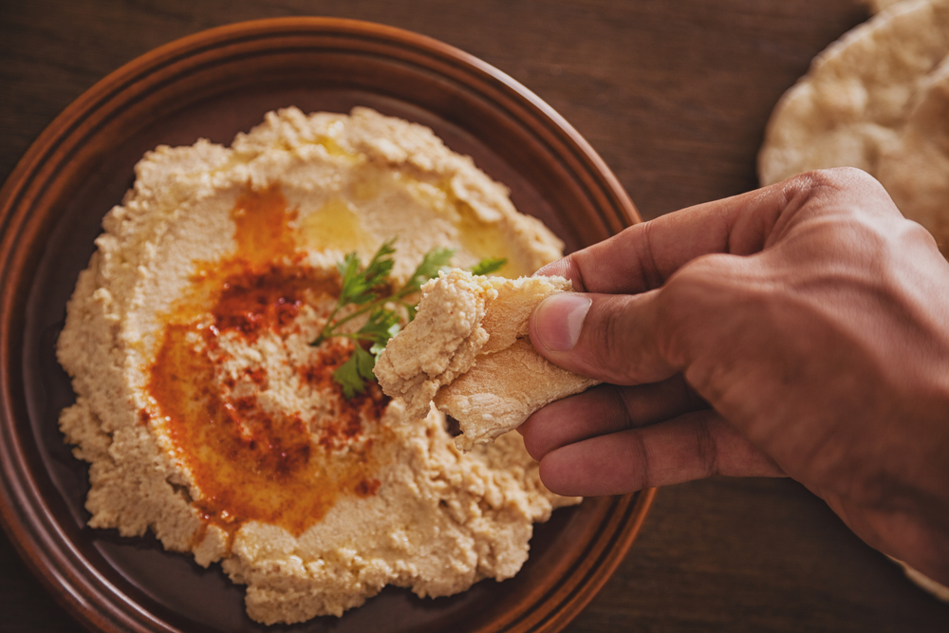
Eat with pita bread and enjoy!

