Slide 1
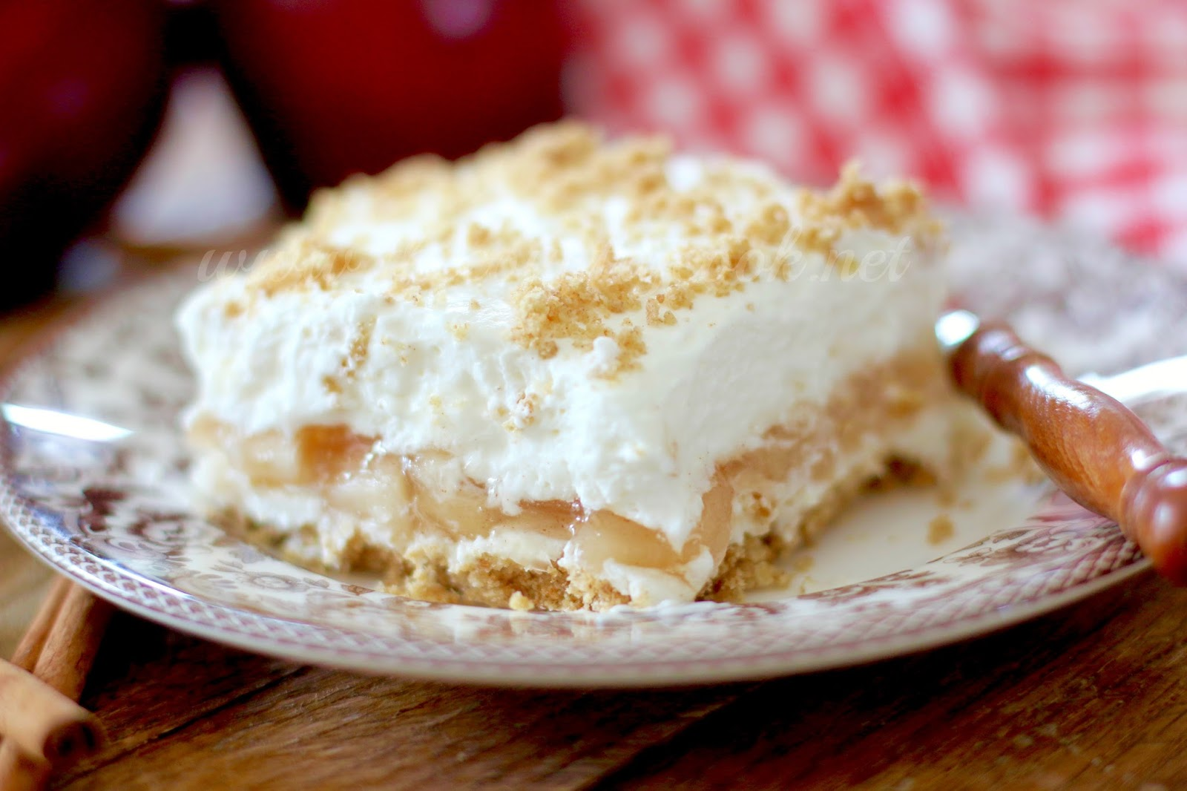
Let’s Make an Apple Delicious Dessert!

Slide 2
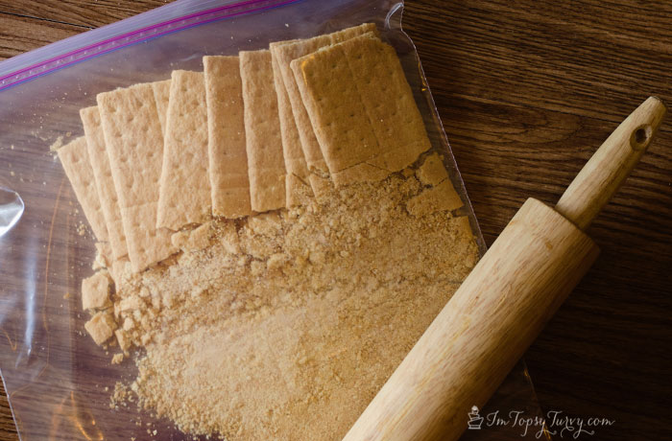
Put 10 cinnamon graham crackers in a bag and
crush them up.

Slide 3
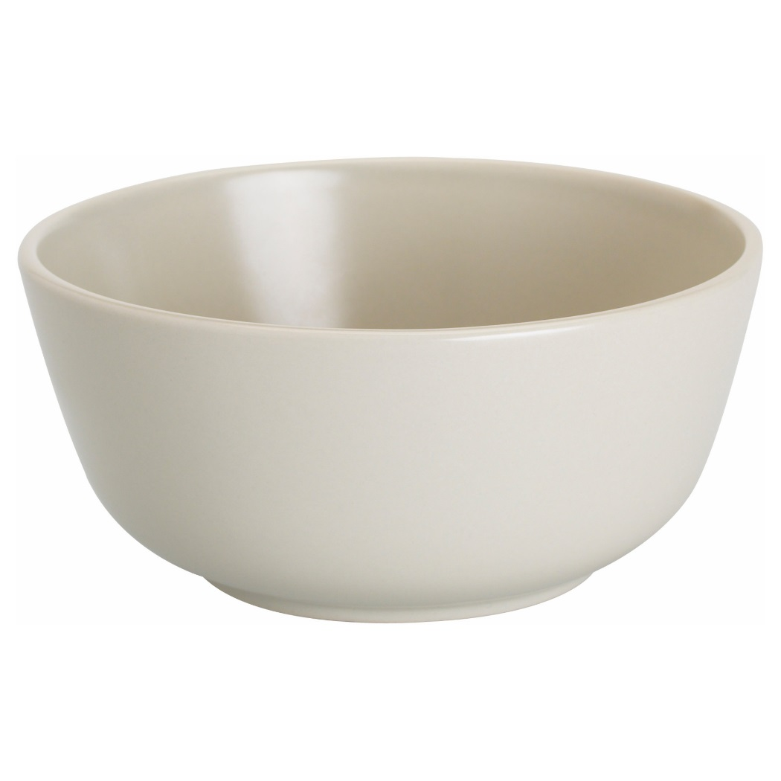
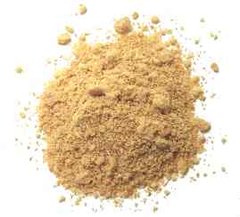
Combine the graham crackers and 6 tbsp. melted
Butter. Set aside 2 tbsp. of the crumbs for later.

Slide 4
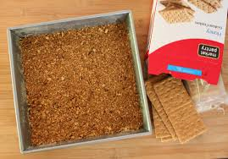
Spread the rest of the crumbs into a 9x9 baking dish.
Push down to make a flat layer.

Slide 5
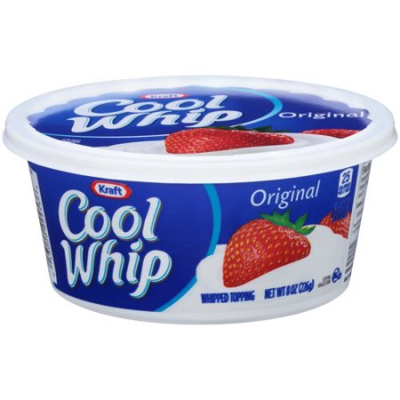
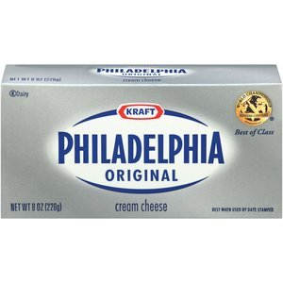
Put a thawed 8 oz tub of whipped cream and an
8 oz block of softened cream cheese into a bowl
and mix up.

Slide 6
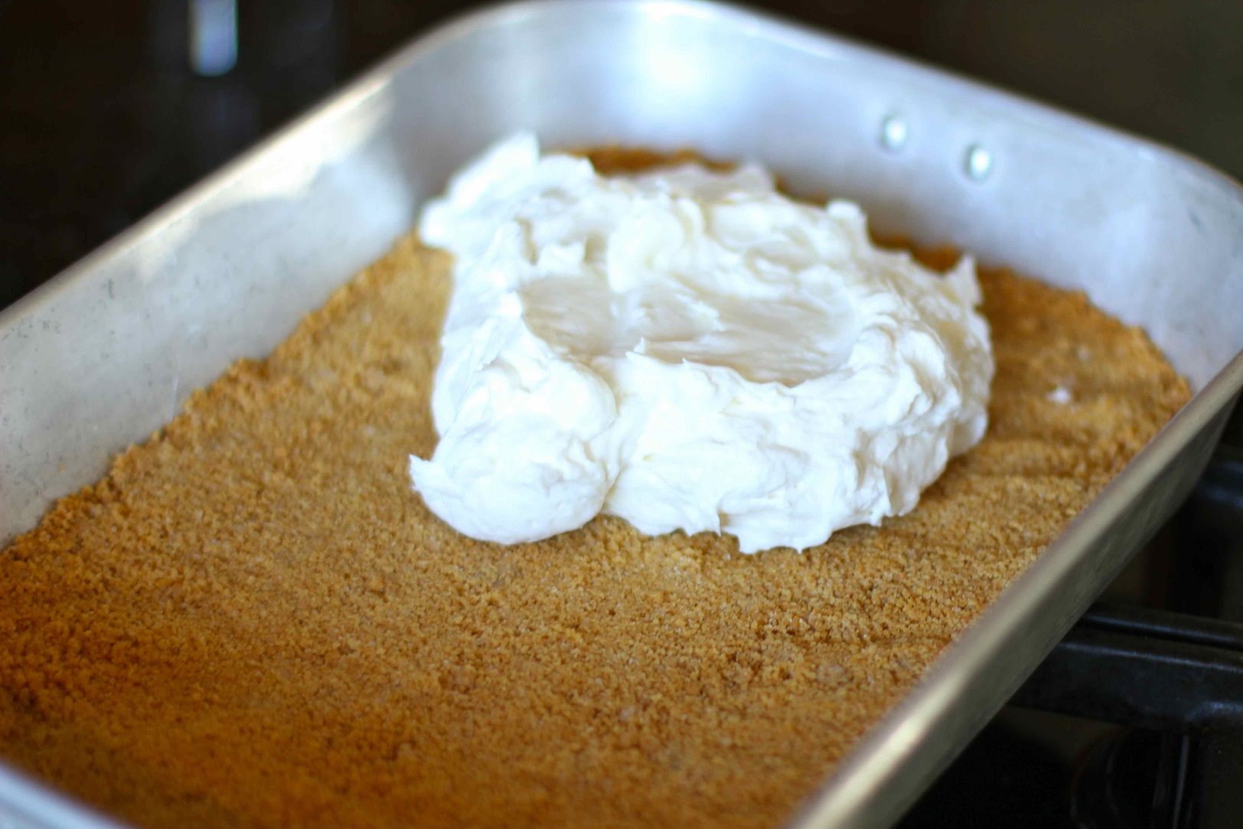
Spread half of the whipped cream mixture
over the graham cracker crust.

Slide 7
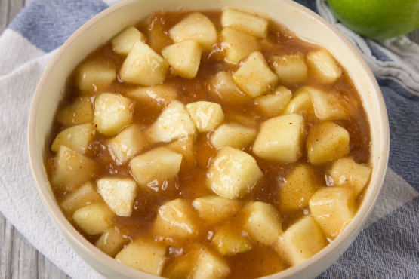
Spread a 21 oz can of apple pie filling
on top of the whipped cream.

Slide 8
Spread the rest of the whipped cream over the apples
and sprinkle the rest of the graham crackers on top.

Slide 9
Eat and Enjoy!

