Slide 1
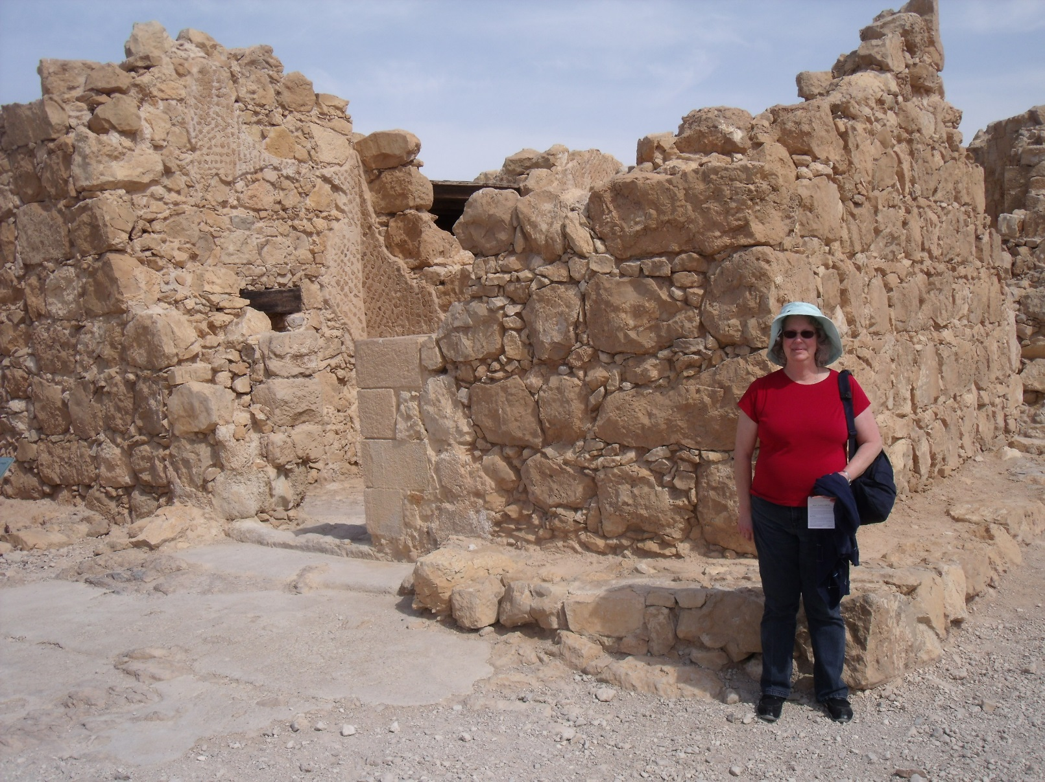
Let’s Learn About Israel
By: Cara Edenfield
Groupbygroup.wordpress.com

Slide 2
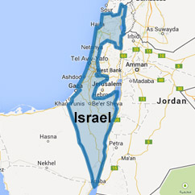
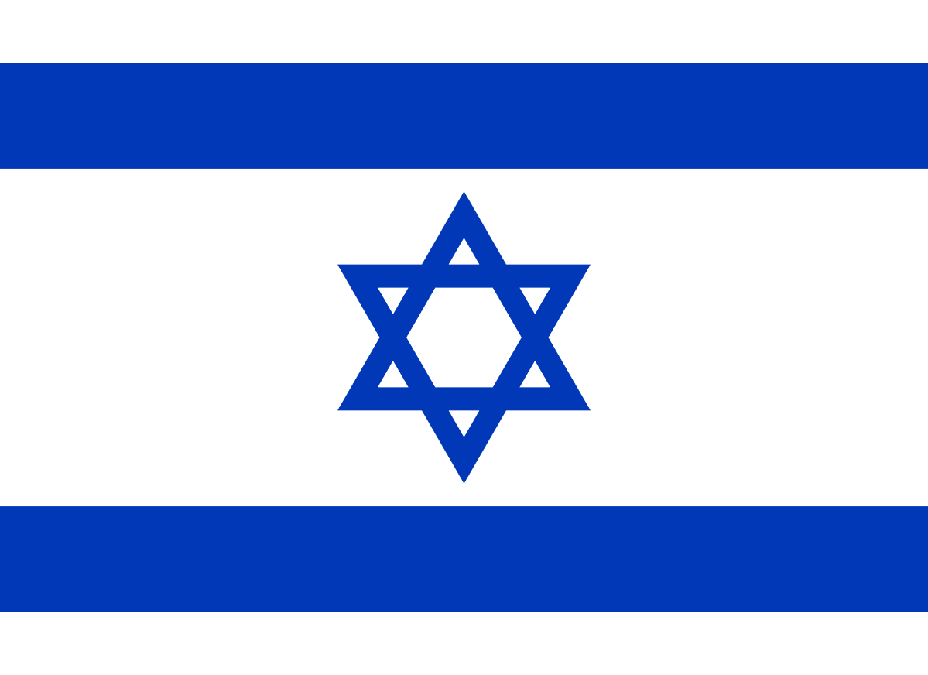
Israel is a small country in the Middle East
about the size of the state of New Jersey.
Let’s learn about Israel

Slide 3
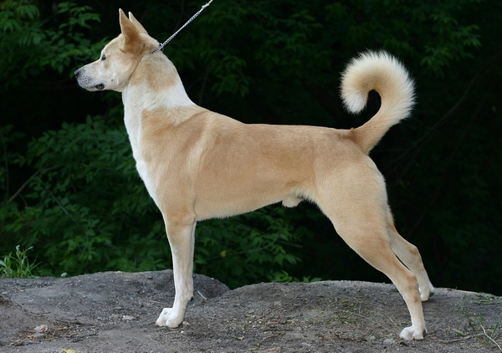
The Canaan dog is the national dog breed of Israel.
Let’s learn about Israel

Slide 4
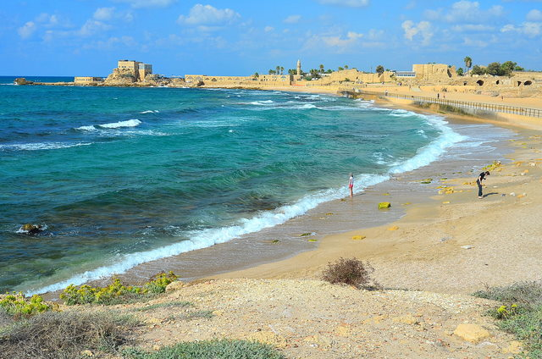
The Mediterranean Sea covers the
western border of Israel.
Let’s learn about Israel

Slide 5
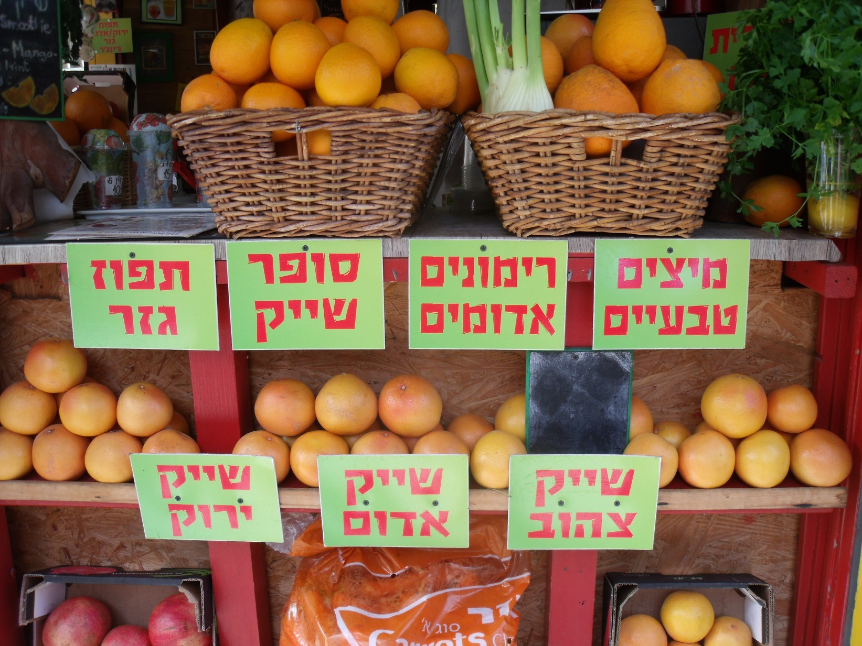
Israel is one of the world's leading fresh citrus
producers and exporters.
Let’s learn about Israel

Slide 6
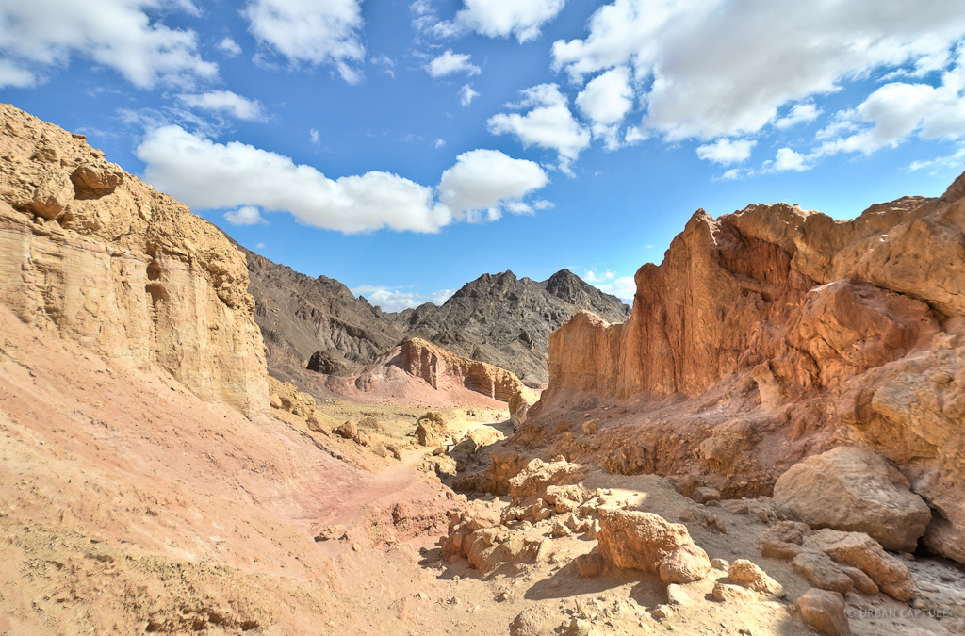
The Negev Desert covers over half of
Israel’s total land area.
Let’s learn about Israel

Slide 7
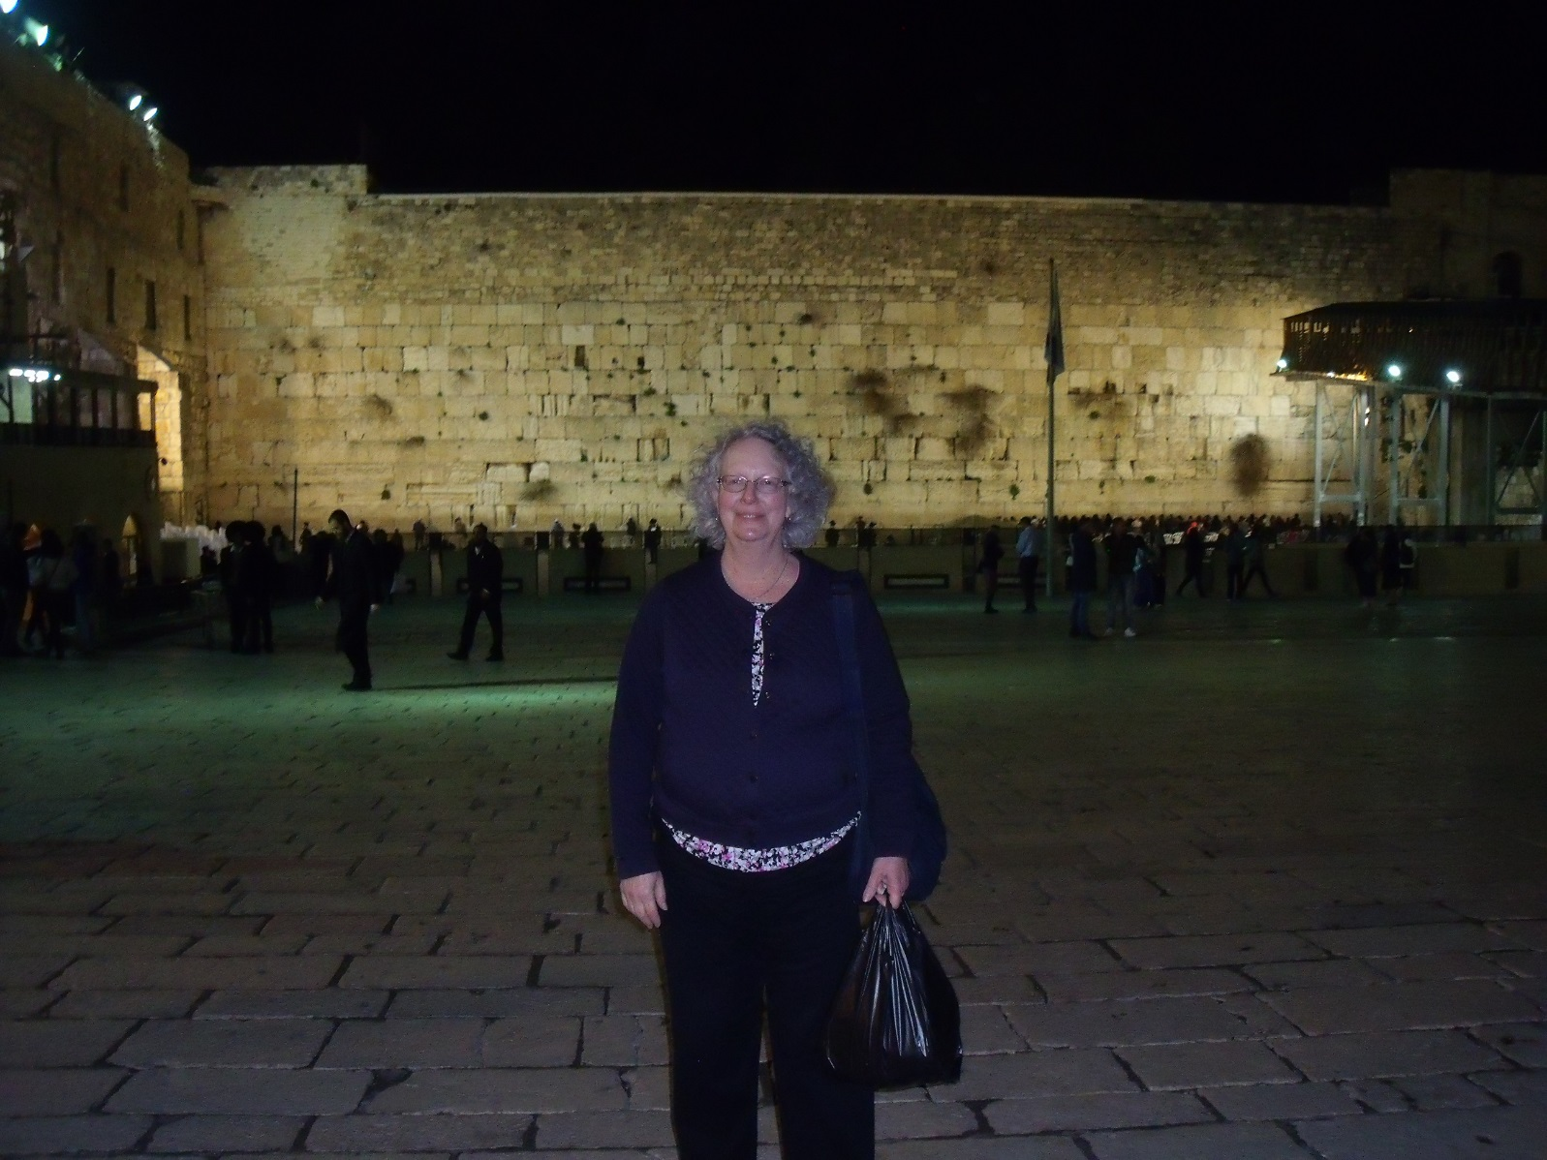
The Western Wall is an ancient limestone wall
in the Old City of Jerusalem.
Let’s learn about Israel

Slide 8
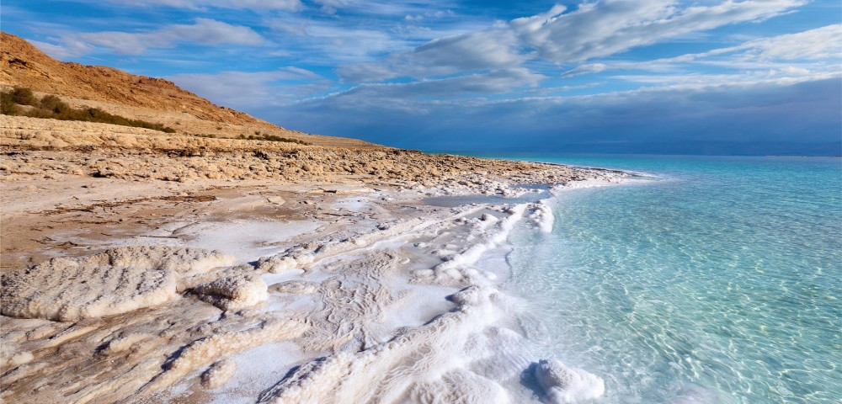
The Dead Sea, which borders Israel, is 1,388 ft below
sea level, making it Earth’s lowest elevation on land.
Let’s learn about Israel

Slide 9
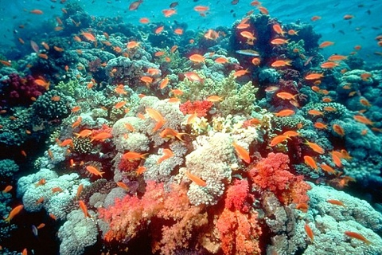
The Red Sea, near the city of Eilat, contains
Israel’s only coral reef.
Let’s learn about Israel

Slide 10
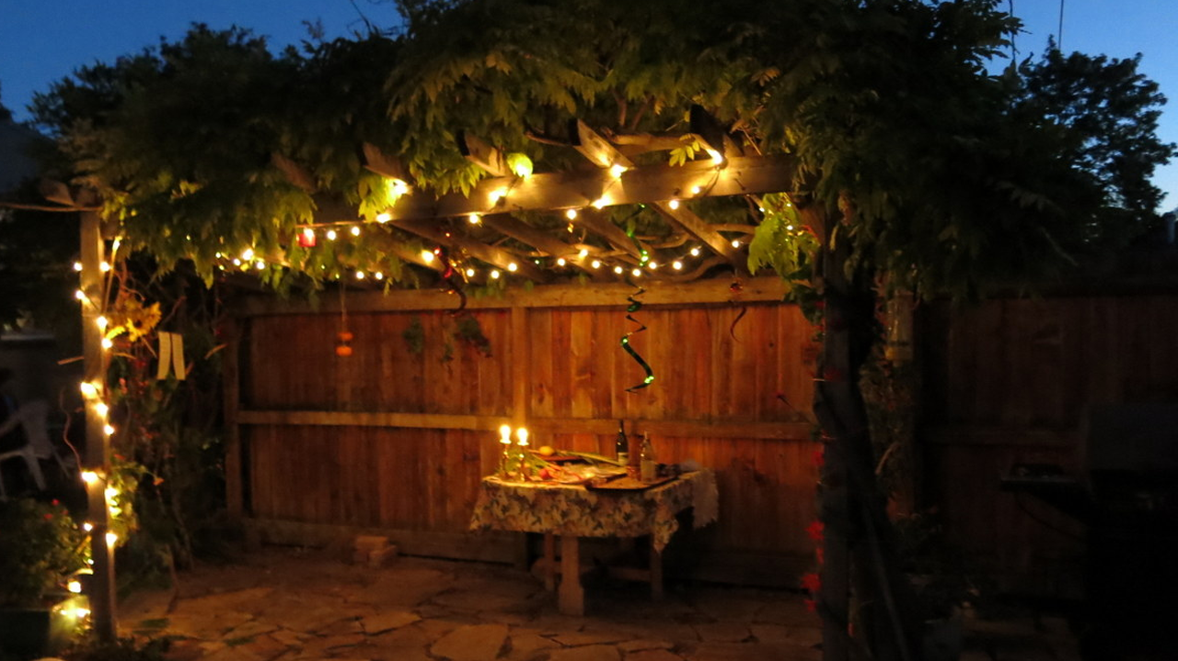
Sukkot is a week-long Jewish festival where huts are
built and decorated with lights.
Let’s learn about Israel

Slide 11
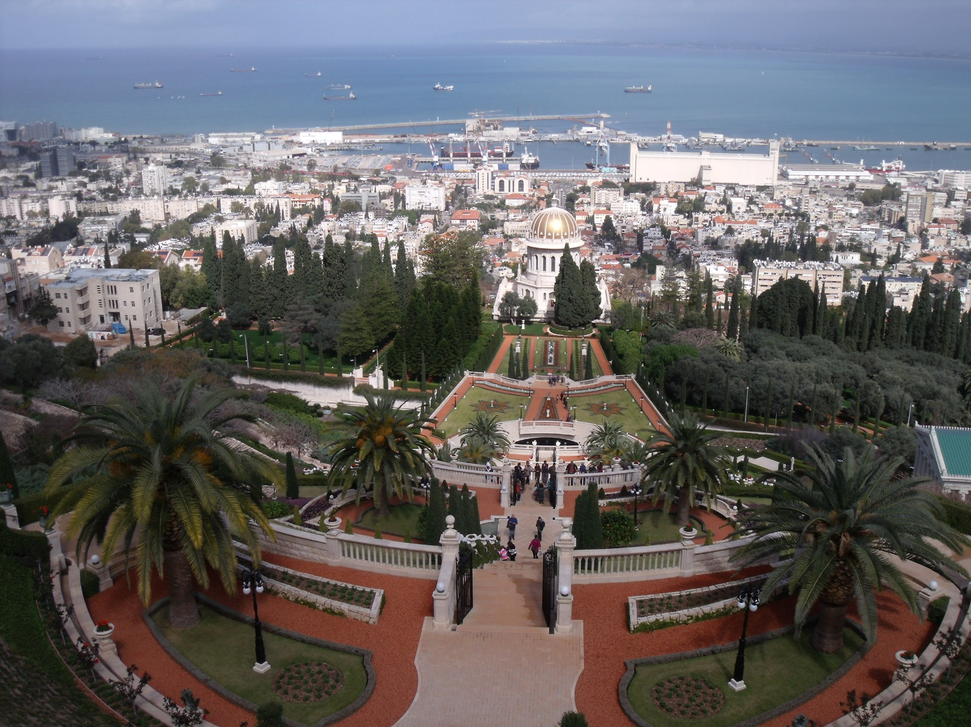
The End
*Special THANK YOU to nurse Jill for letting us use some of her pictures from her trip to Israel!

