Slide 1
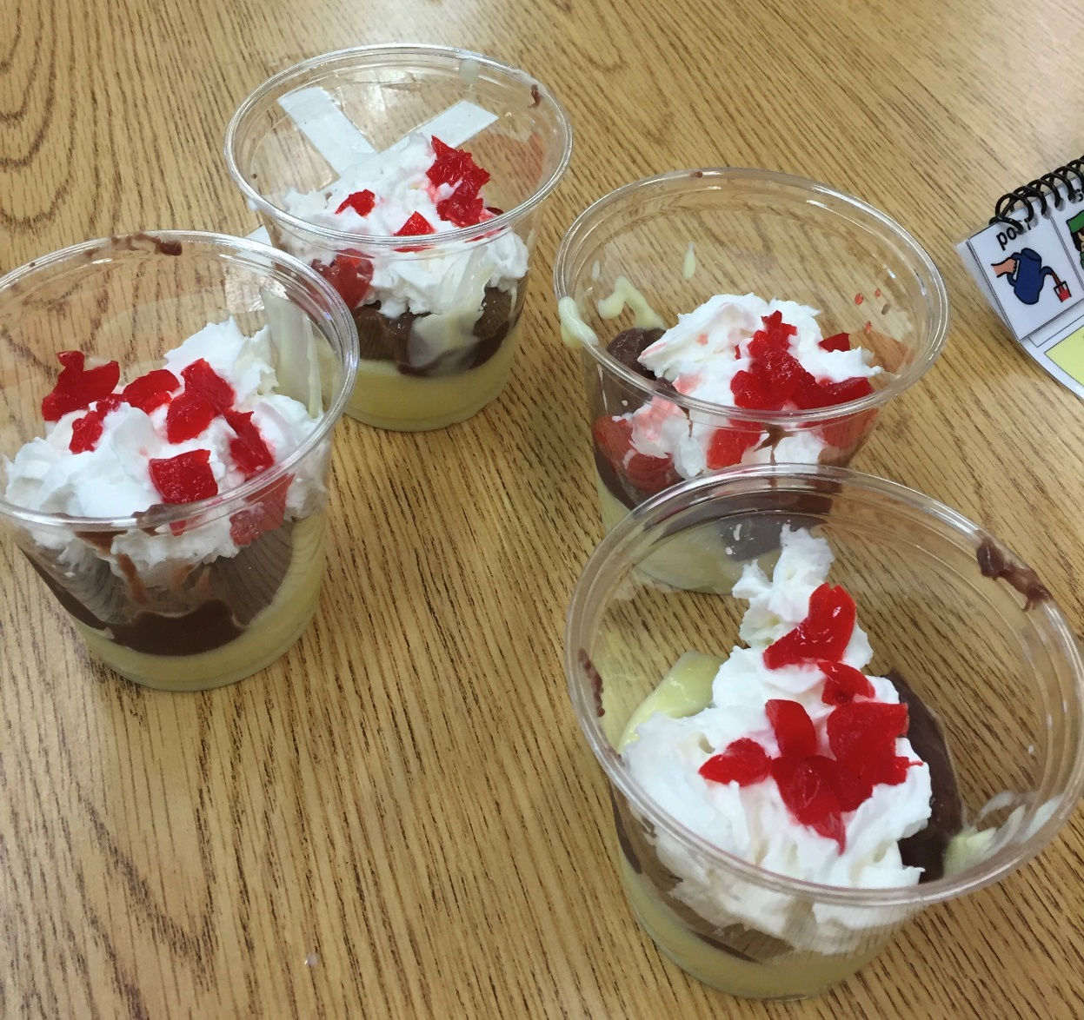
Let’s Invent a Banana Split Pudding

Slide 2
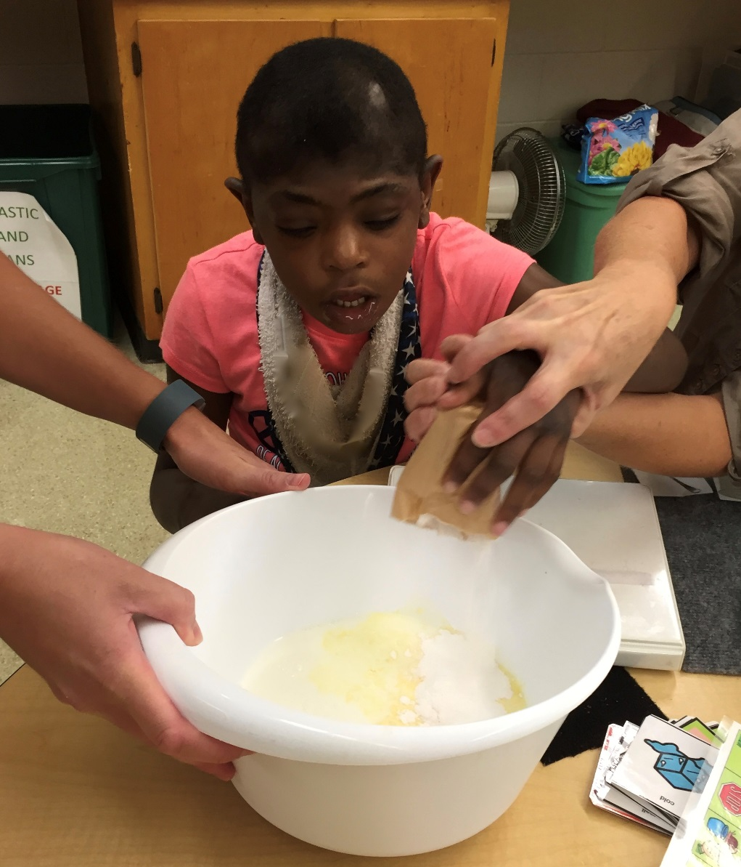
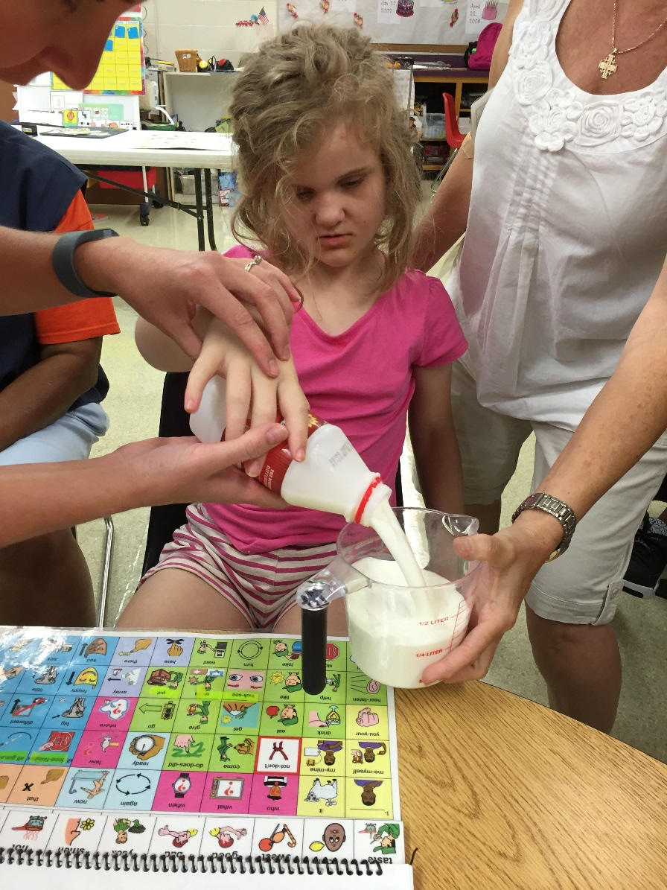
Measure out 2 cups of cold milk and put into a bowl
with banana cream pudding mix.

Slide 3
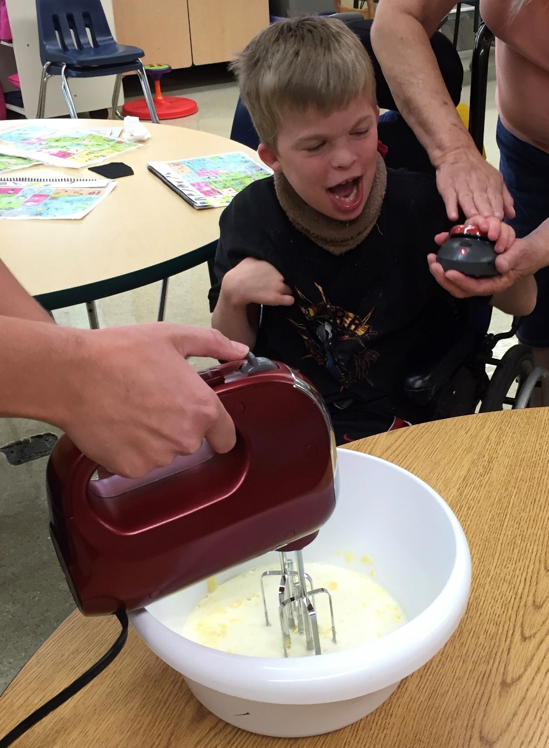
Mix with a mixer for 2 minutes and let it sit for about
5 minutes or until firm.

Slide 4
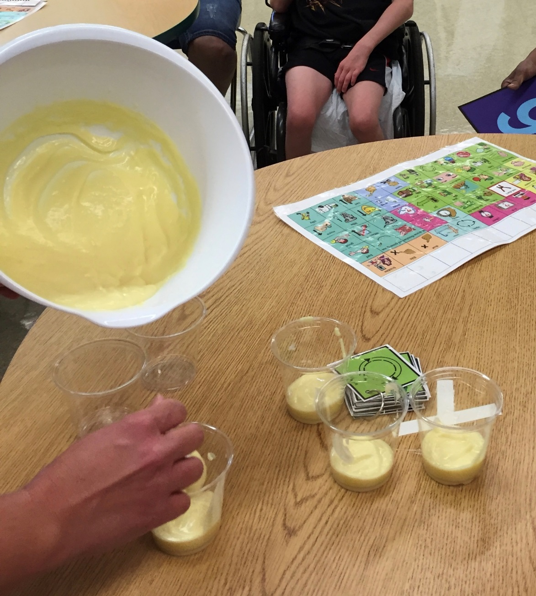
Once pudding is set, put a few spoonful’s in to each cup.

Slide 5
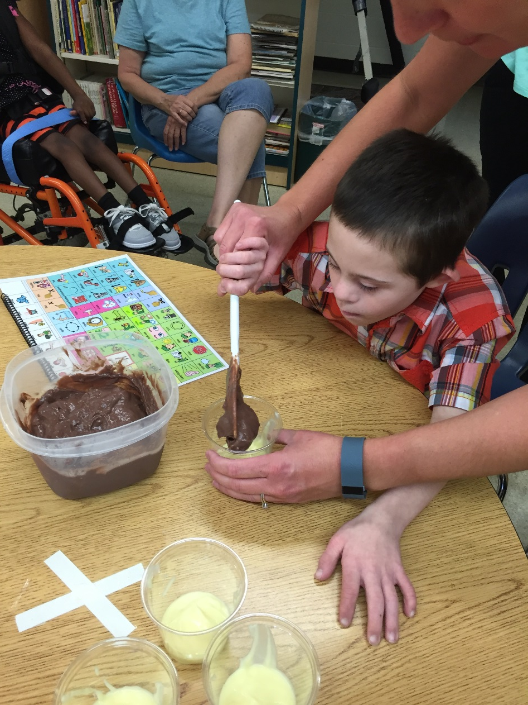
Next, put a few spoonful’s of chocolate pudding
on top of the banana pudding.

Slide 6
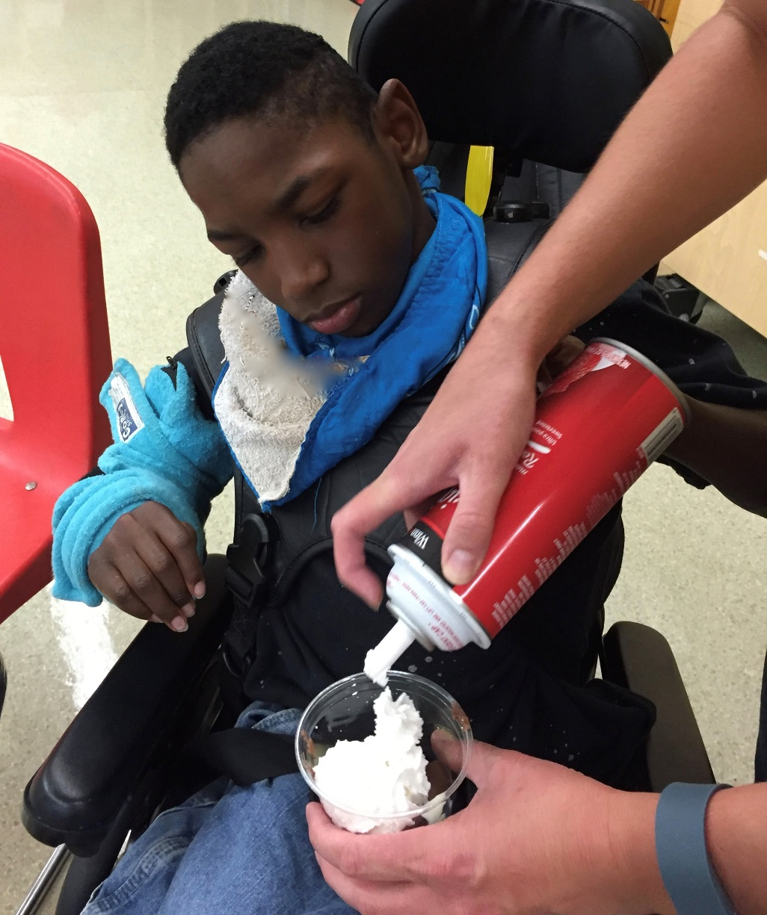
Add whipped cream and some chopped up cherries.

Slide 7
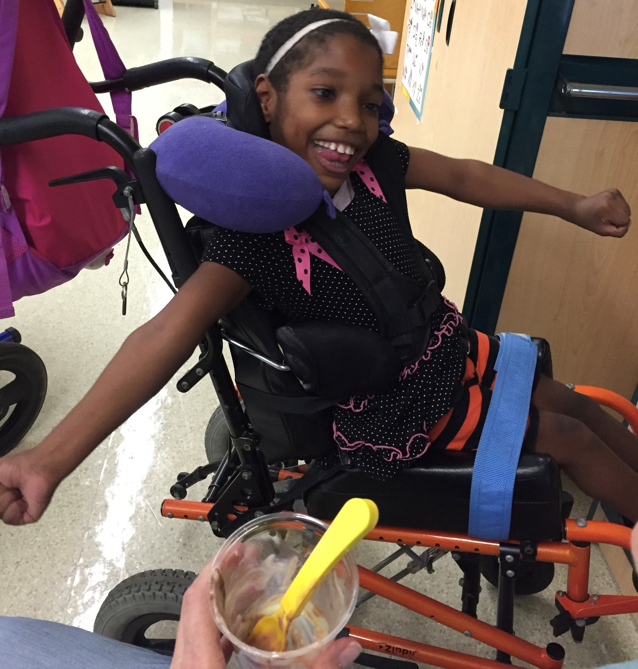
Eat and enjoy!

