Slide 1
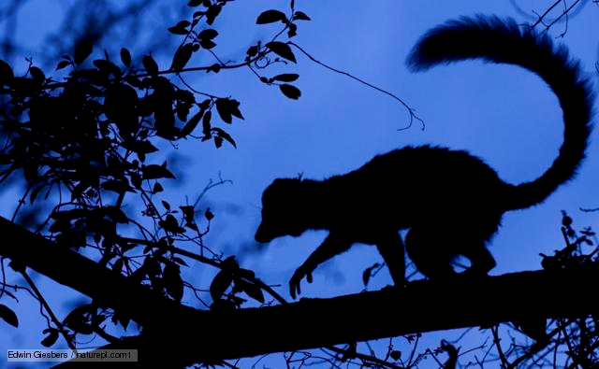
Creepy, Crawly Critters
By: Cara Edenfield
Groupbygroup.wordpress.com

Slide 2
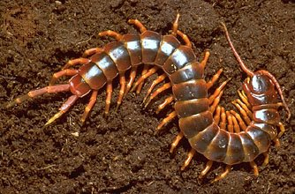
Centipedes live in moist places, like under rocks.
Creepy, Crawly Critters

Slide 3
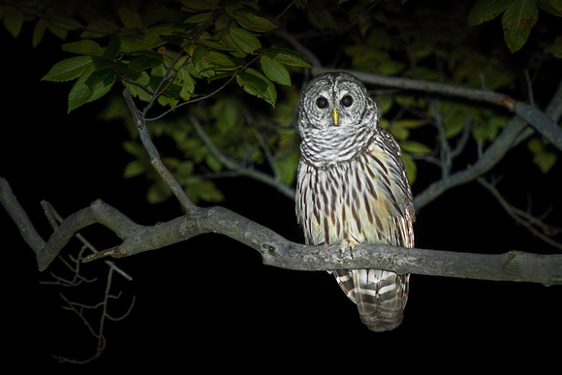
Owls can live in forests, mountains, deserts and plains.
Creepy, Crawly Critters

Slide 4
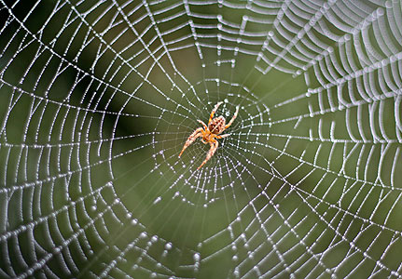
Spiders live in all different kinds of habitats,
from deserts to rain forests.
Creepy, Crawly Critters

Slide 5
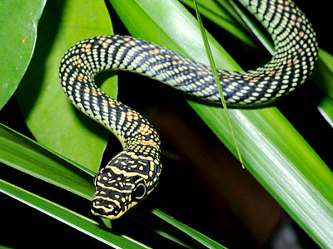
Snakes are found in many habitats including
in the water, forests, deserts and prairies.
Creepy, Crawly Critters

Slide 6
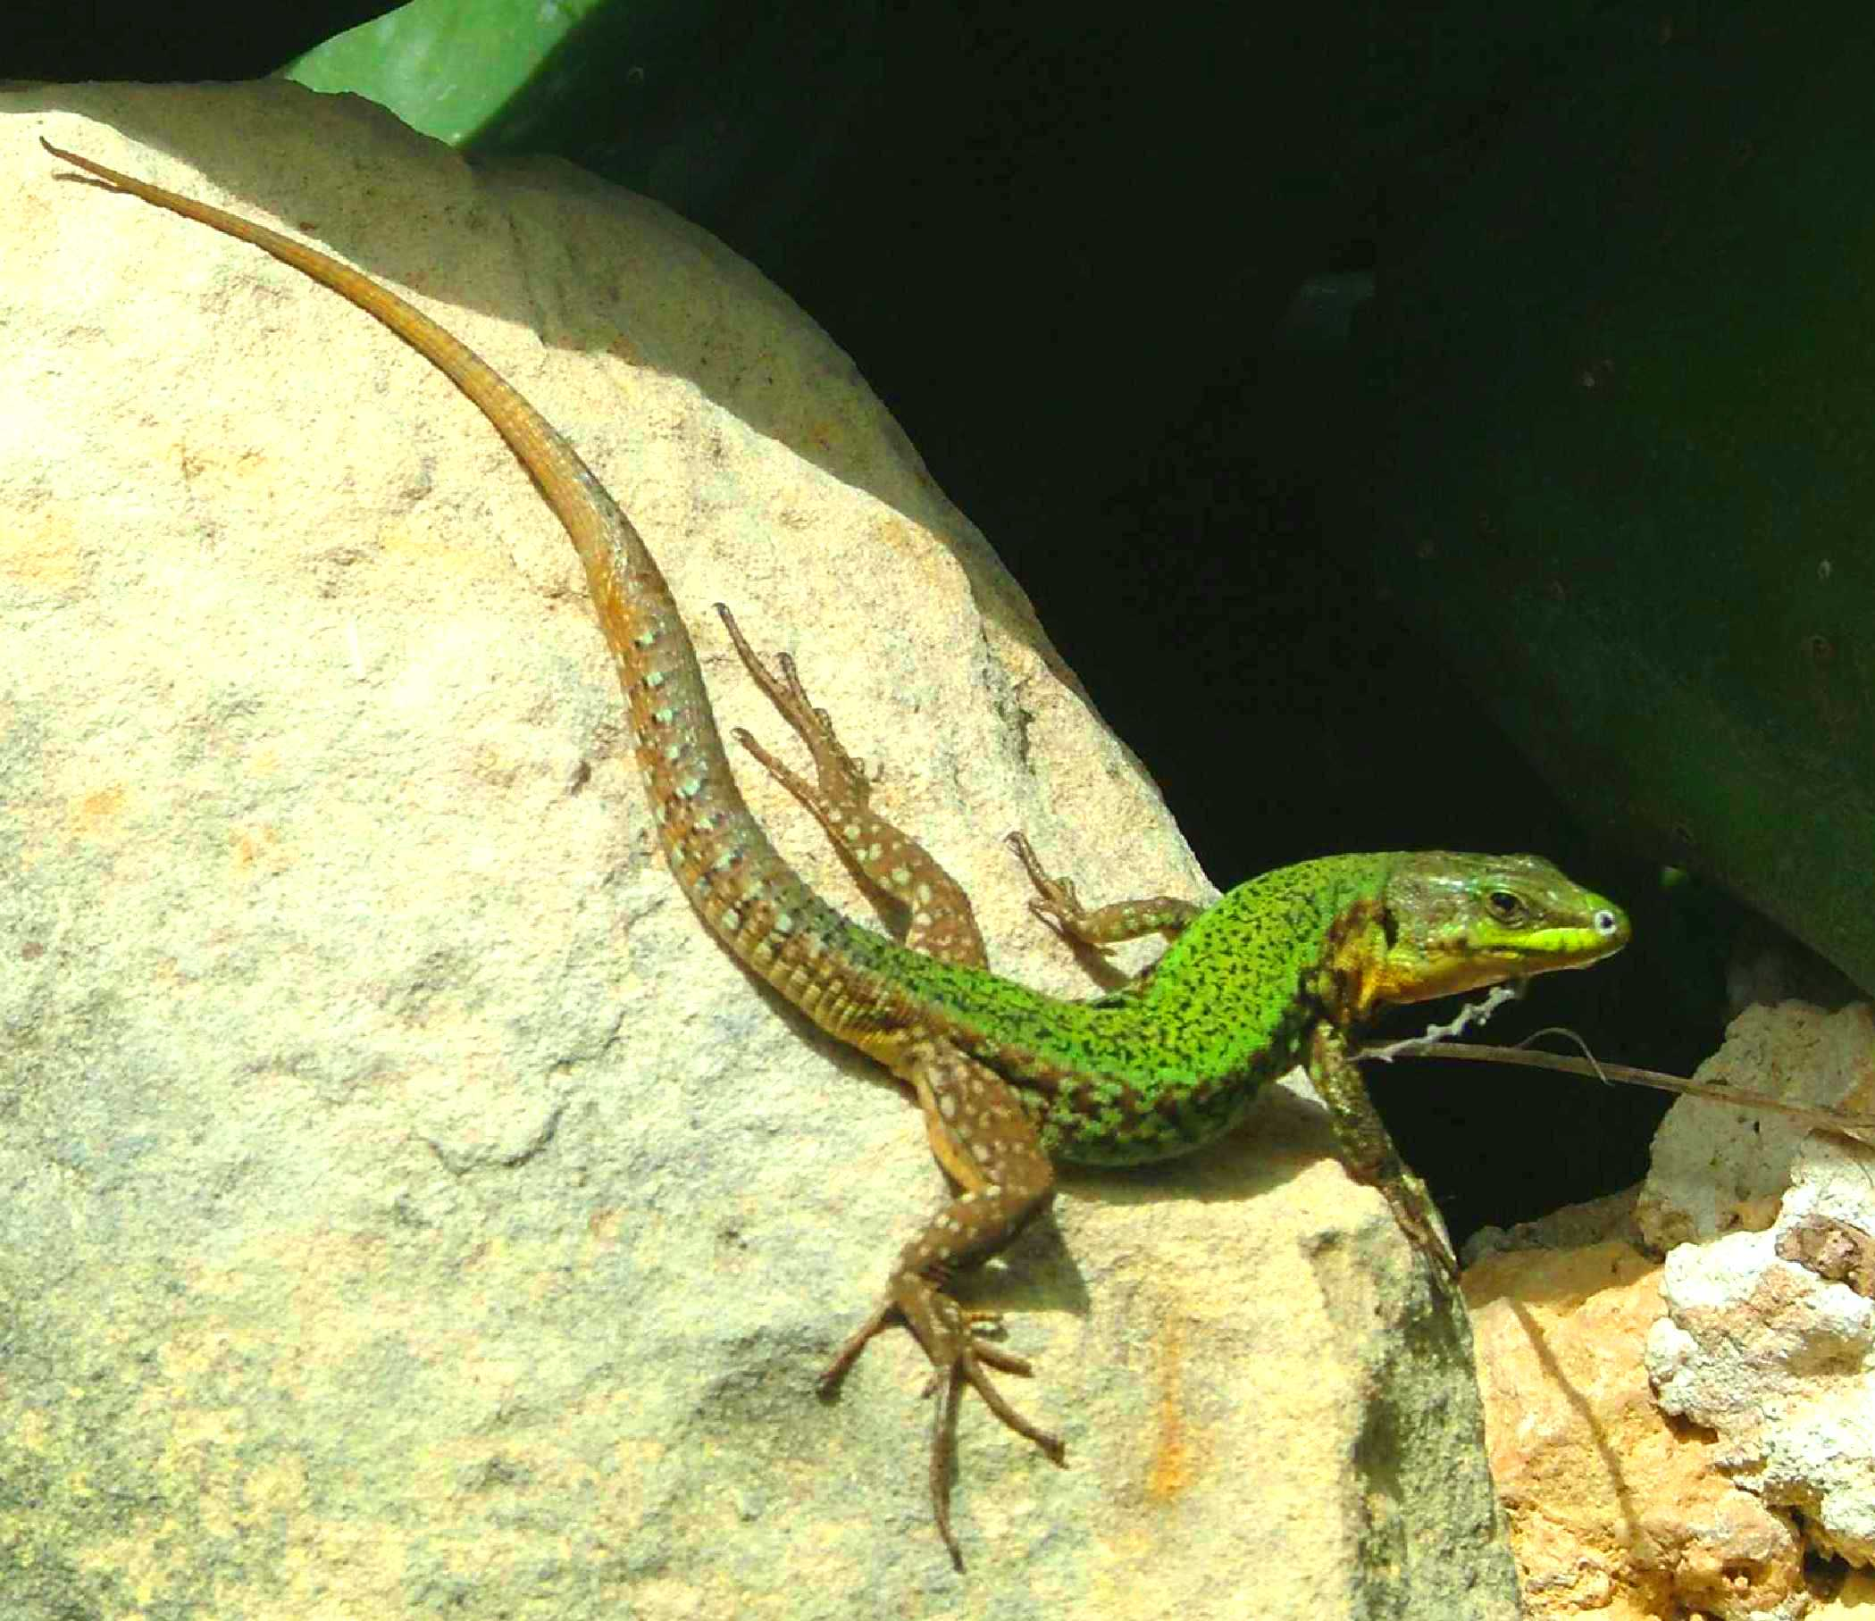
Lizards live in deserts, forests, prairies, marshes,
and rocky areas.
Creepy, Crawly Critters

Slide 7
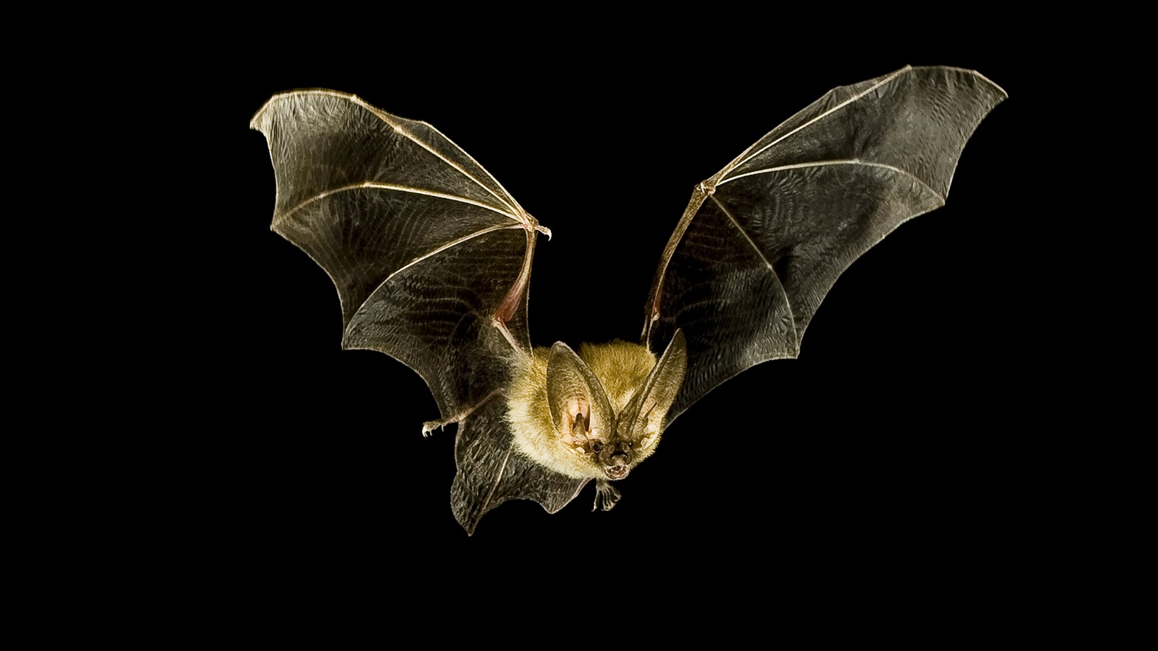
Bats live in lots of different places,
from seasides to mountains and even deserts.
Creepy, Crawly Critters

Slide 8
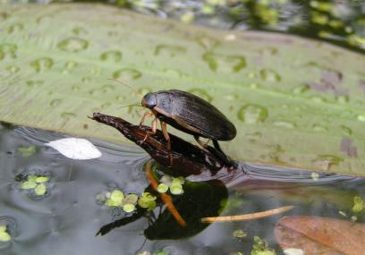
Nearly all water beetles live on or in fresh water.
Creepy, Crawly Critters

Slide 9
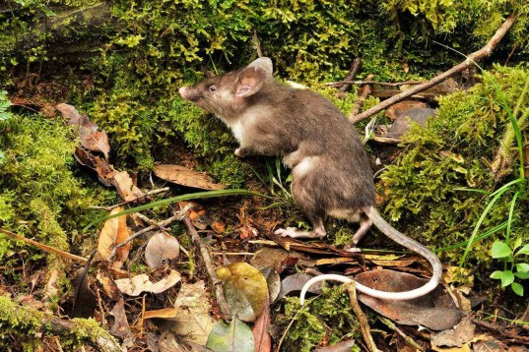
Rats inhabit almost every natural habitat,
from isolated tropical islands to forests.
Creepy, Crawly Critters

Slide 10
The End

